Slide 1

ANCHOR PRO
Enterprise Field Operations & Asset Costing Ecosystem
Multi-Tenant SaaS Platform for Heavy Industries, Contractors & Workshops

Slide 2
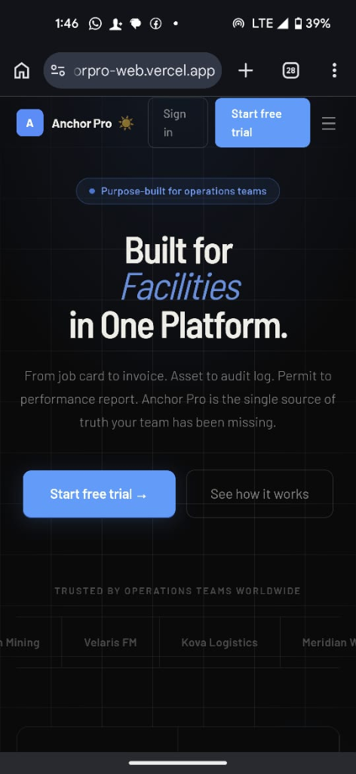
INDUSTRY CHALLENGES
The Cost of Operational Friction
Unplanned Asset Downtime: Breakdown of heavy equipment (CAT trucks, excavators, HVAC) costs thousands per hour in lost production.
Lost Financial Visibility: Paper job cards get lost; parts are consumed without invoices being updated, leaking critical profit margins.
Safety Compliance Risks: Hazardous sites require strict 'Permit to Work' procedures. Bypassing safety checksheets creates immense liability.
Disconnected Systems: Operations scheduling, inventory warehouses, and billing office operate in silos, requiring manual reconciliation.

Slide 3
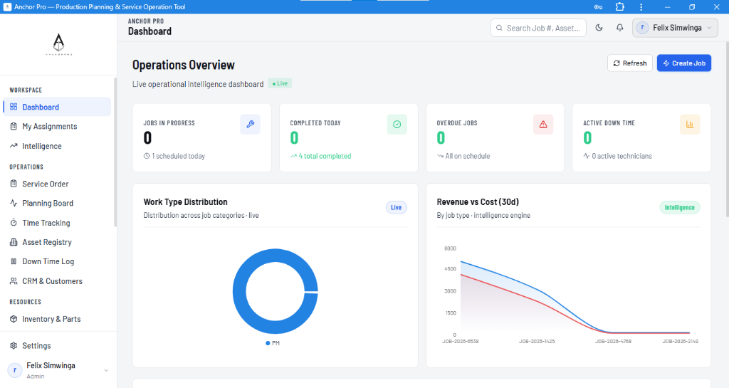
THE ANCHOR PRO SOLUTION
One Platform. Connected Operations.
Interactive Job Cards: Track work orders from request to completion with live technician progress indicators.
Automated Cost Costing: Real-time gross margin calculation based on consumed inventory stock costs & technician hourly labor rates.
Natively Integrated HSE: Pre-work safety checklists and Permit to Work (PTW) gates natively block tasks until supervisor sign-off.
Multi-Tenant Architecture: Isolated secure tenant database workspaces with individual billing and system configurations.

Slide 4
EXECUTIVE DASHBOARD
Real-Time Executive Intelligence & Analytics
Job Completion Rates: Track team utilization and SLA compliance instantly.
Financial Health at a Glance: Natively monitors gross revenue, parts cost overheads, and net profit margins.
Downtime Reporting: Visualizes equipment uptime/downtime by category to pinpoint machinery failures before they happen.
Department Snapshots: Direct comparison of maintenance performance across workshop divisions (e.g. Electrical, Mechanical).

Slide 5
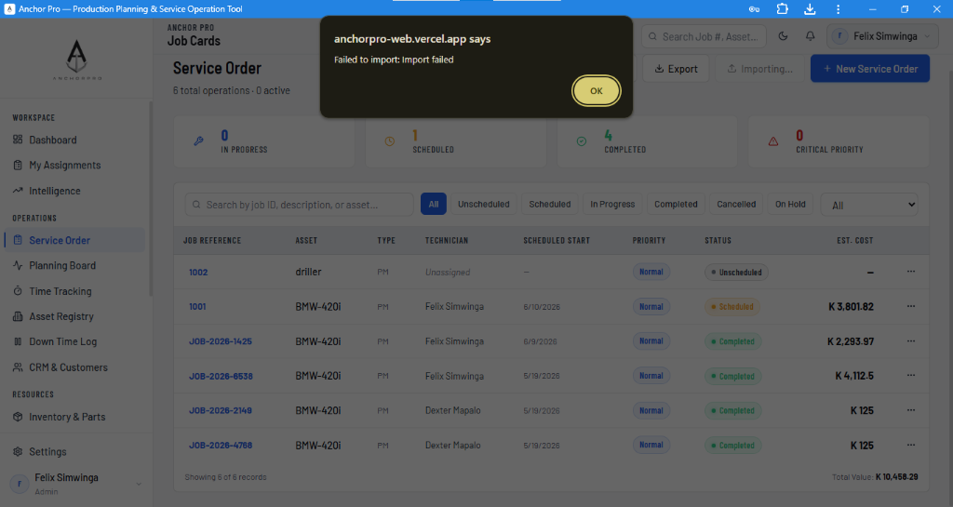
FIELD OPERATIONS
End-to-End Job Card Lifecycle Management
Split-Pane Workspace: Master-detail assignments screen displays pending jobs alongside interactive controls for field mechanics.
Instant Job Costing: Tracks labor hours and inventory reservation. Automatically deducts quantities from the warehouse bin.
One-Click Invoicing: Generates clean quotations and client invoices directly from service logs without external accounting software.
Technician Dispatch: Soft caps active jobs per mechanic to prevent overload and optimize response time.

Slide 6
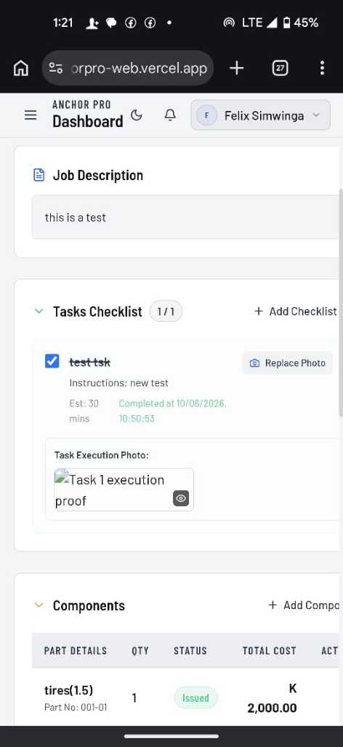
HSE & COMPLIANCE
Enforcing Health & Safety on Site
Permit to Work (PTW) Gate: Core system lock. Hazardous jobs cannot move to 'In Progress' until digital safety permits are approved.
Mobile Inspection Checklists: Field mechanics complete mandatory checklist steps directly on site using browser-compatible PWA.
Immutable Audit Logs: System tracks every state change, technician check-in, and safety permit sign-off for legal compliance.
Low-Stock Alerts: Prevents safety incidents by warning storekeepers when critical spare parts drop below critical reorder limits.

Slide 7
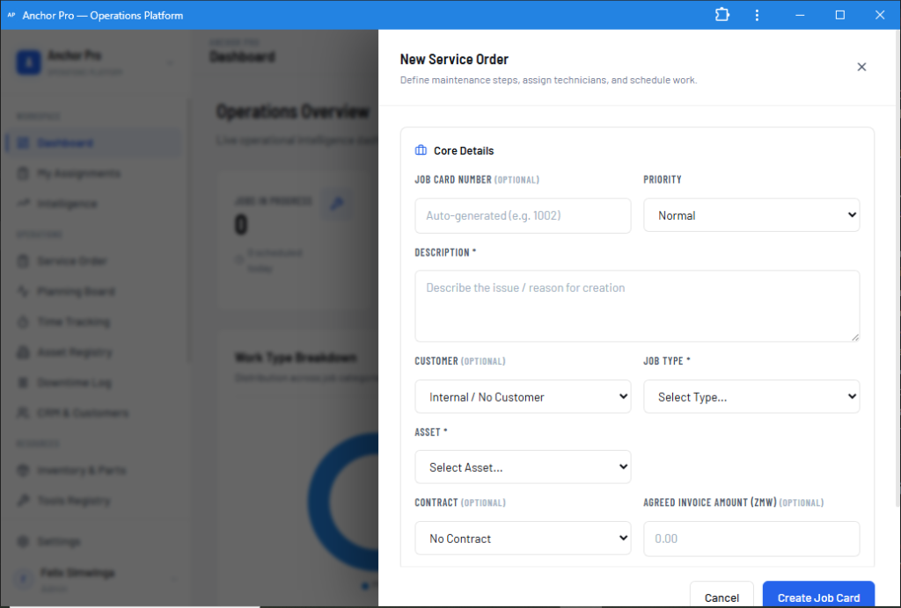
DATA MANAGEMENT
Zero-Friction Client Onboarding & Data Import
Bulk Excel/CSV Import: Instantly import existing spreadsheets containing thousands of Assets, Parts Inventories, or Tools.
Excel Validation Dropdowns: Custom template generator embeds valid statuses (e.g. InProgress, Available) directly into Excel dropdowns.
Auto-Provisioning Rules: Auto-creates missing departments on-the-fly during CSV parsing and generates sequential serial tags.
Seamless Upserts: Syncs inventory quantities based on unique Part Numbers instead of creating duplicate records.

Slide 8
ECOSYSTEM & INTEGRATIONS
Connected Ecosystems: Retrix Car Rental Integration
Automated Damage Pipeline: Damage reports logged on Retrix vehicle returns automatically trigger a Job Card in Anchor Pro.
Mechanic Auto-Dispatch: System schedules the repair order and alerts the workshop mechanics via SMS/mobile push notifications.
Parts Reservation: Instant parts booking matches the vehicle make & model to avoid procurement delays.
Telemetry Status Loop: Updates Retrix as 'Ready for Rental' the moment the mechanic completes the job checklist.

Slide 9
BUSINESS MODEL
Predictive B2B SaaS Monetization Tiers
Free Trial (14-Days): Frictionless trial (max 2 technicians, 10 active jobs) with pre-seeded demo data for quick onboarding.
Professional Tier: Geared toward growing mid-size workshops. Includes all core modules, bulk exports, and SLA warning rules.
Enterprise Tier: Unlimited scale, REST API endpoints access, customized dynamic nomenclature terms, and dedicated priority support.
Low Friction PLG Loops: Pre-populated sandboxes let prospects test-drive a fully populated company environment in under 10 seconds.

Slide 10
Let's Scale Field Service Management Together
Empower your field teams. Enforce safety compliance. Drive gross margins.
support@anchorpro.co.zm
www.anchorpro.co.zm

