Slide 1
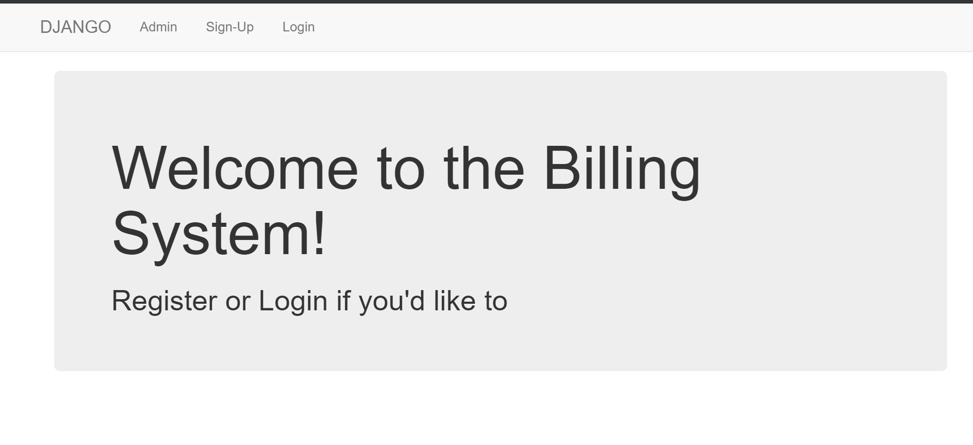
WEBFRAMEWORKS PROJECT

Slide 2
THE BILLING SYSTEM: Website Description
BILLING SYSTEM:
This project mainly aims at students who want to claim their bills incurred while organizing events in college. This was actually the 3rd semester project made using html,css,js and bootstrap.
Now, we have made it using Django framework.

Slide 3
INDIVIDUAL CONTRIBUTION
Khushi M:
Did the login logout
Varsha C:
Did the models and the views
Radhika S:
Deploying on git and python anywhere and creating views.

Slide 4
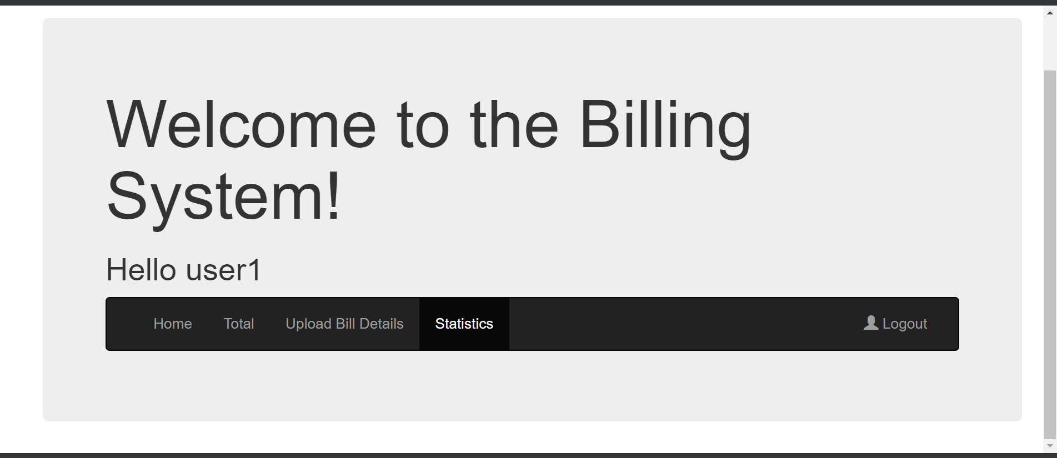
SCREENSHOTS

Slide 5
TAKEAWAYS
Learnt more about how to work with Django and its superior use over simply designing a website from scratch.
Database creation was made so much easier with the use of models.py and the makemigrations, we definitely learnt a lot from it.

Slide 6
CHALLENGES
Working with multiple users and for each user having their own models, and where we had to mandate the authentication for each user.

Slide 7
CONTACT INFORMATION
KHUSHI M PES1201701416 khushim13@gmail.com
VARSHA C
PES1201701387
varshamahadev30@gmail.com
RADHIKA S
PES1201701702
radhikasadanand55@gmail.com

