Slide 1
wobble wobble Making things react to live music inside Unity
Luke Spierewka
Notes:
Hi everyone!
This workshop will focus on the technical aspects of getting live music – either stuff that you’re listening to on your own PC, or external data during a live show – inside Unity for the sake of doing cool stuff with it.

Slide 2
Live demo

Slide 3
USB stick!
I’m passing an USB stick among the participants
Copy the „Live Audio Workshop” directory
Install stuff according to README.txt in the directory
(doesn’t contain any viruses, seriously)
This will save us time!

Slide 4
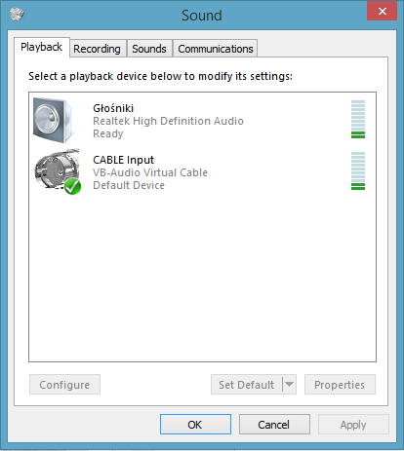
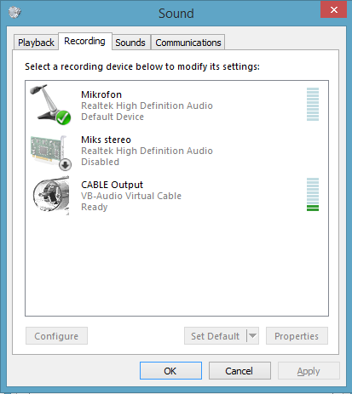
Digital Audio Cable
Notes:
First, we need to figure out a way of routing our sound from the source to a different place. If you’re getting it in a nice form from an external source, you don’t need to do that. However, if you’re playing music on your own computer – via Spotify, foobar, or iTunes, or something else – the best way is to use something called a digital audio cable
You can achieve a similar effect through stereo mix in Windows, but that’s not always reliable and can screw up depending on the sound drivers and other stuff.

Slide 5
Digital Audio Cable
Windows
VBCable
http://vb-audio.pagesperso-orange.fr/Cable/
Mac
Soundflower
https://rogueamoeba.com/freebies/soundflower/

Slide 6
Using Unity microphone
Microphone.Start(), then reading info using AudioSource.GetSpectrumData()
Is doable – but not without problems
Heavy lag on Windows (might be fixable with ASIO4ALL drivers)
Using Microphone is a dirty, dirty hack
Slow implementation
Notes:
So, what do we do after rerouting our music? We can go the easy way, or the hard way – or, actually, the hard way or the harder way. The seemingly easy way is reading this data directly in Unity using the Microphone class, but that can be problematic due to a bunch of reasons.

Slide 7
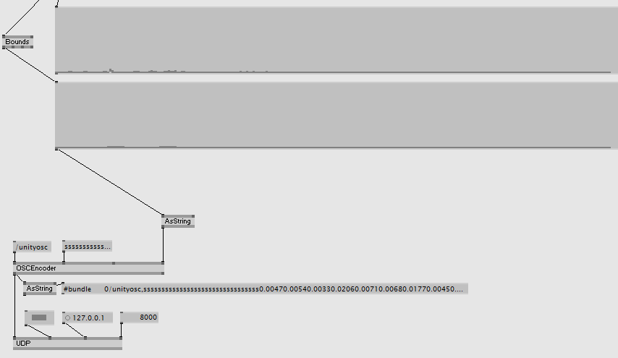
VVVV
Notes:
Which introduces us to this beautiful thing – VVVV is a multipurpose interactive toolkit which allows you to do a ton of amazing stuff with nodes and code.

Slide 8
VVVV
Multipurpose toolkit
Supports:
Boygrouping (controlling multiple computer using a master/slave system)
DirectX, HLSL shaders
Various algorithms for animation, audio analysis and more
Extensibility via community plugins (there’s a ton of them!)
And much, much more
Is faster / easier to use than Unity (at least for audio analysis)
Completely free & open source (for non-commercial stuff)
http://vvvv.org/
Notes:
It supports all this stuff! Theoretically you could do the whole installation thing inside this software – but I prefer using Unity for visual stuff, so we’re only using it for audio analysis and passing data on to Unity

Slide 9
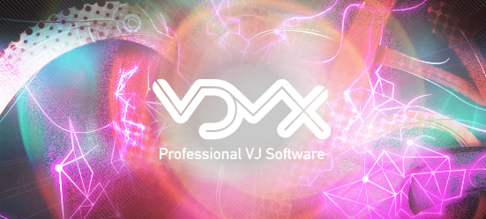
VDMX
http://www.vidvox.net/
http://www.creativeapplications.net/mac/visuals-for-sonar-festival-vdmx-to-unity3d-tutorials/
Notes:
Unfortunately VVVV is Windows-only, but from what I’ve heard (and not tested personally, due to not having a Mac), VDMX is a decent Mac-based alternative for that. Below I’ve added a link to a tutorial that describes how to do something similar with Unity, Soundflower and VDMX.

Slide 10
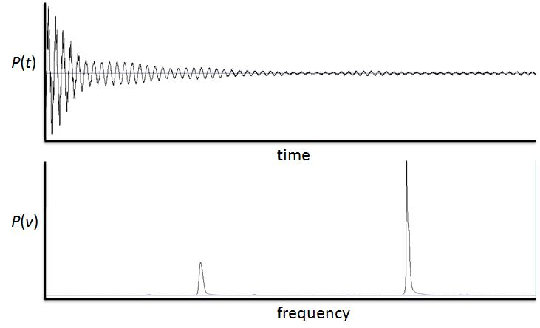
Sound
Notes:
So let’s talk a bit about sound itself – how can we convert this weird looking wave into something nice and immediately usable, that’s basically an array of floats from 0 to 1 representing different frequencies? The answer is – FFT.

Slide 11
Fast Fourier Transform (FFT)
Converts time/space to frequency/wavenumber and vice versa
Does it quickly
Several versions of this algorithm
Numerous applications:
digital signal processing (DSP)
compression
audio analysis

Slide 12
Open Sound Control (OSC)
Communication protocol
Created for passing music-related info via network or USB
(doesn’t necessarily have to be music data!)
Supported by:
pretty much every DAW
Processing
VVVV
Quartz
other software
Notes:
The last theoretical thing I’d like to talk about is OSC

Slide 13
Open Sound Control (OSC)
Unity OSC implementation
https://github.com/heaversm/unity-osc-receiver
We’re using a modified version of this one
https://github.com/jorgegarcia/UnityOSC/
Works a bit differently, is also cool

Slide 14
That’s it for boring talk, let’s do stuff!

