Slide 1
Attention Is All You Need (Transformer)
Ashish Vaswani∗Noam Shazeer∗
Niki Parmar∗Jakob Uszkoreit∗
Llion Jones∗Aidan N. Gomez∗ y
Łukasz Kaiser∗

Slide 2
摘要
The dominant sequence transduction models are based on complex recurrent or convolutional neural networks that include an encoder and a decoder. The best performing models also connect the encoder and decoder through an attention mechanism. We propose a new simple network architecture, the Transformer, based solely on attention mechanisms, dispensing with recurrence and convolutions entirely. Experiments on two machine translation tasks show these models to be superior in quality while being more parallelizable and requiring significantly less time to train. Our model achieves 28.4 BLEU on the WMT 2014 Englishto-German translation task, improving over the existing best results, including ensembles, by over 2 BLEU. On the WMT 2014 English-to-French translation task, our model establishes a new single-model state-of-the-art BLEU score of 41.8 after training for 3.5 days on eight GPUs, a small fraction of the training costs of the best models from the literature. We show that the Transformer generalizes well to other tasks by applying it successfully to English constituency parsing both with large and limited training data.
不同于以往的RNN和卷积，提出了一种新的简单的架构仅仅依赖于注意力机制，在机器翻译的领域性能强劲，实验效果好。

Slide 3
贡献总结
In this work, we presented the Transformer, the first sequence transduction model based entirely on attention, replacing the recurrent layers most commonly used in encoder-decoder architectures with multi-headed self-attention. For translation tasks, the Transformer can be trained significantly faster than architectures based on recurrent or convolutional layers. On both WMT 2014 English-to-German and WMT 2014 English-to-French translation tasks, we achieve a new state of the art. In the former task our bestmodel outperforms even all previously reported ensembles. We are excited about the future of attention-based models and plan to apply them to other tasks. We plan to extend the Transformer to problems involving input and output modalities other than text and to investigate local, restricted attention mechanisms to efficiently handle large inputs and outputs such as images, audio and video. Making generation less sequential is another research goals of ours. The code we used to train and evaluate our models is available at https://github.com/ tensorflow/tensor2tensor. Acknowledgements We are grateful to Nal Kalchbrenner and Stephan Gouws for their fruitful comments, corrections and inspiration
1.第一个做序列转录的模型
2.主要运用多头注意力机制，编码解码器架构，避免了以往的循环结构，速度快，效果好
3.可以应用于别的方向（cv）
4.并行程度高，不用像RNN时序进行，需要等待

Slide 4
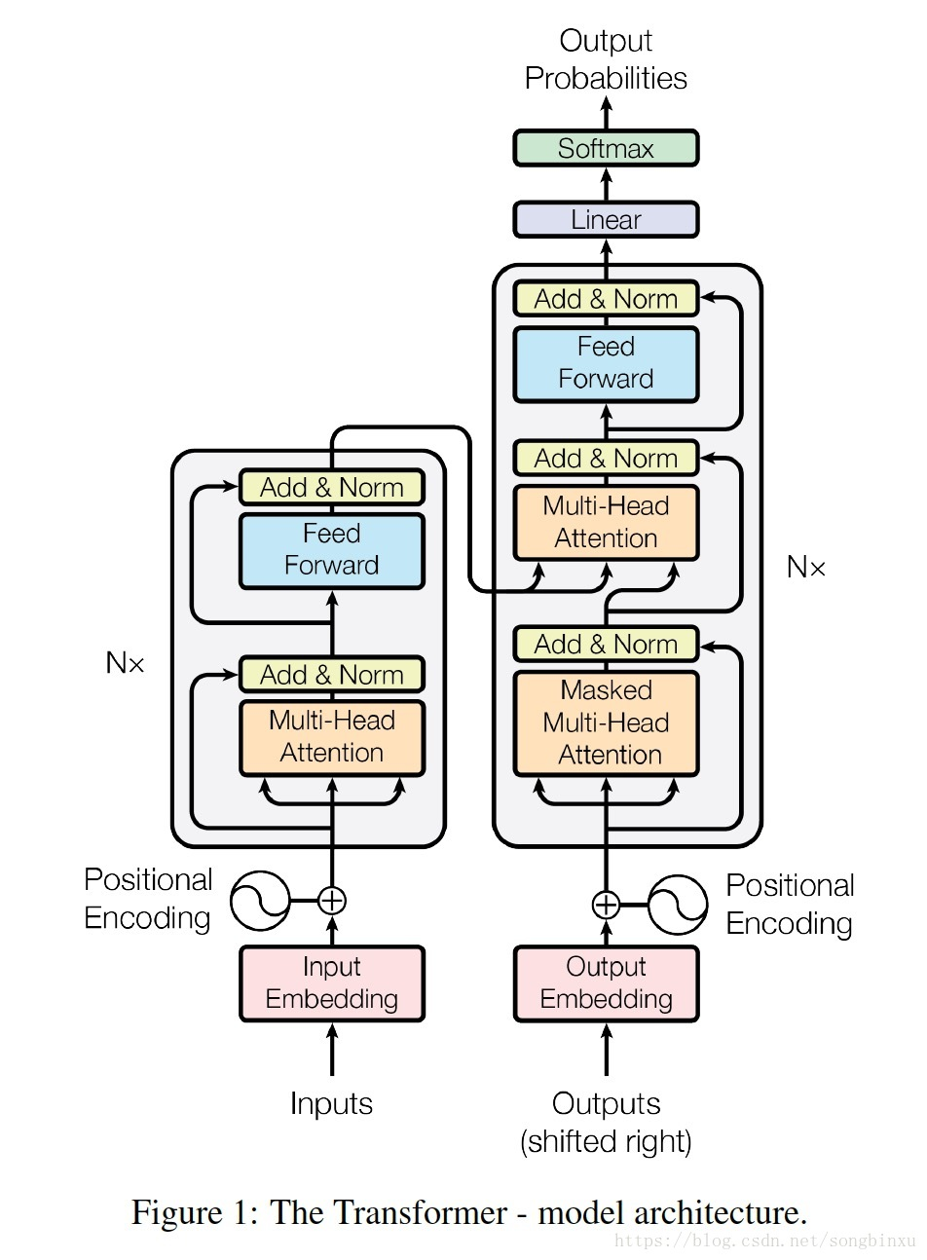
结构图
Encoder: The encoder is composed of a stack of N = 6 identical layers. Each layer has two sub-layers. The first is a multi-head self-attention mechanism, and the second is a simple, positionwise fully connected feed-forward network. We employ a residual connection [11] around each of the two sub-layers, followed by layer normalization [1]. That is, the output of each sub-layer is LayerNorm(x + Sublayer(x)), where Sublayer(x) is the function implemented by the sub-layer itself. To facilitate these residual connections, all sub-layers in the model, as well as the embedding layers, produce outputs of dimension dmodel = 512.
Decoder: The decoder is also composed of a stack of N = 6 identical layers. In addition to the two sub-layers in each encoder layer, the decoder inserts a third sub-layer, which performs multi-head attention over the output of the encoder stack. Similar to the encoder, we employ residual connections around each of the sub-layers, followed by layer normalization. We also modify the self-attention sub-layer in the decoder stack to prevent positions from attending to subsequent positions. This masking, combined with fact that the output embeddings are offset by one position, ensures that the predictions for position i can depend only on the known outputs at positions less than i.
Notes:
layernorm切片标准化，形成均值为0方差为1的标准化模型。解码器跟编码器一样有两个层，但为了保持注意力，不能看到t时刻之后的词，所以用了masked掩码，

Slide 5
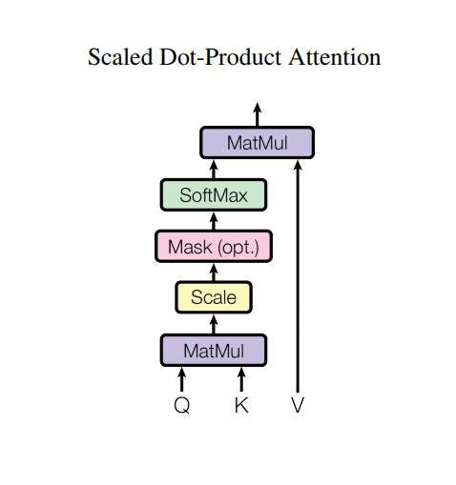

点积注意力机制
Scaled Dot-Product Attention
Q
We call our particular attention "Scaled Dot-Product Attention" (Figure 2). The input consists of
queries and keys of dimension dk, and values of dimension dv. We compute the dot products of the
query with all keys, divide each by pdk, and apply a softmax function to obtain the weights on the
values.
In practice, we compute the attention function on a set of queries simultaneously, packed together
into a matrix Q. The keys and values are also packed together into matrices K and V . We compute
the matrix of outputs as:
K
K
V
V
Notes:
为了避免softmax后向1和0两级靠拢，梯度变小，无法继续运算，所以除根号dk。mask层通过给t时刻之后的输出乘以一个非常小的数，就能使运算检测不到t时刻后的数值

Slide 6
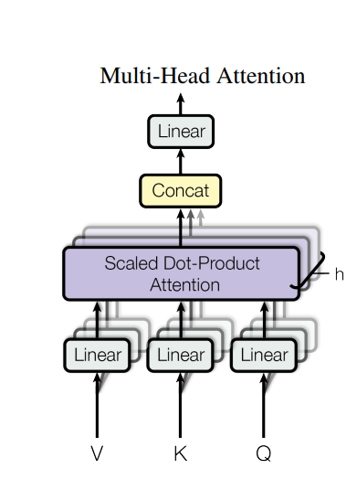
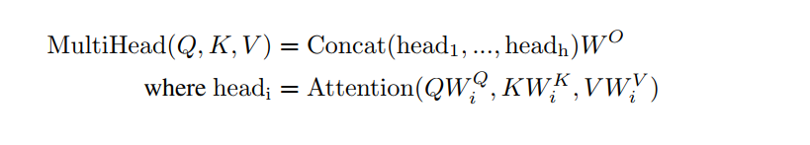
多头注意力机制 Multi-Head Attention
运算过程：V,K,Q来进行h次线性层的低维度投影，再循环进行h次点积注意力，取和后最终在进行线性层投影。
目的：因为点击注意力机制没有什么可训练参数，几乎无法调整，所以在这个环节可以通过不断地投影，训练不同的投影方法，来适应不一样的模式，环境等等，例如加性注意力机制等。
Notes:
输出时512，这里作者设定默认h=8,所以投影到512/8=64维度上

Slide 7
K
V
Q
t
t+1
Notes:
input输入每个词的向量，每个向量复制三次成为K,Q,V（自注意力机制）
三个输入到multi-head
编码器的KV取自解码器，Q取自接码器的下一个输出

Slide 8
最后维度的MLP（多层感知机） Position-wise Feed-Forward Networks
In addition to attention sub-layers, each of the layers in our encoder and decoder contains a fully
connected feed-forward network, which is applied to each position separately and identically. This
consists of two linear transformations with a ReLU activation in between.
FFN(x) = max(0; xW1 + b1)W2 + b2 (2)
While the linear transformations are the same across different positions, they use different parameters
from layer to layer. Another way of describing this is as two convolutions with kernel size 1.
The dimensionality of input and output is dmodel = 512, and the inner-layer has dimensionality
dff = 2048.
Notes:
单隐藏层的mlp,w1扩大4倍到2048，w2缩小4倍回源维度

Slide 9
Embeddings and Softmax
Similarly to other sequence transduction models, we use learned embeddings to convert the input tokens and output tokens to vectors of dimension dmodel. We also use the usual learned linear transformation and softmax function to convert the decoder output to predicted next-token probabilities. In our model, we share the same weight matrix between the two embedding layers and the pre-softmax linear transformation, similar to [30]. In the embedding layers, we multiply those weights by dmodel^0.5.
Notes:
学习的词，转化为一个个512向量需要embedding，编码器，解码器，最后softmax前面需要一共三个，最后乘上根号d是为了与后面的位置向量相加时维持一个平衡。

Slide 10
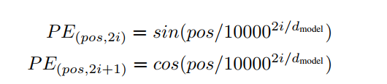
位置时序信息 Positional Encoding
Since our model contains no recurrence and no convolution, in order for the model to make use of the
order of the sequence, we must inject some information about the relative or absolute position of the
5Table 1: Maximum path lengths, per-layer complexity and minimum number of sequential operations
for different layer types. n is the sequence length, d is the representation dimension, k is the kernel
size of convolutions and r the size of the neighborhood in restricted self-attention.

Slide 11
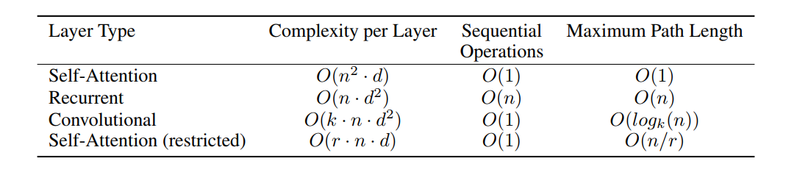
优势
复杂度低，时序不用等待，点对点距离短

Slide 12
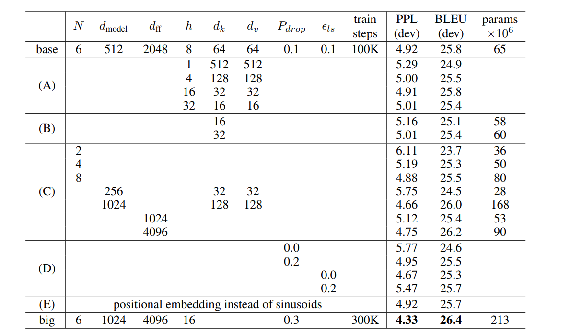
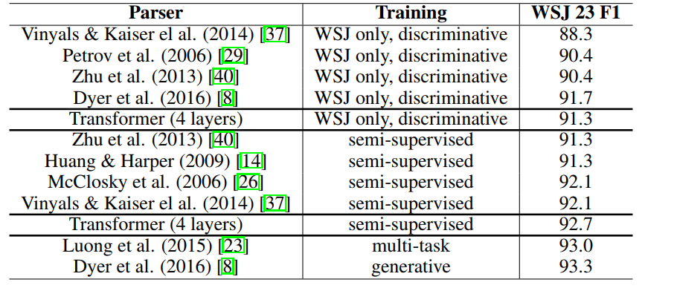
实验数据对比

