Slide 1
End-to-End Object Detection with Transformers
Nicolas Carion?, Francisco Massa?, Gabriel Synnaeve, Nicolas Usunier, Alexander Kirillov, and Sergey Zagoruyko
Facebook AI

Slide 2
摘要
We present a new method that views object detection as a direct set prediction problem. Our approach streamlines the detection pipeline, effectively removing the need for many hand-designed components like a non-maximum suppression procedure or anchor generation that explicitly encode our prior knowledge about the task. The main ingredients of the new framework, called DEtection TRansformer or DETR, are a set-based global loss that forces unique predictions via bipartite matching, and a transformer encoder-decoder architecture. Given a fixed small set of learned object queries, DETR reasons about the relations of the objects and the global image context to directly output the final set of predictions in parallel. The new model is conceptually simple and does not require a specialized library, unlike many other modern detectors. DETR demonstrates accuracy and run-time performance on par with the well-established and highly-optimized Faster R-CNN baseline on the challenging COCO object detection dataset. Moreover, DETR can be easily generalized to produce panoptic segmentation in a unified manner. We show that it significantly outperforms competitive baselines.
我们的方法简化了检测流程，有效地消除了对许多手工设计的组件的需求，例如非最大抑制程序或锚点生成，这些组件明确编码了我们对任务的先验知识。
新框架的主要成分称为DEtection TRANSformer或DETR，是基于集合的全局损耗，它通过二分匹配和变压器编码器-解码器体系结构来强制进行唯一的预测。 给定固定的学习对象查询集，则DETR会考虑对象与全局图像上下文之间的关系，以直接并行并行输出最终的预测集。
与许多其他现代检测器不同，新模型在概念上很简单，并且不需要专门的库。 DETR与具有挑战性的COCO对象检测数据集上成熟且高度优化的Faster RCNN基线具有同等的准确性和运行时性能。 此外，可以很容易地将DETR概括为以统一的方式产生全景分割。

Slide 3
贡献总结
We presented DETR, a new design for object detection systems based on transformers and bipartite matching loss for direct set prediction. The approach achieves comparable results to an optimized Faster R-CNN baseline on the challenging COCO dataset. DETR is straightforward to implement and has a flexible architecture that is easily extensible to panoptic segmentation, with competitive results. In addition, it achieves significantly better performance on large objects than Faster R-CNN, likely thanks to the processing of global information performed by the self-attention. This new design for detectors also comes with new challenges, in particular regarding training, optimization and performances on small objects. Current detectors required several years of improvements to cope with similar issues,and we expect future work to successfully address them for DETR.
我们提出了DETR，这是一种基于变压器和用于直接集预测的二部匹配损耗的目标检测系统的新设计。该方法在具有挑战性的COCO数据集上实现了与优化更快的R-CNN基线相当的结果。
DETR易于实现，具有灵活的体系结构，易于扩展到全景分割，具有竞争性的结果。此外，与速度更快的R-CNN相比，它在大型物体上的表现要好得多，这可能要归功于自我注意对全局信息的处理。

Slide 4
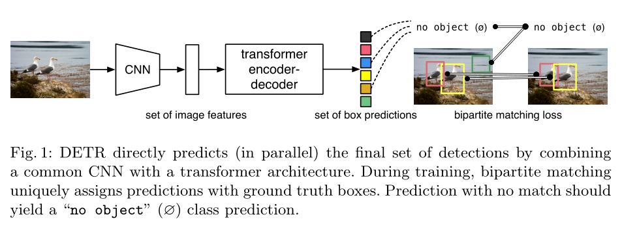
结构图

Slide 5
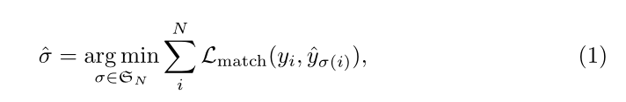


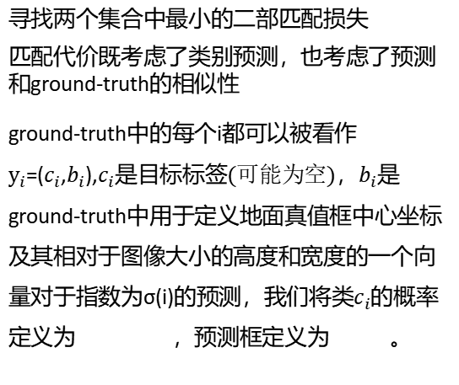
目标检测集预测损失 Object detection set prediction loss
DETR infers a fixed-size set of N predictions, in a single pass through the decoder, where N is set to be significantly larger than the typical number of objects in an image. One of the main difficulties of training is to score predicted objects (class, position, size) with respect to the ground truth. Our loss produces an optimal bipartite matching between predicted and ground truth objects, and then optimize object-specific (bounding box) losses. Let us denote by y the ground truth set of objects, and ˆy = {ˆyi}Ni=1 the set of N predictions. Assuming N is larger than the number of objects in the image, we consider y also as a set of size N padded with ∅ (no object). To find a bipartite matching between these two sets we search for a permutation of N elements σ ∈ SN with the lowest cost:
寻找两个集合中最小的二部匹配损失
匹配代价既考虑了类别预测，也考虑了预测和ground-truth的相似性
ground-truth中的每个i都可以被看作$y_{i}$=($c_{i}$,$b_{i}$),$c_{i}是目标标签(可能为空)$，$b_{i}$是ground-truth中用于定义地面真值框中心坐标及其相对于图像大小的高度和宽度的一个向量对于指数为σ(i)的预测，我们将类$c_{i}$的概率定义为 ，预测框定义为 。
Q
K
K
V
V

Slide 6


匈牙利的损失 （包含BBOX损失） Hungarian loss（Bounding box los）
This procedure of finding matching plays the same role as the heuristic assignment rules used to match proposal [37] or anchors [22] to ground truth objects in modern detectors. The main difference is that we need to find one-to-one matching for direct set prediction without duplicates.The second step is to compute the loss function, the Hungarian loss for all pairs matched in the previous step. We define the loss similarly to the losses of common object detectors, i.e. a linear combination of a negative log-likelihood for class prediction and a box loss defined later:
进行完前一步之后，计算损失函数
ˆσ是在第一步（1）中计算的最优分配，
L1损失可能产生损失相对扩大，这里使用了L1损失和iou损失的相对组合，其中λiou，λL1∈ R是超参数

Slide 7
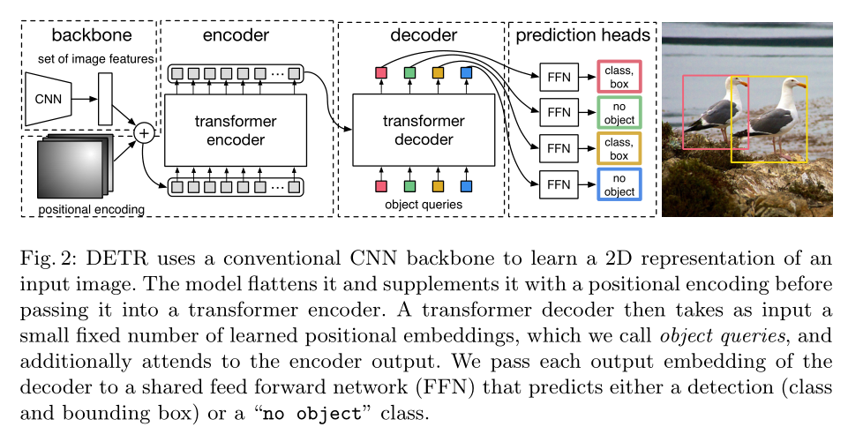
DETR结构

Slide 8
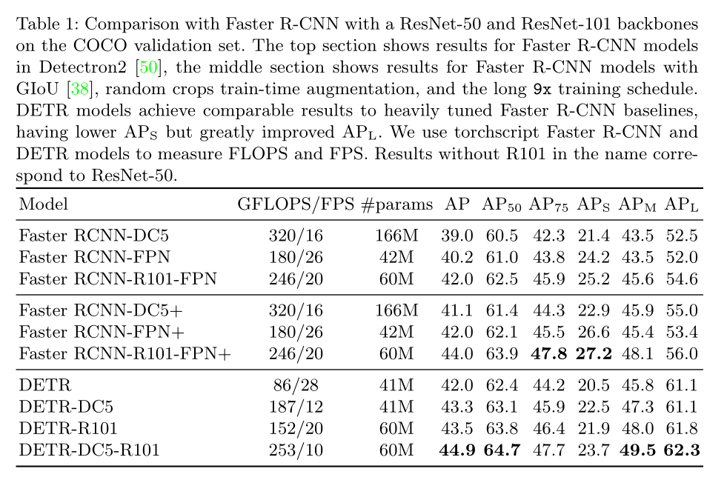
实验

Slide 9
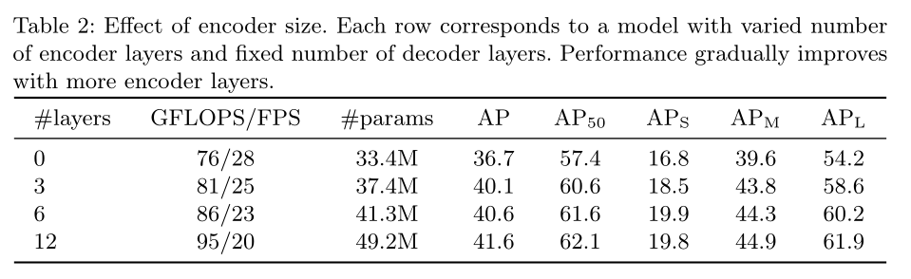

Slide 10
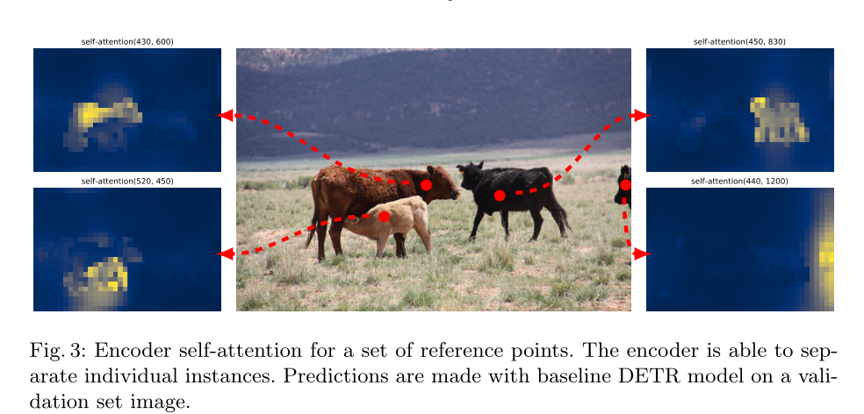

Slide 11
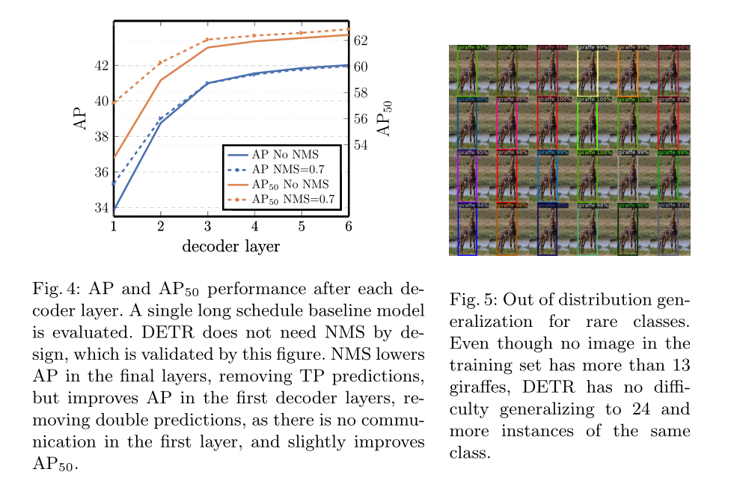

Slide 12
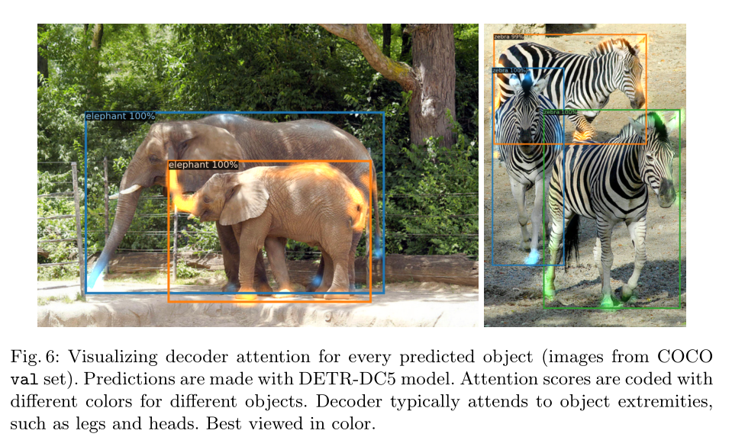

Slide 13
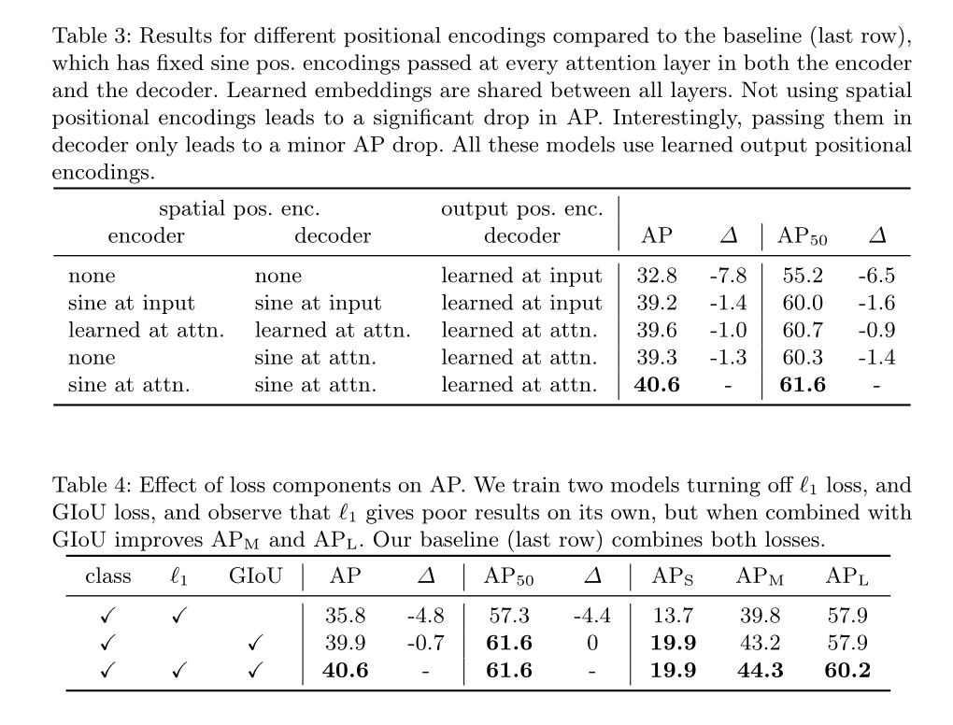

Slide 14
