Slide 1
Not All Images are Worth 16x16 Words: Dynamic Transformers for Efficient Image Recognition
Yulin Wang 1∗ Rui Huang 1∗ Shiji Song 1 Zeyi Huang 2 Gao Huang
arXiv:2105.15075v2 [cs.CV] 26 Oct 2021
NeurIPS-2021

Slide 2
摘要
Vision Transformers (ViT) have achieved remarkable success in large-scale image recognition. They split every 2D image into a fixed number of patches, each of which is treated as a token. Generally, representing an image with more to- kens would lead to higher prediction accuracy, while it also results in drastically increased computational cost. To achieve a decent trade-off between accuracy and speed, the number of tokens is empirically set to 16x16 or 14x14. In this paper, we argue that every image has its own characteristics, and ideally the to- ken number should be conditioned on each individual input. In fact, we have observed that there exist a considerable number of “easy” images which can be accurately predicted with a mere number of 4x4 tokens, while only a small frac- tion of “hard” ones need a finer representation. Inspired by this phenomenon, we propose a Dynamic Transformer to automatically configure a proper number of tokens for each input image. This is achieved by cascading multiple Transformers with increasing numbers of tokens, which are sequentially acti- vated in an adaptive fashion at test time, i.e., the inference is terminated once a sufficiently confident prediction is produced. We further design efficient fea- ture reuse and relationship reuse mechanisms across different components of the Dynamic Transformer to reduce redundant computations. Extensive empirical results on ImageNet, CIFAR-10, and CIFAR-100 demonstrate that our method significantly outperforms the competitive baselines in terms of both theoretical computational efficiency and practical inference speed.
视觉变换器（ViT）在大规模图像识别中取得了显著的成功。他们将每个2D图像分割成固定数量的面片，每个面片都被视为标记。通常，使用更多标记表示图像会导致更高的预测精度，同时也会导致计算成本大幅增加。
文中提出动态Transformer，会自动为输入图像分配合适数量的token，这是通过级联不同token数目的Transformer实现的，他们会自适应的依次激活，一旦预测结果达到一定的置信度，就停止继续激活。

Slide 3
贡献总结
In this paper, we sought to optimally configure a proper number of tokens for each individual image in vision Transformers, and hence proposed the Dynamic Vision Transformer (DVT) framework. DVT processes each test input by sequentially activating a cascade of Transformers using increasing numbers of tokens, until an appropriate token number is reached (measured by the prediction confidence). We further introduce the feature and relationship reuse mechanisms to facilitate efficient computation reuse. Extensive experiments indicate that DVT significantly improves the computational efficiency on top of state-of-the-art vision Transformers, both theoretically and empirically.
在本文中，我们试图为视觉转换器中的每个图像优化配置适当数量的令牌，因此提出了动态视觉转换器（DVT）框架。DVT通过使用越来越多的令牌依次激活变压器级联来处理每个测试输入，直到达到适当的令牌数（通过预测置信度测量）。我们进一步介绍了特征和关系重用机制，以促进高效的计算重用。大量实验表明，无论从理论上还是从经验上，DVT都显著提高了最先进的视觉转换器的计算效率。

Slide 4
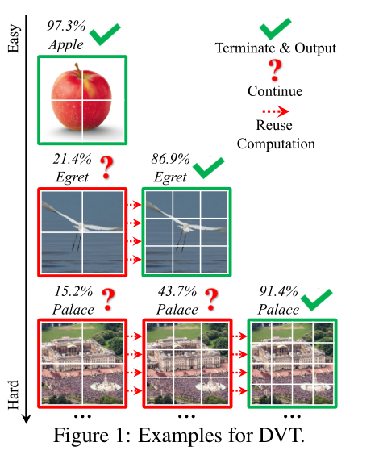
Motivated by this observation, we propose a novel Dynamic Vision Transformer (DVT) framework, aiming to automatically configure a decent token number conditioned on each image for high computational efficiency. In specific, a cascade of Transformers are trained using increasing number of tokens. At test time, these models are sequentially activated starting with less tokens. Once a prediction with sufficient confidence has been produced, the inference procedure will be terminated immediately. As a consequence, the computation is unevenly allocated among “easy” and “hard” samples by adjusting the token number, yielding a considerable improvement in efficiency. Importantly, we further develop feature-wise and relationshipwise reuse mechanisms to reduce redundant computations.The former allows the downstream models to be trained on the basis of previously extracted deep features, while the later enables leveraging existing upstream self-attention relationships to learn more accurate attention maps. Illustrative examples of our method are given in Figure 1.

Slide 5
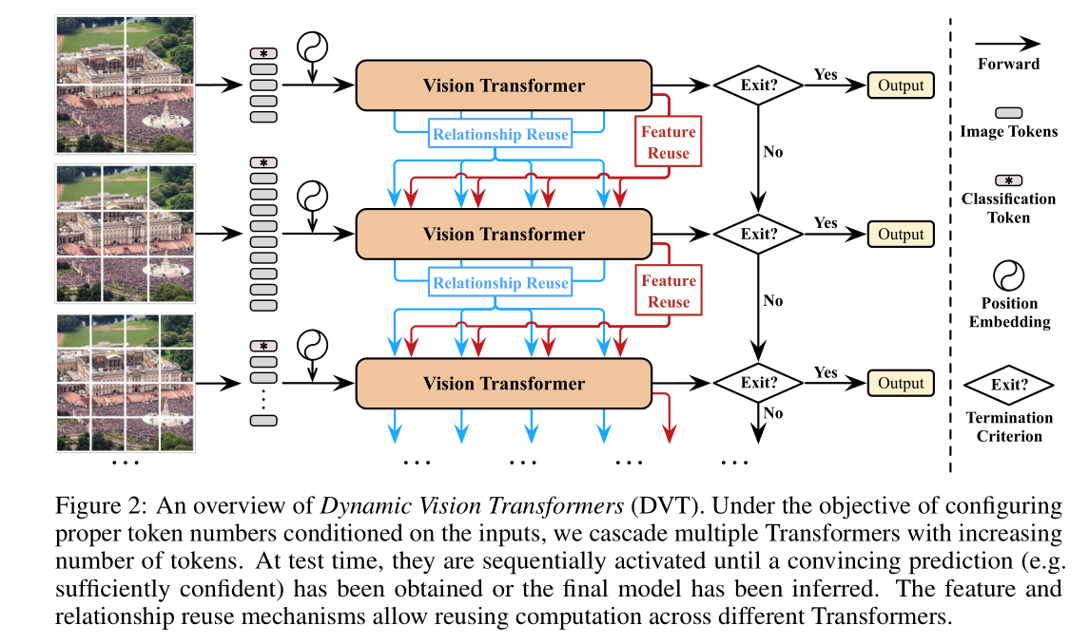
结构图

Slide 6

训练 Training
For training, we simply train DVT to produce correct predictions at all exits (i.e., each with the corresponding number of tokens). Formally, the optimization objective is
where (x,y) denote a sample in the training set D train and its corresponding label. We adopt the standard cross-entropy loss function L CE (·) , while p i denotes the softmax prediction probability output by the i th exit. We find that such a simple training objective works well in practice.
(1)其中（x，y）表示训练集中的样本D序列及其相应的标签。我们采用标准交叉熵损失函数$L_{CE}(.)$，而pi表示softmax最大预测概率第i个出口的输出。
Q
K
K
V
V

Slide 7
特征和关系重用 Feature and Relationship Reuse
An important challenge to develop our DVT approach is how to facilitate the reuse of computation.That is, once a downstream Transformer with more tokens is inferred, it is obviously inefficient if the computation performed in previous models is abandoned. The upstream models, although being based on smaller number of input tokens, are trained with the same objective, and have extracted valuable information for fulfilling the task. Therefore, we propose two mechanisms to reuse the learned deep features and self-attention relationships. Both of them are able to improve the test accuracy significantly by involving minimal extra computational cost.
本文的另一挑战是如何提高DVT的计算复用结果，因为一旦下游Transformer被激活，上游Transformer的计算结果就被丢弃了，这无疑是十分低效的，因为上游模型也是针对当前物体进行训练的，也提取到了有效的特征，虽然精度差了一点，因此本文提出特征复用和关系复用来重用上有计算结果，从而在引入最小的计算成本基础上获得性能提升。

Slide 8
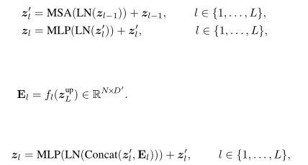
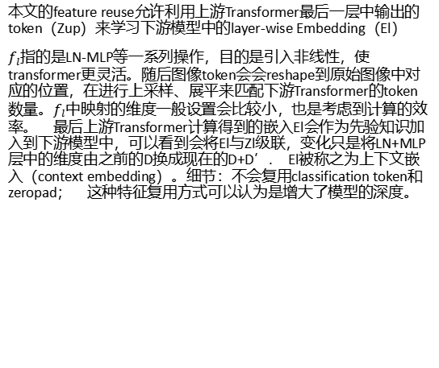
特征重用 Feature reuse
Background. For the ease of introduction, we first revisit the basic formulation of vision Transformers. The Transformer encoders consist of alternatively stacked multi-head self-attention (MSA)and multi-layer perceptron (MLP) blocks [ 40 , 11 ]. The layer normalization (LN) [ 2 ] and residualconnection [ 19 ] are applied before and after each block, respectively. Let z l ∈ R N×D denote the output of the l th Transformer layer, where N is the number of tokens for each sample, and D is the dimension of each token. Note that N = HW + 1 , which corresponds to H×W patches of the original image and a single learnable classification token. Formally, we have
本文的feature reuse允许利用上游Transformer最后一层中输出的token（Zup）来学习下游模型中的layer-wise Embedding（El）
$f_{l}$指的是LN-MLP等一系列操作，目的是引入非线性，使transformer更灵活。随后图像token会会reshape到原始图像中对应的位置，在进行上采样、展平来匹配下游Transformer的token数量。$f_{l}$中映射的维度一般设置会比较小，也是考虑到计算的效率。 最后上游Transformer计算得到的嵌入El会作为先验知识加入到下游模型中，可以看到会将El与Zl级联，变化只是将LN+MLP层中的维度由之前的D换成现在的D+D’. El被称之为上下文嵌入（context embedding）。细节：不会复用classification token和zeropad； 这种特征复用方式可以认为是增大了模型的深度。

Slide 9
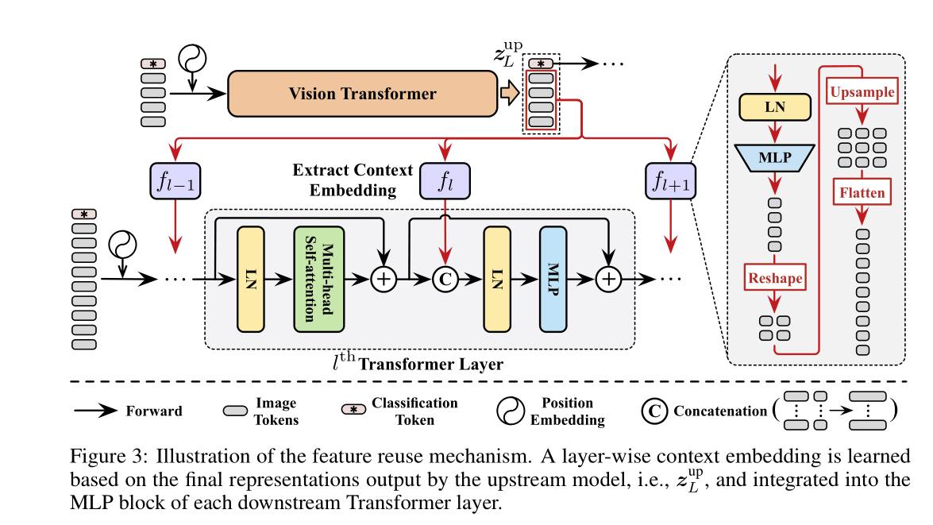

Slide 10
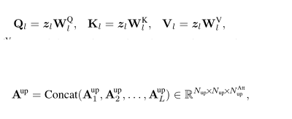

关系重用 Relationship reuse
A prominent advantage of vision Transformers is that their self-attention blocks enable integrating information across the entire image, which effectively models the long-range dependencies in the data. Typically, the models need to learn a group of attention maps at each layer to de- scribe the relationships among tokens. Apart from the deep features mentioned above, the downstream models also have access to the self-attention maps produced in previous models. We argue that these learned relationships are also capable of being reused to facilitate the learning of down- stream Transformers.
Vision Transformer的一大优势是其自注意力模块可以集合整张图的信息，有效的建模了长程依赖关系。通常每一层Transformer layer需要学习一组注意力图来描述token之间的关系，因此下游模型还可以利用上有模型学习到的attention map的信息。
其中Al就是一组注意力图的数值。为了进行关系复用，本文首先将上游模型学习到的注意力图拼接起来，Nup代表token的数目，Natt-up代表注意力图=NhL,Nh表示注意力的头数，L则是层数。这样下游模型就可以同时利用自身的token和上游的注意力图进一步进行学习。

Slide 11
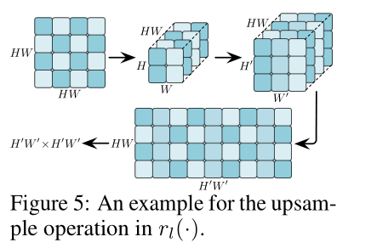
Notably, Eq. (9) is a simple but flexible formulation. For one thing, each self-attention block in the downstream model has access to all the upstream attention heads in both shallow and deep layers, and hence can be trained to leverage multi-level relationship information on its own basis. For another, as the newly generated attention maps and the reused relationships are combined in logits, their relative importance can be automatically learned by adjusting the magnitude of logits. It is also worth noting that the regular upsample operation cannot be directly applied in r l (·) . To illustrate this issue, we take upsampling a HW×HW ( H=W =2 ) attention map to H 0 W 0 ×H 0 W 0 ( H 0 =W 0 =3 ) for example in Figure 5. Since each of its rows and columns corresponds to H×W image tokens, we reshape the rows or columns back to H×W, scale them to H 0 ×W 0 , and then flatten them to H 0 W 0 vectors.
rl并不是简单的上采样，详情参见Fig 5.每一块是HxW token对应的注意力图，现在H=W=2，需要先将所有token对应的att map reshape成HxW大小，再将他们上采样到H’xW’大小，再讲他们组合成HW x H’W’大小，完成上采样操作。

Slide 12
自适应推理 Adaptive Inference
As aforementioned, the proposed DVT framework progressively increases the number of tokens for each test sample and performs early-termination, such that “easy” and “hard” images can be processed using varying tokens with uneven computational cost, improving the overall efficiency. Specifically, at the i th exit that produces the softmax prediction p i , the largest entry of p i , i.e., max j p ij (defined as confidence [ 23 , 52 , 47 ]), is compared with a threshold η i . If max j p ij ≥ η i , the inference will stop by adopting p i as the output. Otherwise, the image will be represented using more tokens to activate the downstream Transformer. We always adopt a zero-threshold for the final Transformer.
DVT会根据输入样本的易难程度逐渐增加token的数目，即不同难度的输入图像处理起来的计算复杂度也不尽相同。即在进行softmax获得最终预测结果时，会与设定的一个阈值进行比较，只有当预测超过阈值推断才会结束，同时将预测结果输出；否则输入图像将会被切分成更多token，并激活下游Transformer进行计算。因此最后一个Transformer输出的地方，阈值设定的是下述公式

Slide 13
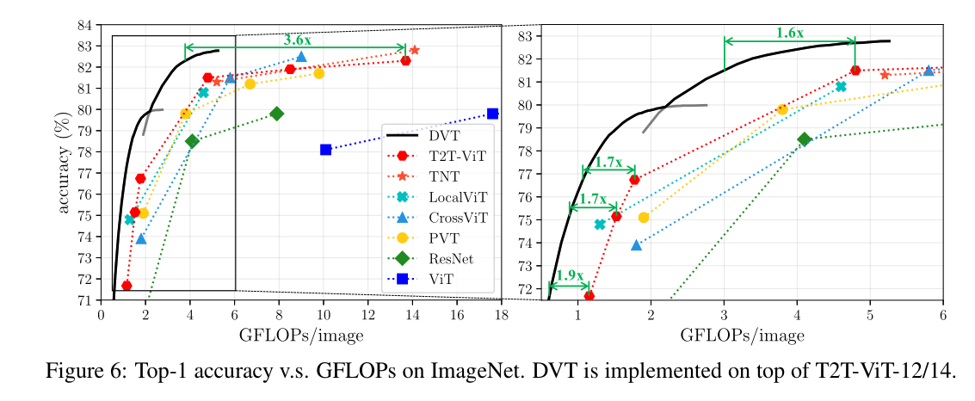
实验

Slide 14
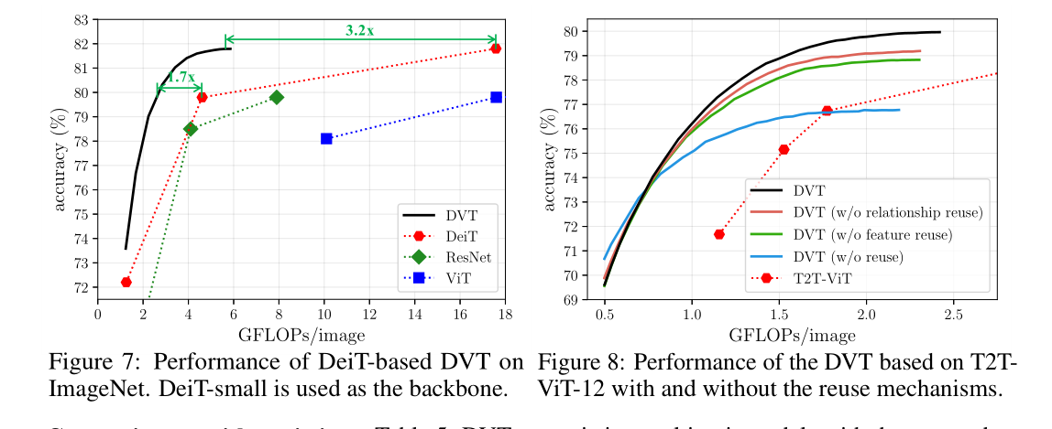

Slide 15
