Slide 1
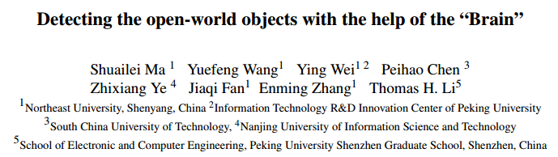
CVPR 2023

Slide 2
摘要
Humans have a natural instinct to identify unknown object instances in their environments. The intrinsic curiosity about these unknown instances aids in learning about them, when the corresponding knowledge is eventually available. This motivates us to propose a novel computer vision problem called: ‘Open World Object Detection’, where a model is tasked to: 1) identify objects that have not been introduced to it as ‘unknown’, without explicit supervision to do so, and 2) incrementally learn these identified unknown categories without forgetting previously learned classes, when the corresponding labels are progressively received. We formulate the problem, introduce a strong evaluation protocol and provide a novel solution, which we call ORE: Open World Object Detector , based on contrastive clustering and energy based unknown identification. Our experimental evaluation and ablation studies analyse the efficacy of ORE in achieving Open World objectives. As an interesting by-product, we find that identifying and characterising unknown instances helps to reduce confusion in an incremental object detection setting, where we achieve state-of-the-art performance, with no extra methodological effort. We hope that our work will attract further research into this newly identified, yet crucial research direction
人类有识别环境中未知物体实例的本能。当相应的知识最终可用时，对这些未知实例的内在好奇心有助于了解它们。这促使我们提出了一个新的计算机视觉问题，称为“开放世界目标检测”
其中一个模型的任务是：
1）在没有明确监督的情况下，将尚未引入该模型的对象识别为“未知”
2）在不忘记之前学习的课程的情况下，逐步学习这些已识别的未知类别，当逐步收到相应的标签时。我们提出了这个问题，引入了一个强大的评估协议，并提供了一个新的解决方案，我们称之为ORE：基于对比聚类和基于能量的未知识别的开放世界目标检测器。
我们的实验评估和烧蚀研究分析了ORE在实现开放世界目标方面的功效。作为一个有趣的副产品，我们发现识别和描述未知实例有助于减少增量对象检测环境中的混乱，在这种环境中，我们实现了最先进的性能，而无需额外的方法学努力。我们希望，我们的工作将吸引对这一新确定但至关重要的研究方向的进一步研究

Slide 3
贡献总结
The vibrant object detection community has pushed the performance benchmarks on standard datasets by a large margin. The closed-set nature of these datasets and evaluation protocols, hampers further progress. We introduce Open World Object Detection, where the object detector is able to label an unknown object as unknown and gradually learn the unknown as the model gets exposed to new labels. Our key novelties include an energy-based classifier for unknown detection and a contrastive clustering approach for open world learning. We hope that our work will kindle further research along this important and open direction.
•We introduce a novel problem setting, Open World Object Detection, which models the real-world more closely.
• We develop a novel methodology, called ORE, based on contrastive clustering, an unknown-aware proposal net- work and energy based unknown identification to address the challenges of open world detection.
• We introduce a comprehensive experimental setting, which helps to measure the open world characteristics of an object detector, and benchmark ORE on it against competitive baseline methods.
• As an interesting by-product, the proposed methodology achieves state-of-the-art performance on Incremental Object Detection, even though not primarily designed for it
充满活力的对象检测社区极大地推动了标准数据集的性能基准。这些数据集和评估协议的封闭性阻碍了进一步的进展。我们引入了开放世界的目标检测，目标检测器能够将未知目标标记为未知，并随着模型暴露于新的标签，逐渐学习未知。我们的主要创新点包括用于未知检测的基于能量的分类器和用于开放世界学习的对比聚类方法。我们希望，我们的工作将沿着这一重要而开放的方向引发进一步的研究。
1 定义了Open World Object Detection问题，更贴近现实生活。
2 提出ORE算法，基于对比聚类(contrastive clustering)、可框出未知类别的检测网络(unknown-aware proposal network)、能量分类器(energy based unknown identification)来解决Open World Object Detection上的问题。
3 设计了完备的实验，用于衡量算法在Open World Object Detection上的性能。
4 作为论文的副产品，ORE在增量学习任务上达到了SOTA，而且还有很大的提升空间。

Slide 4
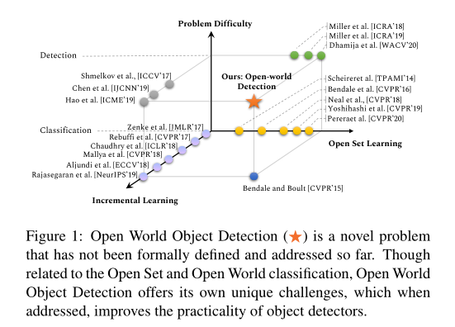
相关工作
Open Set Classification
Open World Classification
Open Set Detection
开放集分类：虽然这些工作可以识别未知的实例，但它们不能在多个训练事件中以增量方式动态更新自己。此外，我们基于能量的未知检测方法以前从未被探索过。
开放世界分类：首次提出了图像识别的开放世界设置。他们提出了一种更灵活的设置，即已知和未知共存，而不是在固定的类集合上训练静态分类器。他们不测试图像分类基准，也不研究电子商务应用中的产品分类。
开放集检测：正式研究了开放集设置对流行对象检测器的影响。他们注意到，最先进的物体检测器通常会对未知类别进行分类，并且对已知类别的可信度很高。然而，这些方法无法在动态世界中逐步调整其知识。

Slide 5
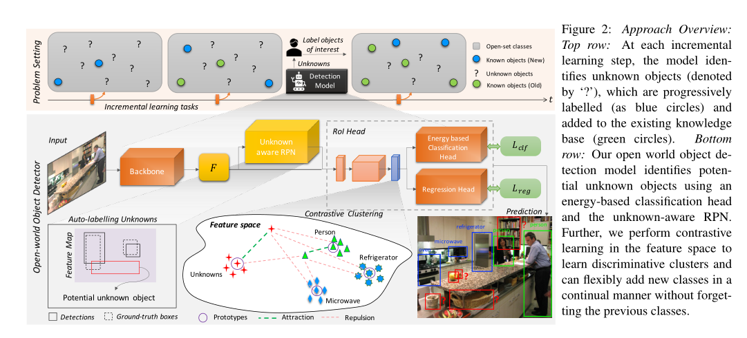
结构图
图2 ORE的高层抽象，以两阶段检测器Faster R-CNN作为基础检测器。在第一阶段，检测器可通过类不可知的RPN给出可能存在物体的所有区域，而在第二阶段，将上述的每个区域进行分类和位置调整。为了更好的适应Open World Object Detection，ORE对RPN和分类器都进行了相应的改进，适应自动打标签和识别未知类的需求。

Slide 6
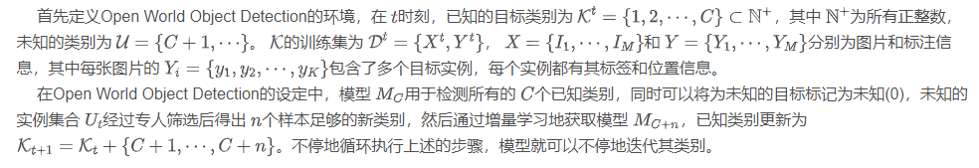


开放世界目标检测 Open World Object Detection
Let us formalise the definition of Open World Object Detection in this section. At any time t, we consider the set of known object classes as Kt = {1, 2, .., C} ⊂ N+ where N+ denotes the set of positive integers. In order to realistically model the dynamics of real world, we also assume that their exists a set of unknown classes U = {C + 1, ...}, which may be encountered during inference. The known object classes Kt are assumed to be labeled in the dataset Dt = {Xt, Yt} where X and Y denote the input im- ages and labels respectively. The input image set comprises of M training images, Xt = {I1, . . . , IM } and associated object labels for each image forms the label set Yt = {Y1, . . . , YM }. Each Yi = {y1, y2, .., yK} encodes a set of K object instances with their class labels and lo- cations i.e., yk = [lk, xk, yk, wk, hk], where lk ∈ Kt and xk, yk, wk, hk denote the bounding box center coordinates, width and height respectively.
The Open World Object Detection setting considers an object detection model MC that is trained to detect all the previously encountered C object classes. Importantly, the model MC is able to identify a test instance belonging to any of the known C classes, and can also recognize a new or unseen class instance by classifying it as an unknown, denoted by a label zero (0). The unknown set of instances Ut can then be forwarded to a human user who can identify n new classes of interest (among a potentially large number of unknowns) and provide their training examples. The learner incrementally adds n new classes and updates itself to produce an updated model MC+n without retraining from scratch on the whole dataset. The known class set is also updated Kt+1 = Kt + {C + 1, . . . , C + n}. This cycle continues over the life of the object detector, where it adaptively updates itself with new knowledge. The problem setting is illustrated in the top row of Fig. 2.
Q
K
K
V
V

Slide 7
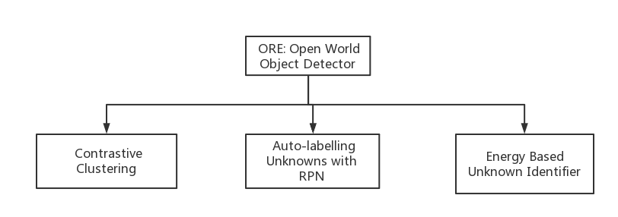

Slide 8
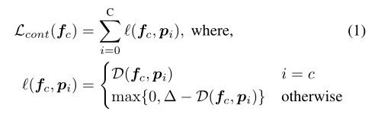
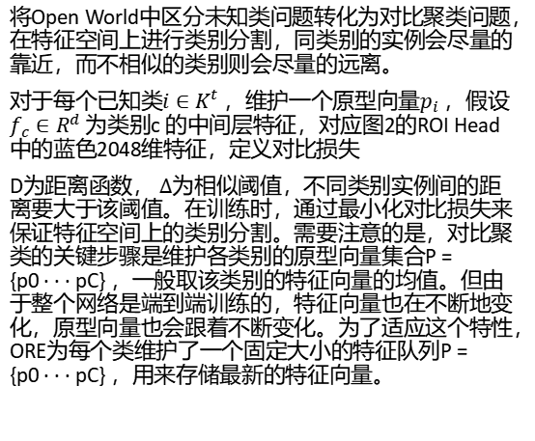
对比聚类 Contrastive Clustering
Class separation in the latent space would be an ideal characteristic for an Open World methodology to identify unknowns. A natural way to enforce this would be to model it as a contrastive clustering problem, where instances of same class would be forced to remain close-by, while instances of dissimilar class would be pushed far apart. For each known class i ∈ Kt, we maintain a prototype vector pi. Let fc ∈ Rd be a feature vector that is generated by an intermediate layer of the object detector, for an object of class c. We define the contrastive loss as follows:
将Open World中区分未知类问题转化为对比聚类问题，在特征空间上进行类别分割，同类别的实例会尽量的靠近，而不相似的类别则会尽量的远离。
对于每个已知类$i∈K^{t}$ ，维护一个原型向量$p_{i}$ ，假设$f_{c}∈R^{d}$ 为类别c 的中间层特征，对应图2的ROI Head中的蓝色2048维特征，定义对比损失
D为距离函数， $∆$为相似阈值，不同类别实例间的距离要大于该阈值。在训练时，通过最小化对比损失来保证特征空间上的类别分割。需要注意的是，对比聚类的关键步骤是维护各类别的原型向量集合P = {p0 · · · pC} ，一般取该类别的特征向量的均值。但由于整个网络是端到端训练的，特征向量也在不断地变化，原型向量也会跟着不断变化。为了适应这个特性，ORE为每个类维护了一个固定大小的特征队列P = {p0 · · · pC} ，用来存储最新的特征向量。

Slide 9
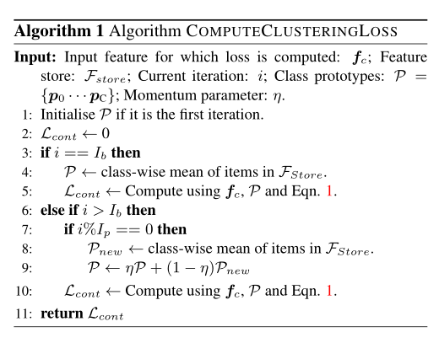
对比损失计算方法
算法1给出了在计算聚类损失时，类别原形是如何被管理的。在一个特定的迭代次数（burnin iteration）之后，我们才会开始计算损失。这使得初始化特征嵌入能使自己更成熟，从而对类别信息进行编码。自此，我们使用公式1计算聚类误差。每个迭代后，一个新类别原形集合被计算（line8）。之后通过一个动量参数衡量和，有的原形被更新。这使得在保持跟随在之前语义的基础上，类别原形可以演化。计算到的聚类损失被加入到标准检测损失中并反向传播来进行端到端的学习

Slide 10
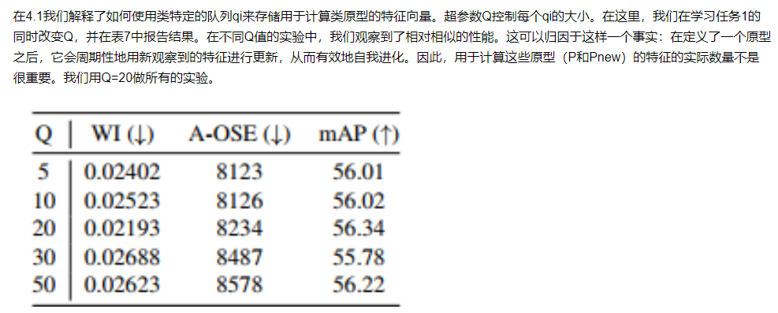
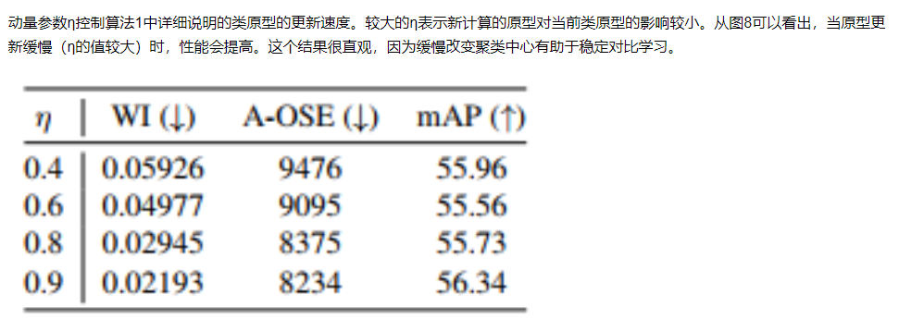

Slide 11
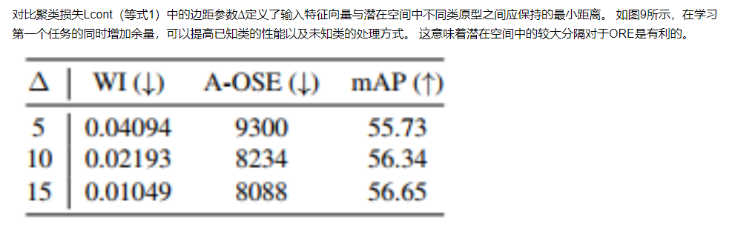

Slide 12
用RPN自动标记未知量 Auto-labelling Unknowns with RPN
While computing the clustering loss with Eqn. 1, we contrast the input feature vector fc against prototype vec-tors, which include a prototype for unknown objects too (c ∈ {0, 1, .., C} where 0 refers to the unknown class). This would require unknown object instances to be labelled with unknown ground truth class, which is not practically feasible owing to the arduous task of re-annotating all instances of each image in already annotated large-scale datasets. As a surrogate, we propose to automatically label some of the objects in the image as a potential unknown object. For this, we rely on the fact that Region Proposal Network (RPN) is class agnostic. Given an input image, the RPN generates a set of bounding box predictions for foreground and background instances, along with the corresponding objectness score, but do not overlap with a ground-truth object top-k background region proposals, sorted by its objectness scores, as unknown objects. This seemingly simple heuristic achieves good performance as demonstrated in Sec. 5.
当通过公式1计算聚类损失时，我们将输入的特征参数与包含了未知目标的原型向量进行对比。这个过程可以要求将未知目标实例标记为的真值，但实际上并不可行，因为重新标注每个已经在大规模数据集中标注过的每个图片的所有实例是一个非常艰难的工作。
作为替代，我们提出对图片中的一些目标自动标注为潜在的位置目标。我们为此依赖RPN的类别不可知性。给定一个输入图像，RPN网络生成一个边框集合来对前景实例和背景实例进行预测，并同时得到对应目标的分数。我们将那些有高目标评分的候选区域进行标注，但不要与真值目标作为潜在的未知目标重叠。简单来说，我们选择前k个目标评分高的背景候选区域，作为未知目标。这个看上去简单地启发式方法取得了很好饿的效果，这会在第5节中进行叙述。

Slide 13
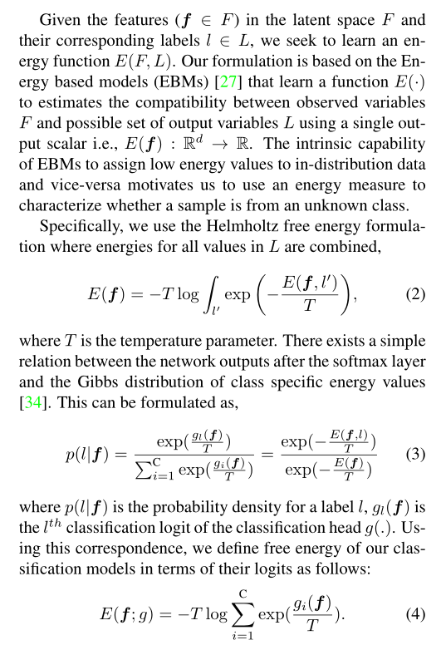
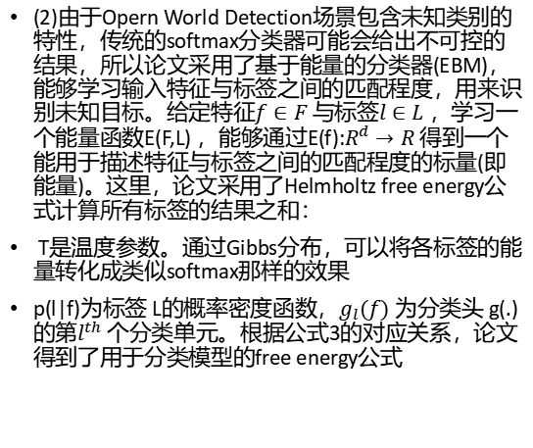
基于能量的未知辨别 Energy Based Unknown Identifier
(2)由于Opern World Detection场景包含未知类别的特性，传统的softmax分类器可能会给出不可控的结果，所以论文采用了基于能量的分类器(EBM)，能够学习输入特征与标签之间的匹配程度，用来识别未知目标。给定特征$f∈F$ 与标签$l∈L$ ，学习一个能量函数E(F,L) ，能够通过E(f):$R^{d}→R$ 得到一个能用于描述特征与标签之间的匹配程度的标量(即能量)。这里，论文采用了Helmholtz free energy公式计算所有标签的结果之和：
T是温度参数。通过Gibbs分布，可以将各标签的能量转化成类似softmax那样的效果
p(l|f)为标签 L的概率密度函数，$g_{l}(f)$ 为分类头 g(.)的第$l^{th}$ 个分类单元。根据公式3的对应关系，论文得到了用于分类模型的free energy公式

Slide 14
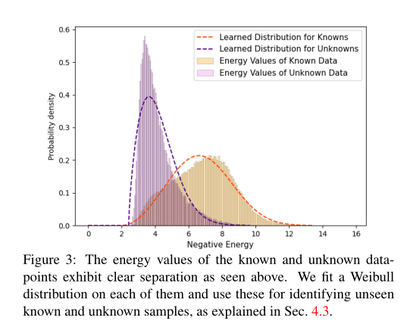
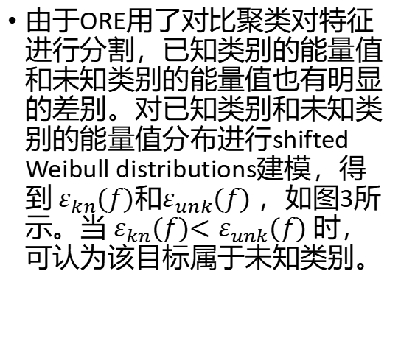
由于ORE用了对比聚类对特征进行分割，已知类别的能量值和未知类别的能量值也有明显的差别。对已知类别和未知类别的能量值分布进行shifted Weibull distributions建模，得到 $ε_{kn}(f)$和$ε_{unk}(f)$ ，如图3所示。当 $ε_{kn}(f){<ε}_{unk}(f)$时，可认为该目标属于未知类别。

Slide 15
削弱遗忘 Alleviating Forgetting
After the identification of unknowns, an important requisite for an open world detector is to be able to learn new classes, when the labeled examples of some of the unknown classes of interest are provided. Importantly, the training data for the previous tasks will not be present at thisstage since retraining from scratch is not a feasible solution. Training with only the new class instances will lead to catastrophic forgetting [40, 11] of the previous classes. We note that a number of involved approaches have been developed to alleviate such forgetting, including methods based on parameter regularization [2, 24, 29, 66], exemplar replay [6, 51, 37, 5], dynamically expanding networks [39, 60, 56] and meta-learning [50, 25]. We build on the recent insights from [49, 26, 62] which compare the importance of example replay against other more complex solutions. Specifically, Prabhu et al. [49] retrospects the progress made by the complex continual learning methodologies and show that a greedy exemplar selection strategy for replay in incremental learning consistently outperforms the state-of-the-art methods by a large margin. Knoblauch et al. [26] develops a theoretical justification for the unwarranted power of replay methods. They prove that an optimal continual learner solves an NP-hard problem and requires infinite memory. The effectiveness of storing few examples and replaying has been found effective in the related few-shot object detection setting by Wang et al. [62].These motivates us to use a relatively simple methodology for ORE to mitigate forgetting i.e., we store a balanced set of exemplars and finetune the model after each incremental step on these. At each point, we ensure that a minimum of Nex instances for each class are present in the exemplar set
在对识别出来的未知目标进行标注后，得到了新的数据集，如果将所有数据集混合重新训练会很耗时且不够灵活，所以只能使用新数据集进行增量学习，这就需要解决新类别训练对旧类别识别效果的影响。
论文参照了增量学习的SOTA方法，使用简单的样本回放策略来保证旧类别的效果，先构造一个小的样本集(exemplar set)，包含每个类别的 个样本，每次使用全量新数据集进行增量学习后，都使用小样本集进行一次finetune训练，这样就能很好地保证旧类别的效果而且不耗时。

Slide 16
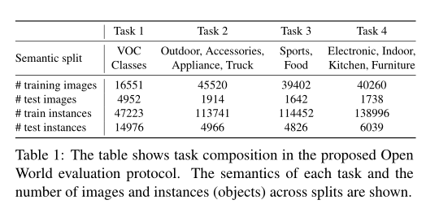
实验

Slide 17
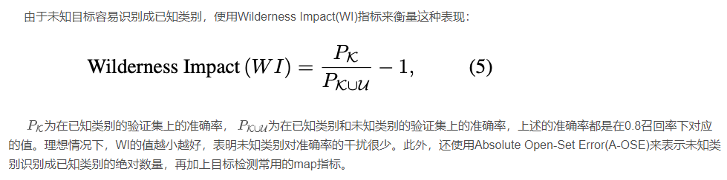
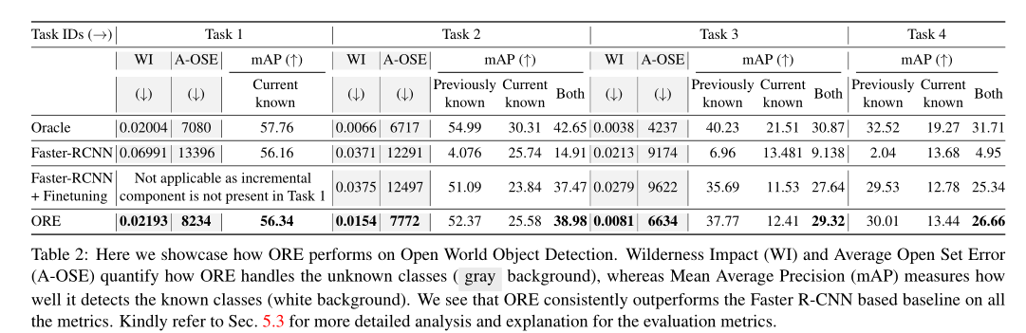

Slide 18
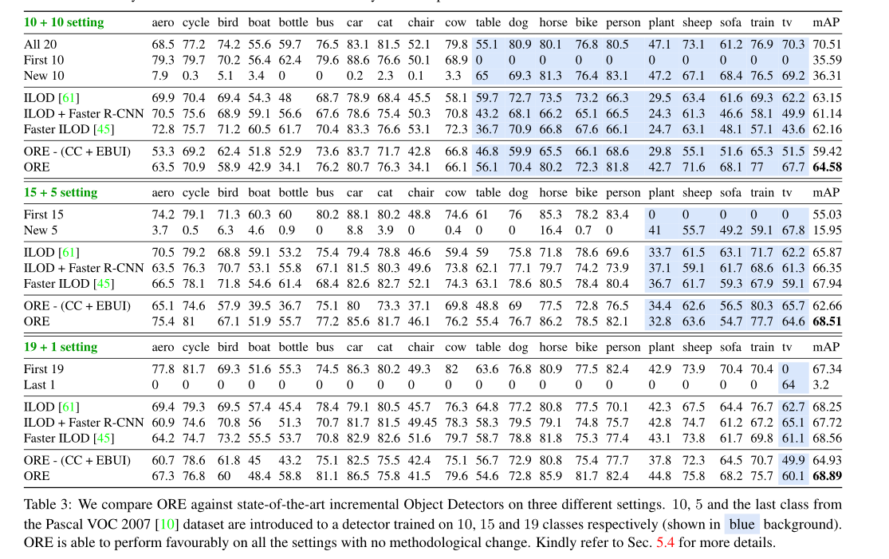

Slide 19
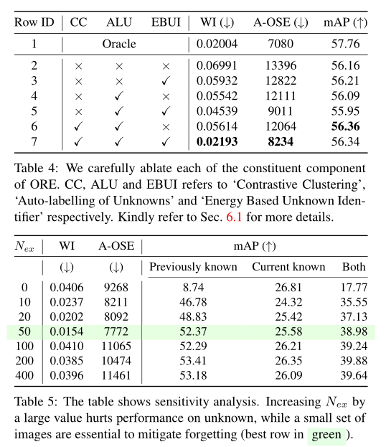

Slide 20
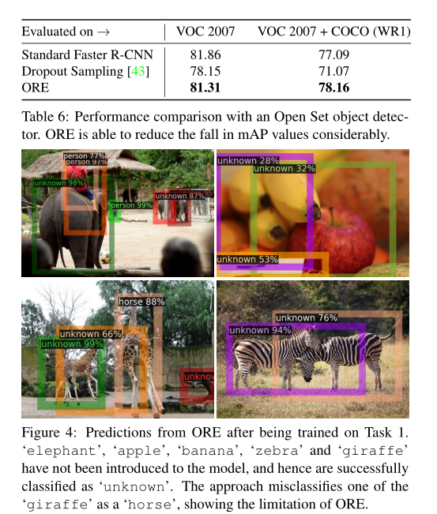
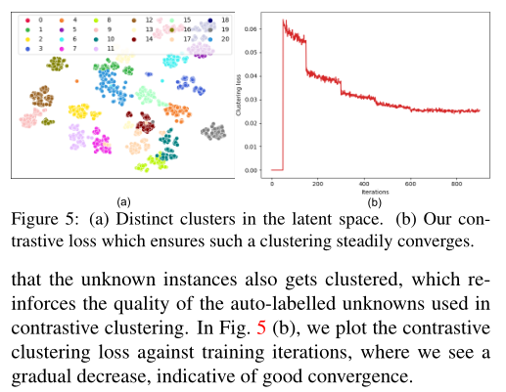

Slide 21
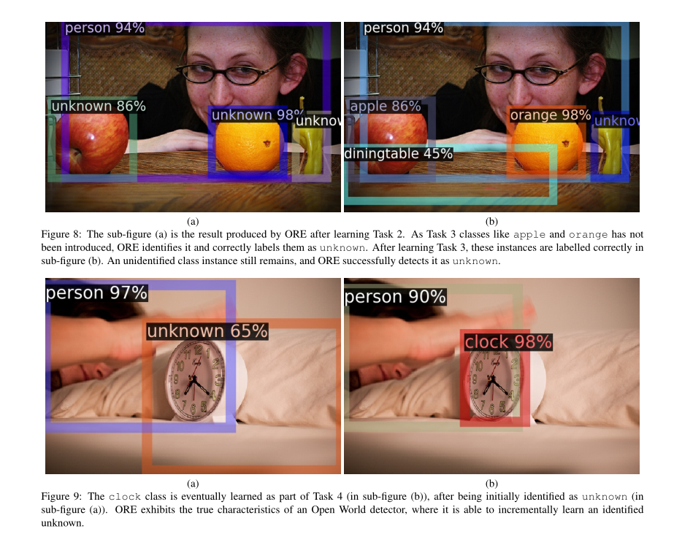

Slide 22
感谢观看！

