Slide 1
AN IMAGE IS WORTH 16X16 WORDS: TRANSFORMERS FOR IMAGE RECOGNITION AT SCALE
Alexey Dosovitskiy∗;y, Lucas Beyer∗, Alexander Kolesnikov∗, Dirk Weissenborn∗,
Xiaohua Zhai∗, Thomas Unterthiner, Mostafa Dehghani, Matthias Minderer,
Georg Heigold, Sylvain Gelly, Jakob Uszkoreit, Neil Houlsby∗;y

Slide 2
摘要
While the Transformer architecture has become the de-facto standard for natural language processing tasks, its applications to computer vision remain limited. In vision, attention is either applied in conjunction with convolutional networks, or used to replace certain components of convolutional networks while keeping their overall structure in place. We show that this reliance on CNNs is not necessary and a pure transformer applied directly to sequences of image patches can perform very well on image classification tasks. When pre-trained on large amounts of data and transferred to multiple mid-sized or small image recognition benchmarks (ImageNet, CIFAR-100, VTAB, etc.), Vision Transformer (ViT) attains excellent results compared to state-of-the-art convolutional networks while requiring substantially fewer computational resources to train.1
摆脱了传统的基于卷积的图像处理的方法
直接给予transformer的架构也能在大数据的支持下达到很好的效果
运算所需要的资源烧

Slide 3
贡献总结
We have explored the direct application of Transformers to image recognition. Unlike prior works using self-attention in computer vision, we do not introduce image-specific inductive biases intothe architecture apart from the initial patch extraction step. Instead, we interpret an image as a sequence of patches and process it by a standard Transformer encoder as used in NLP. This simple,yet scalable, strategy works surprisingly well when coupled with pre-training on large datasets.Thus, Vision Transformer matches or exceeds the state of the art on many image classificationdatasets, whilst being relatively cheap to pre-train. While these initial results are encouraging, many challenges remain. One is to apply ViT to other computer vision tasks, such as detection and segmentation. Our results, coupled with those in Carion et al. (2020), indicate the promise of this approach. Another challenge is to continue exploring selfsupervised pre-training methods. Our initial experiments show improvement from self-supervised pre-training, but there is still large gap between self-supervised and large-scale supervised pretraining. Finally, further scaling of ViT would likely lead to improved performance.
把自注意力机制和transformer模型应用到cv领域，通过把图片按16x16的切片转化为一个个向量，再带入transformer模型，解决了一开始图片内容过大导致的序列长度过大导致的运算量大的问题，训练便宜（相对的）
大规模预训练，能够在几乎不大规模改动transformer模型的情况下能取得很好的效果

Slide 4
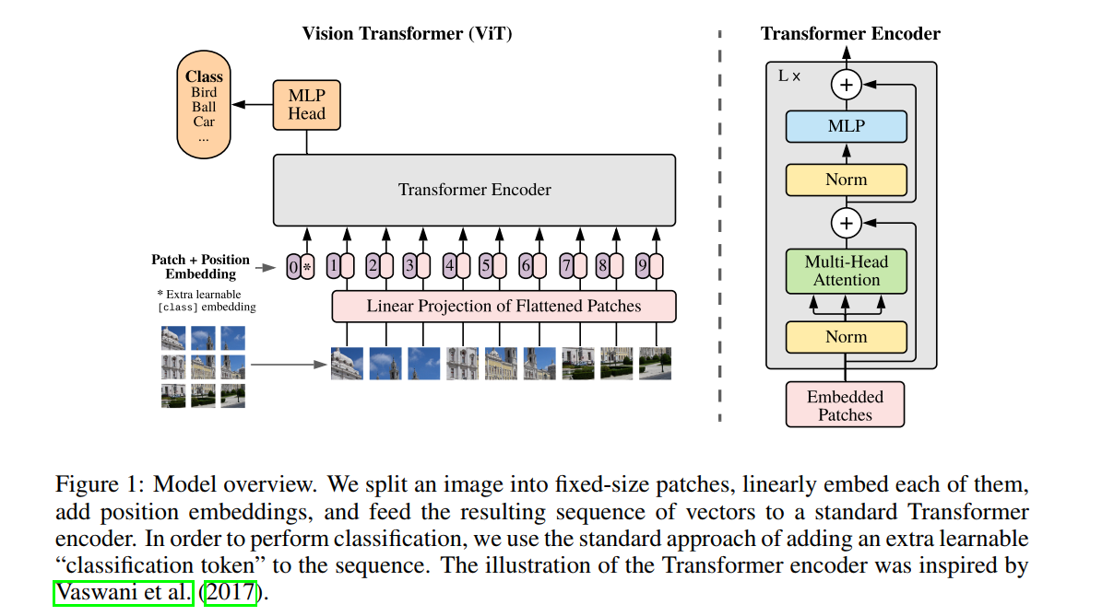
结构图

Slide 5
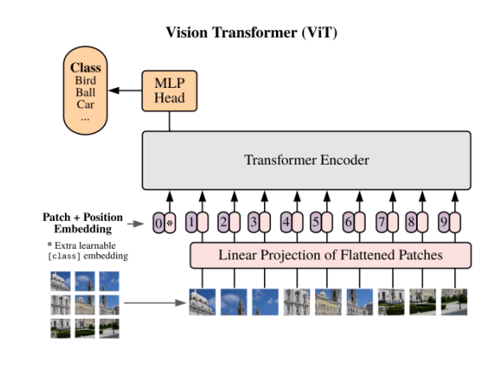
基本架构
An overview of the model is depicted in Figure 1. The standard Transformer receives as input a 1Dsequence of token embeddings. To handle 2D images, we reshape the image x 2 RH×W×C into a sequence of flattened 2D patches xp 2 RN×(P2·C), where (H; W ) is the resolution of the original image, C is the number of channels, (P; P ) is the resolution of each image patch, and N = HW=P 2 is the resulting number of patches, which also serves as the effective input sequence length for the Transformer. The Transformer uses constant latent vector size D through all of its layers, so we flatten the patches and map to D dimensions with a trainable linear projection (Eq. 1). We refer to the output of this projection as the patch embeddings. Similar to BERT’s [class] token, we prepend a learnable embedding to the sequence of embedded patches (z0 0 = xclass), whose state at the output of the Transformer encoder (z0 L) serves as the image representation y (Eq. 4). Both during pre-training and fine-tuning, a classification head is attached to z0 L. The classification head is implemented by a MLP with one hidden layer at pre-training time and by a single linear layer at fine-tuning time. Position embeddings are added to the patch embeddings to retain positional information. We use standard learnable 1D position embeddings, since we have not observed significant performance gains from using more advanced 2D-aware position embeddings (Appendix D.4). The resulting sequence of embedding vectors serves as input to the encoder.

Slide 6
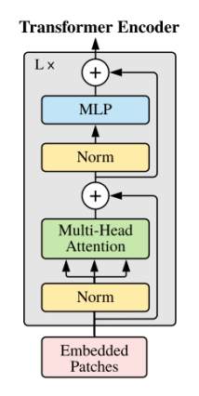
transformer encoder
The Transformer encoder (Vaswani et al., 2017) consists of alternating layers of multiheaded selfattention (MSA, see Appendix A) and MLP blocks (Eq. 2, 3). Layernorm (LN) is applied before every block, and residual connections after every block (Wang et al., 2019; Baevski & Auli, 2019). 3Published as a conference paper at ICLR 2021 The MLP contains two layers with a GELU non-linearity

Slide 7
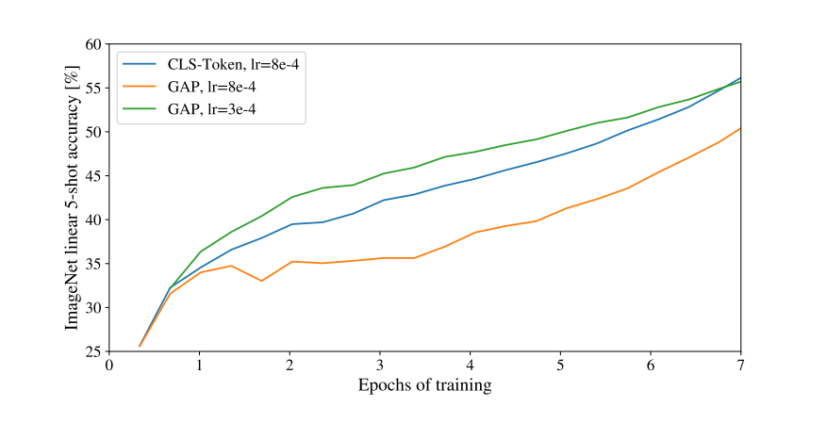
测试参数对比（学习率参数对比）
In order to stay as close as possible to the original Transformer model, we made use of an additional [class] token, which is taken as image representation. The output of this token is then transformed into a class prediction via a small multi-layer perceptron (MLP) with tanh as non-linearity in the single hidden layer.This design is inherited from the Transformer model for text, and we use it throughout the main paper. An initial attempt at using only image-patch embeddings, globally average-pooling (GAP)them, followed by a linear classifier—just like ResNet’s final feature map—performed very poorly.However, we found that this is neither due to the extra token, nor to the GAP operation.

Slide 8
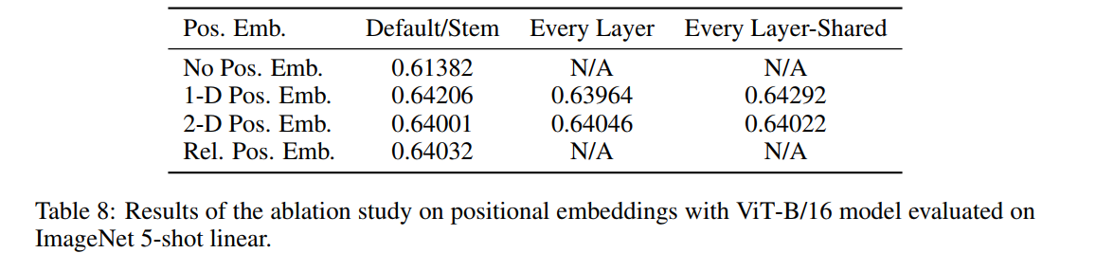
位置编码 POSITIONAL EMBEDDING
We ran ablations on different ways of encoding spatial information using positional embedding. We tried the following cases:
Providing no positional information: Considering the inputs as a bag of patches.
1-dimensional positional embedding: Considering the inputs as a sequence of patches in the raster order (default across all other experiments in this paper).
2-dimensional positional embedding: Considering the inputs as a grid of patches in two dimensions. In this case, two sets of embeddings are learned, each for one of the axes,X-embedding, and Y -embedding, each with size D/2. Then, based on the coordinate on the path in the input, we concatenate the X and Y embedding to get the final positional embedding for that patch.
Relative positional embeddings: Considering the relative distance between patches to encode the spatial information as instead of their absolute position. To do so, we use 1-dimensional Relative Attention, in which we define the relative distance all possible pairs of patches. Thus, for every given pair (one as query, and the other as key/value in the attention mechanism), we have an offset pq − pk, where each offset is associated with an embedding. Then, we simply run extra attention, where we use the original query (the content of query), but use relative positional embeddings as keys. We then use the logits from the relative attention as a bias term and add it to the logits of the main attention (content-based attention) before applying the softmax.
1D位置编码
2D位置编码
相对位置编码
0 | 1 | 2 | 3 | 4
11 | 12 | 13
21 | 22 | 23
31 | 32 | 33
D/2
D/2
0 | 1 | 2 | 3 | 4

Slide 9
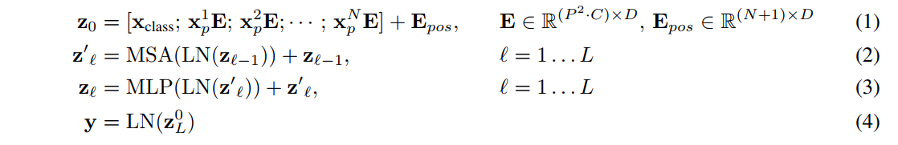
总体计算步骤
（1）每个patch跟全连接层转换，前面拼接一个class embedding,最后加上位置编码
（2）多头自注意力循环（L次）
（3）MLP循环（L次）
（4）最后那层输出的第一个，即ZL^0当做整体图像特征（以此来做分类
任务）
先做layer norm，再做残差连接

Slide 10
归纳偏置 Inductive bias
We note that Vision Transformer has much less image-specific inductive bias than CNNs. In CNNs, locality, two-dimensional neighborhood structure, and translation equivariance are baked into each layer throughout the whole model. In ViT, only MLP layers are local and translationally equivariant, while the self-attention layers are global. The two-dimensional neighborhood structure is used very sparingly: in the beginning of the model by cutting the image into patches and at fine-tuning time for adjusting the position embeddings for images of different resolution (as described below). Other than that, the position embeddings at initialization time carry no information about the 2D positions of the patches and all spatial relations between the patches have to be learned from scratch.
相对于CNN而言，少很多图像特有的归纳偏置（g[f(x)]=f[g(x)]平移和卷积先做哪个都没关系），没有用太多的卷积，所以在小型数据集上效果比不上卷积神经网络可以理解

Slide 11
大尺寸图片位置信息 FINE-TUNING AND HIGHER RESOLUTION
Typically, we pre-train ViT on large datasets, and fine-tune to (smaller) downstream tasks. Forthis, we remove the pre-trained prediction head and attach a zero-initialized D × K feedforward layer, where K is the number of downstream classes. It is often beneficial to fine-tune at higher resolution than pre-training (Touvron et al., 2019; Kolesnikov et al., 2020). When feeding images of higher resolution, we keep the patch size the same, which results in a larger effective sequence length. The Vision Transformer can handle arbitrary sequence lengths (up to memory constraints), however, the pre-trained position embeddings may no longer be meaningful. We therefore perform 2D interpolation of the pre-trained position embeddings, according to their location in the original image. Note that this resolution adjustment and patch extraction are the only points at which an inductive bias about the 2D structure of the images is manually injected into the Vision Transformer.
更大尺寸时可能产生更多的patch，加大计算量，为此需要更大的patch size，例如25X25等，并且需要重新编码位置信息来匹配,也可以运用2d的差值的方法（可能会引起精度下降）

Slide 12
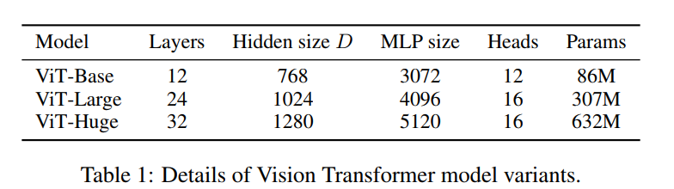
实验 （各种不同规格模型对比的）
To explore model scalability, we use the ILSVRC-2012 ImageNet dataset with 1k classesand 1.3M images (we refer to it as ImageNet in what follows), its superset ImageNet-21k with 21k classes and 14M images (Deng et al., 2009), and JFT (Sun et al., 2017) with 18k classes and 303M high-resolution images. We de-duplicate the pre-training datasets w.r.t. the test sets of the downstream tasks following Kolesnikov et al. (2020). We transfer the models trained on these dataset to several benchmark tasks: ImageNet on the original validation labels and the cleaned-up ReaL labels (Beyer et al., 2020), CIFAR-10/100 (Krizhevsky, 2009), Oxford-IIIT Pets (Parkhi et al., 2012), and Oxford Flowers-102 (Nilsback & Zisserman, 2008). For these datasets, pre-processing ollows Kolesnikov et al. (2020).

Slide 13
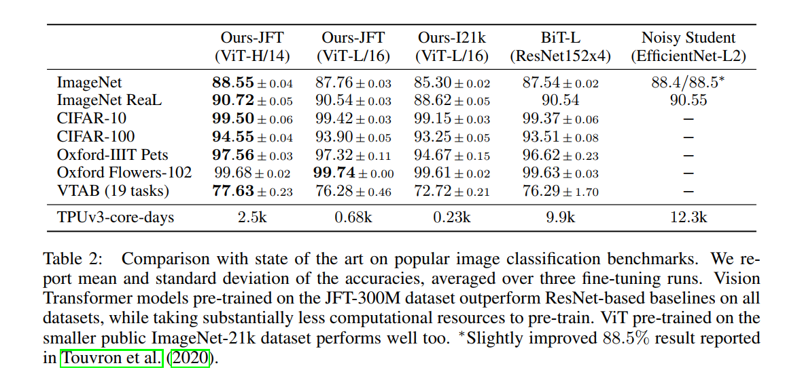
实验 （与其他cv模型对比的）
The smaller ViT-L/16 model pre-trained on JFT-300M outperforms BiT-L(which is pre-trained on the same dataset) on all tasks, while requiring substantially less computational resources to train. The larger model, ViT-H/14, further improves the performance, especially on the more challenging datasets – ImageNet, CIFAR-100, and the VTAB suite. Interestingly, thismodel still took substantially less compute to pre-train than prior state of the art. However, we note that pre-training efficiency may be affected not only by the architecture choice, but also other parameters, such as training schedule, optimizer, weight decay, etc. We provide a controlled study of performance vs. compute for different architectures in Section 4.4. Finally, the ViT-L/16 model pre-trained on the public ImageNet-21k dataset performs well on most datasets too, while taking fewer resources to pre-train: it could be trained using a standard cloud TPUv3 with 8 cores in approximately 30 days.

Slide 14
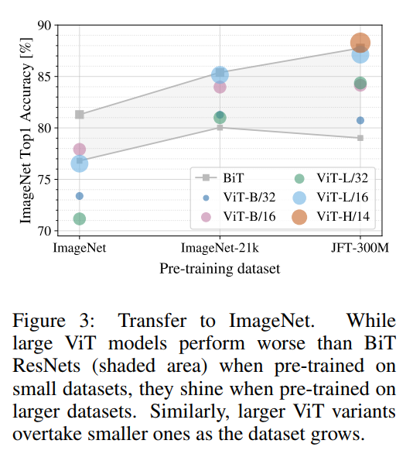
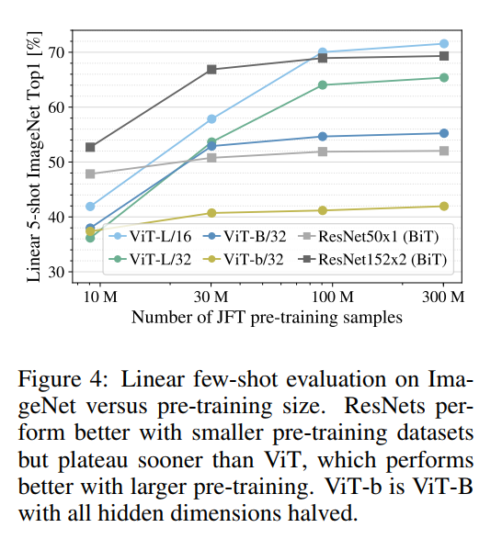
实验 （不同数据量下个模型性能）

Slide 15
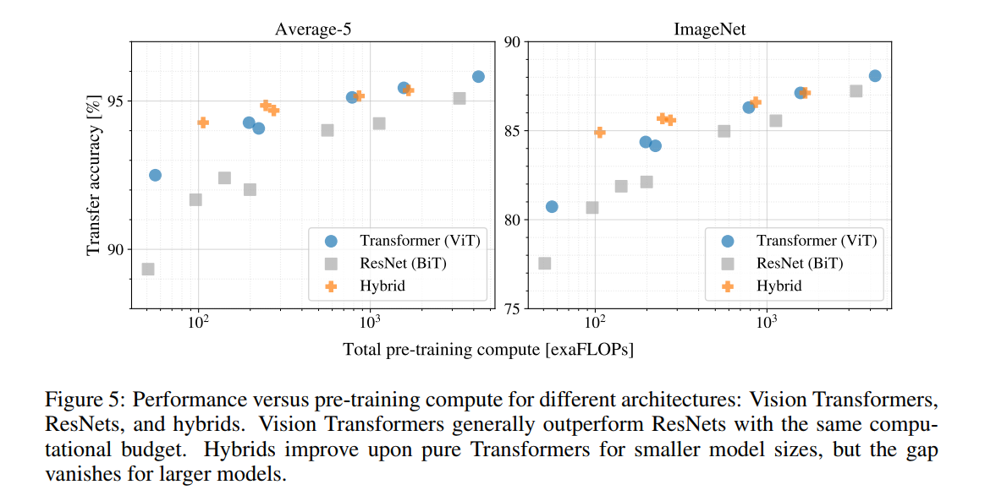
实验 （5种大数据集下transformer比其他模型更好，更便宜）

Slide 16
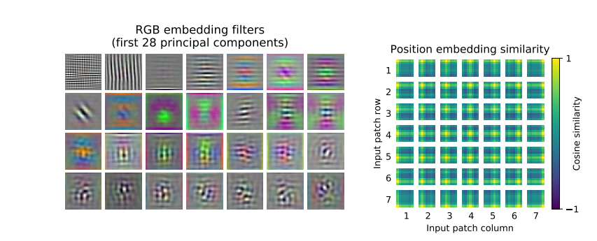
实验 （特征学习）
第一层学到的一些纹理特征 位置信息的学习

Slide 17
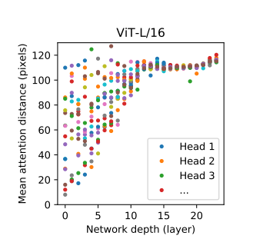
实验 （全局信息）
在前几层，点之间已经有了位置的大小，证明，在一开始不同位置的像素点就有了自注意力的性质
Notes:
纵坐标是平均注意力距离

