Slide 1
OW-DETR: Open-world Detection Transformer
Akshita Gupta* 1 Sanath Narayan* 1 K J Joseph2,4
Salman Khan4,3 Fahad Shahbaz Khan4,5 Mubarak Shah6
1Inception Institute of Artificial Intelligence 2IIT Hyderabad 3Australian National University
4Mohamed Bin Zayed University of Artificial Intelligence 5CVL, Linköping University 6University of Central Florid
CVPR 2022

Slide 2
摘要
Open-world object detection (OWOD) is a challenging computer vision problem, where the task is to detect a known set of object categories while simultaneously identifying unknown objects. Additionally, the model must in- crementally learn new classes that become known in the next training episodes. Distinct from standard object detection, the OWOD setting poses significant challenges for generating quality candidate proposals on potentially un- known objects, separating the unknown objects from the background and detecting diverse unknown objects. Here, we introduce a novel end-to-end transformer-based frame- work, OW-DETR, for open-world object detection. The proposed OW-DETR comprises three dedicated components namely, attention-driven pseudo-labeling, novelty classification and objectness scoring to explicitly address the aforementioned OWOD challenges. Our OW-DETR explic- itly encodes multi-scale contextual information, possesses less inductive bias, enables knowledge transfer from known classes to the unknown class and can better discriminate between unknown objects and background. Comprehensive experiments are performed on two benchmarks: MS-COCO and PASCAL VOC. The extensive ablations reveal the mer- its of our proposed contributions. Further , our model out- performs the recently introduced OWOD approach, ORE, with absolute gains ranging from 1.8% to 3.3% in terms of unknown recall on MS-COCO. In the case of incremental object detection, OW-DETR outperforms the state-of-the- art for all settings on PASCAL VOC.
开放世界目标检测（OWOD）是一个具有挑战性的计算机视觉问题，其任务是检测一组已知的对象类别，同时识别未知对象。
模型必须以增量方式学习新课程，这些课程将在下一次训练中被了解。与标准对象检测不同，OWOD设置对生成潜在未知对象的高质量候选方案、将未知对象与背景分离以及检测各种未知对象提出了重大挑战。在这里，我们介绍了一种新的基于端到端转换器的开放世界目标检测框架OW-DETR。
OW-DETR包括三个专用组件，即注意驱动的伪标记、新颖性分类和对象性评分，以明确解决上述OWOD挑战。我们的OW-DETR显式编码多尺度上下文信息，具有较少的归纳偏差，能够将知识从已知类转移到未知类，并且能够更好地区分未知对象和背景。

Slide 3
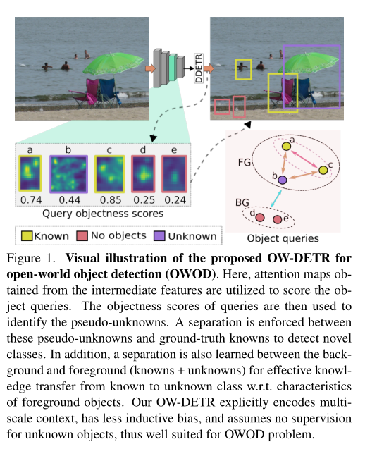
开放世界目标检测（OWOD）拟议OW-DETR的视觉演示。这里，利用从中间特征获得的注意图对对象查询进行评分。然后使用查询的对象性得分来识别伪未知数。在这些伪未知数和基本真相之间进行分离，以检测新类。此外，还学习了背景和前景（已知+未知）之间的分离，以便有效地将前景对象的已知类w.r.t.特征知识转移到未知类w.r.t.特征。我们的OW-DETR显式编码多尺度上下文，具有较少的归纳偏差，并且假设对未知对象没有监督，因此非常适合OWOD问题。

Slide 4
贡献总结
We proposed a novel transformer-based approach, OW-DETR, for the problem of open-world object detection.The proposed OW-DETR comprises dedicated components to address open-world settings, including attention-driven pseudo-labeling, novelty classification and objectness scoring in order to accurately detect unknown objects in images.We conduct extensive experiments on two popular benchmarks: PASCAL VOC and MS COCO. Our OW-DETR consistently outperforms the recently introduced ORE for all task settings on the MS COCO dataset. Furthermore, OW-DETR achieves state-of-the-art performance in case of incremental object detection on PASCAL VOC dataset.
We introduce an attention-driven pseudo-labeling scheme for selecting the object query boxes having high attention scores but not matching any known class box as unknown class. The pseudo-unknowns along with the ground-truth knowns are utilized to learn a novelty classifier to distinguish the unknown objects from the known ones.
• We introduce an objectness branch to effectively learn a separation between foreground objects (knowns, pseudo-unknowns) and the background by enabling knowledge transfer from known classes to the un- known class w.r.t. the characteristics that constitute a foreground object.
• Our extensive experiments on two popular benchmarks demonstrate the effectiveness of the proposed OW- DETR. Specifically, OW-DETR outperforms the recently introduced ORE for both OWOD and incremental object detection tasks. On MS-COCO, OW-DETR achieves absolute gains ranging from 1.8% to 3.3% in terms of unknown recall over ORE.
针对开放世界目标检测问题，我们提出了一种新的基于变换器的方法OWDETR。OW-DETR由专用组件组成，用于处理开放世界设置，包括注意驱动的伪标记、新颖性分类和对象性评分。
我们引入了一种注意驱动的伪标记方案，用于选择注意分数高但不匹配任何已知类框的对象查询框作为未知类。利用伪未知数和地面真值知识学习新颖性分类器，将未知对象与已知对象区分开来。
我们引入了一个对象性分支来有效地学习前景对象（已知、伪未知）和背景之间的分离，通过将知识从已知类转移到未知类w.r.t.构成前景对象的特征
我们在两个流行基准上的大量实验证明了所提出的OWDETR的有效性。具体而言，OW-DETR在OWOD和增量目标检测任务方面都优于最近引入的ORE。在MS-COCO上，OW-DETR在ORE的未知召回率方面实现了1.8%-3.3%的绝对收益。

Slide 5
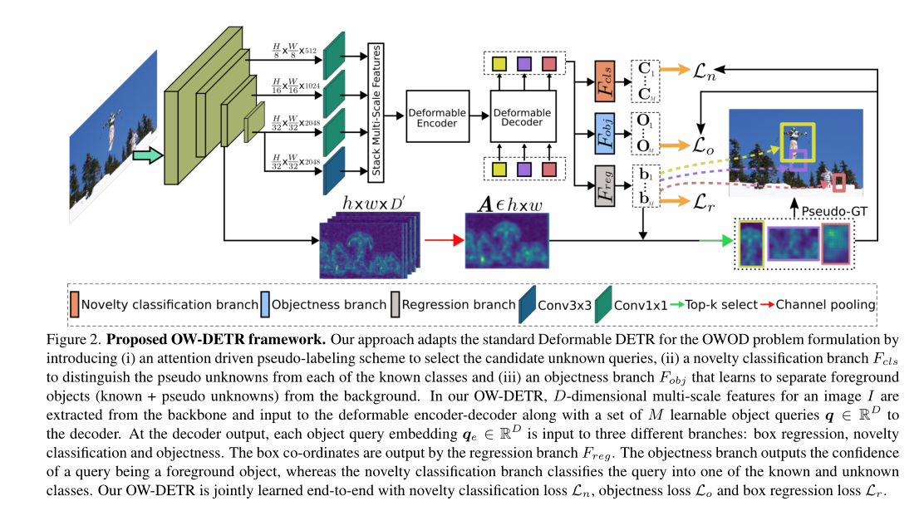
结构图

Slide 6
多尺度上下文编码 Multi-scale Context Encoding
As discussed earlier in Sec. 1, given the diverse nature of unknown objects that can possibly occur in an image, detecting objects of different sizes while encoding their rich context is one of the major challenges in open-world object detection (OWOD). Encoding such rich context re-3quires capturing long-term dependencies from large receptive fields at multiple scales of the image. Moreover, having lesser inductive biases in the framework that make fewer assumptions about unknown objects, occurring during testing, is likely to be beneficial for improving their detection. Motivated by the above observations about OWOD task requirements, we adapt the recently introduced single-stage Deformable DETR [38] (DDETR), which is end-to-end trainable and has shown promising performance in standard object detection due to its ability to encode long-term multi-scale context with fewer inductive biases. DDETR introduces multi-scale deformable attention modules in the transformer encoder and decoder layers of DETR [3] for encoding multi-scale context with better convergence and lower complexity. The multi-scale deformable attention module, based on deformable convolution [5, 37], only attends to a small fixed number of key sampling points around a reference point. This sampling is performed across multiscale feature maps and enables encoding richer context over a larger receptive field. For more details, we refer to [3,38]. Despite achieving promising performance for the object detection task, the standard DDETR is not suited for detecting unknown class instances in the OWOD setting. To enable detecting novel objects, we introduce an attention-driven pseudo-labeling scheme along with novelty classification and objectness branches, as explained next.
丰富的上下文需要从图像的多个尺度的大感受野中捕获长期依赖性。此外，在测试过程中对未知物体进行较少假设的框架中具有较小的归纳偏差，可能有助于改进其检测。
基于上述对OWOD任务要求的观察，我们采用了最近引入的单级可变形DETR（DDETR），该DETR是端到端可训练的，由于其能够以较少的诱导偏差对长期多尺度上下文进行编码，因此在标准目标检测中显示出良好的性能。
DDETR在DETR的transformer编码器和解码器层中引入了多尺度可变形注意模块，用于编码多尺度上下文，具有更好的收敛性和更低的复杂性。基于可变形卷积[5，37]的多尺度可变形注意模块只关注参考点周围固定数量的少量关键采样点。此采样跨多尺度特征映射执行，并允许在更大的感受野上编码更丰富的上下文。
但标准DDETR不适合在OWOD设置中检测未知类实例。为了能够检测新对象，我们引入了一种注意力驱动的伪标记方案，以及新颖性分类和对象性分支
Q
K
K
V
V

Slide 7
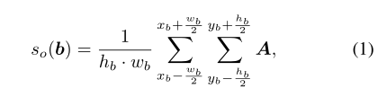
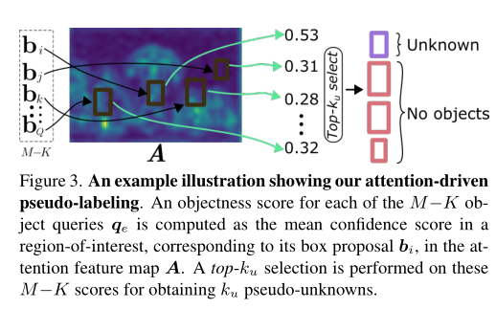
注意驱动的伪标记 Attention-driven Pseudo-labeling
For learning to detect unknown objects without any corresponding annotations in the train-set, an OWOD framework must rely on selecting potential unknown instances occurring in the training images and utilizing them as pseudo-unknowns during training. The OWOD approach of ORE [15] selects proposals having high objectness scores and not overlapping with the ground-truth (GT) known instances as pseudo-unknowns. These proposals obtained from a two-stage detector RPN are likely to be biased to the known classes since it is trained with strong supervision from known classes. Distinct from such a strategy, we introduce a bottom-up attention-driven pseudo-labeling scheme that is better generalizable and applicable in a single-stage object detector. Let f denote intermediate D′-dimensional feature maps extracted from the backbone, with a spatial size h×w. The magnitude of the feature activations gives an indication of presence of an object in that spatial position, and thereby can be used to compute the confidence of objectness within a window. Let b = [xb, yb, wb, hb] denote a box proposal with center (xb, yb), width wb and height hb. The objectness score so(b) is then computed as,where A ∈ Rh×w is the feature map f averaged over the channels D ′. The object proposals in our framework are obtained as the bounding boxes b predicted by the regression branch for the M object query embeddings qe output by the deformable transformer decoder. For an image with K known object instances, the objectness score so is computed for the M −K object queries not selected by the bipartite matching loss1 of DDETR as best query matches to the GT known instances. The top-ku queries among M−K with the high objectness scores so are then pseudo-labeled as unknown objects with bounding boxes given by their corresponding regression branch predictions (see Fig. 3).

Slide 8
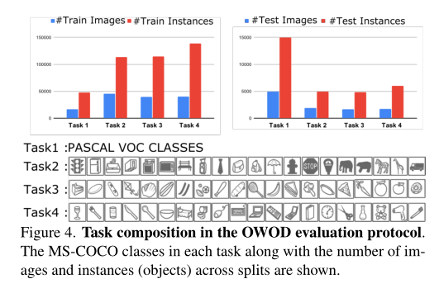
新颖性分类 Novelty Classification
我们的OW-DETR不需要任何未知对象监控，完全依赖于使用注意驱动伪标记选择的伪未知，在分类分支中为新对象引入了一个类标签
The ORE [15] approach introduces an energy-based unknown identifier for classifying a proposal between known and unknown classes. However, it relies on a held-out validation set with weak unknown supervision to learn the energy distributions for the known and unknown classes. In contrast, our OW-DETR does not require any unknown object supervision and relies entirely on the pseudo-unknowns selected using attention-driven pseudo-labeling described in Sec. 2.3. Furthermore, the classification branch Fcls in the standard DDETR classifies an object query embedding qe into one of the known classes or background, i.e. Fcls : RD → RC. However, when an unknown object is encountered, it fails to classify it into a novel class. To overcome these issues and enable our OW-DETR framework to be trained with only the selected pseudo-unknown objects, we introduce a class label for novel objects in the classification branch. Query embeddings qe selected as pseudounknowns are then trained with the pseudo-label (set to 0 for ease) associated with the novel class in the novelty classification branch Fcls : RD → RC+1. Such an introduction of the novelty class label in classification branch enables qe to be classified as unknown objects in OW-DETR, which otherwise would have been learned as background, as in the standard object detection task. This helps our model to discriminate potential unknown objects from the background.

Slide 9
Foreground Objectness
As discussed above, the novelty classification branch Fcls is class-specific and classifies a query embedding qe into one of the C + 1 classes: C known classes or 1 unknown class or background. While this enables the learning of class-specific separability between known and unknown classes, it does not permit a transfer of knowledge from the known to the unknown objects, which is crucial in understanding as to what constitutes an unknown object in the OWOD setting. Furthermore, the attentiondriven pseudo-labeling is likely to be less accurate due to absence of unknown class supervision resulting in most of the query embeddings to be predicted on the background. To alleviate these issues, we introduce a foreground objectness branch Fobj : RD → [0, 1] that scores the ‘objectness’ [18, 31] of the query embeddings qe in order to better separate the foreground objects (known and unknown) from the background. Learning to score the queries corresponding to foreground objects higher than the background enables improved detection of unknown objects which otherwise would have been detected as background. Such a class-agnostic scoring also aids the model to transfer knowledge from the known classes to the unknowns w.r.t. the characteristics that constitute a foreground object.
新颖性分类分支Fcls是特定于类的，并将qe的查询分类归类到C+1类中的一个：C已知类或1未知类或背景。
1 虽然这样可以学习已知类和未知类之间的类特定可分性，但不允许将知识从已知对象转移到未知对象，这对于理解OWOD设置中未知对象的构成至关重要。
2 此外，注意力驱动的伪标记可能不太准确，因为缺少未知类的监督，导致大多数查询嵌入都是在后台预测的。
为了缓解这些问题，我们引入了一个前台对象分支Fobj:RD→ [0，1]对查询嵌入qe的“对象性”[18，31]进行评分，以便更好地将前景对象（已知和未知）从背景中分离出来。学习对与高于背景的前景对象相对应的查询进行评分，可以改进对未知对象的检测，否则这些未知对象会被检测为背景。此类类不可知评分也有助于模型将知识从已知类转移到未知类，即构成前景对象的特征。

Slide 10

训练和推理 Training and Inference
Training: Our OW-DETR framework is trained end-to-end using the following joint loss formulation,
where Ln, Lr and Lo denote the loss terms for novelty classification, bounding box regression and objectness scoring, respectively. While the standard focal loss [19] is employed for formulating Ln and Lo, the term Lr is the standard ℓ1 regression loss. Here, α denotes the weight factor for the objectness scoring. When a set of new categories are introduced for the incremental learning stage at each episode in OWOD, motivated by the findings in [15, 29, 35], we employ an exemplar replay based finetuning to alleviate catas trophic forgetting of previously learned classes. Specifically, the model is finetuned after the incremental step in each episode using a balanced set of exemplars stored for each known class.
Inference: M object query embeddings qe are computed for a test image I and their corresponding bounding box and class predictions are obtained, as in [38]. Let Ct be the number of known classes at time t in addition to the unknown class, i.e., Ct =|Kt| + 1. A top-k selection is employed on M · Ct class scores and these selected detections with high scores are used during the OWOD evaluation.
OW-DETR框架采用以下联合损失公式进行端到端训练
Ln、Lr和Lo分别表示新颖性分类、边界框回归和客观评分的损失项，α表示客观评分的权重因
为测试图像I计算M个对象查询嵌入qe，并获得相应的边界框和类预测。设Ct为t时刻已知类加上未知类的个数，即Ct =|Kt| + 1。对M·Ct类分数采用top-k选择，这些选择的高分检测用于OWOD评价。

Slide 11
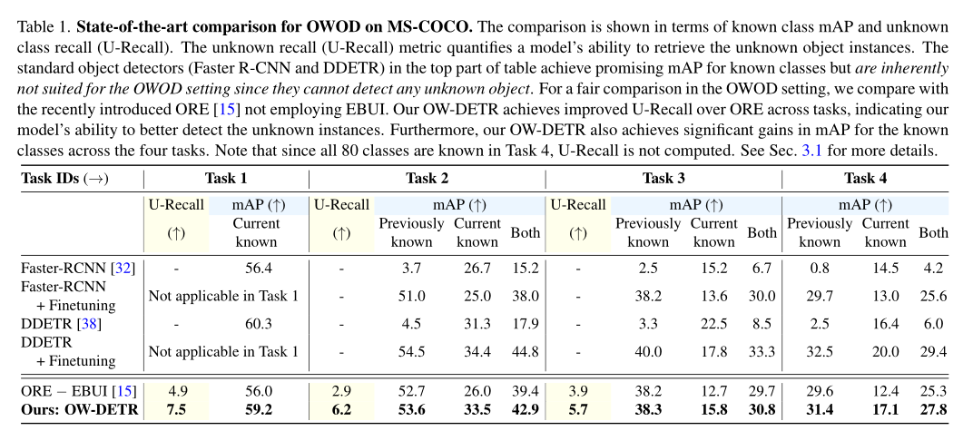
实验

Slide 12
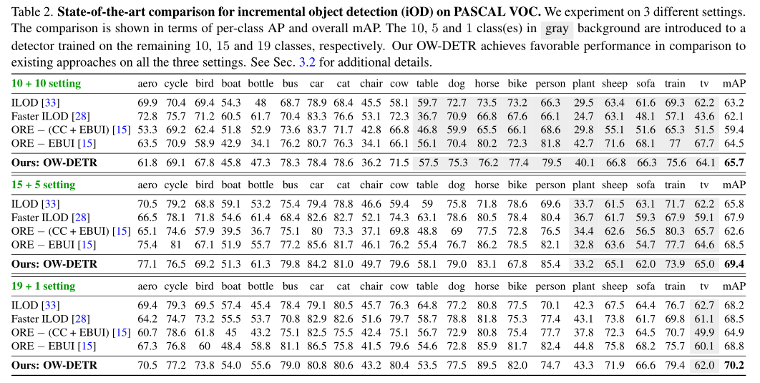

Slide 13
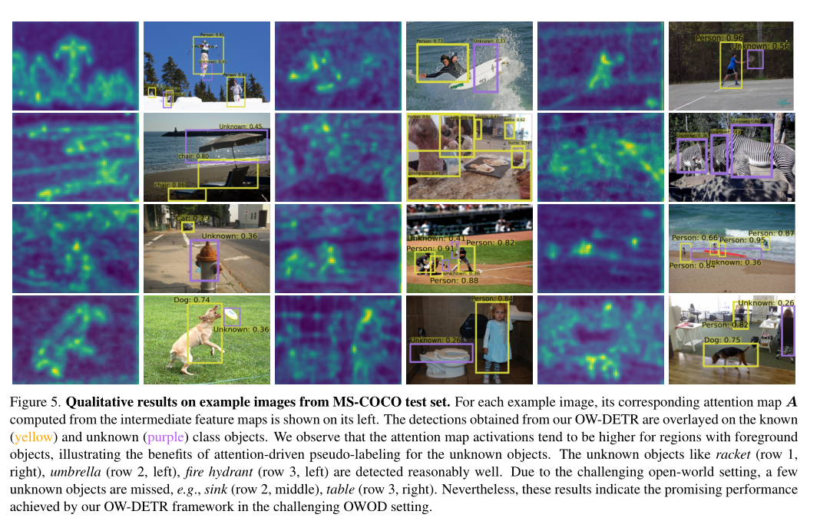

Slide 14
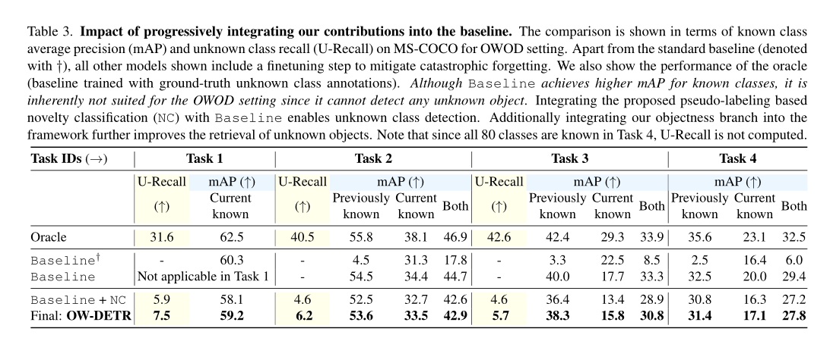

Slide 15
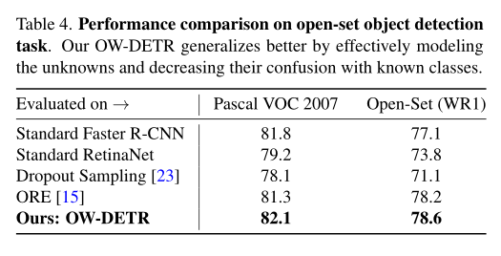

Slide 16
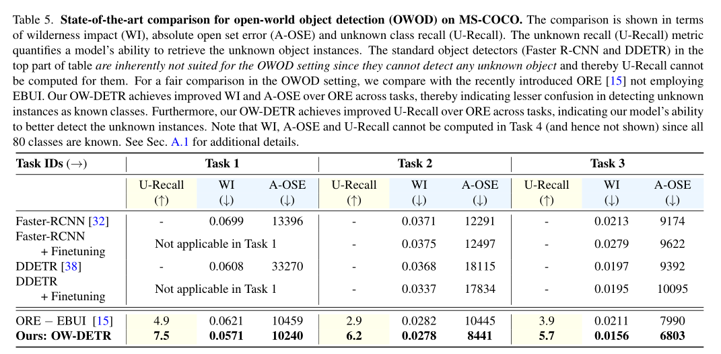

Notes:
这两种方法(WI和A-OSE)都表明了在未知实例存在的情况下预测已知类时的混淆程度。

Slide 17
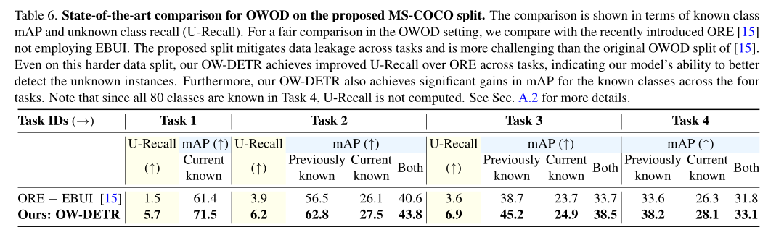

Slide 18
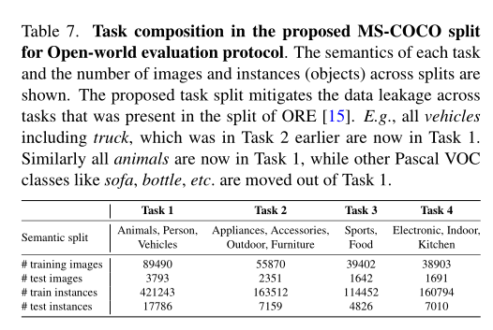
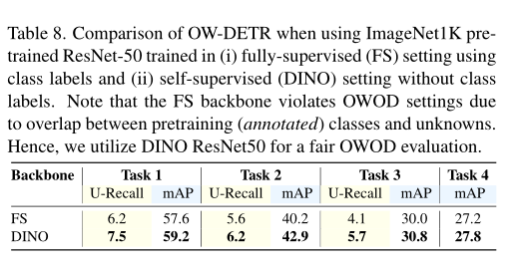

Slide 19
