Slide 1

VRPTW Problem and its Solver
Seminar Pre
Technische Universität München
Report: Weiyuan Du, Yiying Song
Algorithmic Decision Making: Metaheuristics and Decomposition in Practice
12/7/25
Notes:
Good afternoon! Everyone ,welcome to my presentation. My name is " ". The paper I want to report today is named " ".

Slide 2
Content
Background
Motivation
Investigation
Approach: VCP + APU
Evaluation: 4 Research Questions
Conclusion
Algorithmic Decision Making: Metaheuristics and Decomposition in Practice
2
12/7/25
Notes:
This is the content of my presentation.
I will introduce the core part of the research.Then an Q&A section will follow. Where you can ask any question regarding to the research.

Slide 3
Background
Bugs
Outdated
Suboptimal
…
Algorithmic Decision Making: Metaheuristics and Decomposition in Practice
12/7/25
Notes:
As we all know SO is a very famous QA platform among software engineers.
Here is an example of QA on SO. what you might ignored are these comments. Which points out the weakness in the code.
What I want to say is there indeed are some bugs hidden in the code of some answers. And some of them are using outdated APIs. some are suboptimal solutions.
As showed in the example here. comment 1 and 2 were overlooked and never integrated.
Leaving these issues a long time. Which might mislead some developers and even their related works.

Slide 4

Motivation
Errors found
Stack Overflow
Comments
Update
Only 4.6% of the answers are edited after comments are posted.
“Feel free to update the answer yourself, if you like. I honestly would, but I don’t have the time.”
Algorithmic Decision Making: Metaheuristics and Decomposition in Practice
12/7/25
Notes:
Comments are very important part for SO, as it includes discussion to a possible solution. Normally, if problems are found by others in the comments. Corresponding code in the post should be updated.
But in fact. most of these comments are ignored and left the issues for even decades. According to our investigation. only around 5 % of the answers are edited after comments are posted.
If you want to ask why. One of the post editor might tell you this :" "
This actually make a negative influence on SO. So we want to help solve this issue.

Slide 5
Motivation
To help update these posts we need to recognize:
1. Suboptimal Code
But it’s very time and labor consuming to do this manually !!
2. Outdated Code
3. Bugs
Solution:
Automatically recognize and update code snippets based on their associated comments with LLMs.
Algorithmic Decision Making: Metaheuristics and Decomposition in Practice
12/7/25
Notes:
To solve this issue, A question raise,
How we can recognize these weakness hidden in the solution.
Of course, we can do this manually, but it's very time and labor consuming.
You might come up with LLMs, as they nowadays provide the possiblity to understand codes and very powerful to construct automatic work flow.
Inspried by this, we come up with the solution, we can " "

Slide 6
Investigation
Tang’s work
Tang’s three heuristic rules
They used match pattern to build a dataset.
Time_{c} < Time_{e}
Valid comment-edit pairs is only 56%
Code Terms Changes
Different Users.
Too much noise in the dataset !!!
Limitations：
1. Ignores the semantic relationship between code terms and edits
2. Some editing might be similar with those in comments.
3. Some comments lead an edit without any code terms
Algorithmic Decision Making: Metaheuristics and Decomposition in Practice
12/7/25
Notes:
First, we did an investigation on related work. And we found Tang's paper is the only work in this scenario.
They firstly used a match pattern to build a dataset. It follows 3 heuristic rules. which filter out all the comments posted before the editing in timeline and comments which has code term changes .Lastly, they only consider comments posted by different users.
Finally, they get a datasets with only 56% precision. This precision is hard for a model to train. as half of the data are noises.
After manually analzied the dataset, we find some limiations of Tang’s approach.
1.""" 2. "" but actually they are not 3. "" making it impossible to be captured by a matching pattern.

Slide 7





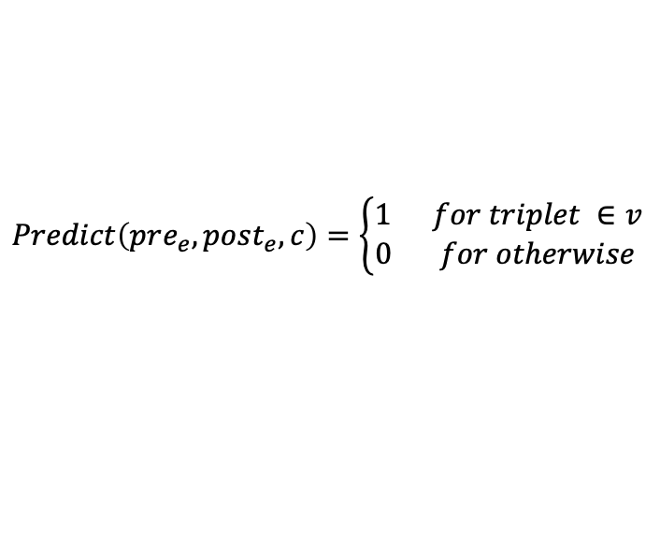
SOUP VCP Task
Approach
Valid Comment-edit Prediction(VCP):
Goal: To build a High-Quality Dataset.
$$Predict\left(pre_{e},post_{e},c\right)=\left\{\begin{aligned}1 for triplet ∈v \\ 0 for otherwise \end{aligned}\right.$$
heuristic rules
Java
With
Code
Full-scale Dataset(300k)
Human Annotation
Stack Overflow
Post Edit History
Single
Edit
Closest
Edit
Sep,23,2019
Sample 5k
Algorithmic Decision Making: Metaheuristics and Decomposition in Practice
12/7/25
Notes:
We firstly defined a VCP task, which is a binary prediction task. It's designed to predict whether a tuple of post updated before, after and corresponding comments are related or not.
The goal of this task is to build a HQ dataset.
Below it's the work flow of VCP. We collect changes from SO Post edit history since Sep,23,2019,which is the same configuration as Tang's work.
To check if they are valid, we apply 4 heuristic rules as showed here.
1. Java, 2. With code 3.Single edit due to hardware limiation 4.The closest edit.
After getting a full scale dataset, we sampled 5k data to do a human annotation. which is lead by 2 experienced java software engineering.

Slide 8
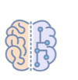
VCP Fine-tuning
Approach
Prompt Engineering
Label | Train | Validation | Test
Valid | 1094 | 135 | 127
Invalid | 2906 | 365 | 373
Template
Input:
<s> Please check if the code before, comment, and code after simultaneously meet the following four conditions.
Condition 1: The comment points out a general or specific flaw
in code before, or provides a general or specific suggestion for code before, or raises a general or specific question about code before.
Condition 2: code after has optimized all the flaws pointed out in the comment, implemented all the suggestions given in the
comment, And resolved all the questions raised in the comment.
Condition 3: code after has not made any changes beyond those
mentioned in the comment.
Condition 4: code after has not introduced any new errors. Please answer with yes or no whether they meet the aforementioned four conditions simultaneously.
Prompt Learning
Original
LLM
Fine-tuned
LLM(SOUP_{p})
Judgment criteria
structural output
Delimiters < >
Error Case learning
Output ###Response: <label></s>
Valid or not ?
Algorithmic Decision Making: Metaheuristics and Decomposition in Practice
12/7/25
Notes:
We split the human annotated dataset into three datasets.
the train set is used to fine-tune LLMs for the VCP task,
the validation set is used to minimize the overfitting, and the
test set is only used for evaluation.
The technique we used here is Prompt learning. Which is a hot topic currenlty. The main idea is to give instruction to LLM and ask them to follow. Our template for prompt is shown here on the right. We give prompt includes 1. """ 2. "" requirements delimiters and also ask LLM to learn from error case iteratively. Which is called prompt learning.
As you can see here on the right. The label of the output shows the validation of an instance.

Slide 9

SOUP APU Task
Approach
Automatic Post Updating (APU):
Goal: To give updated post with corresponding comment
$$Update\left(pre_{e},c\right)=pose_{e}$$
CodeLlama
Full-scale Dataset(300k)
HQ Dataset(78k)
Prompt Learning
SOUP_{p}
SOUP_{u}
Algorithmic Decision Making: Metaheuristics and Decomposition in Practice
12/7/25
Notes:
Then I would like to introduce our APU task, which is designed to give an updated post with post before and corresponding comments.
We firstly generate a HQ dataset with the help of SOUP-p. And we feed this HQ dataset into LLM, here we use CodeLlamma. By doing prompt learning again here. we can get SOUP-u. A fine-tuned LLM to give updated post with required VCP.

Slide 10




APU Fine-tuning
Approach
Low Rank Adaptation
Dataset | Train | Validation | Test
HQ | 62664 | 7827 | 7826
X = N x d1
X = N x d1
Update Parameters
Large
Parameters
Y = N x d2
Y = N x d2
Prompt Learning
+
LoRA
X = N x d1
X = N x d1
Original
LLM
Fine-tuned
LLM(Soup_{u})
A= d1 x r
B= r x d2
Instead of
Use
$$y=W_{0}x$$
Y = N x d2
Y = N x d2
$$y=W_{0x}+BAx$$
Algorithmic Decision Making: Metaheuristics and Decomposition in Practice
12/7/25
Notes:
After constructing the large-scale HQ dataset, we
randomly split the dataset into train/validation/test set by the
ratio of 8:1:1.
The train set is used to fine-tune LLMs on
the APU task, the validation set is used to assess how well
the model generalizes to new samples.
What I want to mention here is that we also used a technique called LoRA. which is short " ". The main idea of this technique is to add a new parameter matrix BAx, so that we can calculate the change of parameters matrix instead of updating the whole large parameters matrix.
The diagram on the right shows how this works with two small matrix.

Slide 11
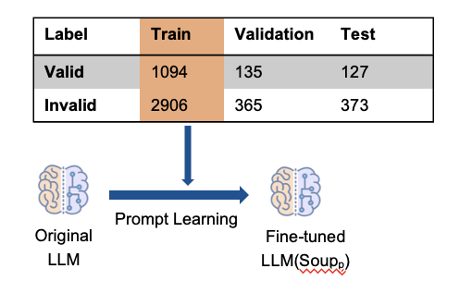
Evaluation
RQ1: How effective is our approach for predicting VCP?
Experiment:
Analysis
Tang’s
Recall: Can’t recognize comments without code.
Precision: Can’t capture semantics between comments and edits.
Algorithmic Decision Making: Metaheuristics and Decomposition in Practice
12/7/25
Notes:
Then we can talk about the evaluation of our research.
The first RQ is """.
Here is our experiment setting, which use 80% of human annoatated data to get SOUP-p
The result comes out on the right part. As you can see clearly that our approach to predict VCP has a much higher precision and also recall.
This is becauseTang's approach cant' """, which miss a lot valid tuples, leading to a low recall. and it cant'""" as it regards code term as a key factor,ends up with a low precision.
为什么我们的Precision低
：1.部分修改没有被计算在内 2.评论中包含不利于LLM的指令
Recall80是因为：1.token太短，2.功能大改（太复杂）

Slide 12
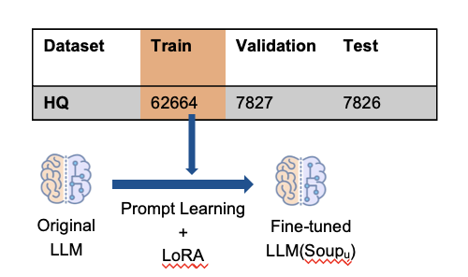
Evaluation
RQ2: How effective is SOUP on APU based on comments?
Experiment:
Approach | EM | CB
CodeLlama_{pr}(13B) | 0.2% | 33.8%
ChatGPT(175B) | 2.1% | 59.6%
SOUP-CodeLlama | 25.6% | 73.5%
SOUP-CoditT5 | 25.9% | 76.4%
Analysis
Improvement are easy to LLM
Weakness are hard since no context
Algorithmic Decision Making: Metaheuristics and Decomposition in Practice
12/7/25
Notes:
And the second RQ of our research is """
In this evaluation, we use the same method described before to build fine-tuned LLMs. And to explore the effectiveness of SOUP, we tested 4 different models.
Which are "" "" "", Pretrained Language Model are LLM with smaller paramter numbers.
and we use ChatGPT as our baseline model. We also use EM, CB for evaluation.
EM metric is used to evaluate whether the model prediction exactly matches the ground truth.
CB is a common metric that measures lexical overlap for code generations.
And the result show that our SOUP framework can sharply increase the performance of model on APU task.
We also did an manual analysis sampled from the datasets. We sampled 50 from both positive and negative cases.
Improvement has the highest preicision，因为LLM好理解，Weakness对模型来说不好理解因为没有上下文结构

Slide 13
Evaluation
RQ3: To what extent does the dataset influence model performance in the APU task?
Experiment:
HQ Dataset(78k)
Approach |  | Tang’s Test | HQ Test
Model | Train | EM | EM
SOUP-CoditT5 | Tang’s | 9.2% | 5.5%
 | HQ | 15.1% | 25.9%
SOUP-CodeLlama | Tang’s | 24.8% | 21.4%
 | HQ | 25.6% | 25.6%
CodeLlama
Tang’s Dataset(17k)
Analysis
CoditT5
HQ is a large dataset than Tangs’s
And it includes more scenarios and situations.
Algorithmic Decision Making: Metaheuristics and Decomposition in Practice
12/7/25
Notes:
For RQ3, we researched ""
We use Cross Dataset Evaluation to test how our HQ can effect the final
fine-tuned model.
As you can see from the right. that both model trained on HQ always has a better performance compared with Tang's. That's because we have a large dataset than Tang's. And model trained with Tang's can not good fit on our HQ datasets. As HQ dataset includes more scenarios and situations.
Overall,
Our HQ-dataset is superior to the dataset constructed by Tang's method in terms of quantity,validity and variety.
Tang‘s data比原来小是因为我们只选取一段代码的post

Slide 14
Evaluation
RQ4: How acceptable are our updated SO posts in real-world scenarios?
Experiment:
rules
Human Selection
Stack Overflow
Post Edit History
1 Year
keyword
Proposal
SOUP_{u}
Analysis
21 out of the 50 suggested edits generated by Soup were accepted, with an acceptance rate of 42%.
Shows the practical value of our framework.
Algorithmic Decision Making: Metaheuristics and Decomposition in Practice
12/7/25
Notes:
Our last RQ is ""
On Stack Overflow, users can edit a post when they want to improve the post quality，experienced reviewer will do an evaluation.Proposals those are get accapted will be integrated into the solution post.
To test how our model perform in wild scenario.
We collect all the post comments in recent year since they are more possible to relate with an imperfect solution.
And then we filter these comments with keywords like error, wrong etc.
we do a human selection to pick out 50 cases which are more likely to make a difference.
Feed them to our fine-tuned SOUP-u to get corresponding proposals.
Lastly but most important step, is to submit them on SO.
As a result, " """

Slide 15
Conclusion
We constructed
a high quality dataset of 78K valid comment-edit pairs.
We proposed
a framework SOUP to perform SO post updating efficiently.
Algorithmic Decision Making: Metaheuristics and Decomposition in Practice
12/7/25
Notes:
To draw a conclusion.
"""
"""

Slide 16
Conclusion
Thanks !
Q&A
Algorithmic Decision Making: Metaheuristics and Decomposition in Practice
12/7/25
Notes:
Thanks for your listening.

