Slide 1
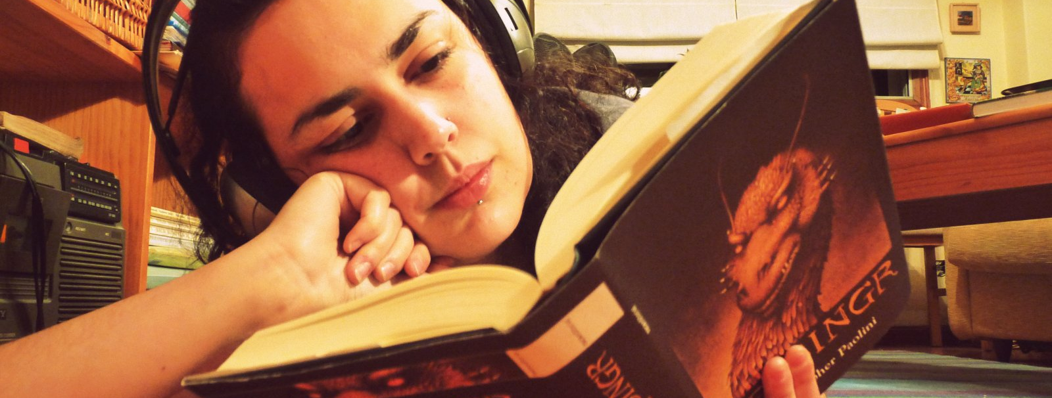

PocketReader
2016 CSUN Accessibility Competition
Team 1
Rosy Davis
Sina Eradat
Anthony Pichardo
Ben Villalobos
Eddie Villamor
Mentor: Devon Smart
Image Credit: xanetia@Flickr, “Un libro, una sensación, una canción,” 2009 (CC-BY-2.0)

Slide 2
PocketReader
Overview

Slide 3
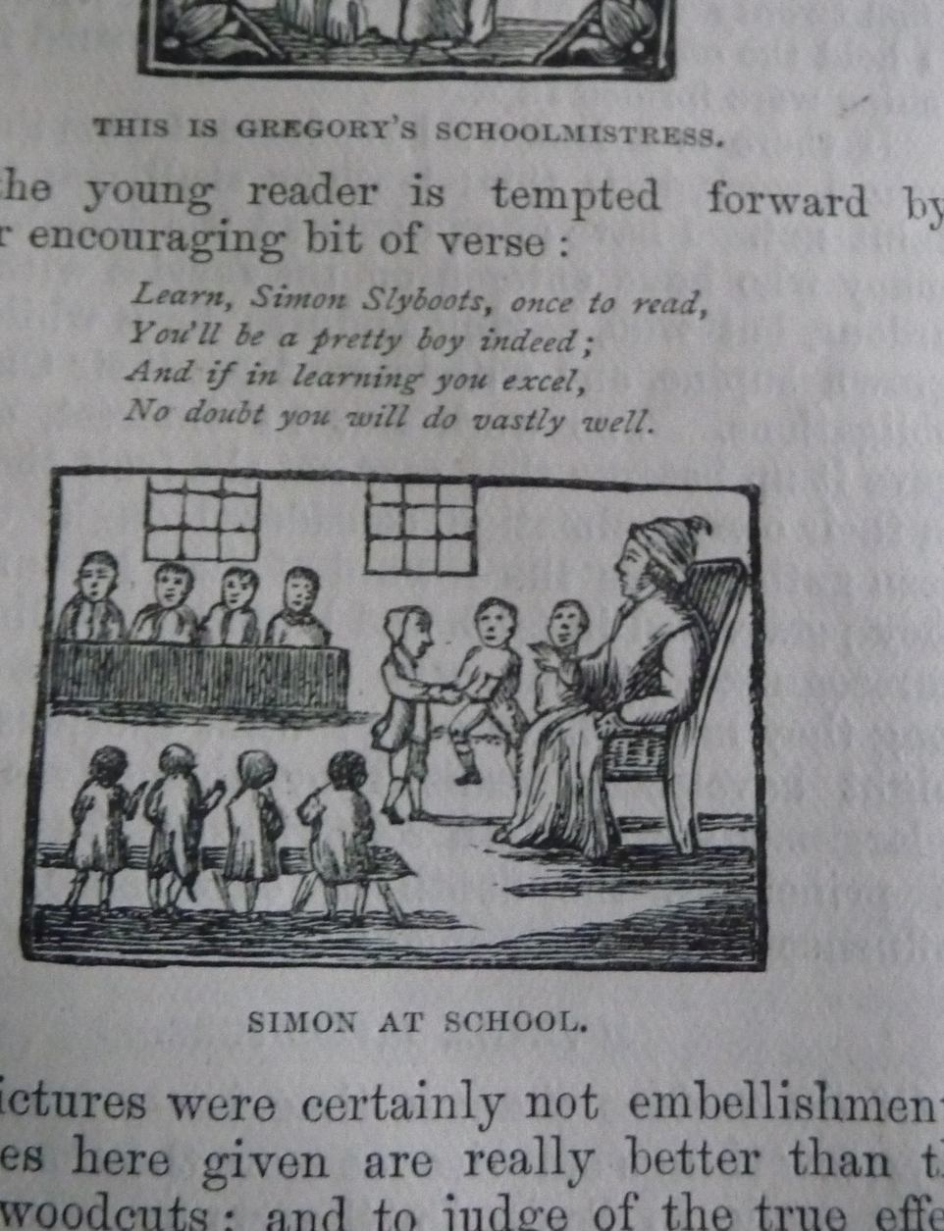
Image Credit: tomylees@Flickr, “Simon Slyboots 004,” 2010 (CC-BY-NC-SA-2.0)
PocketReader
finds words in what your camera sees.
Image Capture
Optical Character Recognition
Save As Text
Built-In Reader
Flexible text sizing
Text-to-speech
Notes:
Discuss use cases: difficulty processing visual information due to visual disability (e.g. color blindness, nearsightedness), neurological disability (e.g. dyslexia). Signs? Homework assignments? Textbooks?

Slide 4
Design Priorities
Core Functionality
Flexibility
Compatibility
Ease of Use
Notes:
Flexibility: Varying user intent leads to varying user behavior. Compatibility: it should be easy to dump to another application. Ease of use: the UI should be simple and intuitive, and the application should contain a built-in path from image to reader, if the user wants to use it, so that it’s an out-of-the-box solution.

Slide 5
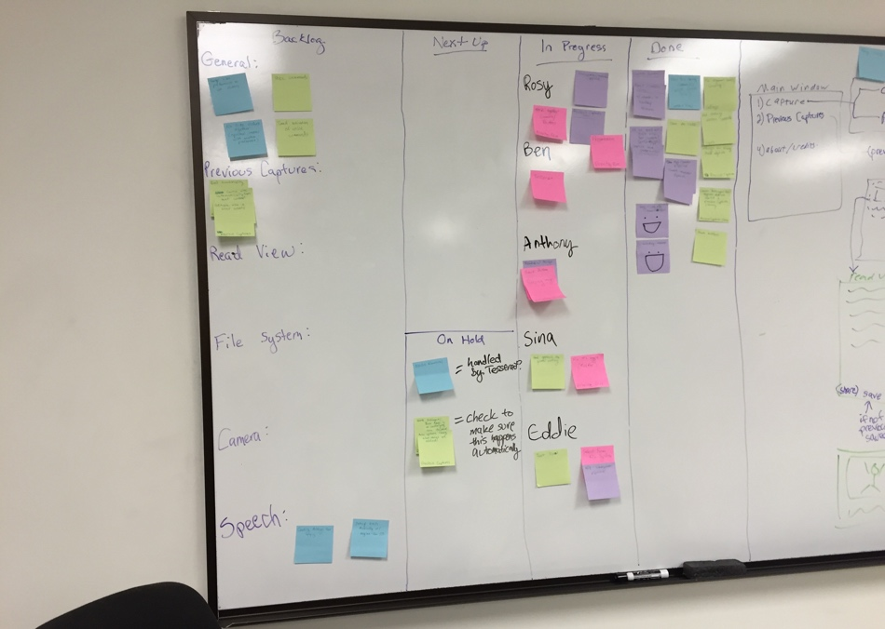
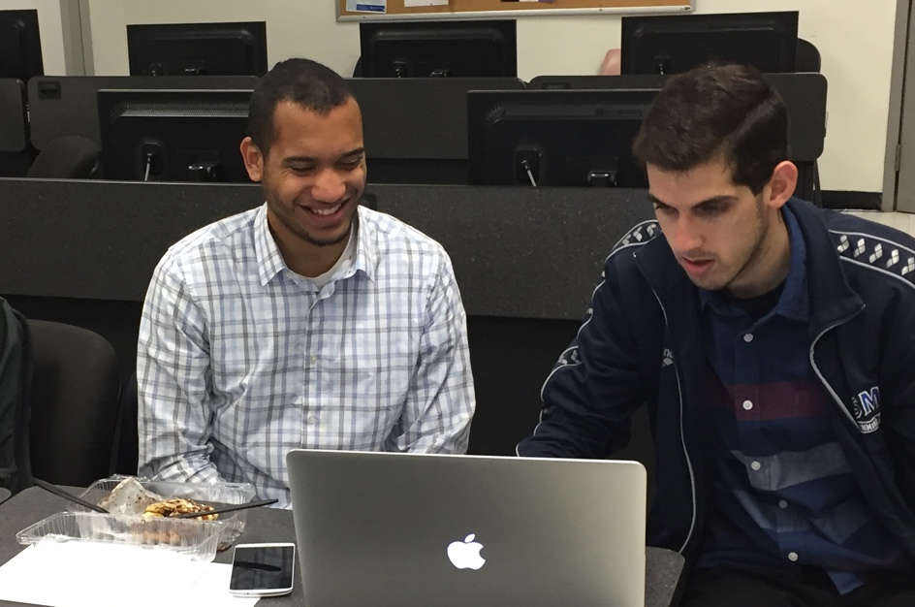
Development Process
Agile Scrum?
Notes:
Were we using Agile and Scrum?

Slide 6
Development Process
Agile-ish Scrumlet
Brainstorm → research → deconstruct or implement
Pair programming
The good: useful specialization
The bad: ineffective implementation
The ugly: 11 hours with Tesseract later…
Frequent Check-Ins
Project focus
Development efficiency
Notes:
Sort of. Evolving goals as we saw how app would be used, broadcasting information, flexibility of assignment, prioritizing speed. But we did a few other things, too. Co-programming wasn’t always successful—some tasks lent themselves to two developers better than others. Ben got stuck w/ building Tesseract.

Slide 7
PocketReader
App Tour

Slide 8
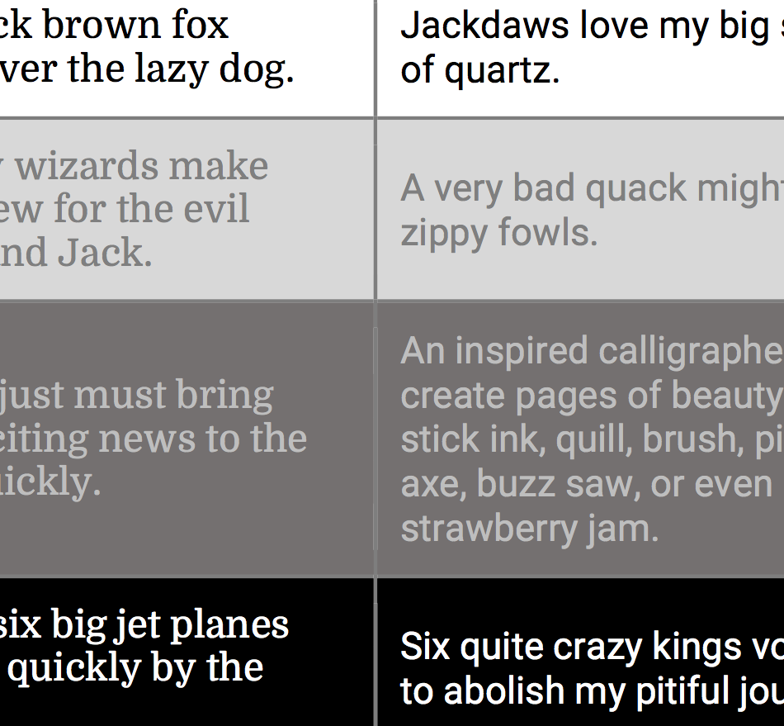
Capture
Internal image capture
Data handling
Processing
Can this image be processed?
Retake if not
Notes:
Why did we build our own img capture? We had data handling requirements. Needed a sensical retake workflow.

Slide 9
Convert
(via Tesseract and Leptonica)
Tesseract: bitmap from file path
Leptonica: image cleanup

Slide 10
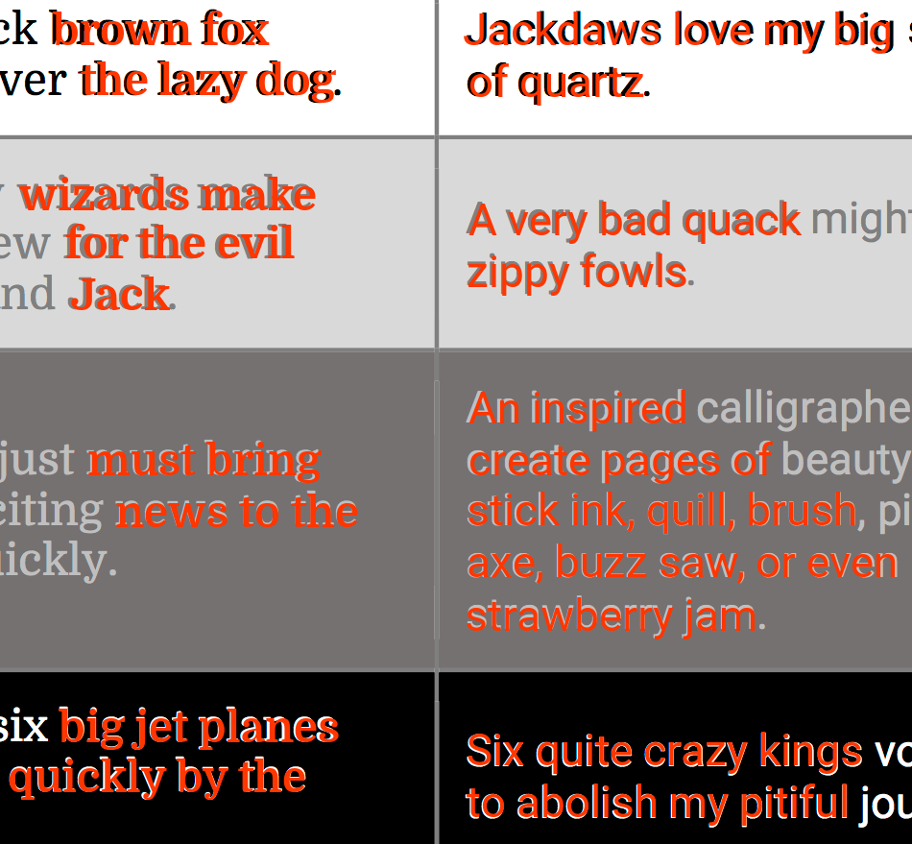
Convert
(via Tesseract and Leptonica)
Tesseract: bitmap from file path
Leptonica: image cleanup
Tesseract: performs OCR
Outputs: String

Slide 11
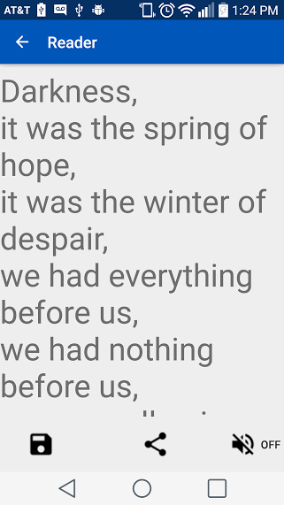
View
Scrolling text
Adjustable size
Listen
Text-to-speech
Moves with scroll
Save and Share
Previous Captures Library
Send to External App
Notes:
Built-in Reader and Library

Slide 12
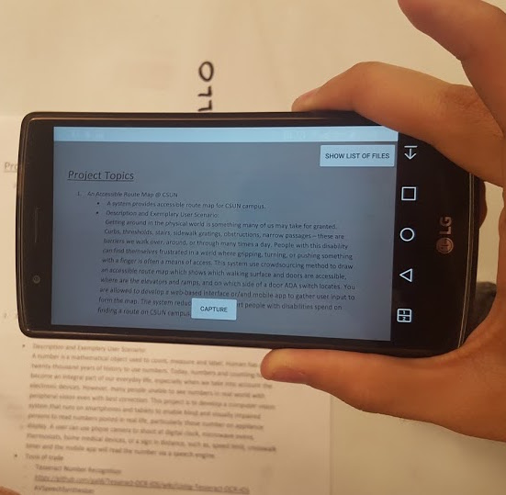
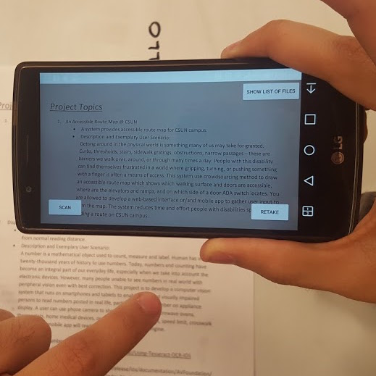
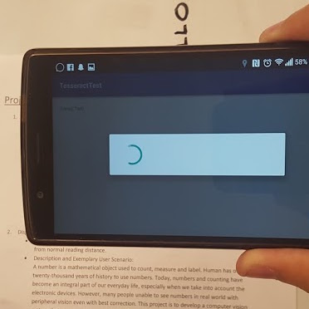
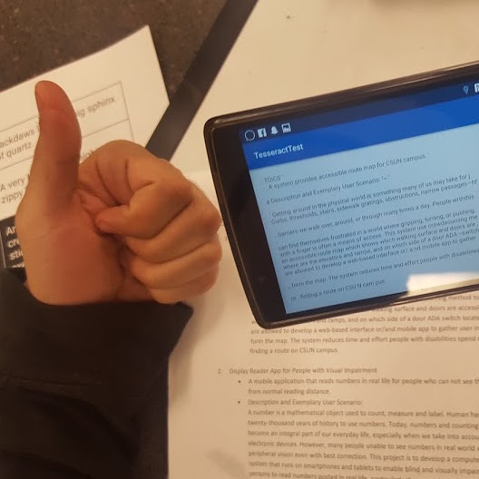
PocketReader
Demo
Capture
Scan
Wait
Profit!

Slide 13
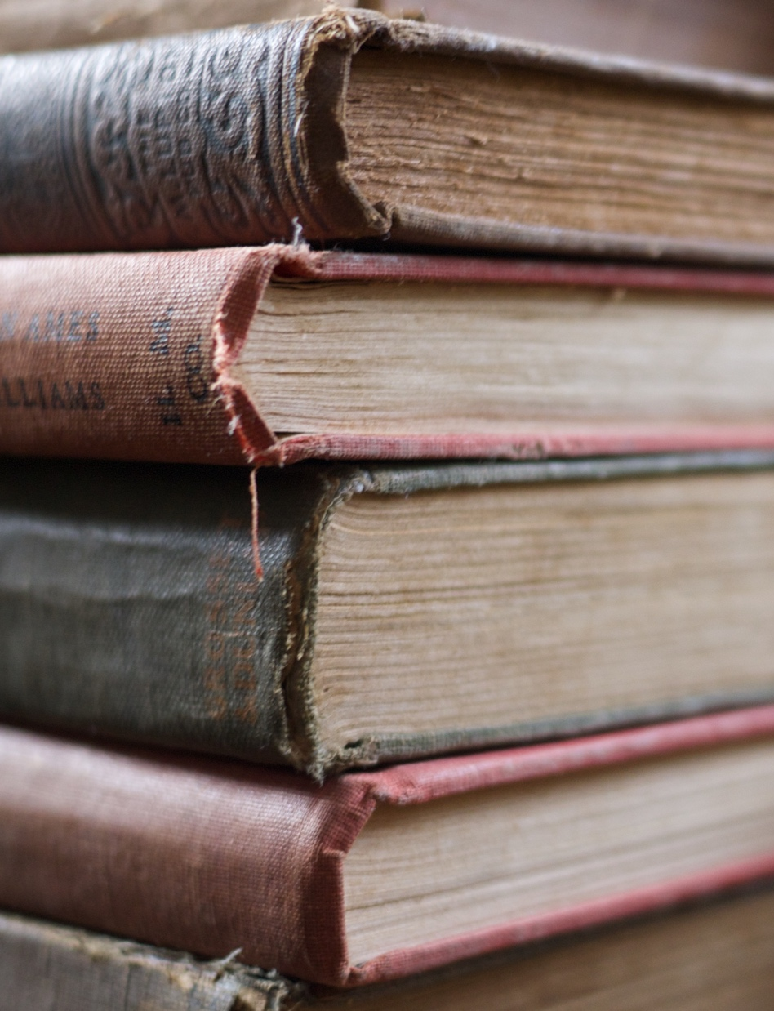
Image Credit: aukirk@Flickr, “Stack of Old Books,” 2015 (CC-BY-2.0)
Future Plans
More input formats
Multi-page documents
Other languages
Error correction
Voice controls
Cloud Backup
Notes:
Input requires only embedded text. Multi-page documents: attach images. Other languages: minor programmatically, but would increase size of install -> add-on? Error correction: Google Voice API or similar. Cloud backup using Dropbox or Google Drive.

Slide 14
Thank You to…
our mentor, Devon Smart…
Doris Chaney and Dr. Li Liu for organizing the event…
the Judges, for their time and attention…
and Northrop-Grumman for sponsoring the competition!

Slide 15
Q&A

