Slide 1
Introduction to Weka

Slide 2
Outline
Weka
  Data Source
  Feature selection
  Model building
    Classifier / Cross Validation
  Result visualization

Slide 3
WEKA
http://www.cs.waikato.ac.nz/ml/weka/
Data mining software in Java
Open source software
UCI Data Repository
  http://www.ics.uci.edu/~mlearn/MLRepository.html

Slide 4
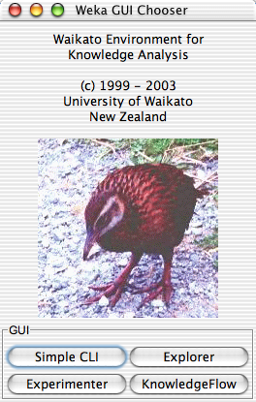
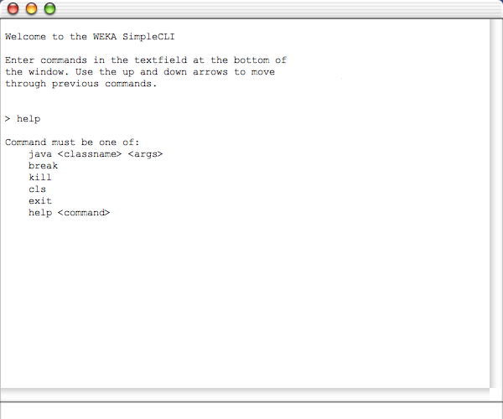
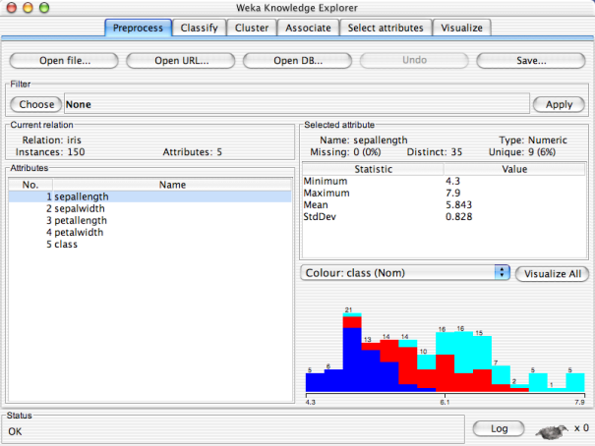
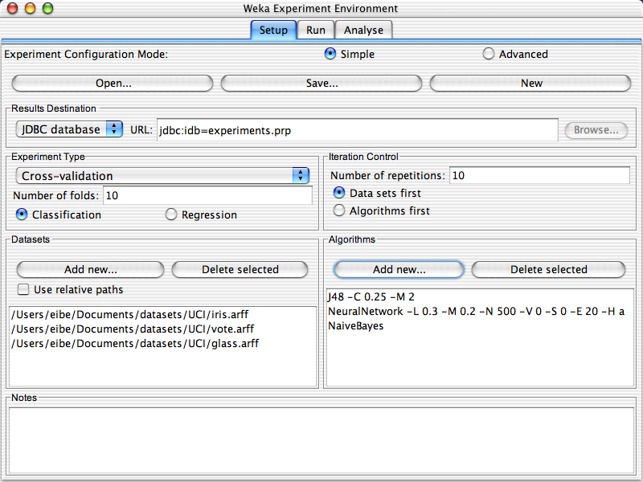
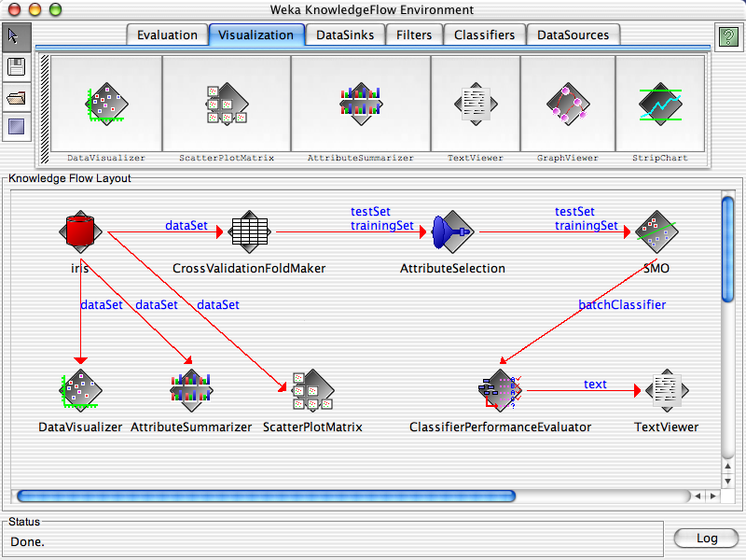

Slide 7
Explorer: pre-processing the data
Data can be imported from a file in various formats: ARFF, CSV, C4.5, binary
Data can also be read from a URL or from an SQL database (using JDBC)
Pre-processing tools in WEKA are called “filters”
WEKA contains filters for:
  Discretization, normalization, resampling, attribute selection, transforming and combining attributes, …

Slide 8
WEKA only deals with “flat” files
@relation heart-disease-simplified
@attribute age numeric
@attribute sex { female, male}
@attribute chest_pain_type { typ_angina, asympt, non_anginal, atyp_angina}
@attribute cholesterol numeric
@attribute exercise_induced_angina { no, yes}
@attribute class { present, not_present}
@data
63,male,typ_angina,233,no,not_present
67,male,asympt,286,yes,present
67,male,asympt,229,yes,present
38,female,non_anginal,?,no,not_present
...
Flat file in
ARFF format

Slide 9
WEKA only deals with “flat” files
@relation heart-disease-simplified
@attribute age numeric
@attribute sex { female, male}
@attribute chest_pain_type { typ_angina, asympt, non_anginal, atyp_angina}
@attribute cholesterol numeric
@attribute exercise_induced_angina { no, yes}
@attribute class { present, not_present}
@data
63,male,typ_angina,233,no,not_present
67,male,asympt,286,yes,present
67,male,asympt,229,yes,present
38,female,non_anginal,?,no,not_present
...
numeric attribute
nominal attribute

Slide 10
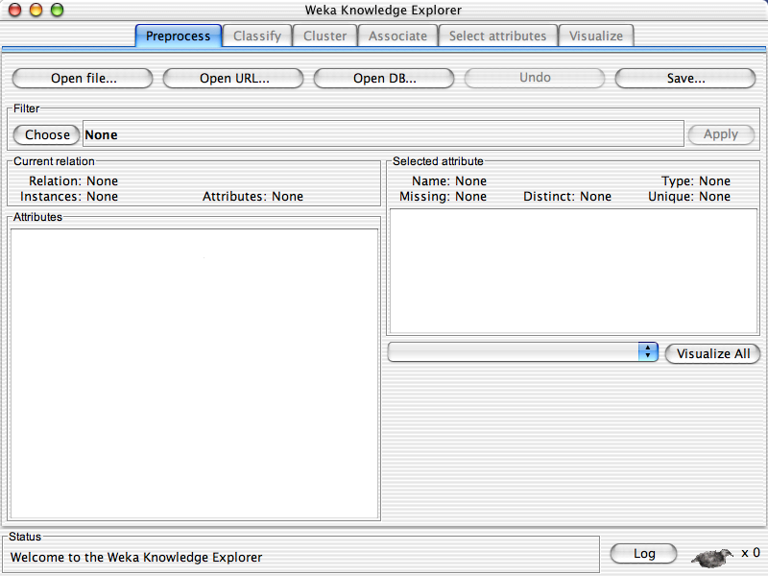

Slide 12
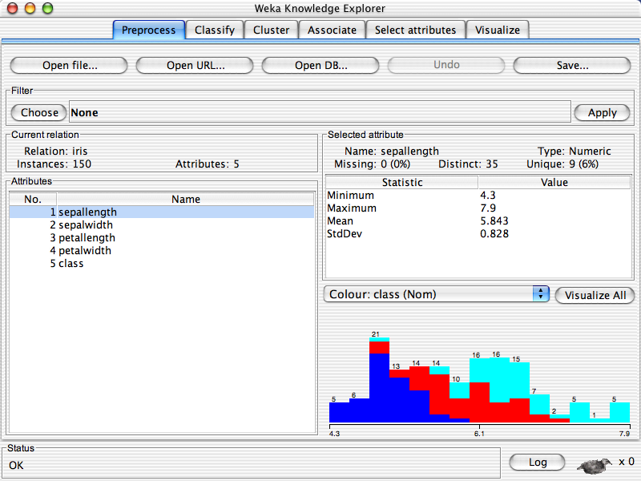

Slide 14
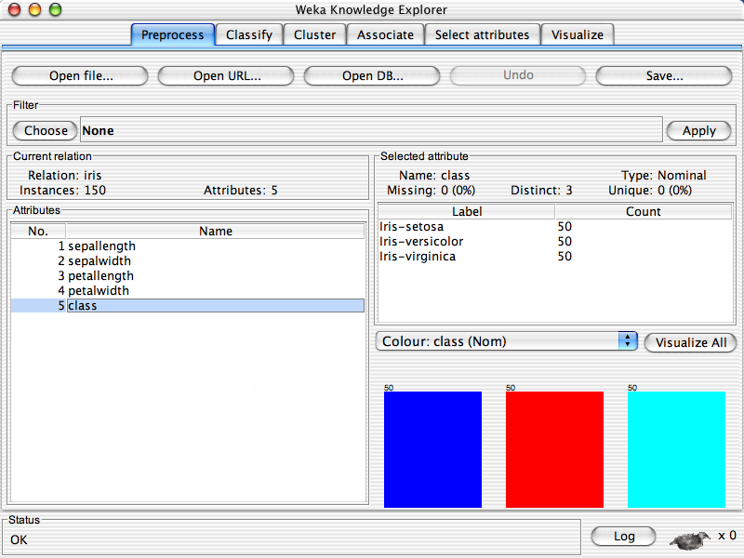

Slide 16
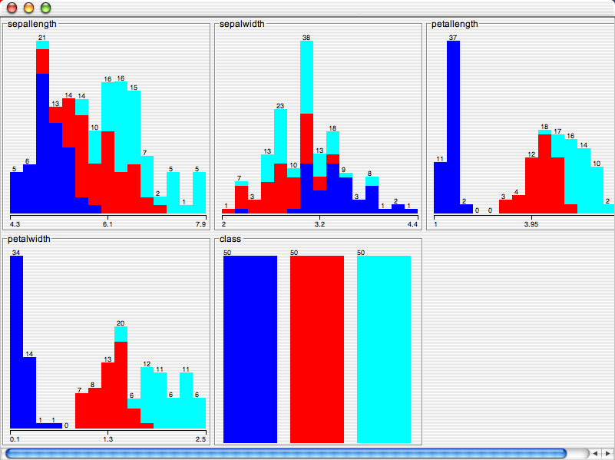

Slide 17
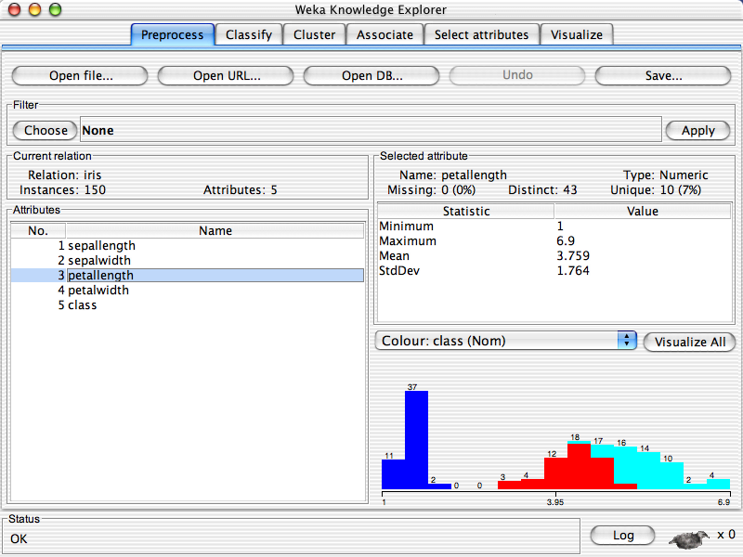

Slide 19
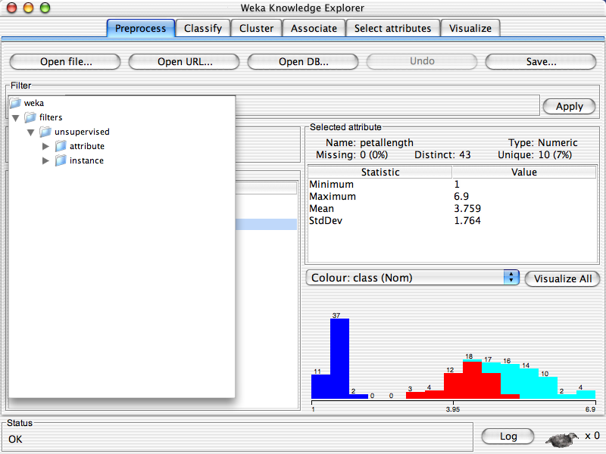

Slide 21
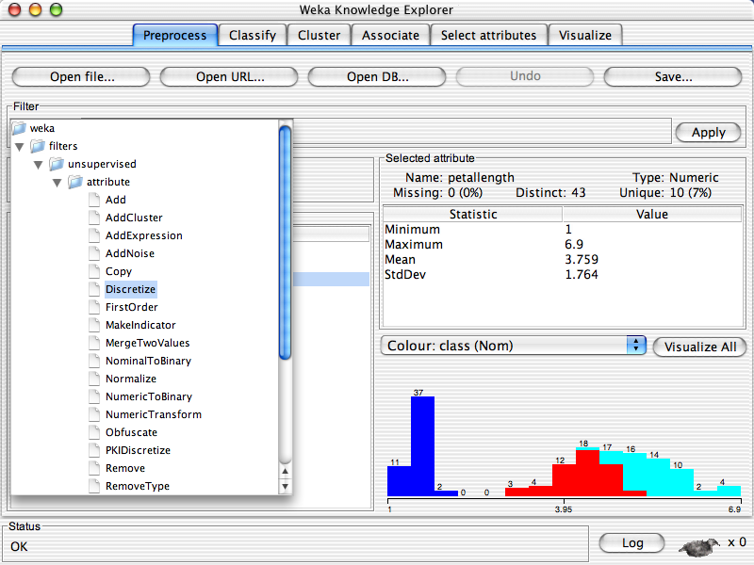

Slide 22
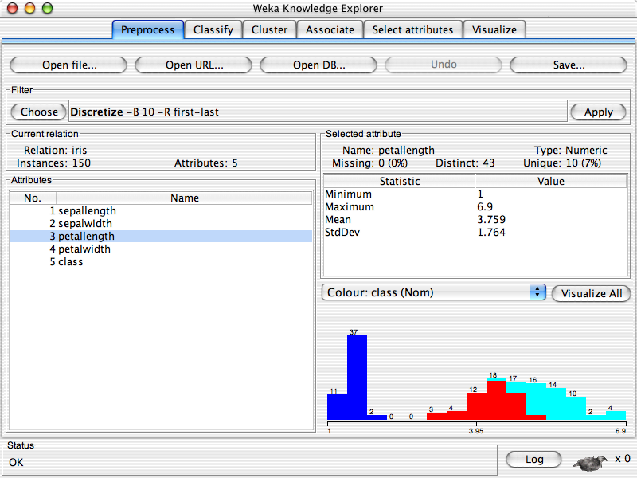

Slide 24
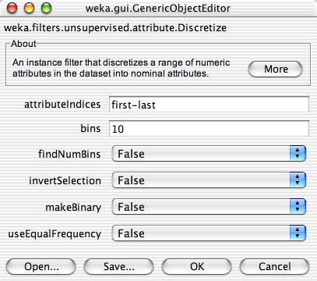

Slide 26
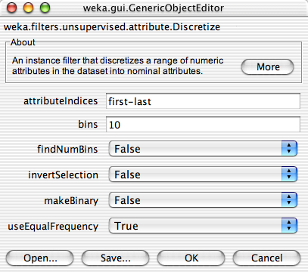

Slide 28


Slide 30
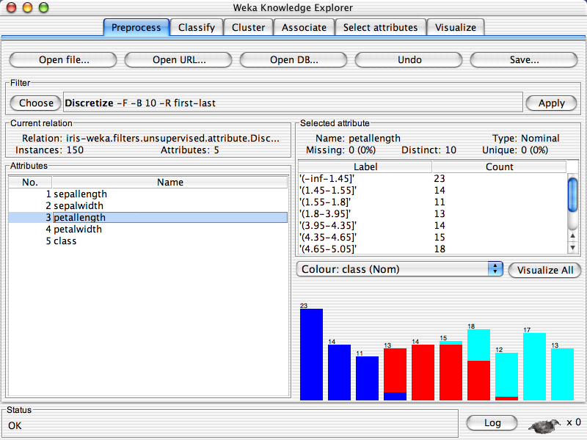

Slide 31
Explorer: attribute selection
Panel that can be used to investigate which (subsets of) attributes are the most predictive ones
Attribute selection methods contain two parts:
  A search method: best-first, forward selection, random, exhaustive, genetic algorithm, ranking
  An evaluation method: correlation-based, wrapper, information gain, chi-squared, …
Very flexible: WEKA allows (almost) arbitrary combinations of these two

Slide 32
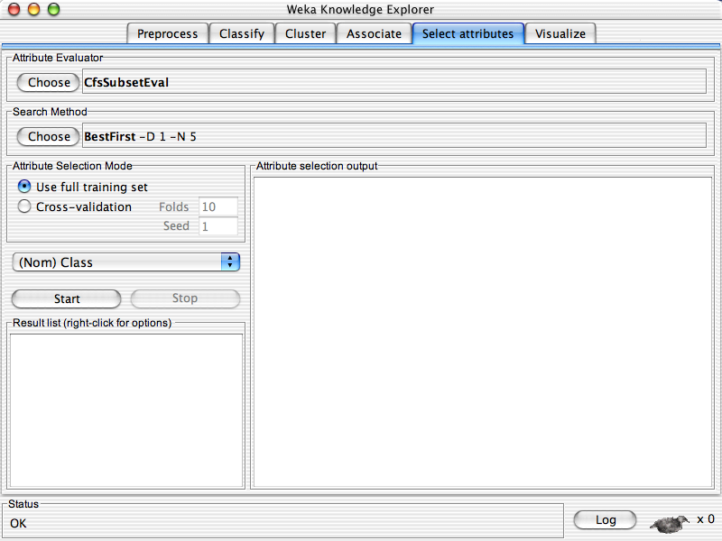

Slide 34
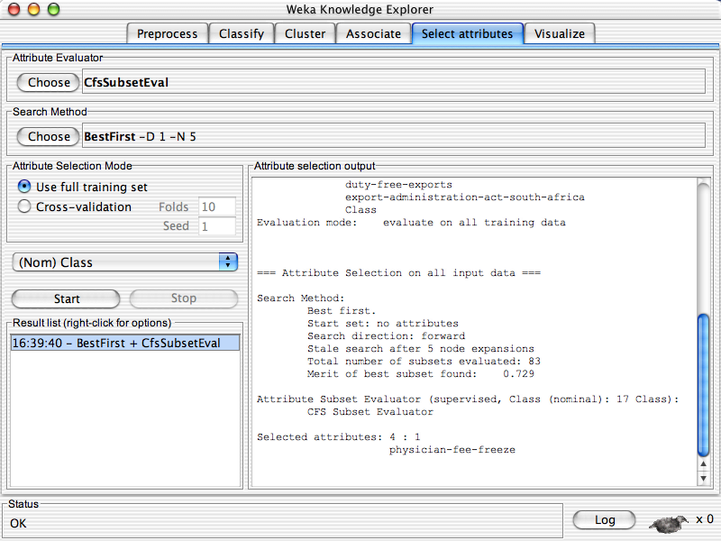

Slide 36
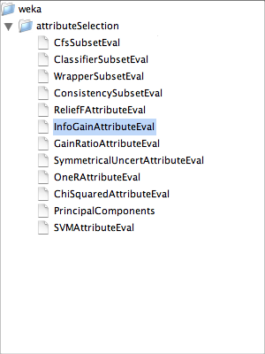

Slide 37
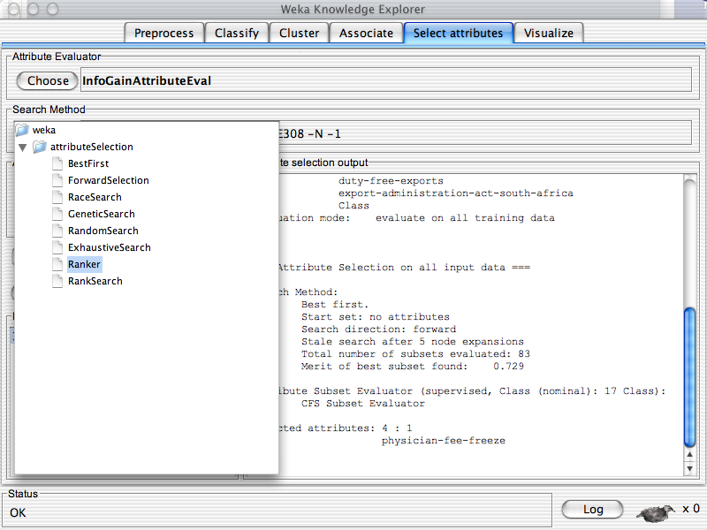

Slide 38
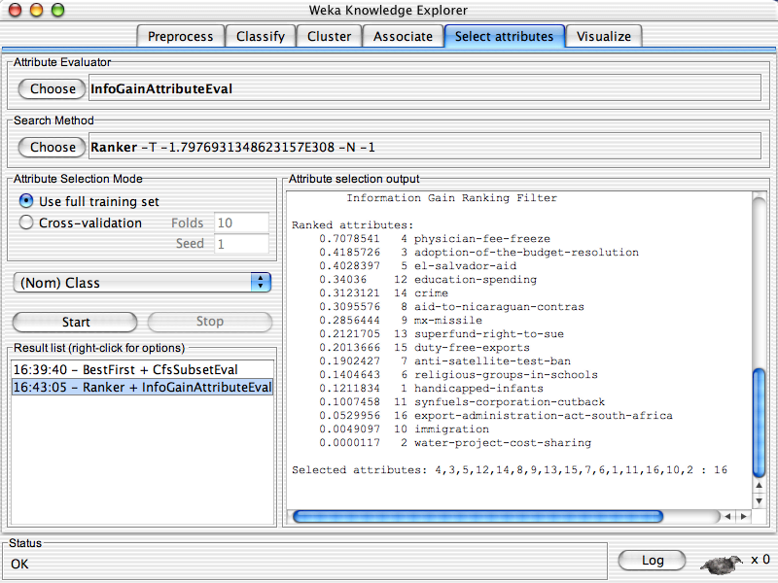

Slide 40
Explorer: building “classifiers”
Classifiers in WEKA are models for predicting nominal or numeric quantities
Implemented learning schemes include:
  Decision trees and lists, instance-based classifiers, support vector machines, multi-layer perceptrons, logistic regression, Bayes’ nets, …
“Meta”-classifiers include:
  Bagging, boosting, stacking, error-correcting output codes, locally weighted learning, …

Slide 41
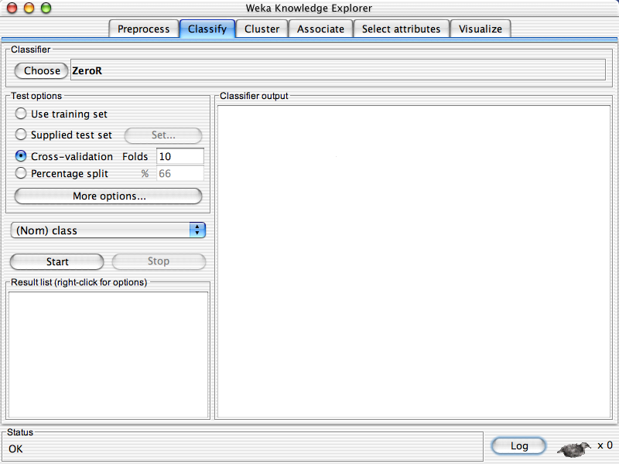

Slide 43
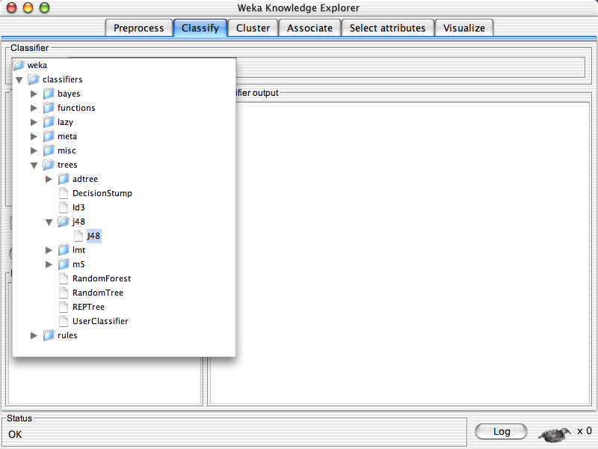

Slide 44
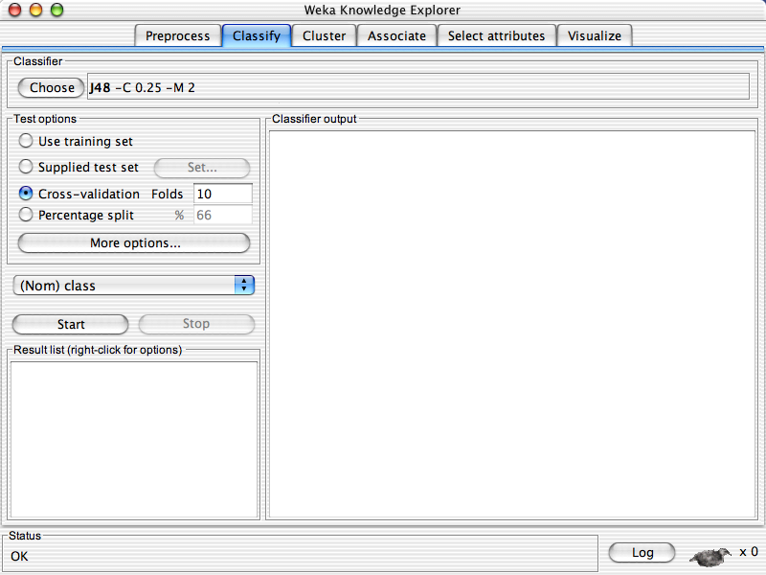

Slide 46
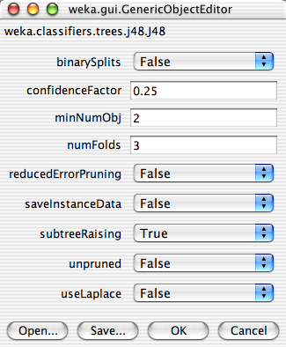

Slide 50
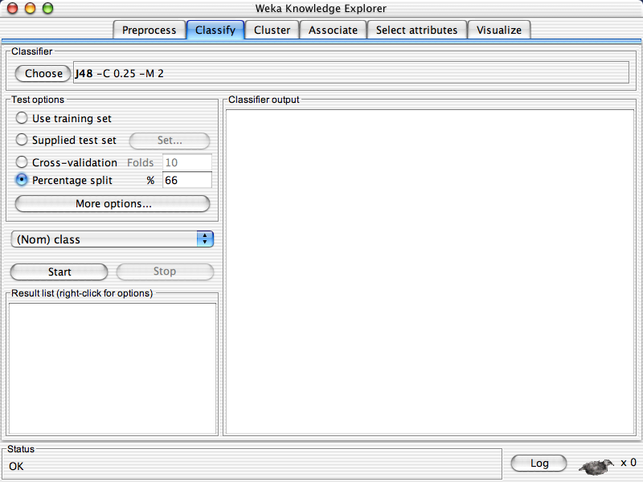

Slide 52
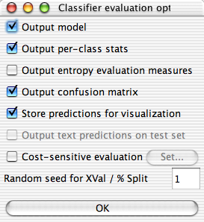

Slide 56
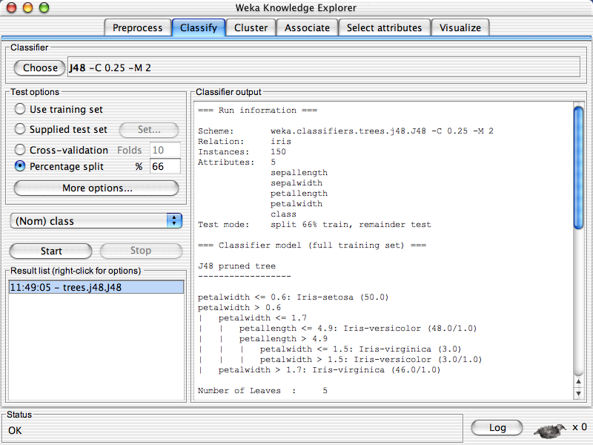

Slide 58
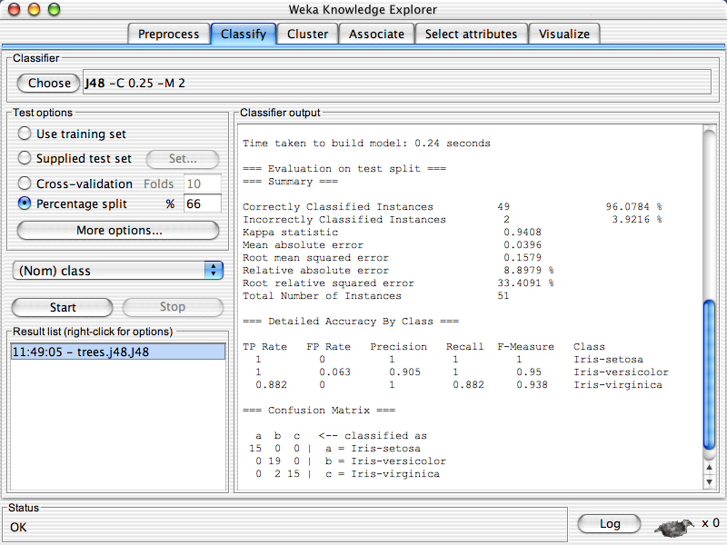

Slide 60
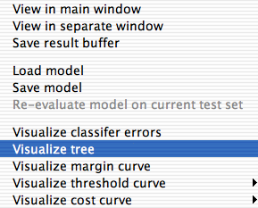

Slide 61
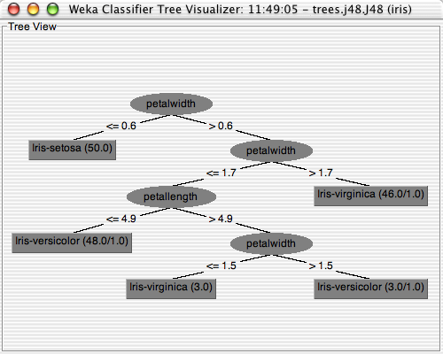

Slide 62
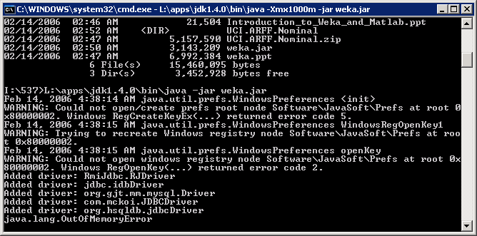
Problem with Running Weka
Problem : Out of memory for large data set
Solution : java -Xmx1000m -jar weka.jar

Slide 63
Outline
Weka
  Data Source
  Feature selection
  Model building
    Classifier / Cross Validation
  Result visualization

