Slide 1
Statistical Learning
Introduction to Weka

Slide 2
Machine Learning with Weka
Comprehensive set of tools:
  Pre-processing and data analysis
  Learning algorithms
  (for classification, clustering, etc.)
  Evaluation metrics
Three modes of operation:
  GUI
  command-line (not discussed today)
  Java API (not discussed today)

Slide 3
Weka Resources
Web page
  http://www.cs.waikato.ac.nz/ml/weka/
  Extensive documentation
  (tutorials, trouble-shooting guide, wiki, etc.)
At Columbia
  Installed locally at:
    ~mg2016/weka (CUNIX network)
    ~galley/weka (CS network)
  Downloads for Windows or UNIX: http://www1.cs.columbia.edu/~galley/weka/downloads

Slide 4
Attribute-Relation File Format (ARFF)
Weka reads ARFF files:
    @relation adult
    @attribute age numeric
    @attribute name string
    @attribute education {College, Masters, Doctorate}
    @attribute class {>50K,<=50K}
    @data
    50,Leslie,Masters,>50K
    ?,Morgan,College,<=50K
Supported attributes:
  numeric, nominal, string, date
Details at:
  http://www.cs.waikato.ac.nz/~ml/weka/arff.html
Header
Comma Separated Values (CSV)

Slide 5
Sample database: the sensus data (“adult”)
Binary classification:
  Task: predict whether a person earns > $50K a year
  Attributes: age, education level, race, gender, etc.
  Attribute types: nominal and numeric
  Training/test instances: 32,000/16,300
Original UCI data available at:
  ftp.ics.uci.edu/pub/machine-learning-databases/adult
Data already converted to ARFF:
  http://www1.cs.columbia.edu/~galley/weka/datasets/

Slide 6
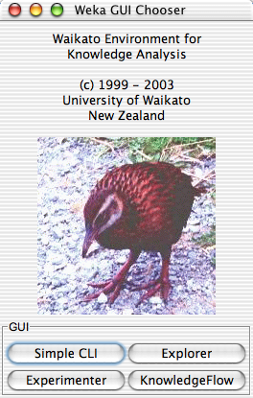
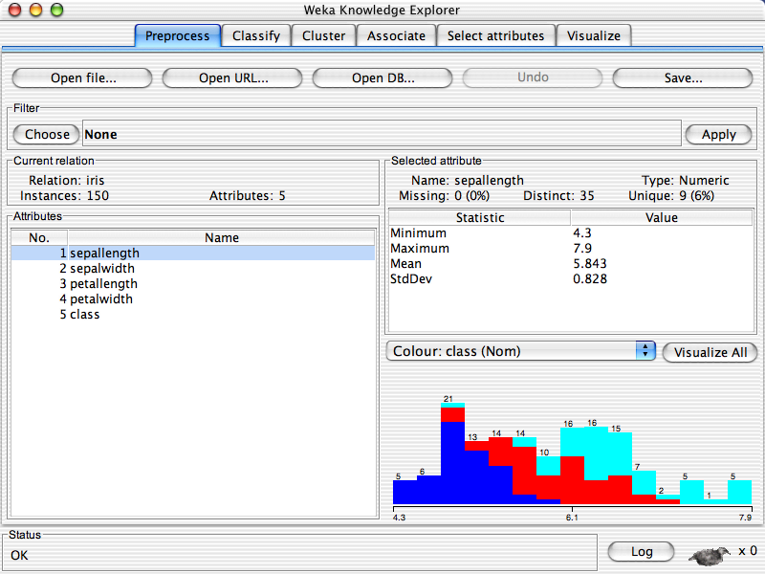
Starting the GUI
CS accounts
  > java -Xmx128M -jar ~galley/weka/weka.jar
  > java -Xmx512M -jar ~galley/weka/weka.jar (with more mem.)
CUNIX accounts
  > java -Xmx128M -jar ~mg2016/weka/weka.jar
Start “Explorer”

Slide 7
Weka Explorer
What we will use today in Weka:
Pre-process:
  Load, analyze, and filter data
Visualize:
  Compare pairs of attributes
  Plot matrices
Classify:
  All algorithms seem in class (Naive Bayes, etc.)
Feature selection:
  Forward feature subset selection, etc.

Slide 8
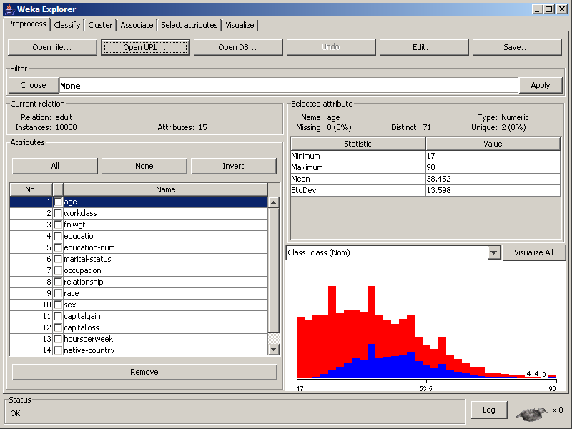
load
filter
analyze

Slide 9
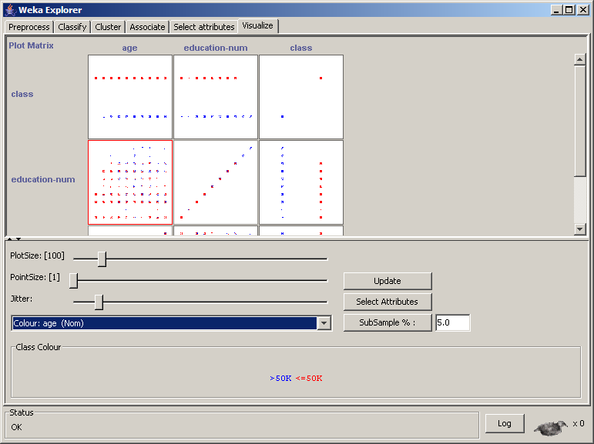
visualize
attributes

Slide 10
Demo #1: J48 decision trees (=C4.5)
Steps:
  load data from URL:
  http://www1.cs.columbia.edu/~galley/weka/datasets/adult.train.arff
  select only three attributes: age, education-num, class weka.unsupervised.attribute.Remove –V –R 1,5,last
  visualize the age/education-num matrix:
  find this in the Visualize pane
  classify with decision trees, percent split of 66%:
  weka.classifier.trees.J48
  visualize decision tree:
  (right)-click on entry in result list, select “Visualize tree”
  compare matrix with decision tree:
  does it make sense to you?
Try it for yourself after the class!

Slide 11
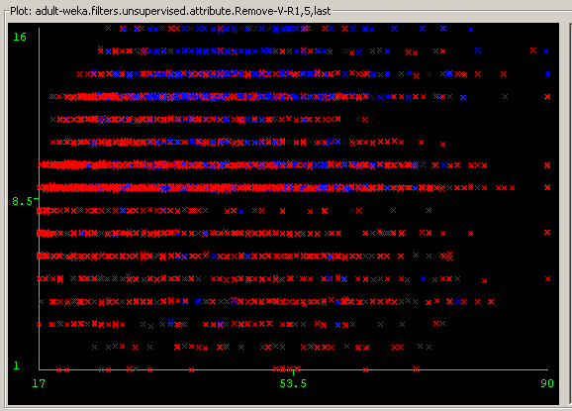
Demo #1: J48 decision trees
EDUCATION-NUM
>50K
<=50K
AGE

Slide 12
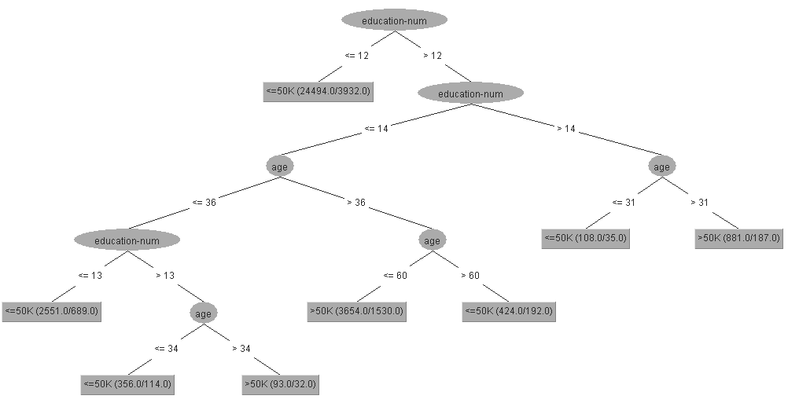
Demo #1: J48 decision trees
>50K
<=50K
_
_
+
_
_
+
_
+

Slide 13
Demo #1: J48 decision trees
13
EDUCATION-NUM
>50K
<=50K
31
34
36
60
AGE

Slide 14
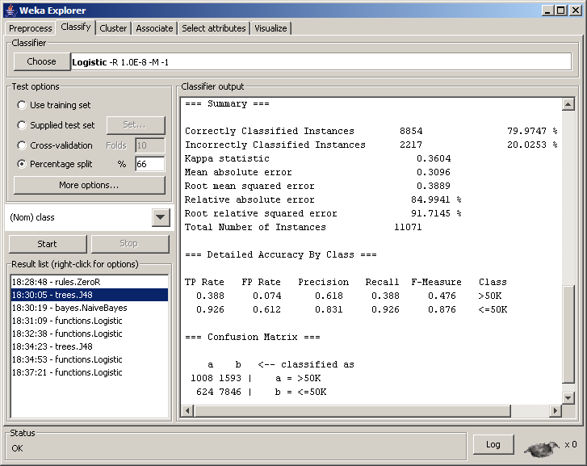
Demo #1: J48 result analysis

Slide 15
Comparing classifiers
Classifiers allowed in assignment:
  decision trees (seen)
  naive Bayes (seen)
  linear classifiers (next week)
Repeating many experiments in Weka:
  Previous experiment easy to reproduce with other classifiers and parameters (e.g., inside “Weka Experimenter”)
  Less time coding and experimenting means you have more time for analyzing intrinsic differences between classifiers.

Slide 16
Linear classifiers
Prediction is a linear function of the input
  in the case of binary
  predictions, a linear classifier
  splits a high-dimensional
  input space with a hyperplane
  (i.e., a plane in 3D, or a
  straight line in 2D).
  Many popular effective classifiers are linear: perceptron, linear SVM, logistic regression (a.k.a. maximum entropy, exponential model).

Slide 17
Comparing classifiers
Results on “adult” data
  Majority-class baseline: 76.51%
  (always predict <=50K)
  weka.classifier.rules.ZeroR
  Naive Bayes: 79.91%
  weka.classifier.bayes.NaiveBayes
  Linear classifier: 78.88%
  weka.classifier.function.Logistic
  Decision trees: 79.97%
  weka.classifier.trees.J48

Slide 18
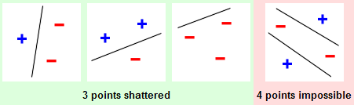
Why this difference?
A linear classifier in a 2D space:
  it can classify correctly (“shatter”) any set of 3 points;
  not true for 4 points;
  we say then that 2D-linear classifiers have capacity 3.
A decision tree in a 2D space:
  can shatter as many points as leaves in the tree;
  potentially unbounded capacity! (e.g., if no tree pruning)

Slide 19
Demo #2: Logistic Regression
Can we improve upon logistic regression results?
Steps:
  use same data as before (3 attributes)
  discretize and binarize data (numeric → binary):
  weka.filters.unsupervised.attribute.Discretize –D –F –B 10
  classify with logistic regression, percent split of 66%:
  weka.classifier.function.Logistic
  compare result with decision tree: your conclusion?
  repeat classification experiment with all features, comparing the three classifiers: J48, Logistic, and Logistic with binarization: your conclusion?
Notes:
weka.filters.unsupervised.attribute.Discretize –D –F –B 10: discretize with 10 bins of equal frequencies, and create binary variables.

Slide 20
Demo #2: Results
two features (age, education-num):
  decision tree 79.97%
  logistic regression 78.88%
  logistic regression with feature binarization 79.97%
all features:
  decision tree 84.38%
  logistic regression 85.03%
  logistic regression with feature binarization 85.82%
Notes:
Number of binary/numeric features: 5) 18, 4) 104, 6) 152
Questions:
How could a low capacity outperform a high capacity one? We actually increased the capacity of the linear classifier, so that it is close decision trees.
Is high capacity always better?
If not, under what circumstances is it better to have low capacity? Discuss amount of training data, number of features, generalization error.
What is the capacity of a naive Bayes classifier?
Is it sound to do feature selection with low-capacity classifiers? Why?

Slide 21
Feature Selection
Feature selection:
  find a feature subset that is a good substitute to all features
  good for knowing which features are actually useful
  often gives better accuracy (especially on new data)
Forward feature selection (FFS): [John et al., 1994]
  wrapper feature selection: uses a classifier to determine the goodness of feature sets.
  greedy search: fast, but prone to search errors

Slide 22
Feature Selection in Weka
Forward feature selection:
  search method: GreedyStepwise
    select a classifier (e.g., NaiveBayes)
    number of folds in cross validation (default: 5)
  attribute evaluator: WrapperSubsetEval
    generateRanking: true
    numToSelect (default: maximum)
    startSet: good features you previously identified
  attribute selection mode: full training data or cross validation
Notes:
  double cross validation because of GreedyStepwise
  change number of folds to achieve desired
  tade-off between selection accuracy and running time.

Slide 23
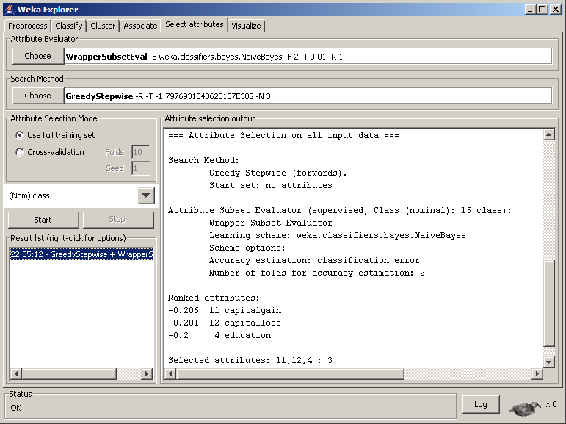

Slide 24
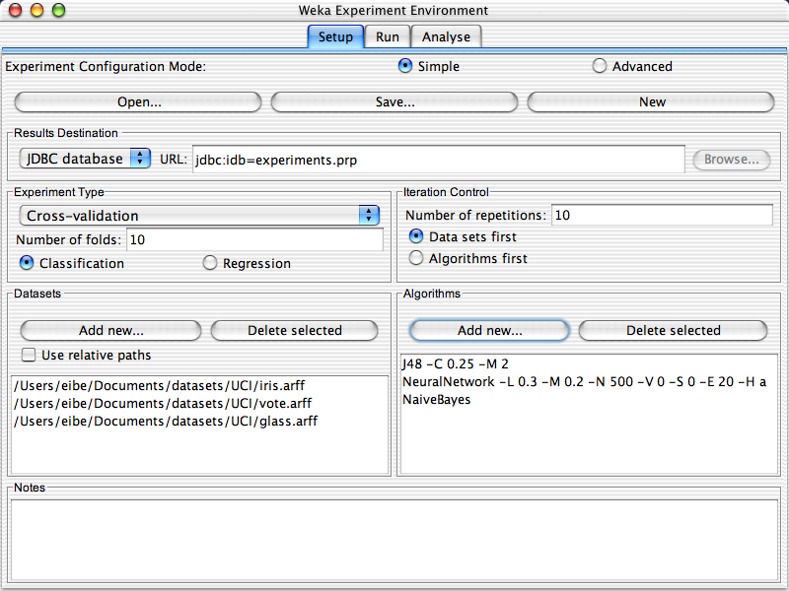
Weka Experimenter
If you need to perform many experiments:
  Experimenter makes it easy to compare the performance of different learning schemes
  Results can be written into file or database
  Evaluation options: cross-validation, learning curve, etc.
  Can also iterate over different parameter settings
  Significance-testing built in.

Slide 25
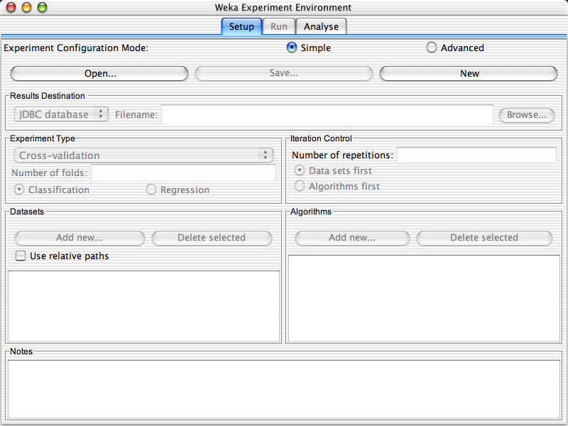

Slide 29
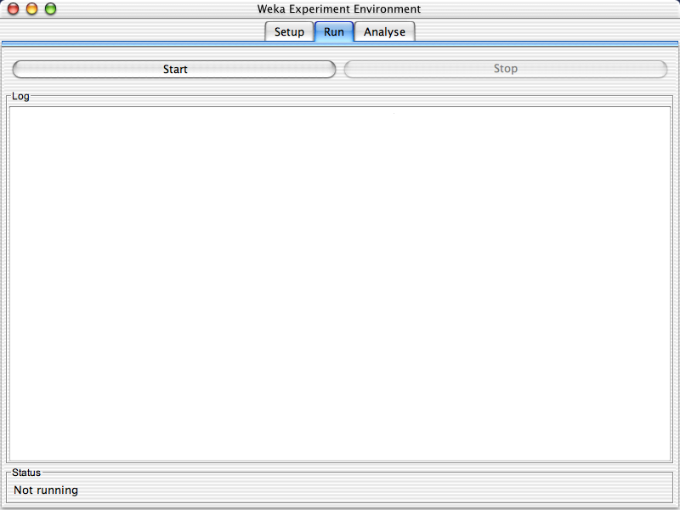

Slide 31
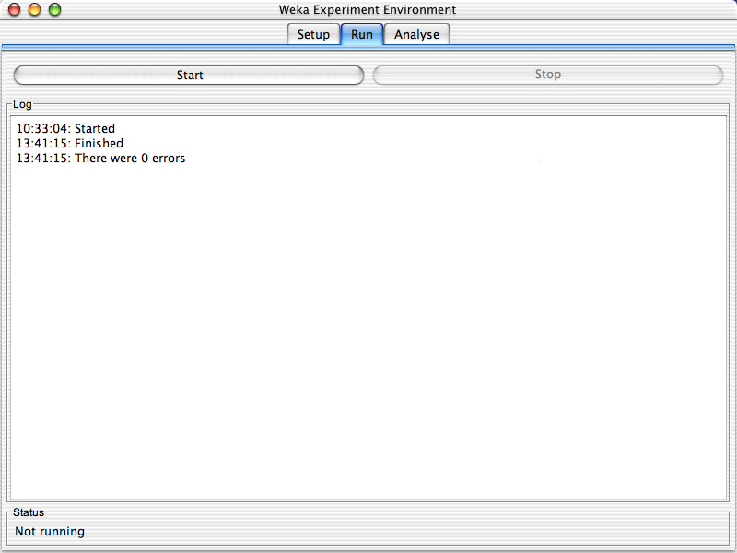

Slide 33
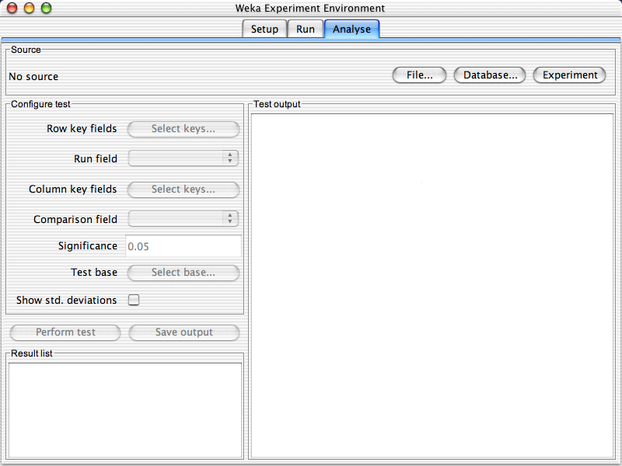

Slide 35
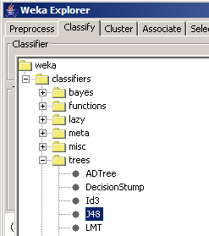

Beyond the GUI
How to reproduce experiments with the command-line/API
  GUI, API, and command-line all rely on the same set of Java classes
  Generally easy to determine what classes and parameters were used in the GUI.
  Tree displays in Weka reflect its Java class hierarchy.
  > java -cp ~galley/weka/weka.jar
  weka.classifiers.trees.J48 –C 0.25 –M 2
  -t <train_arff> -T <test_arff>

Slide 36
Important command-line parameters
where options are:
Create/load/save a classification model:
  -t <file> : training set
  -l <file> : load model file
  -d <file> : save model file
Testing:
  -x <N> : N-fold cross validation
  -T <file> : test set
  -p <S> : print predictions + attribute selection S
  > java -cp ~galley/weka/weka.jar
  weka.classifiers.<classifier_name> [classifier_options] [options]

