Slide 1
Batch Lab. Scale
E1=20e3; %J/mol
E2=100e3; %J/mol
deltaH1 = -300e3; %J/mol
deltaH2 = -250e3;
Conversion: 93.302380 %
Selectivity: 42.200889 %
Yield: 39.374434 %
t_switch = 3600 s

Slide 2
Batch Lab. Scale
E1=20e3; %J/mol
E2=100e3; %J/mol
deltaH1 = -300e3; %J/mol
deltaH2 = -250e3;
Conversion: 90.763436 %
Selectivity: 57.111351 %
Yield: 51.836225 %
t_switch = 3000 s

Slide 3
Industrial Lab. Scale
E1=20e3; %J/mol
E2=100e3; %J/mol
deltaH1 = -300e3; %J/mol
deltaH2 = -250e3;
Conversion: 90.763436 %
Selectivity: 57.111351 %
Yield: 51.836225 %
t_switch = 3000 s
Notes:
We have to Control the temperature! To control the temperature, we need another configuration that called “Semi-Batch”.

Slide 4
Industrial Lab. Scale
E1=20e3; %J/mol
E2=100e3; %J/mol
deltaH1 = -300e3; %J/mol
deltaH2 = -250e3;
Conversion: 90.763436 %
Selectivity: 57.111351 %
Yield: 51.836225 %
Conversion: 61.065092 %
Selectivity: 85.985832 %
Yield: 52.507328 %
t_switch = 3000 s

Slide 5
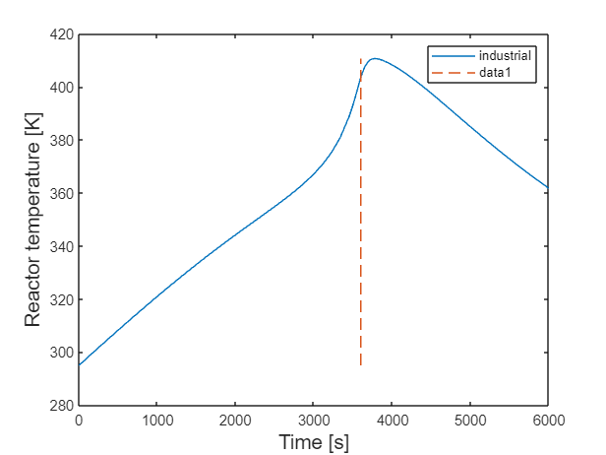
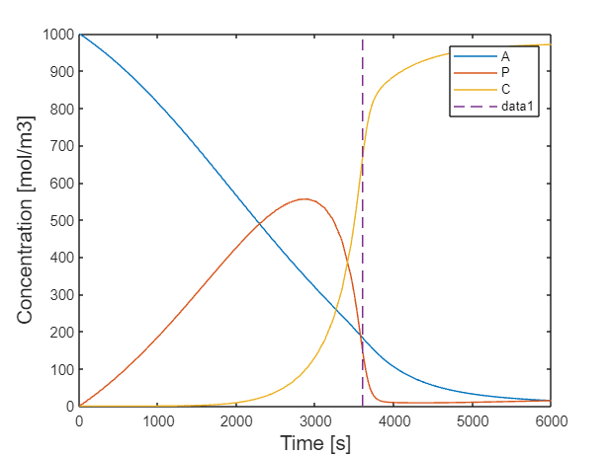
Industrial Semi-Batch Lab. Scale
E1=20e3; %J/mol
E2=100e3; %J/mol
deltaH1 = -300e3; %J/mol
deltaH2 = -250e3;
Conversion: 61.065092 %
Selectivity: 85.985832 %
Yield: 52.507328 %
t_switch = 3000 s

