Slide 1

Quantifying Organizational Efficiency Gains from AI-Driven Treatment Decision Tools
An Agent-Based Modeling and Strategic Management Perspective
Fundamentals of Organization and Strategic Business Management
University OF Genova - January 2026

Slide 2

Problem Statement
The Managerial Problem Behind AI Adoption
Healthcare organizations face rising demand and limited resources
Clinical decision-making is a major organizational bottleneck
AI tools are usually evaluated only by accuracy and usability
Organizational performance is often overlooked
*Improving task-level accuracy does not automatically improve organizational efficiency*

Slide 3
Research Gap & Research Objective
3
Research Gap
Existing studies focus on:
Our Objective
AI accuracy and technical performance
User acceptance and usability
Limited attention to:
Organizational efficiency
System-level dynamics
Congestion, delays, and variability over time
This project aims to:
Evaluate AI as an organizational process innovation
Quantify its impact on:
i. Length of Stay (LOS), ii. Throughput, iii. Decision latency, iv. System stability
system-level, dynamic approach
*Real Gap: From “Does AI work?” to “Does AI improve organizational value?”*

Slide 4
Conceptual Framework
Decision Delays
A system perspective
Healthcare organizations are complex adaptive systems.
Performance emerges from:
  Interactions between patients, clinicians, and resources
  Time delays and feedback loops
Two types of variability:
  Natural variability (patient heterogeneity)
  Artificial variability (decision delays, poor coordination)
AI acts by:
  Reducing decision latency
  Reducing variability
  Stabilizing system dynamics
Patient Deterioration
Longer LOS & Congestion
Feedback Loop
4
*AI improves performance by reshaping feedback loops, not by increasing capacity.*

Slide 5
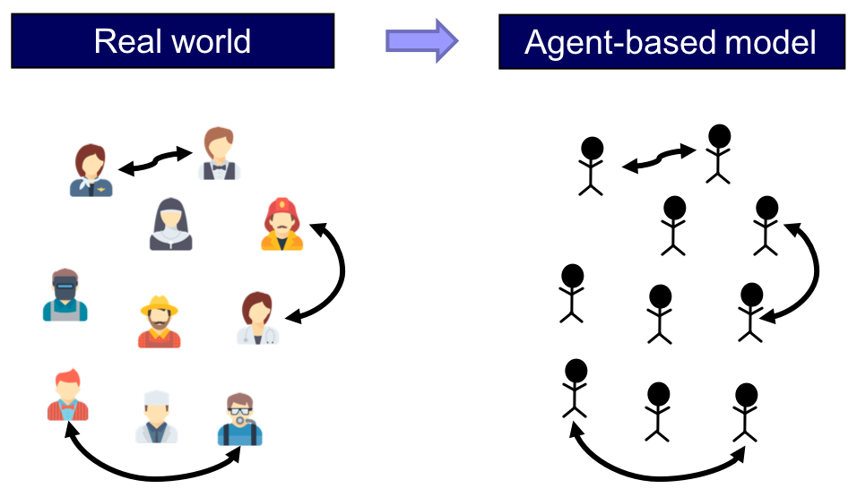
Methodology:
Agent-Based Modeling Approach
Patients
Clinicians
AI Support
Organizational KPIs (LOS, Throughput, Stability)
Healthcare systems exhibit:
Heterogeneous actors
Nonlinear interactions
Feedback loops and delays
Agent-Based Modeling (ABM) is well-suited to capture these dynamics
Agents modeled:
Patients (arrival, waiting, deterioration)
Clinicians (decision-making under workload)
AI as decision-support (not replacement)
Enables linking: Micro-level behavior → Macro-level performance
*ABM allows us to study organizational outcomes emerging from individual decisions.*

Slide 6

Scenario Design & Experimental Setup
Scenario 1 – Baseline (Traditional)
4 clinicians No AI support
Scenario 2 – AI-Assisted
3 clinicians AI reduces decision latency and variability
Demand and capacity are kept constant
AI effectiveness tested from 10% to 40%
6
*Any performance difference is driven by way of decision-making, not by demand or capacity changes.*

Slide 7
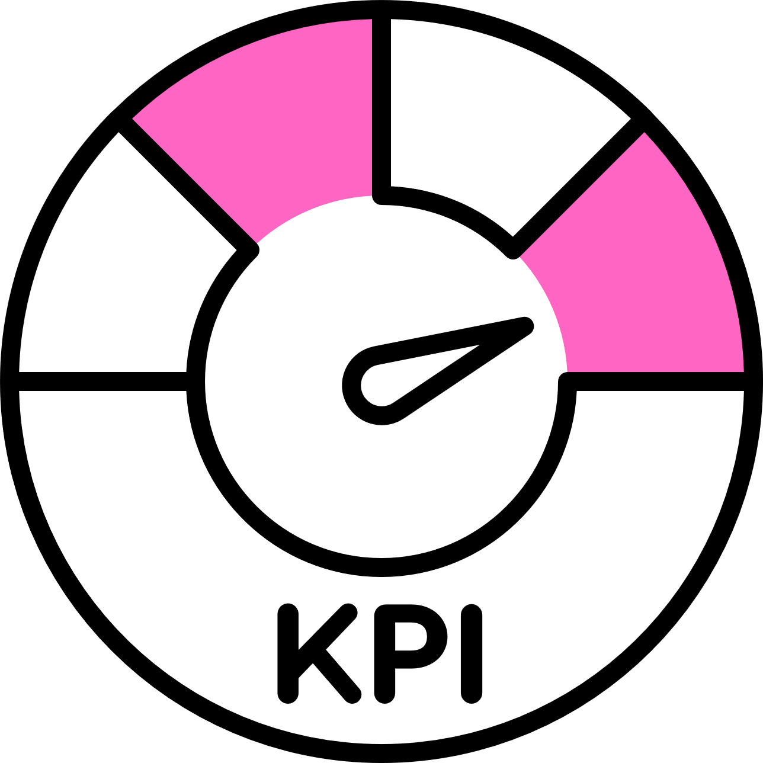
KPIs & Evaluation Metrics
Organizational KPIs and Evaluation Logic
Evaluation focuses on organizational performance, not clinical accuracy
Key Performance Indicators (KPIs):
Decision Latency
Mean Length of Stay (LOS)
LOS – 95th Percentile (Tail Risk)
Throughput
Note: Stability and variability are explicitly considered KPIs interpreted through a value-based management perspective.
Efficiency = Output / Organizational Effort
*Organizational value depends on flow, stability, and coordination, not only averages.*
7

Slide 8
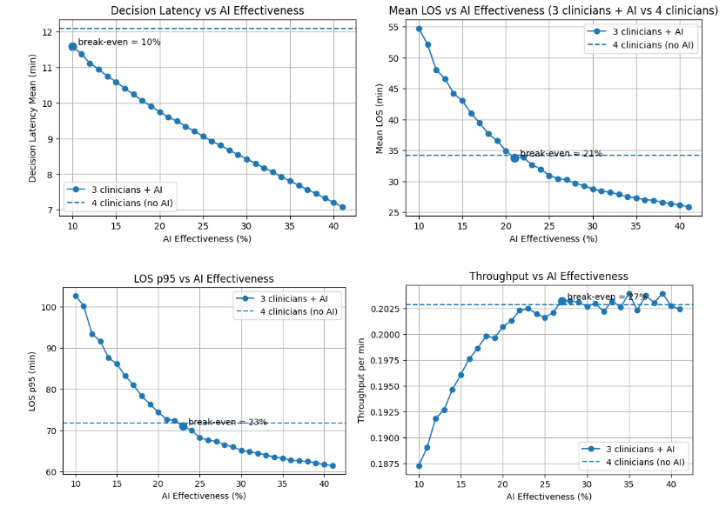
Results: Performance Curves
8
Low Load Scenario
*There exists a clear break-even region where AI compensates for reduced staffing.*

Slide 9
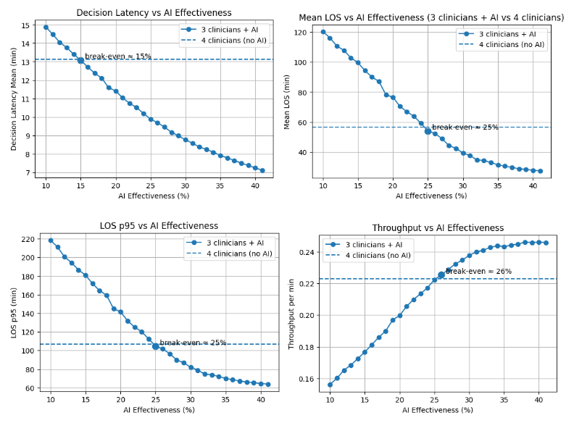
Results: Performance Curves
9
High Load Scenario
*There exists a clear break-even region where AI compensates for reduced staffing.*

Slide 10

Results: Managerial Interpretation
AI reduces decision delays, not demand or capacity.
Reduced delays weaken congestion feedback loops.
Break-even points define:
Minimum AI effectiveness needed
Feasible staffing reduction
Under high load: AI improves efficiency and resilience!
10
*The value of AI is context-dependent and emerges under pressure.*

Slide 11
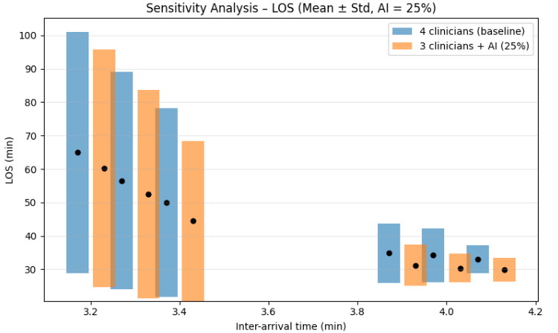
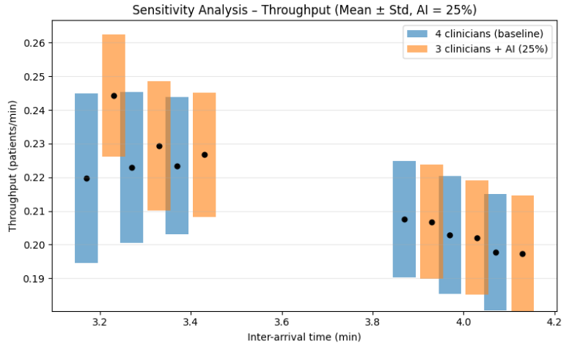
Sensitivity Analysis & Robustness
11
*The relative performance advantage of AI remains stable under demand uncertainty.*

Slide 12

Managerial Implications & Final Takeaways
AI should be evaluated as an organizational process innovation
Efficiency gains come from:
Reduced decision latency
Lower variability
Improved system stability
AI enables:
Staffing optimization without performance loss
Better performance under high-demand conditions
Simulation provides a tool for ex-ante strategic decision-making
12
*AI is a strategic lever, not just a technological upgrade.*

Slide 13
Thank you
Team Members:
Ehsan Izadi Zamanabadi – S5968888
Reza Dehghnaniabbasi – S6939946
Seyedmahdi Seyedishandiz – S7452028
Sina Gholami Fashkhami – S7015801

