Slide 1



Attacking Windows using Intel TSX
1

Slide 2



[ ]
W h o A m I
I’m Sina,
A Windows Internals enthusiast
@Intel80x86
Rayanfam.com

Slide 3
This presentation a new improvement to the following articles :
KASLR is Dead: Long Live KASLR
https://gruss.cc/files/kaiser.pdf
I Know Where Your Page Lives
De-Randomizing the Latest Windows 10 Kernel
https://github.com/IOActive/I-know-where-your-page-lives

Slide 4
Intel TSX
Intel Transactional Synchronization eXtensions (TSX) is the product name for two x86 instruction set extensions, called Hardware Lock Elision (HLE) and Restricted Transactional Memory (RTM). HLE is a set of prefixes that can be added to specific instructions.
Derived from : LazyFP: Leaking FPU Register State using Microarchitectural Side-Channels (https://arxiv.org/pdf/1806.07480.pdf)

Slide 5

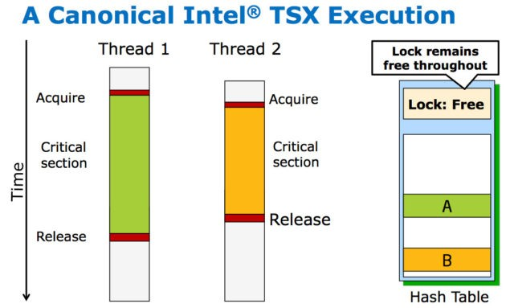
Intel’s
Transactional Synchronization Extensions

Slide 6
Hardware Lock Elision
VS
Restricted Transactional Memory

Slide 7
Hardware Lock Elision
- [ ] -
I n t r o d u c i n g t o
lock elision is a general concept that can be implemented in different
ways.
e.g XACQUIRE and XRELEASE Prefixes in Intel Processors

Slide 8
Restricted Transactional Memory (RTM)
- [ ] -
I n t r o d u c i n g t o
Introducing new instructions :
XBEGIN, XEND, XABORT & XTEST
Somehow like try/catch when it comes to programming.
It’s all about atomicity.

Slide 9
What is OoO ?
It’s one of three components of out-of-order execution, also known as dynamic execution.
Along with multiple branch prediction (used to predict the instructions most likely to be needed in the near future) and dataflow analysis (used to align instructions for optimal execution, as opposed to executing them in the order they came in), speculative execution delivered a dramatic performance improvement over previous Intel processors.

Slide 10
IA32 & IA32e Paging

Slide 11
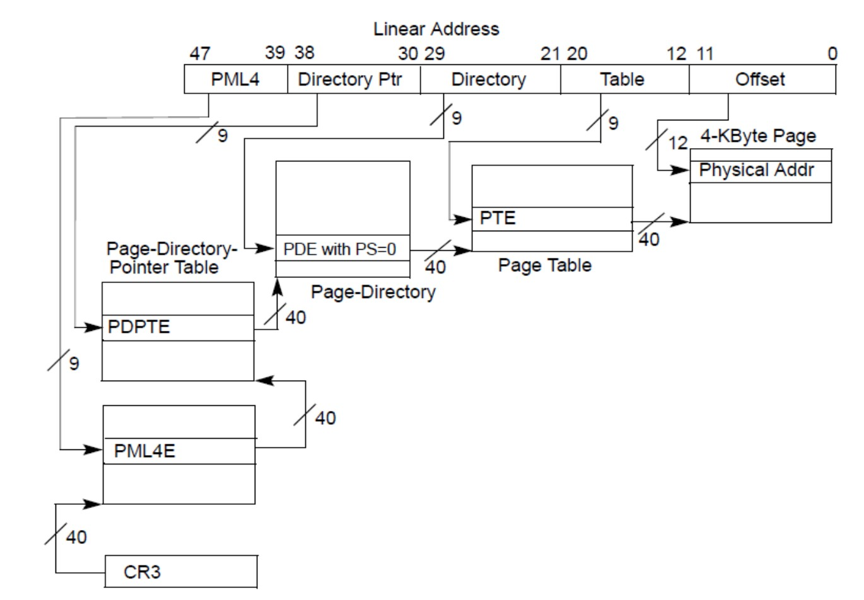
Intel Paging in IA32-e Mode and it’s submodes

Slide 12
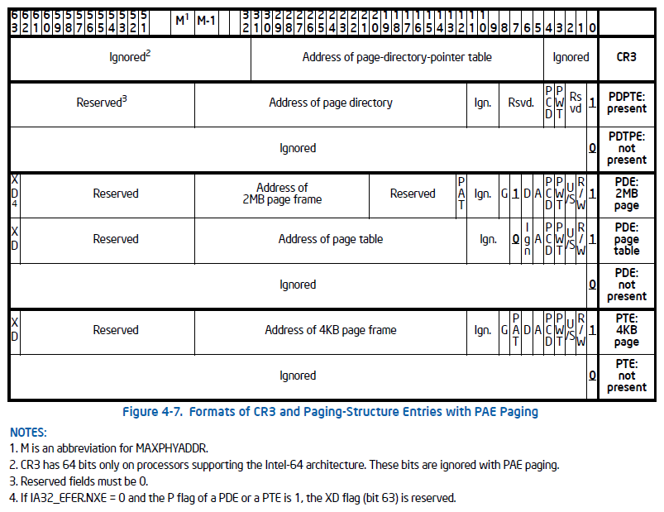
Paging Attr.
Overview

Slide 13
Let’ s see some examples
Pictures From :
https://www.secureauth.com/blog/getting-physical-extreme- abuse-of-intel-based-paging-systems-part-2-windows
E x a m p l e
13

Slide 14
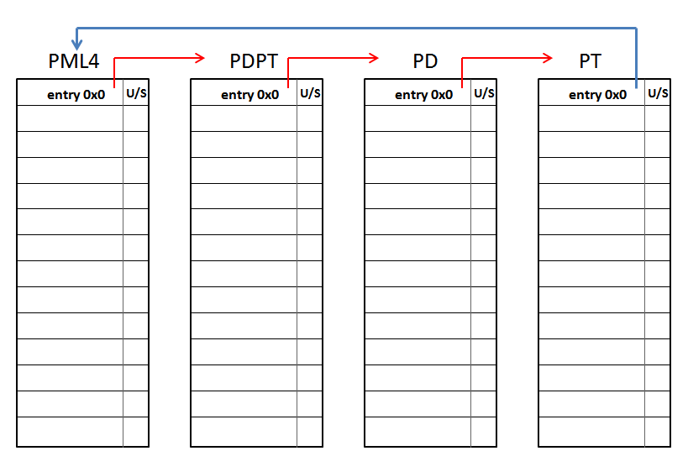
Using the self-ref entry located at the PML4 position number 0 (zero):
14

Slide 15
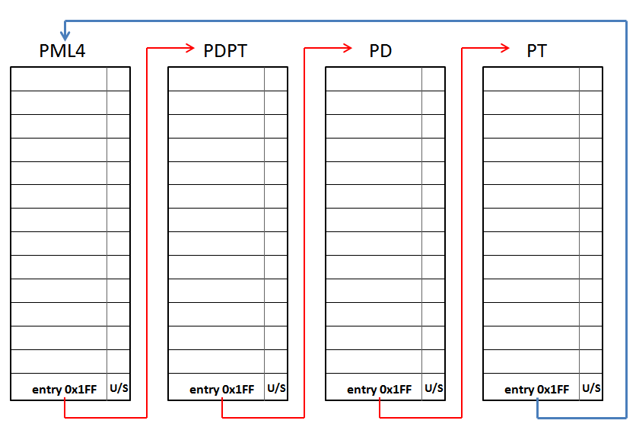
Using the self-ref entry located at the PML4 position number 0x1FF (511):
15

Slide 16

Ok, but
What was the Windows Plan for self-referential entries?
16

Slide 17
Windows Self-Ref Entries
Only one PML4 entry is used for Paging management (0x1ED).
Entry 0x1ED is self-referential or the physical address points to PML4 physical address
17

Slide 18
Self-Ref of Death Attack
18

Slide 19
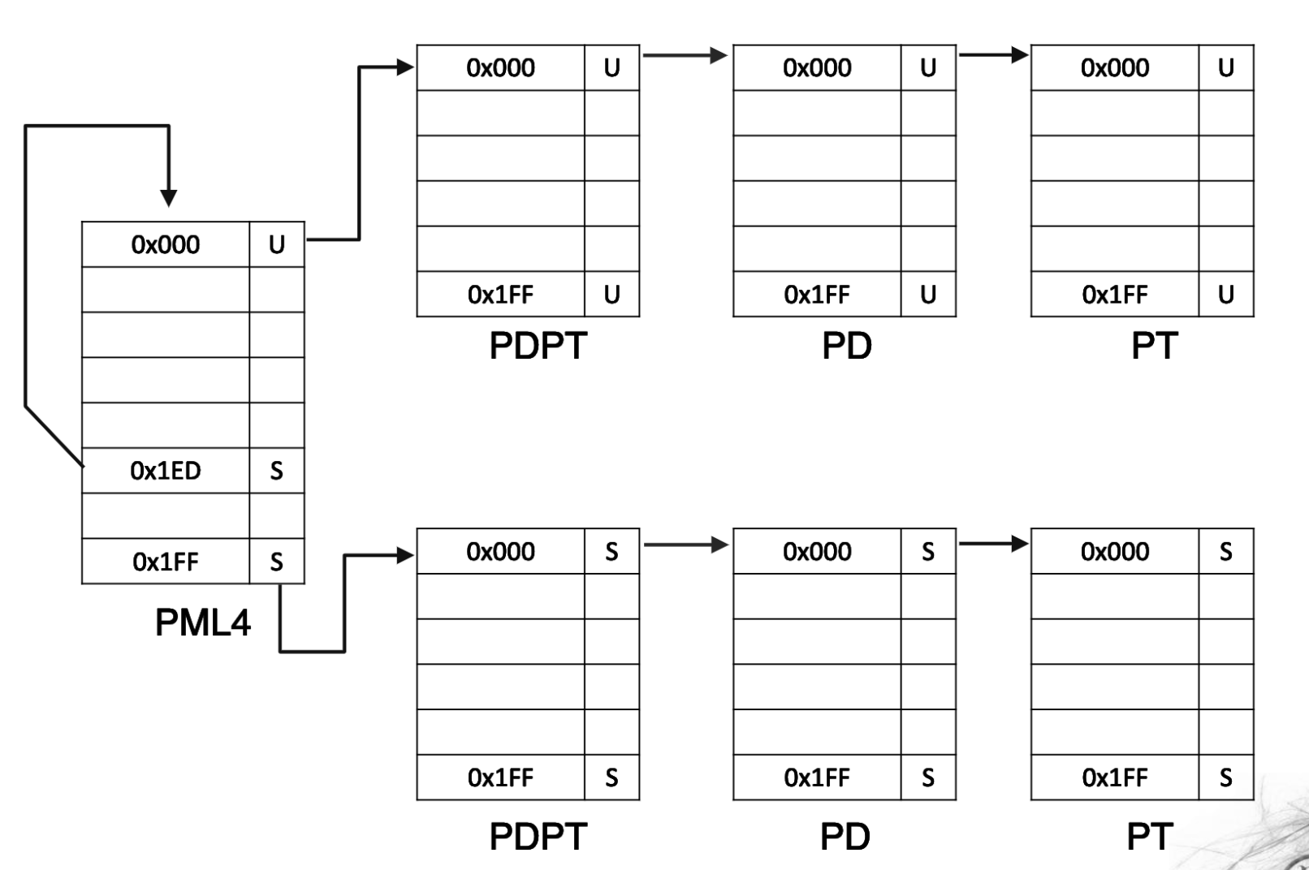
Self-Ref of Death
19

Slide 20
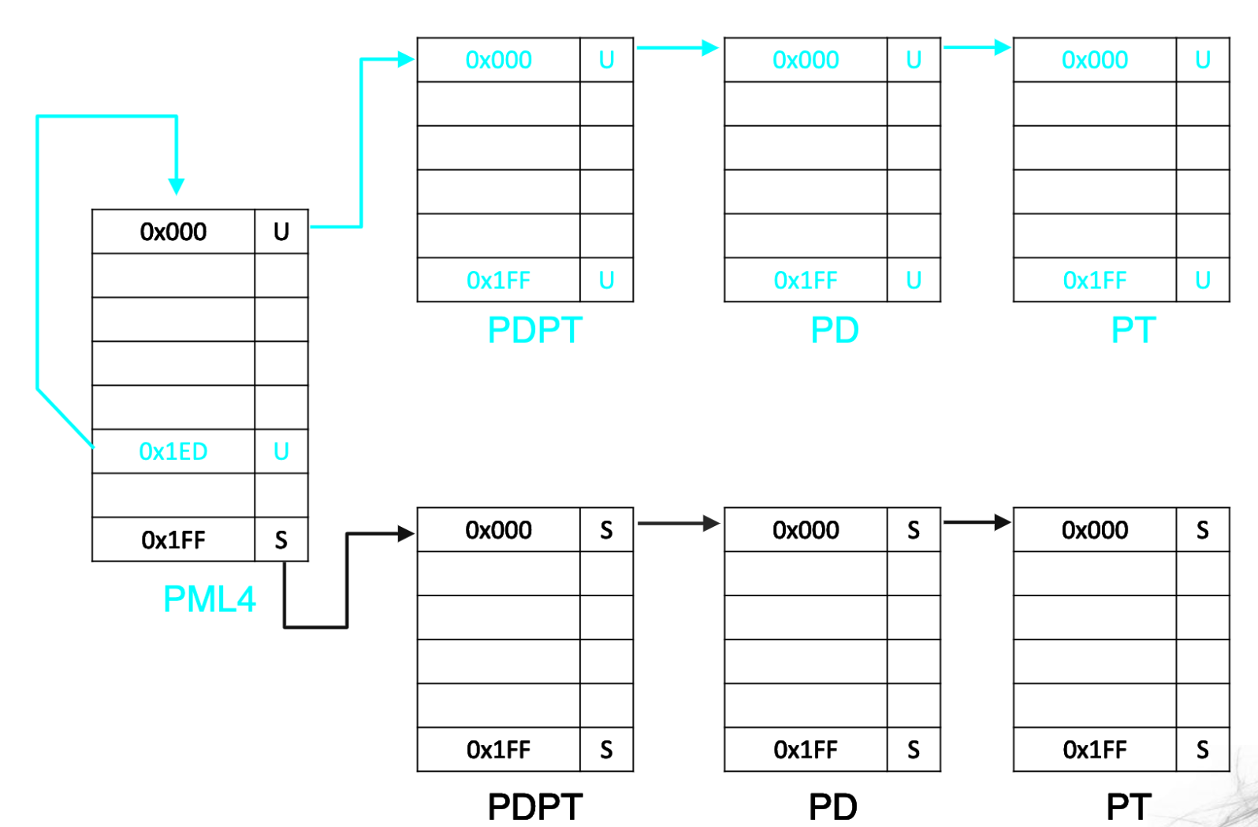
Self-Ref of Death
20

Slide 21
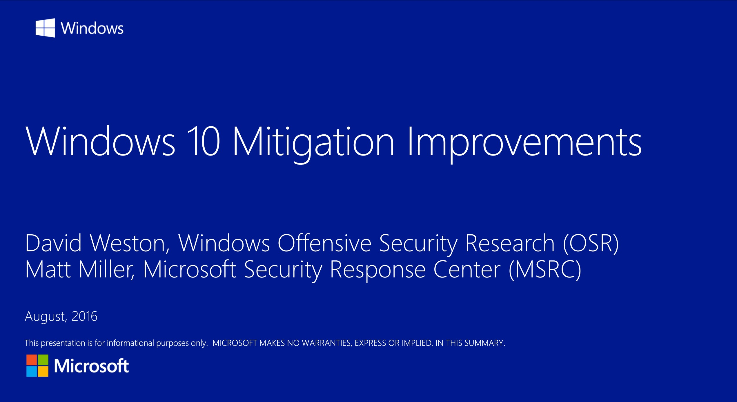
https://www.blackhat.com/docs/us-16/materials/us-16-Weston-Windows-10-Mitigation-Improvements.pdf
21

Slide 22
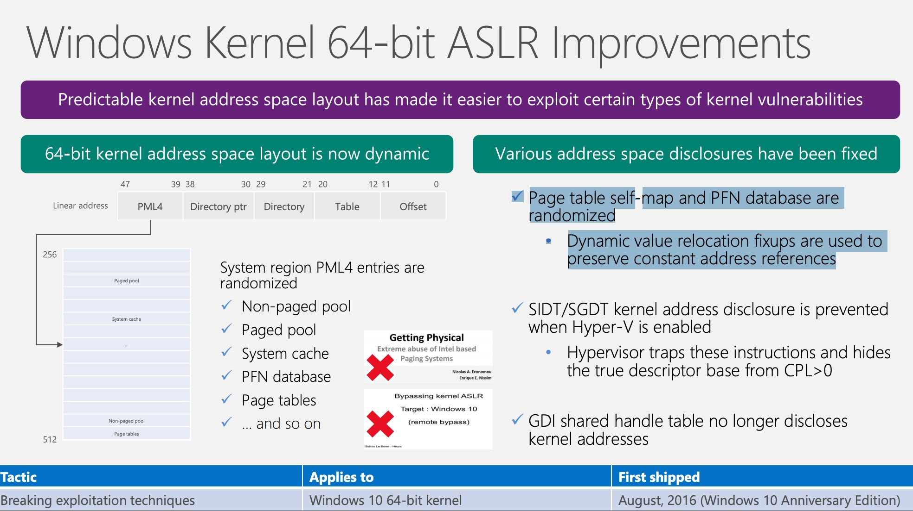
22

Slide 23

It was impressive, compared to other OSs !
23

Slide 24
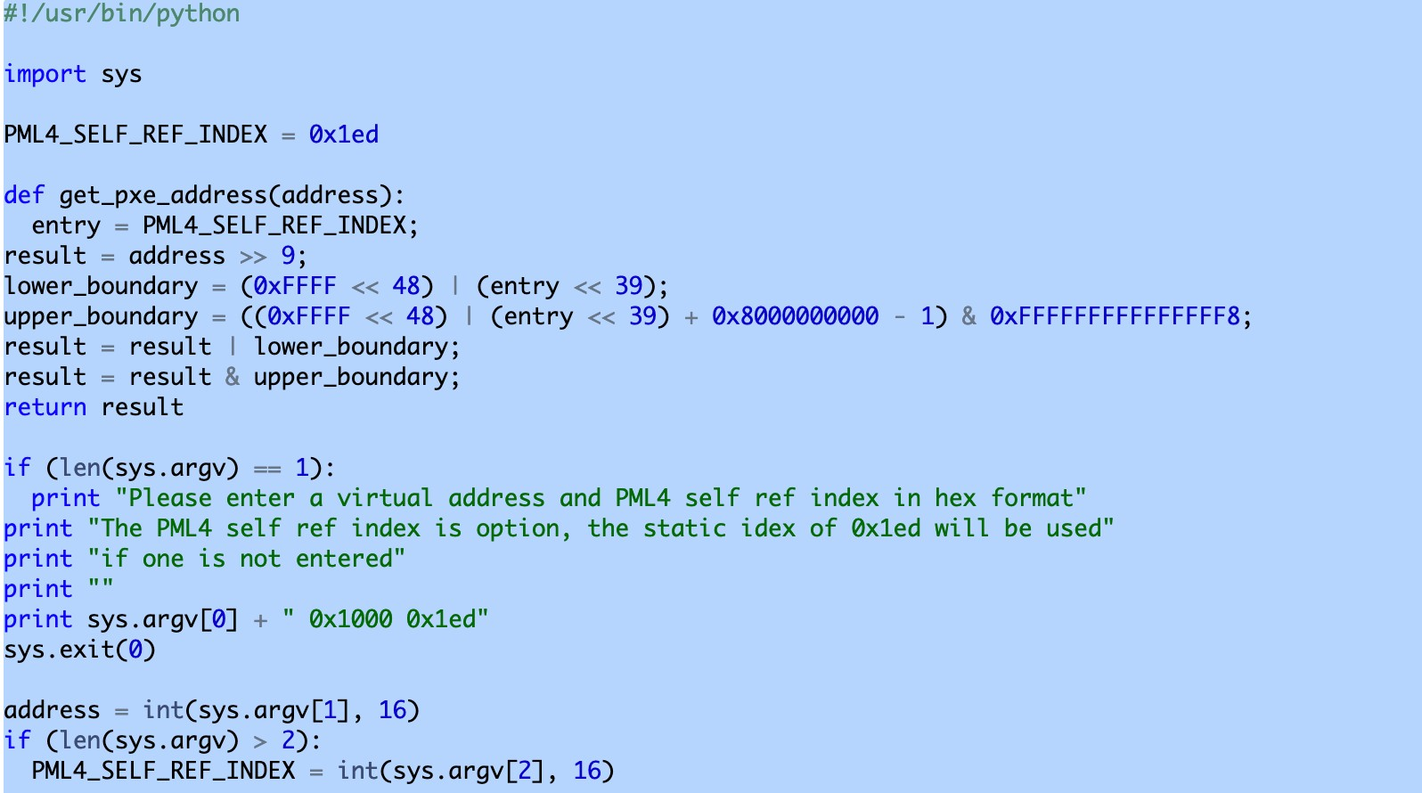
24

Slide 25
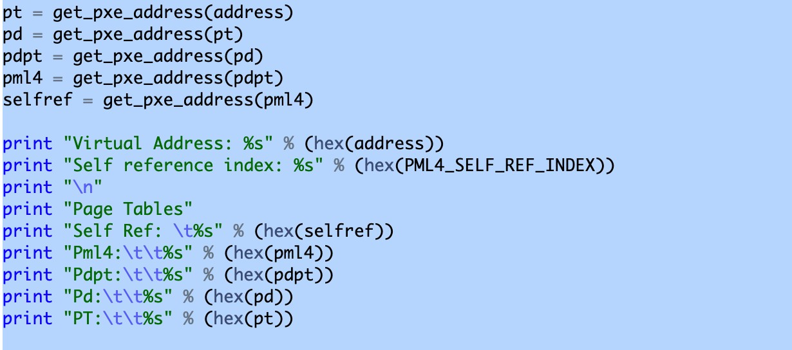
25

Slide 26
Demo Time !
It’s kinda heavy unsafe abuse…
26

Slide 27
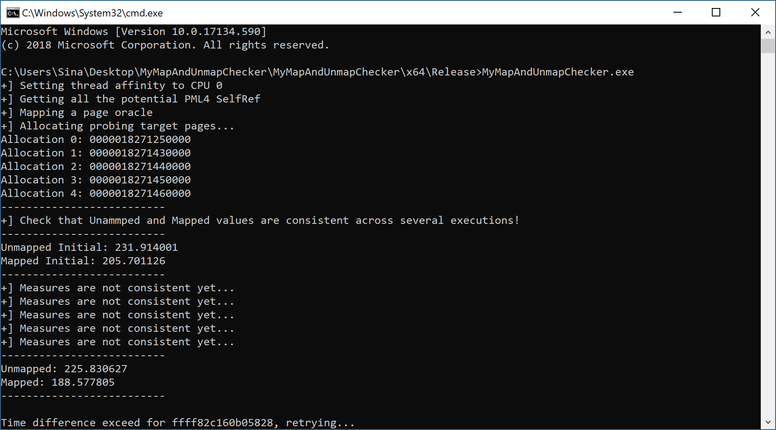
27

Slide 28
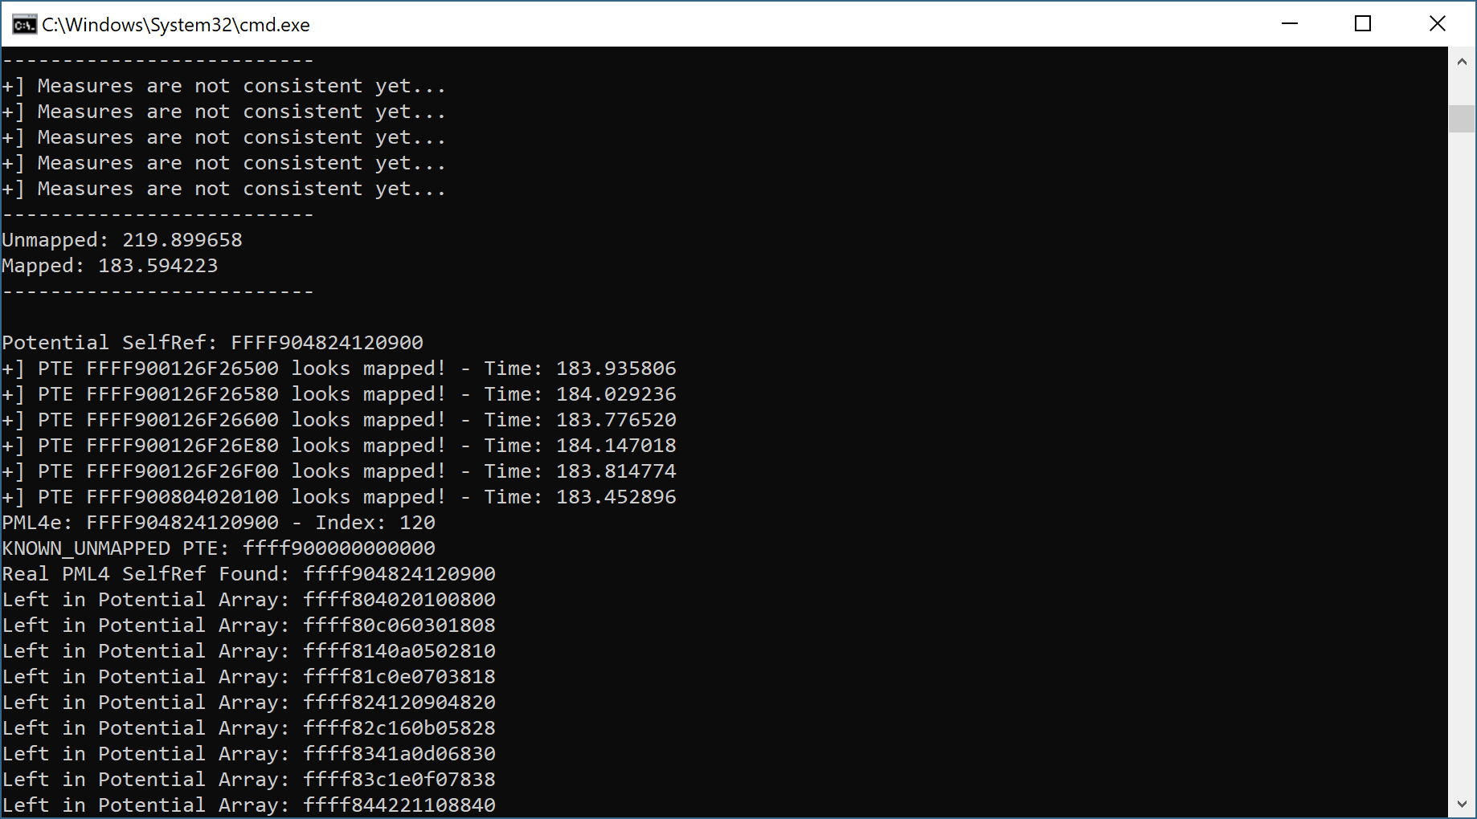
28

Slide 29
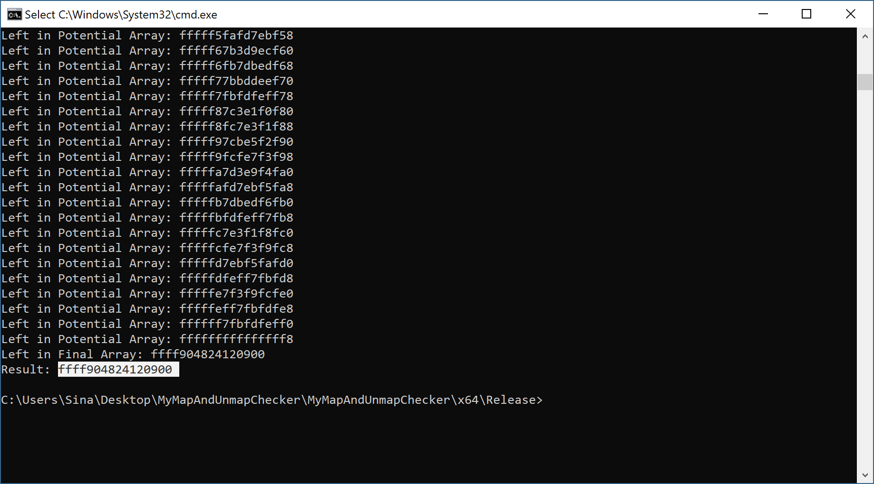
29

Slide 30
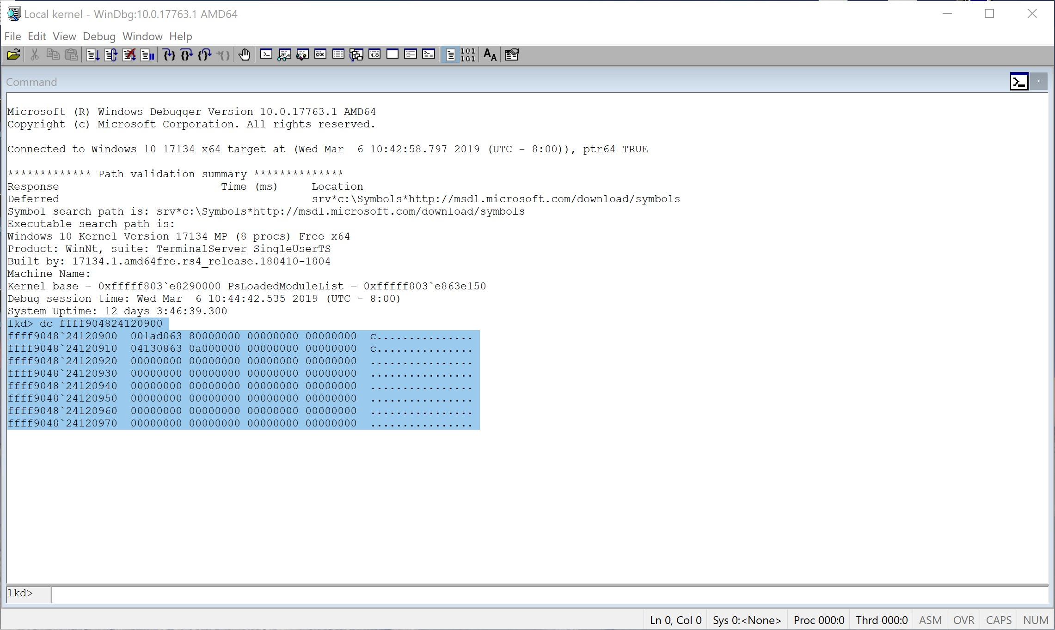
30

Slide 31
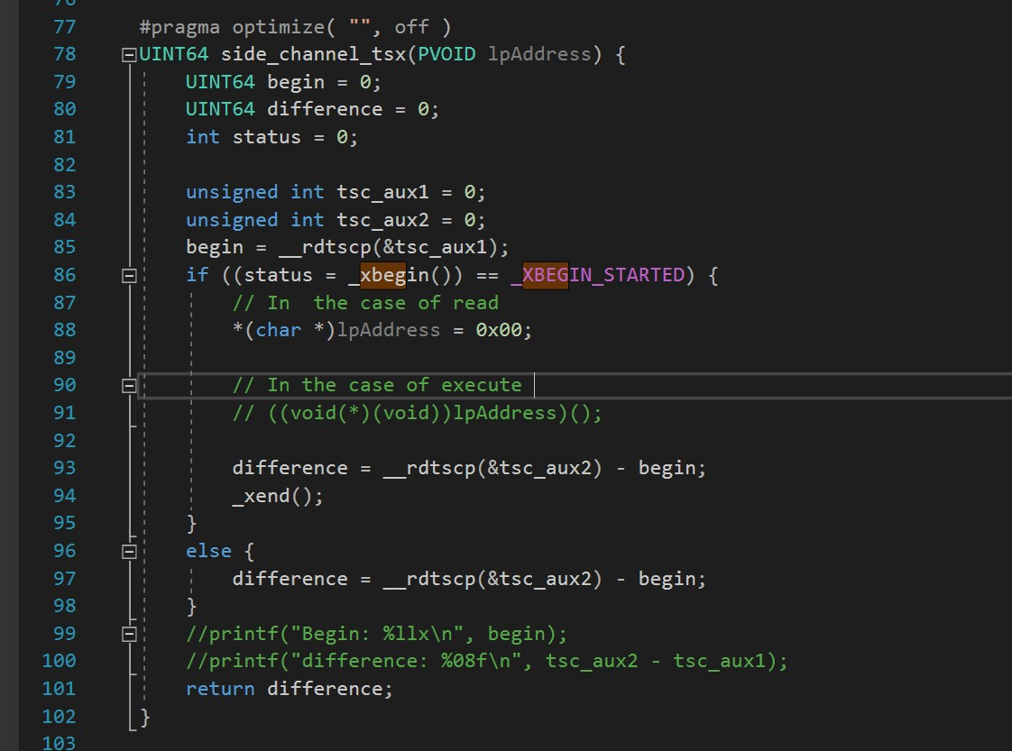
31

Slide 32
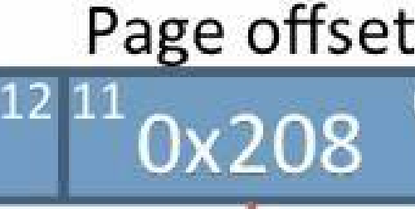



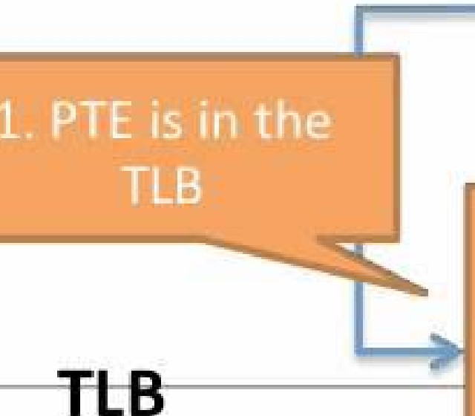
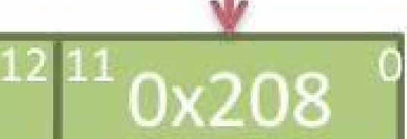
Examp e translation (TBL hit)
Virtual Address
Ox00003208
Virt ual page number
DISK
0x0003
0x08'04
0x0006
0x00¹08
0x0009
1 - - - - - - - - -
tag
physica page number
i}(:000031
0x0006
•••
0x00f6
Physical Address ₋₋₋₋₋₋₋₋₋₋
Phy5ical page number Page offset

Slide 33
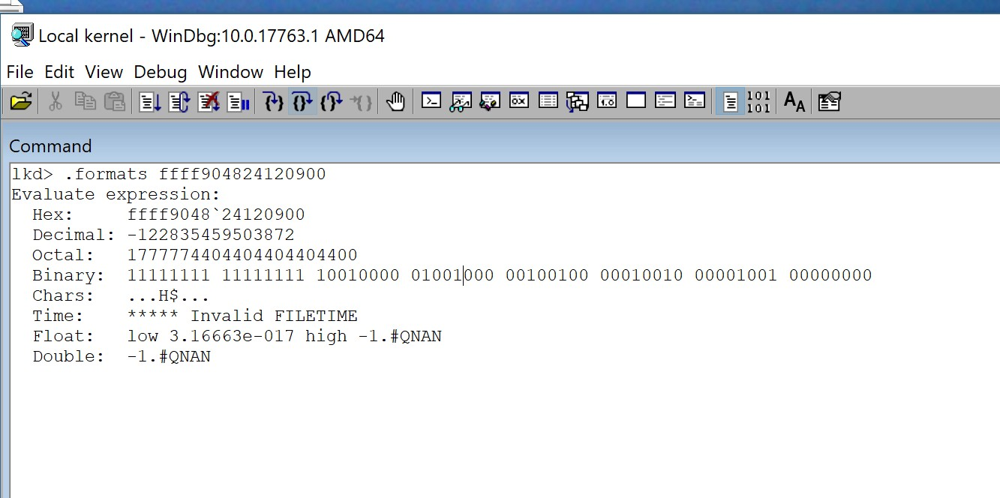

Slide 34
Hal!HalpInterruptController
For many years, the HAL's heap in Windows has always been located at the same static kernel address :
On 32-bit versions of Windows it was located at the address 0xﬀd00000
On 64-bit versions of Windows it could be found at the address 0xﬀﬀﬀﬀ'ﬀd00000.
No longer works ! :(

Slide 35
But we can still map, all the memories into our user-mode apps !
Currently it works on all Intel Processors Even the 9th generation

Slide 36
But, Do We Surrender ?!
Definitely No!

Slide 37
Mitigation

Slide 38
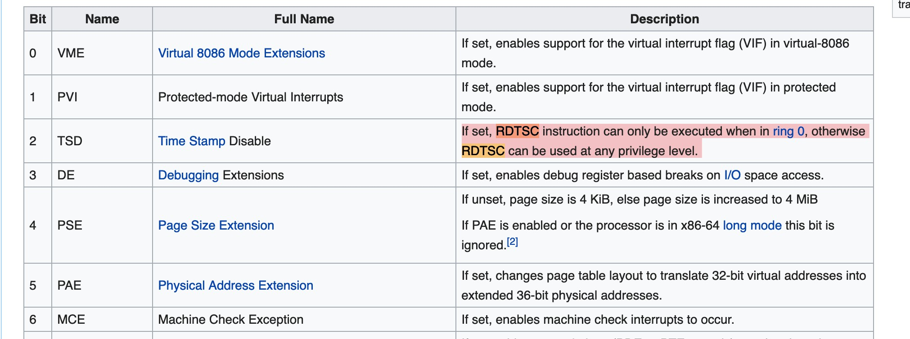
CR4.TSD

Slide 39
Not possible through modern OSs :
✴Heavy use of RDTSC and RDTSCP in user-mode applications as performance measuring Mechanism through Serialization and getting Current Clock Cycle.
✴ For instance CPUID + RDTSC , RDTSCP
✴Used internally for Windows for Thread synchronizations and user-mode timings.

Slide 40
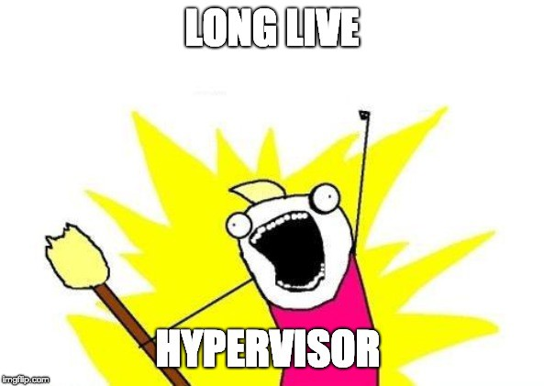

Slide 41
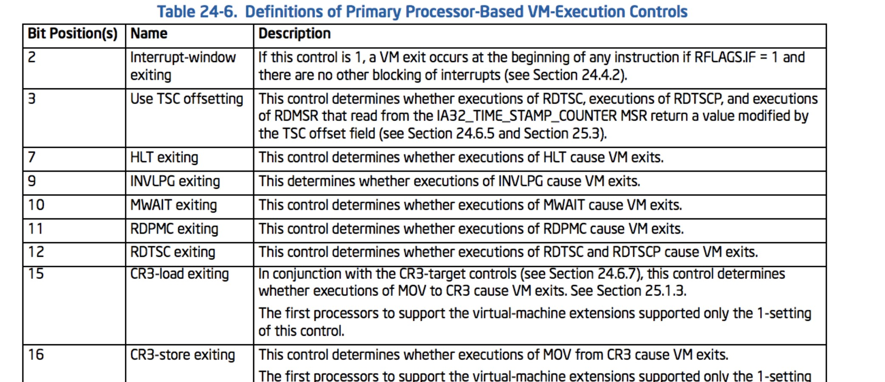

Slide 42
Hypervisor From Scratch
Hypervisor From Scratch – Part 1: Basic Concepts & Configure Testing Environment
Hypervisor From Scratch – Part 2: Entering VMX Operation
Hypervisor From Scratch – Part 3: Setting up Our First Virtual Machine
Hypervisor From Scratch – Part 4: Address Translation Using Extended Page Table (EPT)
Hypervisor From Scratch – Part 5: Setting up VMCS & Running Guest Code
Hypervisor From Scratch – Part 6: Virtualizing An Already Running System
Available at : https://rayanfam.com/tutorials/

Slide 43
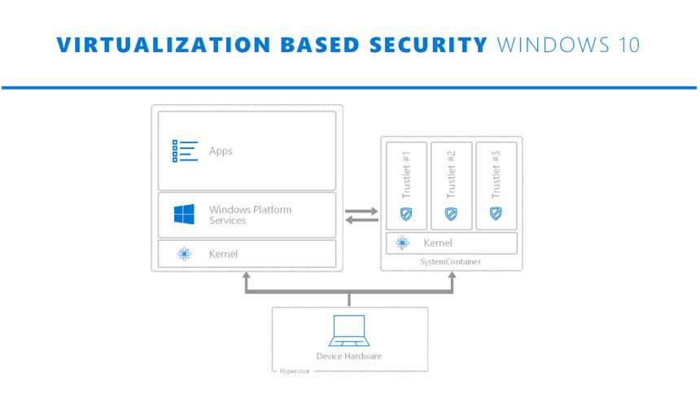

Slide 44
Why VBS can’t stop this kinds of attack ?

Slide 45
It’s because OSs internally use RDTSC and RDTSCP.
We can stop it because we don’t need user-mode timing !
We can modify RDTSC and RDTSCP ‘ s result to avoid error.
For this, we give user-mode apps clock time + 20 clk tolerance.

Slide 46
Disadvantages
Because both Kernel-Mode and User-Mode cause VM-Exits
so it makes our system much more slower !
Some applications may have undefined behaviours/

Slide 47
Questions ?
47

Slide 48
Thanks
48

