Slide 1
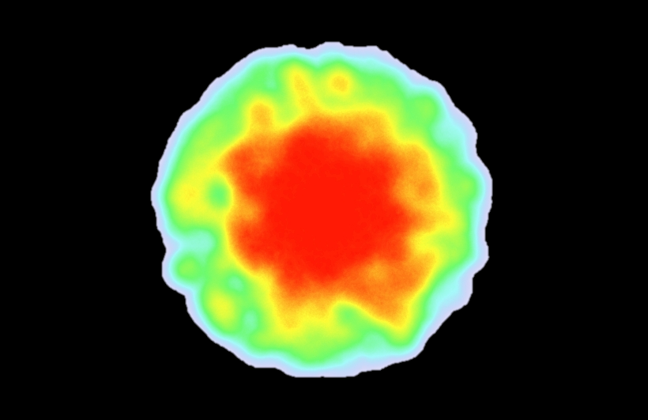

Most important area
Highest value
Lowest value
Least important area

Slide 2
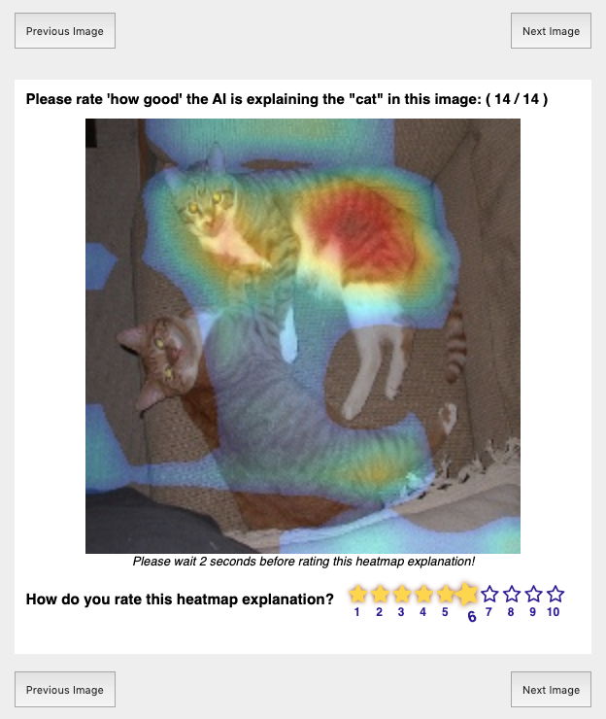
Heatmap shows the important regions the AI uses to detect ‘cat’
Your Rating on scale of 1 to 10

Slide 3

Click to navigate through your image set.
Consider the image for at least 2 seconds before rating!
Click to select a rating

Slide 4
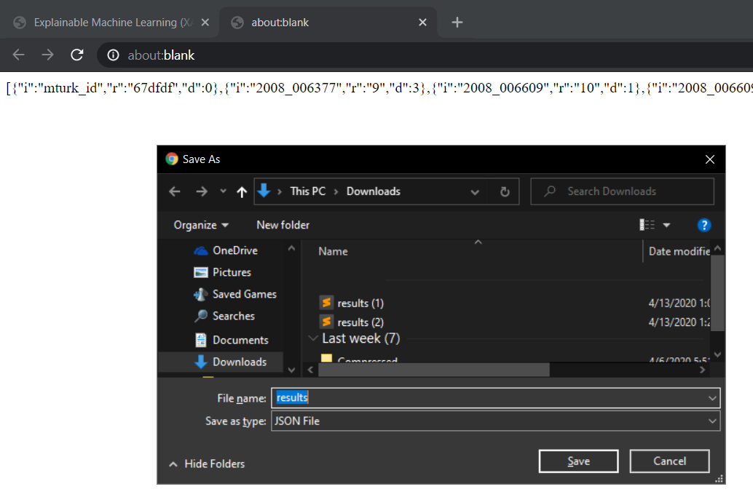
Copy the HIT code in the new tab.
Paste it in the AMT designated box to finish.

Slide 5
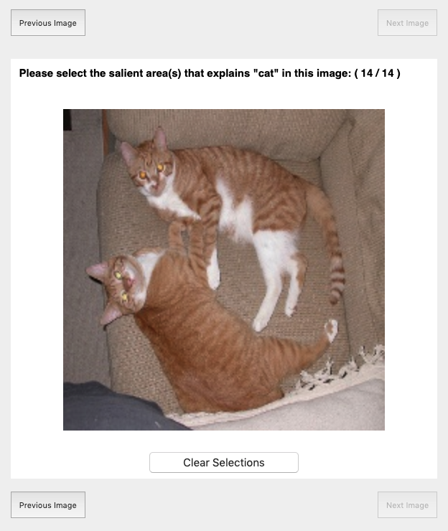
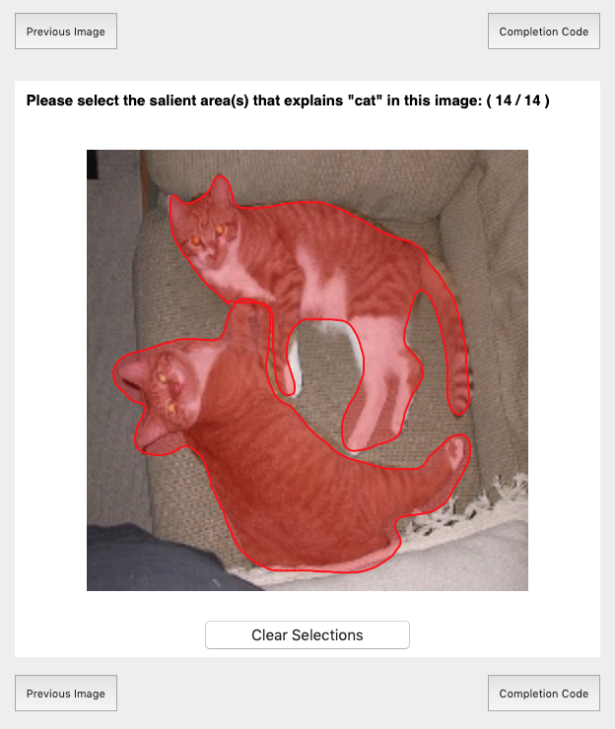
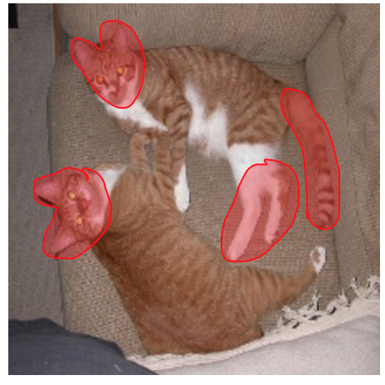
Select the best areas that describe pets in the image.
Could be like this
or like this
or any other way you think describes “pet”

Slide 6

Select all areas related to the specified pet
Right-click and drag your mouse to select areas that represent pets.
If you make a mistake, click clear selection to start fresh on this image.
Click to navigate through your image set.

Slide 7
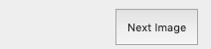
Click to see next image.
HIT progress.

Slide 8
Copy the HIT completion code printed in a new tab. Paste it in the AMT designated box to finish.

Slide 9
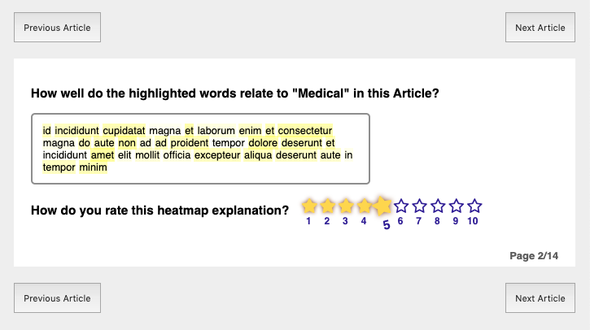
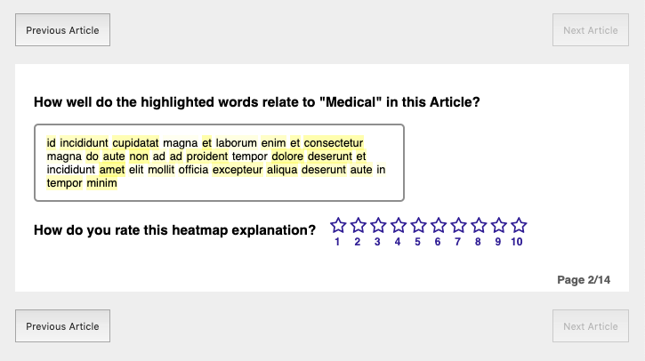
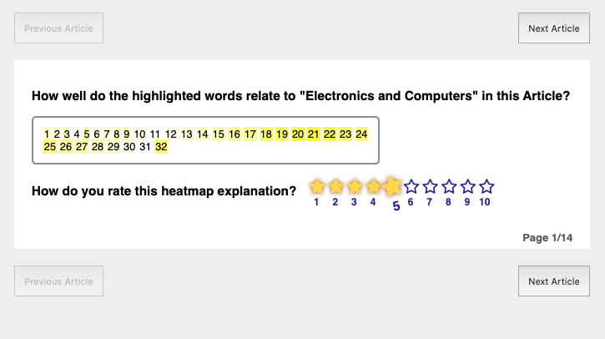
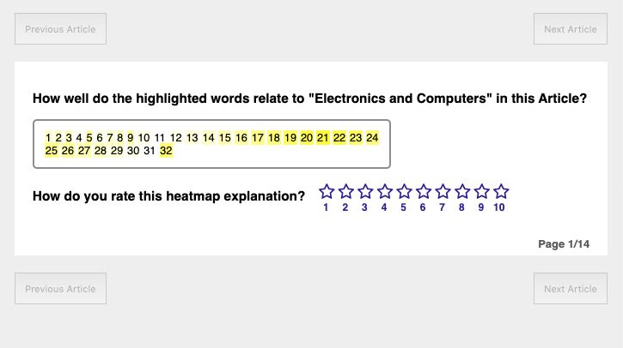
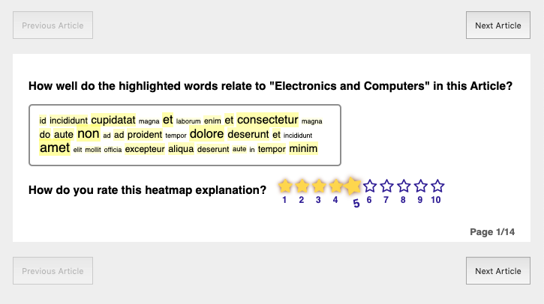
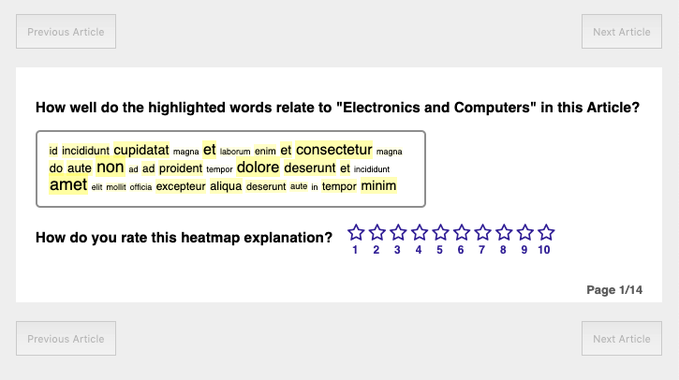
Highlights show the important words the AI uses to detect ‘electronics and computers’
Your Rating on scale of 1 to 10

Slide 10
Click to navigate through your articles.
Click to select a rating

Slide 11


Slide 12
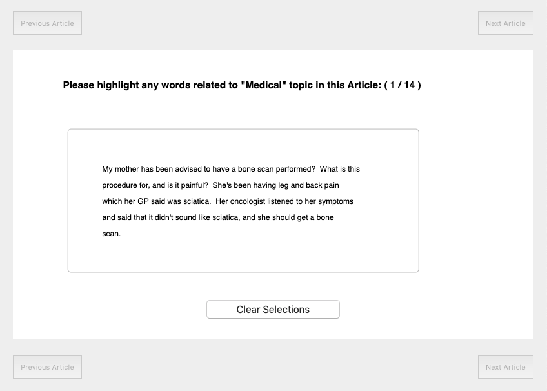
Select the best words that describe the topic:

Slide 13
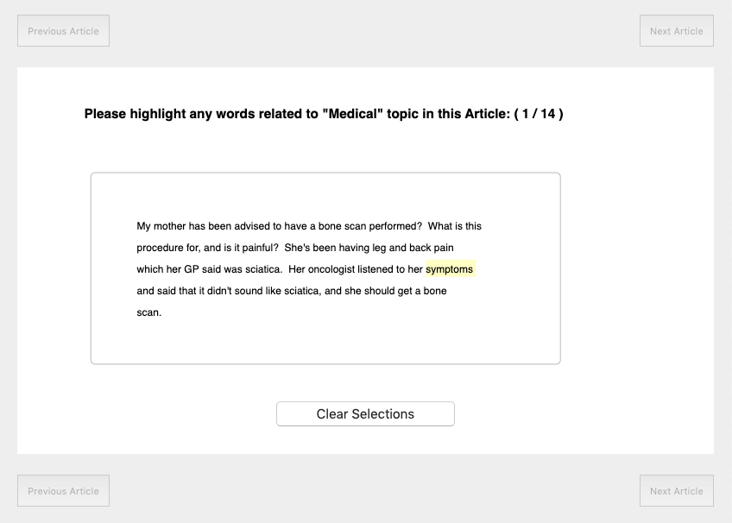
Select the best words that describe the topic:

Slide 14
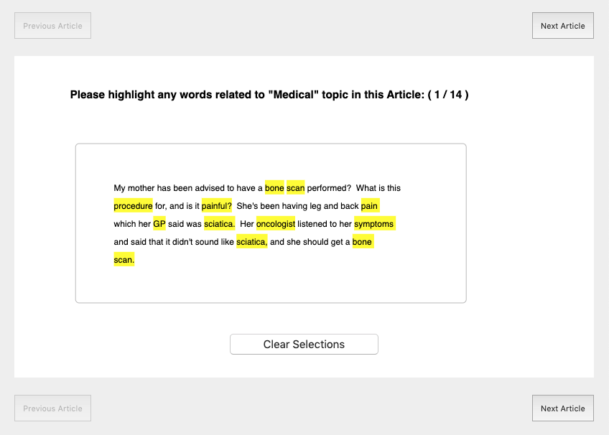
Click to Select words
If you make a mistake, click clear selections to start fresh on this article.
Click to navigate through your articles.

