Slide 1
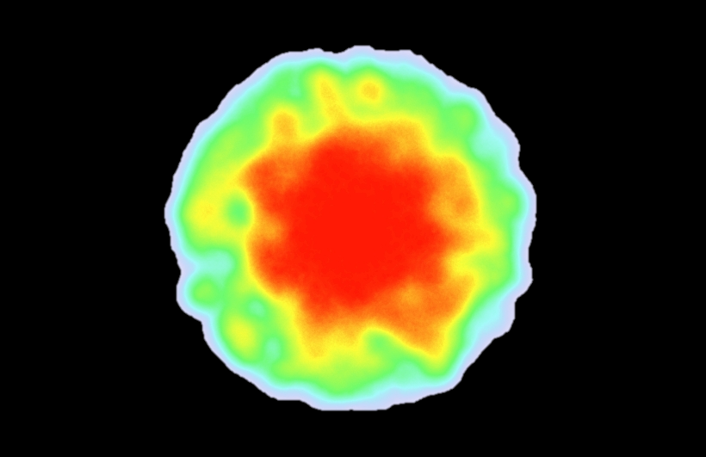

Most important area
Highest value
Lowest value
Least important area

Slide 2
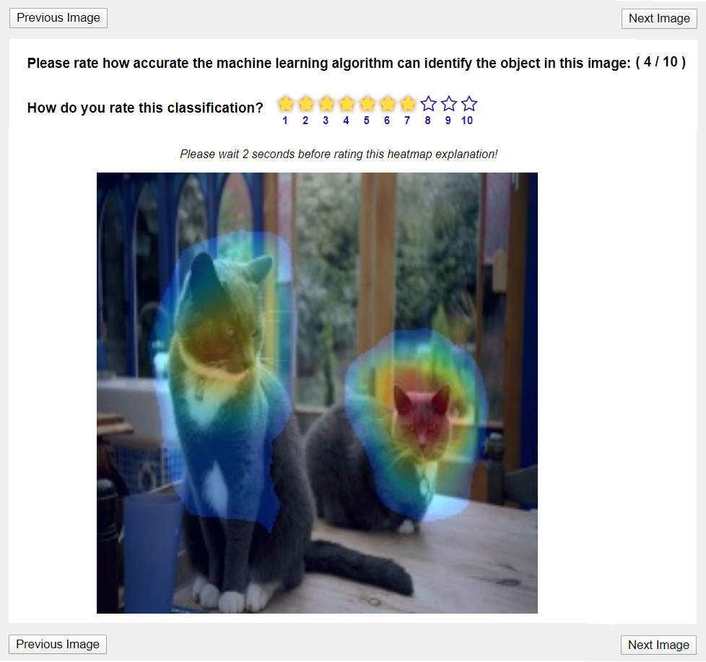
Rating on scale of 1 to 10
Highlight area shows how important were these regions for AI to detect pets.

Slide 3
Click to rate next image.
HIT progress.
Wait 2 seconds before rating!

Slide 4
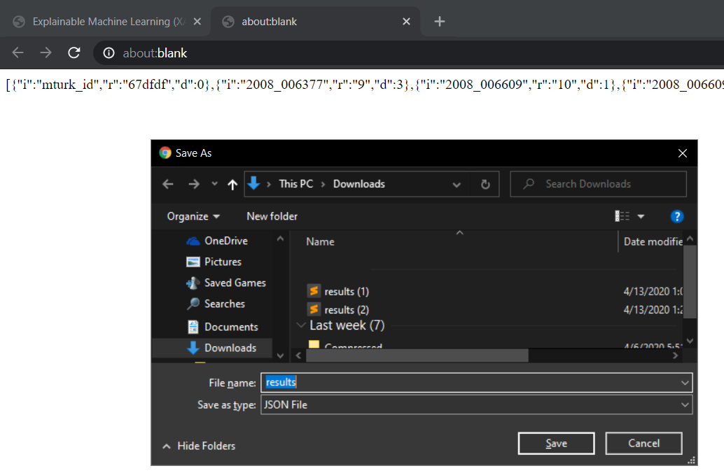
Option 1: Copy the HIT code in the new tab. Paste it in the AMT designated box to finish.
Option 2: Download the code and then copy it.

Slide 5
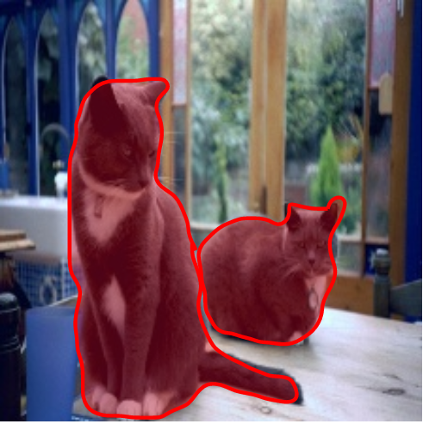
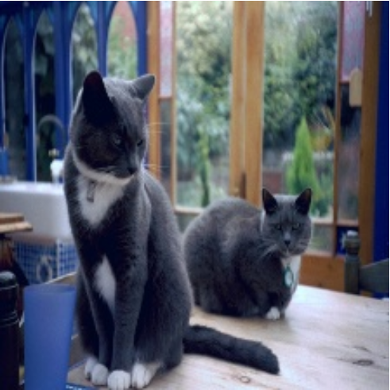
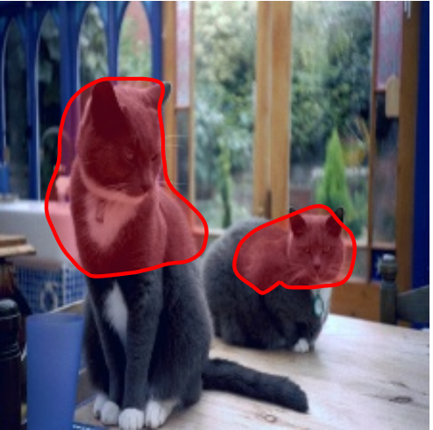
Select the salient areas that is mostly explaining pets in the image in your opinion.
This way
or this way
or any other salient region that you find

Slide 6
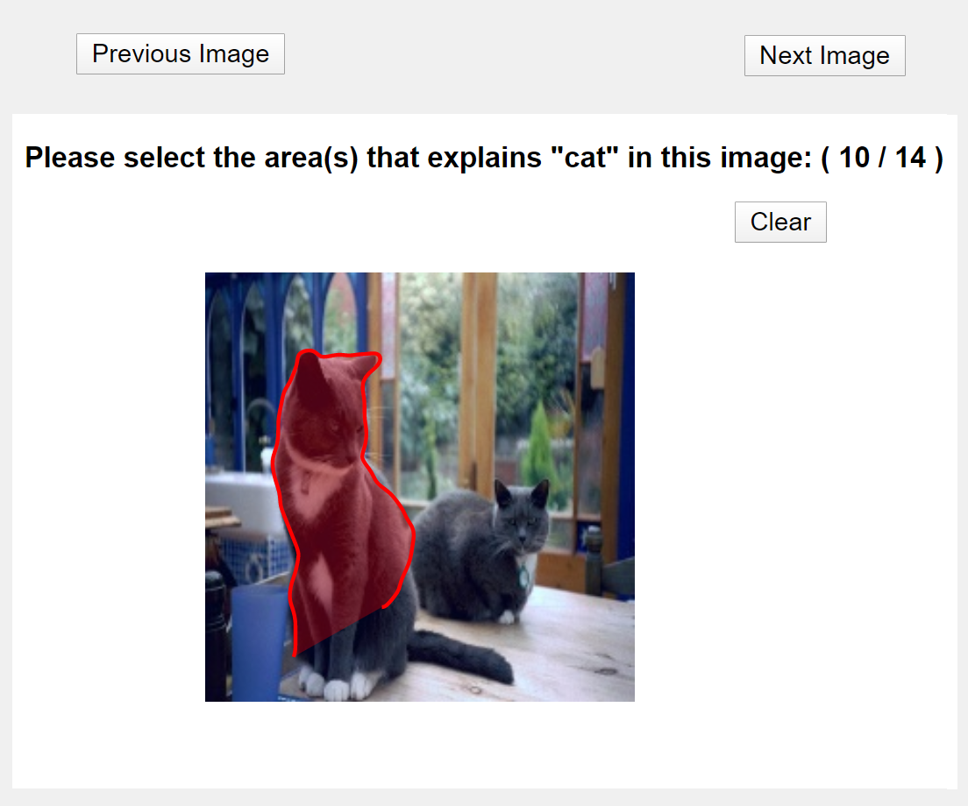
User mouse to draw around pets

Slide 7
Click to rate next image.
HIT progress.

Slide 8
The HIT completion code will be printed in a new tab. Paste it in the AMT designated box to finish.

