Slide 1
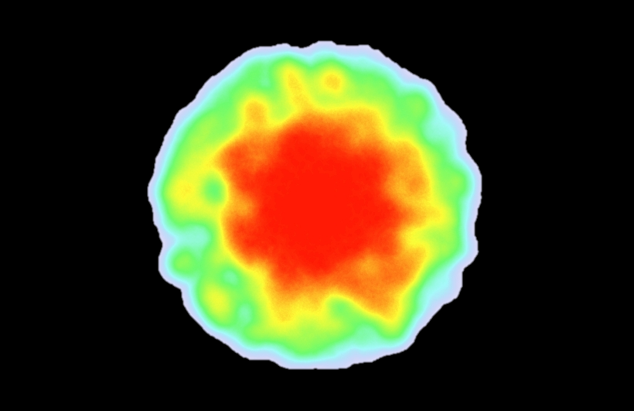

Most important area
Highest value
Lowest value
Least important area

Slide 2
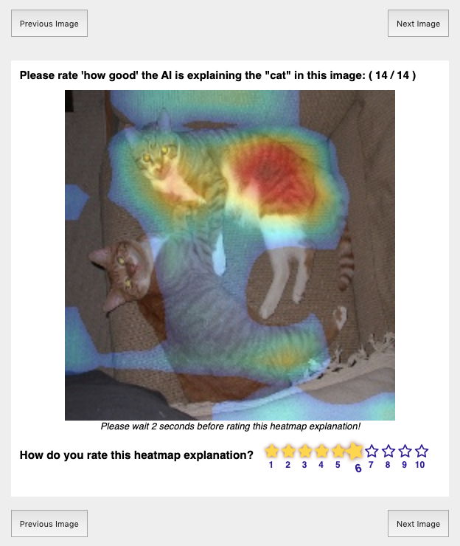
Heatmap shows the important regions the AI uses to detect ‘cat’
Your Rating on scale of 1 to 10

Slide 3

Click to navigate through your image set.
Consider the image for at least 2 seconds before rating!
Click to select a rating

Slide 4
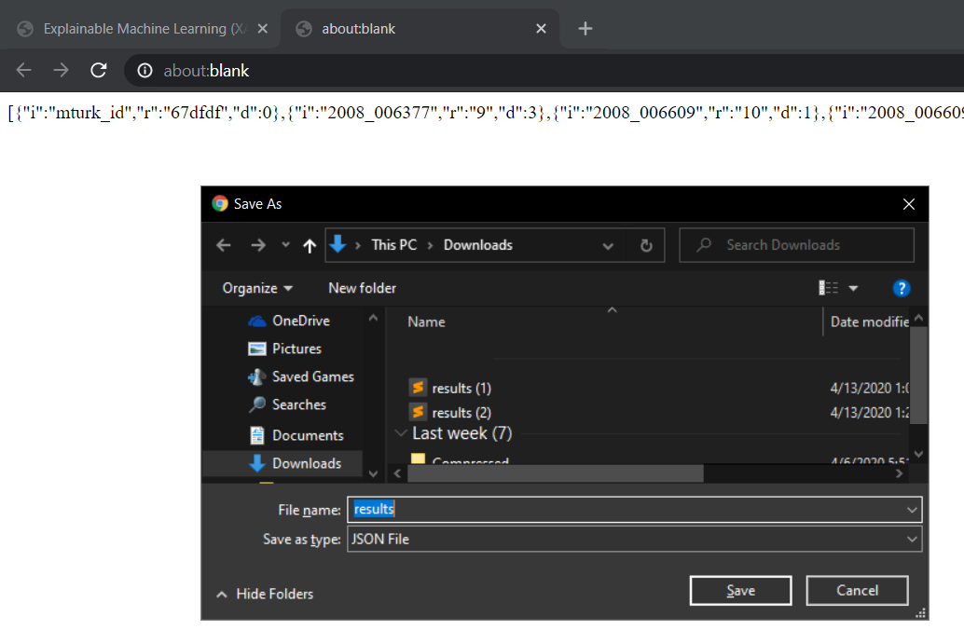
Copy the HIT code in the new tab.
Paste it in the AMT designated box to finish.

Slide 5
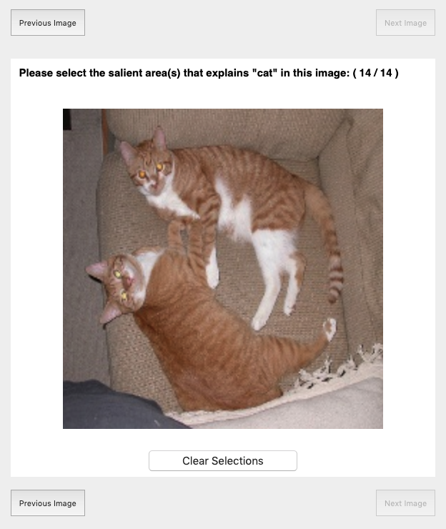
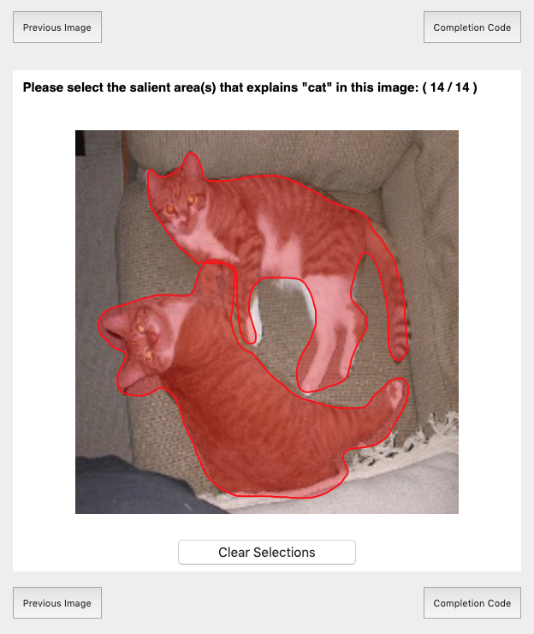
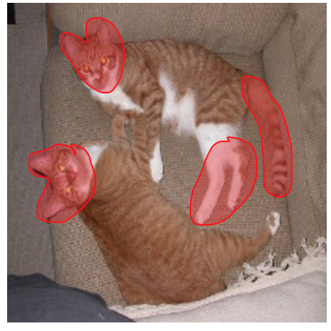
Select the best areas that describe pets in the image.
Could be like this
or like this
or any other way you think describes “pet”

Slide 6

Select all areas related to the specified pet
Right-click and drag your mouse to select areas that represent pets.
If you make a mistake, click clear selection to start fresh on this image.
Click to navigate through your image set.

Slide 7
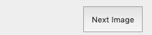
Click to see next image.
HIT progress.

Slide 8
Copy the HIT completion code printed in a new tab. Paste it in the AMT designated box to finish.

Slide 9
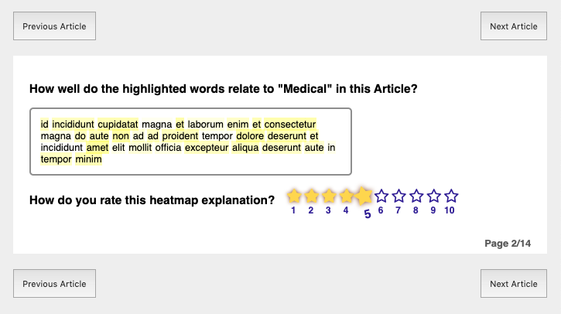
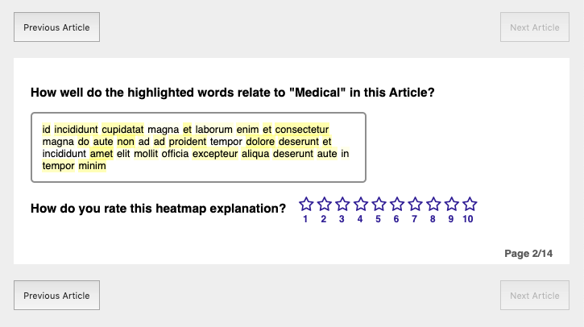
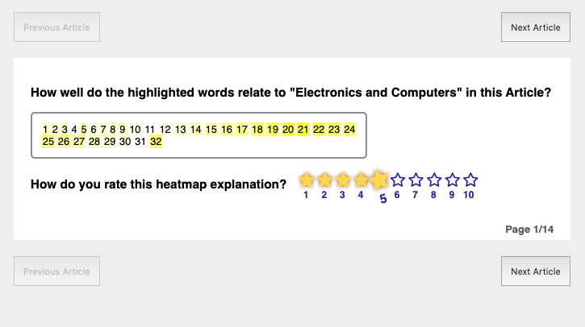
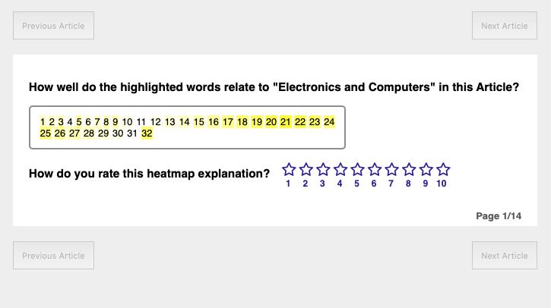
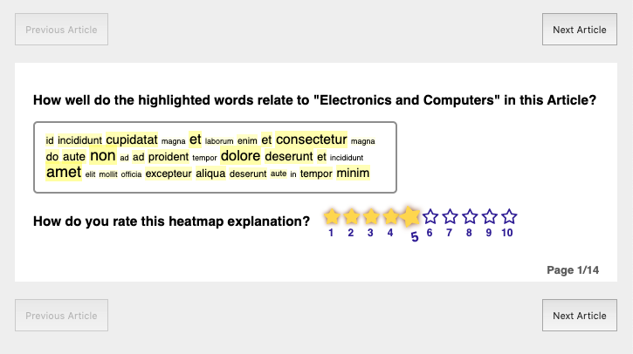
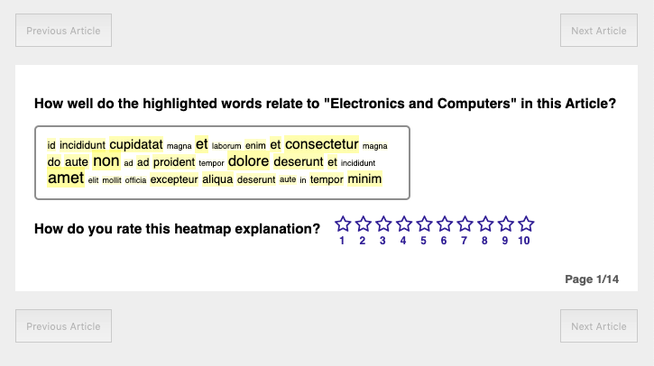

Highlights show the important words the AI uses to detect ‘electronics and computers’ topic
Highest importance
What do colors mean?
Lowest importance

Slide 10
Click to navigate through your articles.
Click to select a rating
Your Rating on scale of 1 to 10 1: Worst explanation 10: Best explanation

Slide 11


Slide 12
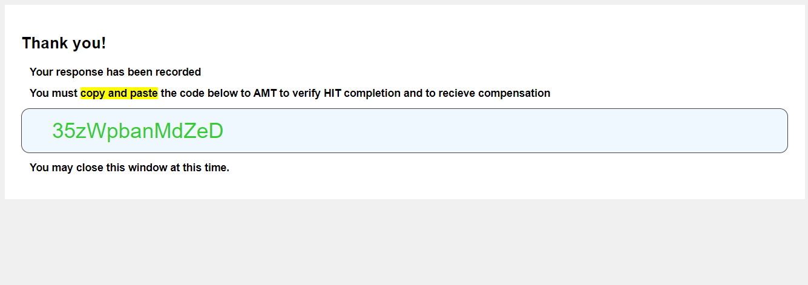

Slide 13
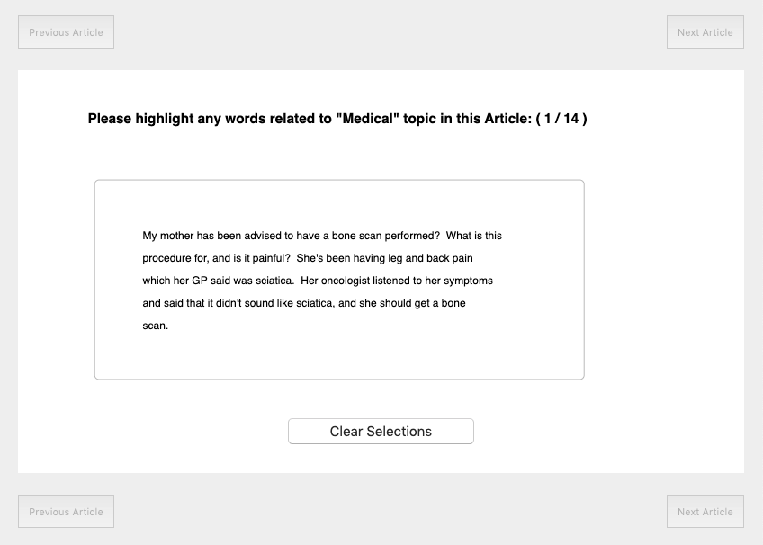
Select the best words that describe the topic:

Slide 14
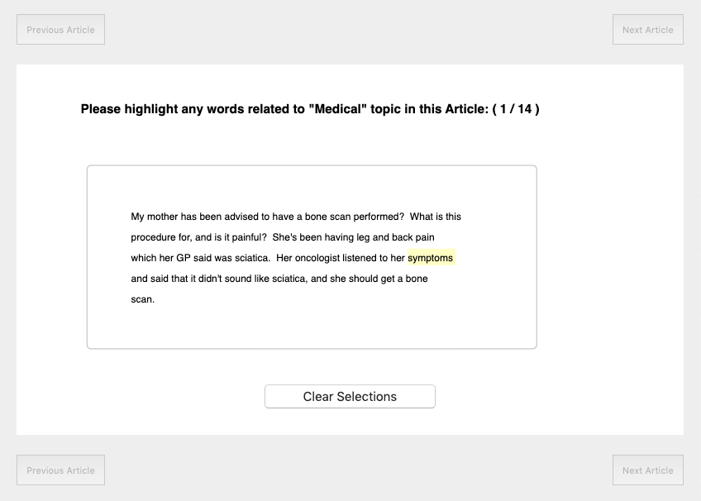
Select the best words that describe the topic:

Slide 15
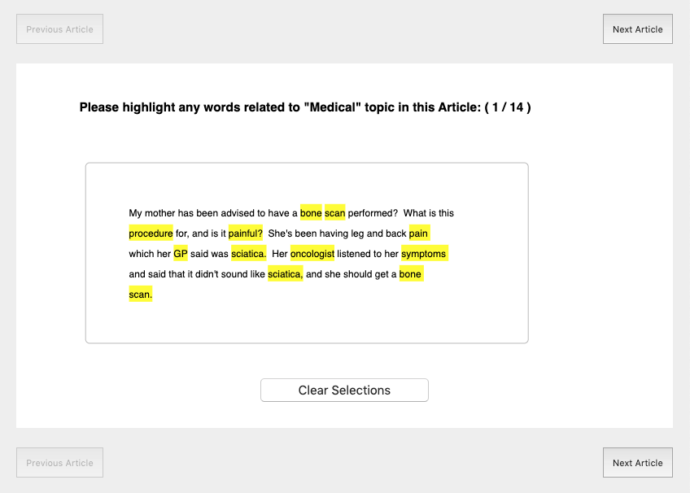
Click to Select words
If you make a mistake, click clear selections to start fresh on this article.
Click to navigate through your articles.

