Slide 1
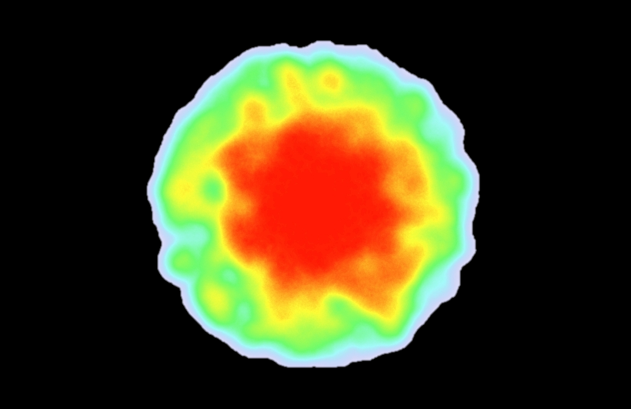

Most important area
Highest value
Lowest value
Least important area

Slide 2
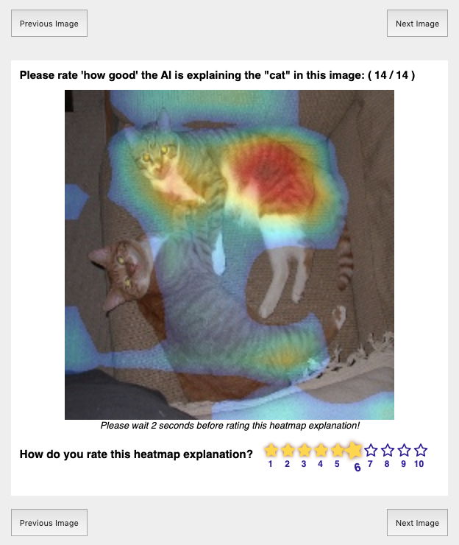
Heatmap shows the important regions the AI uses to detect pets.
Your Rating on scale of 1 to 10

Slide 3
Click to rate next image.
HIT progress.
Wait 2 seconds before rating!

Slide 4
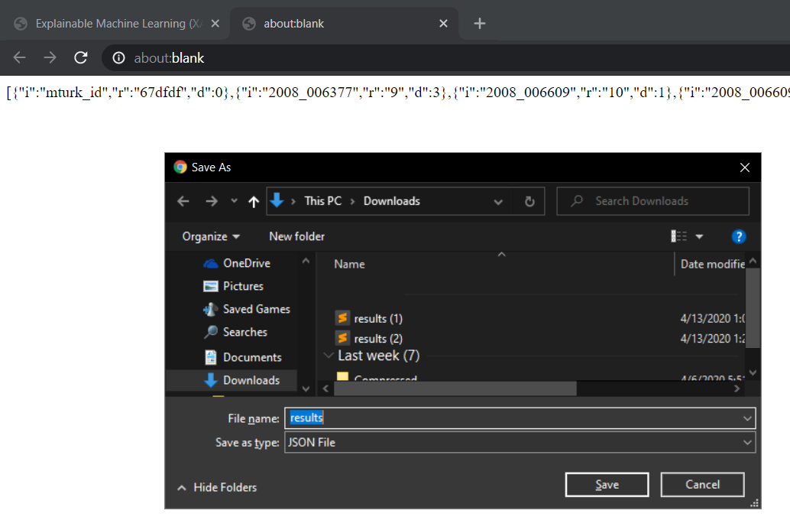
Copy the HIT code in the new tab.
Paste it in the AMT designated box to finish.

Slide 5
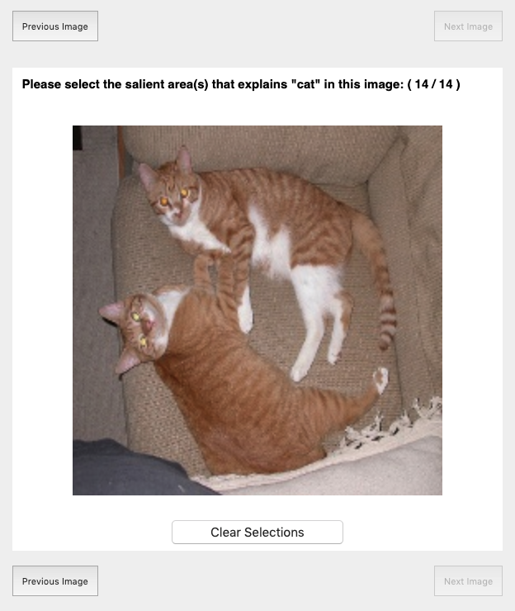
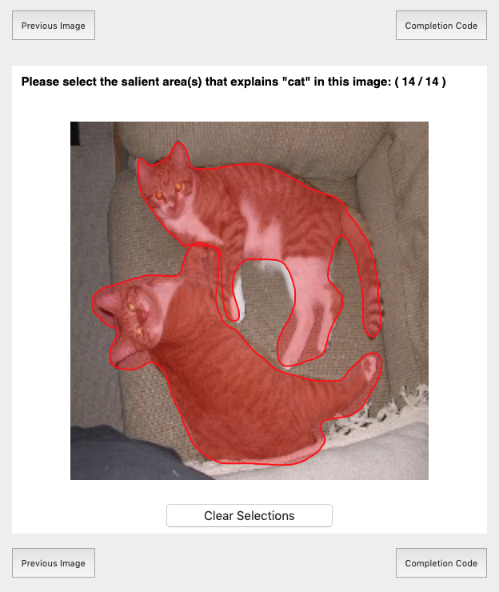
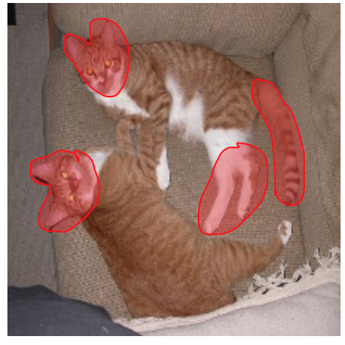
In your opinion, select the best areas that describe pets in the image.
Could be like this
or like this
or any other way you think describes “pet”

Slide 6

Select the specified pet
Use your mouse to draw around pets

Slide 7
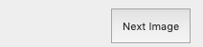
Click to rate next image.
HIT progress.

Slide 8
Copy the HIT completion code printed in a new tab. Paste it in the AMT designated box to finish.

