Slide 1

Data mining vs statistical learning vs Machine learning
. Dr.Rezaii Tabar
. Dorsa Maleki
. Sina Molla Ebrahimi

Slide 2
Data mining
Introduction
Data mining, an essential and important step in knowledge discovery in databases, is used to discover useful unknown patterns from large repository of data.
Data mining consists of various functionalities, techniques and algorithms that are being used to discover and extract interesting patterns from the large repository of data.
Due to the importance in decision making, in the last two decades, data mining got a wide focus and has become an essential tool in performing variety of operations of the organizations.
Data mining is a step in the knowledge discovery in databases process consisting of applying data analysis and discovery algorithms that, under accept-able computational efficiency limitations, produce a particular enumeration of patterns over the data…
Many techniques from other domains such as statistics, database/data warehouse systems, machine learning, algorithms, pattern recognition, visualization, information retrieval , high-performance computing, etc. Incorporated in data mining. First three techniques are the primary contributors of data mining.

Slide 3
Data mining
Trends in data mining research
Data mining functions
Data mining techniques
Data mining algorithms
Data mining applications
Data mining domains

Slide 4
Data mining
Data mining tasks (or functions)
Summarization
Characterization and discrimination
Classification
Clustering
Association analysis
Outlier analysis
Regression and trend analysis

Slide 5
Data mining
Summarization
Summarization results into a smaller set and presents a summary of the detailed data based on concept hierarchy. Usually, summarization is performed using aggregation which can be extended to different levels of abstraction and can be viewed from diverse angles. Various kinds of patterns can be extracted based on combinations of various levels of abstractions and different dimensions . Data summarization is usually accomplished using attributed-oriented induction approach and data cube approach. Data cube approach (also referred to as ‘multidimensional databases’, ‘materialized views’)
materializes frequently queried expensive computations which involve group functions and then store the result as materialized views in a MDDB for decision support and knowledge discovery.
The attribute-oriented induction approach collects the related data in a database with the help of SQL-like DMQL and then a set of data generalization techniques are applied for data generalization.

Slide 6
Data mining
Characterization and discrimination
Classification
Characterization is basically summarization of data based concept hierarchy and generate es characterization rules. On the other side, discrimination is used for identifying the varieties among various data sets. The output of the discrimination is generated in the form of discriminant rules.
Classification is the process to classify new observation based on the predetermined classes, i.e. supervised learning. A classification algorithm is used to forecast classes of the data. A large collection of classification algorithms(or classifiers) have been proposed by the research hers so far.
The classifiers based on genetic algorithms, rough set approach, fuzzy sets, semi-supervised learning and active learning have been also proposed by some researchers .

Slide 7
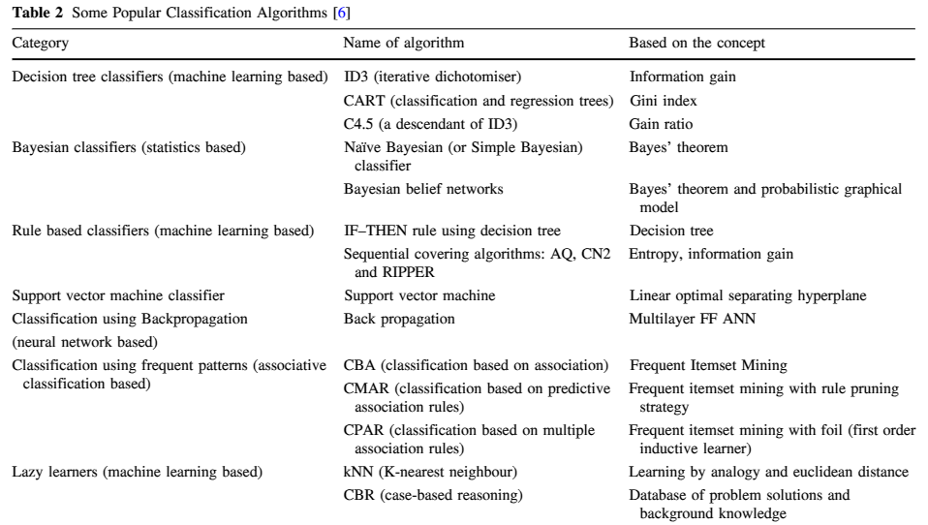
Data mining

Slide 8
Data mining
Clustering
Clustering is used for partitioning or segmenting data objects (or observations) into subsets called as groups or clusters. The objects that are closed to each other are positioned in same group. Like classification, clustering classifies the similar data objects but unlike classification, the class labels are unknown (i.e. unsupervised learning). Cluster analysis is one of the most popular techniques which is not only used in data mining but also used in other domains such as statistics, segmentation, pattern recognition, Object recognition, information retrieval,bioinformatics, etc.
A large collection of clustering algorithms has been suggested by many researchers in the last two decades.. The clustering algorithms based on probabilistic model, fuzzy sets, expectation–maximization, correlation using PCA, graph have been also proposed by some researchers .

Slide 9
Data mining
Outlier analysis
Data objects that differ in general behavior of the data are called as outliers. The outliers are generally discarded by most of data mining methods as noise or exceptions. Sometimes, outliers may have more information in comparison to other data objects. Therefore outlier analysis is important for some application areas such as intrusion detection, fraud detection, anomaly detection, etc.
Many data mining techniques generally use clustering to detect the outliers as a noise. The outlier detection methods can be classified as classification-based methods, statistical methods, clustering-based methods, supervised, semi-supervised and unsupervised methods, deviation-based methods and proximity-based methods.
Angiulli and Fassetti stated that the background knowledge (or domain knowledge) can be used to detect the outliers easily . They proposed the solution as unsupervised but it can have relationship with supervised learning. Gradient outlier factor is investigated in Angiulliand Fassetti for generalization and unification of statistical outliers. Campello et al. presented a framework for density-based outlier detection. Two new algorithmsinc-iVAT and dec-iVAT based on visual

Slide 10
Data mining
Association analysis
Association analysis discovers associations (or links)among datasets and identifies data objects that can be realized collectively satisfying a minimum support and confidence thresholds. Identification of all frequent item sets followed by generation of strong association rules is accomplished in association mining .
Association analysis includes mining frequent item sets, subsequences and substructures . Market-basket analysis is mainly using the association analysis. Apriori algorithm is widely used for association algorithms .
Association analysis algorithms can be classified into classical algorithms, condensed representation algorithms, and incomplete set algorithms .

Slide 11
Data mining
Regression and trend analysis
Regression predicts the value of attribute based on regression technique(s) over time. The future values of variables are predicted with the help of historical timeseries plot .
Trend analysis (also called as evolution analysis) dis-covers interesting patterns in the evolution history of the objects. Identification of patterns in an object’s evolution and matching of the objects’ changing trends are the two major aspects of trend analysis .
Trends of the objects, whose behavior evolves over time, can be described using trend analysis and regression models. Trend analysis exposes time-varying trends of the data objects within the dataset. The association analysis can also be used for evolution analysis .

Slide 12
Data mining
Data mining techniques
Statistical approaches
Machine learning
Neural network
Database systems and data warehouses
Genetic algorithms
Fuzzy sets
Visualization

Slide 13
Statistical learning
Statistical learning is a field within statistics and machine learning that focuses on understanding data and making predictions. Here are some key concepts:
Supervised Learning: This involves training a model on labeled data, where the outcome is known. Common algorithms include linear regression, logistic regression, and support vector machines.
2. Unsupervised Learning: This involves training a model on data without labeled outcomes. Common algorithms include clustering (like K-means) and dimensionality reduction (like PCA).
3. Regression: A type of supervised learning used to predict continuous outcomes, such as predicting a house price based on its features

Slide 14
Statistical learning
4.Classification: Another type of supervised learning used to predict categorical outcomes, such as determining whether an email is spam or not.
5. Overfitting and Underfitting: Overfitting occurs when a model is too complex and captures noise in the data. Underfitting occurs when a model is too simple and misses important patterns in the data.
6.Regularization: Techniques like Lasso and Ridge Regression that are used to prevent overfitting by adding a penalty for larger coefficients in the model.
7.Cross-Validation: A technique used to assess how a model will generalize to an independent dataset by splitting the data into training and testing subsets.
8. Bias-Variance Tradeoff: This concept involves balancing the model's ability to fit the data well (low bias) with its ability to generalize to new data (low variance).
9. Feature Selection: The process of identifying the most important variables to include in the model.
10. Ensemble Methods: Techniques like bagging (e.g., Random Forests) and boosting (e.g., Gradient Boosting Machines) that combine multiple models to improve performance.

Slide 15
Statistical learning
Example: Predicting House Prices
Problem Statement
You want to predict the selling price of houses based on various features such as the size of the house, the number of bedrooms, the number of bathrooms, the location, and the age of the house.
Steps in Statistical Learning
Data Collection: Gather data on houses that have been sold recently, including all the features mentioned above.
Data Preprocessing:
Handle missing values.
Convert categorical variables (e.g., location) into numerical values using techniques like one-hot encoding.
Normalize or standardize the numerical features.
3.Splitting the Data: Split the data into training and testing sets. Typically, 70-80% of the data is used for training, and the remaining 20-30% is used for testing.
4.Model Selection: Choose a suitable algorithm for predicting house prices. Linear regression is a good starting point for regression problems.
5.Training the Model: Use the training data to train the linear regression model. The model will learn the relationship between the features and the selling price.
6.Evaluating the Model: Test the model on the testing data to evaluate its performance. Common evaluation metrics for regression problems include Mean Absolute Error (MAE), Mean Squared Error (MSE), and R-squared.
7. Making Predictions: Once satisfied with the model's performance, use it to predict the selling prices of new houses.

Slide 16
Machine learning
Machine learning (ML) is a branch of artificial intelligence (AI) that enables computers to learn from data without explicit programming. Here's a breakdown of key ML concepts:
Core Concepts:
Algorithms:
These are sets of rules or instructions that computers follow to learn from data.
Different algorithms are suited for different types of tasks and data.
Data:
The fuel of machine learning. ML models learn patterns and relationships from data.
Data can be labeled (for supervised learning) or unlabeled (for unsupervised learning).
Models:
A model is the output of a machine learning algorithm. It represents the learned patterns and can be used to make predictions or decisions.
Training:
The process of feeding data to an algorithm to create a model.
Testing/Evaluation:
Assessing the performance of a model on unseen data to ensure it can generalize.
Representation:
This is how the model represents the learned knowledge.
Evaluation:
This is how the quality of the models is assessed.
Optimization:
This is the process of finding the best possible model.

Slide 17
Machine learning
1. Recommendation Systems (Netflix, Amazon, Spotify):
How it works:
These systems gather vast amounts of data about user behavior:
What movies/shows you've watched (and how much).
What products you've viewed or purchased.
What songs you've listened to (and how often).
Ratings and reviews you've provided.
ML algorithms (often collaborative filtering or content-based filtering) analyze this data to find patterns and similarities:
Users with similar viewing habits tend to like the same movies.
Products frequently bought together are likely related.
Songs with similar musical characteristics are often enjoyed by the same listeners.
The system then predicts what you might like based on these patterns and recommends relevant content.

Slide 18
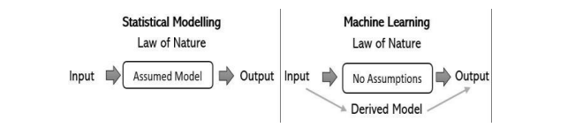
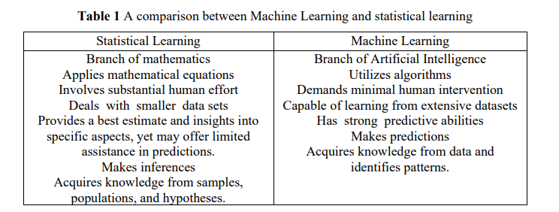
Machine learning

Slide 19
EM
انواع روش های خوشه بندی :
1. خوشه بندی سخت (Hard) خوشه ها هم پوشانی ندارند .
یعنی هر عنصر یا به خوشه تعلق دارد یا ندارد .
2. خوشه بندی نرم (Soft) خوشه ها ممکن است هم پوشانی داشته باشند .
قدرت ارتباط میان خوشه و نمونه (ممکن است با احتمالی به هر خوشه تعلق داشته باشد )

Slide 20
EM
مدل های آمیخته
روش مبتنی بر احتمال برای خوشه بندی نرم
هر خوشه مدل مولد گاوسی یا چند جمله ای است
پارامتر ها(مثل میانگین و واریانس) ناشناخته است

Slide 21



EM
مثال :
مشاهده $x_{1}…x_{n}$ را در نظر بگیرید .
به ازای k = 2 از توزیع گاوسی با مقادیر $μ, σ^{2}$ معلوم، آنگاه برآورد بی معنی است اگر بدانیم هر مشاهده از کدام توزیع آمده است .
حال اگر منبع توزیع هر مشاهده را ندانیم ؟
اگر پارامتر های توزیع ها را بدانیم ، می توانیم حدس بزنیم که هر مشاهده بیشتر شباهت به توزیع اول دارد یا دوم .

Slide 22
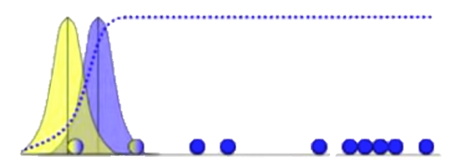
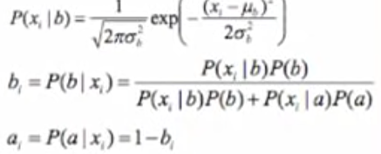

EM
مثال :
مشاهده $x_{1}…x_{n}$ را در نظر بگیرید .
حال تمایل داریم که بدانیم هر مشاهده بیشتر مربوط به کدام جامعه است (جامعه a یا جامعه b) که در آن جامعه a دارای توزیع گاوسی با پارامتر های $μ_{a}, σ_{a}^{2}$ است و جامعه b دارای توزیع گاوسی با پارامتر های $μ_{b}, σ_{b}^{2}$ است .
حال مراحل الگوریتم EM به شرح زیر است :
1. دو توزیع به طور تصادفی در نظر میگیریم و به محاسبه احتمال تخصیص هر نقطه میپردازیم .

Slide 23
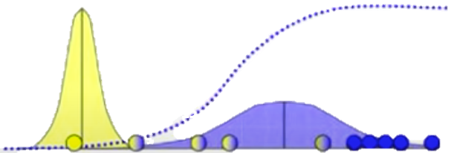
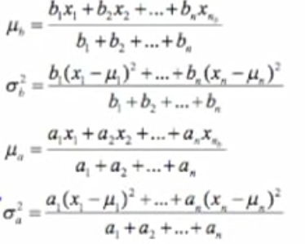
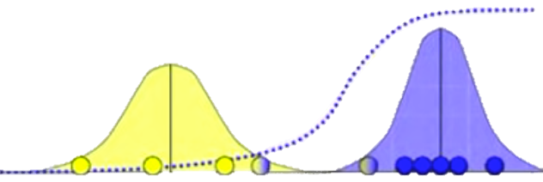
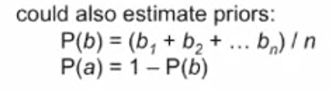
EM
2. توزیع را مرحله به مرحله تغییر داده تا امید مورد نظر ماکزیمم شود .

