Slide 1
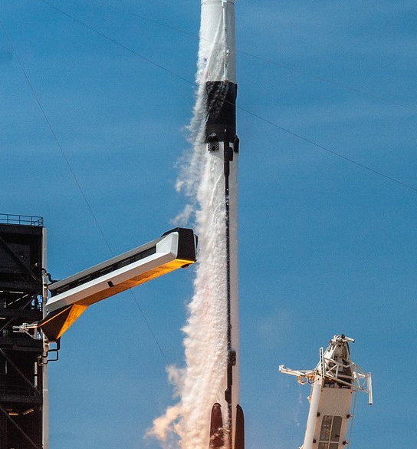
SPACE X FALCON 9
First Stage Landing Prediction
Data collection, EDA, SQL, interactive analytics, and classification modeling
https://github.com/SinaQP/SpaceX-Falcon9-Prediction
1/15

Slide 2
SPACE X FALCON 9 LANDING PREDICTION
Executive Summary
90
66.7%
83.3%
87.7%
cleaned launch records
overall landing success
best model test accuracy
best CV score
• Goal: predict Falcon 9 first-stage landing success.
• Workflow: collect, wrangle, explore, map, dashboard, model.
• Best model: Decision Tree selected by cross-validation.
• Key drivers: launch site, orbit, reuse, grid fins, legs, and flight history.
GitHub: github.com/SinaQP/SpaceX-Falcon9-Prediction
2/15

Slide 3
SPACE X FALCON 9 LANDING PREDICTION
Introduction
Business Context
Project Question
• Reusable first stages reduce launch cost.
• Can historical launch data predict landing success?
• Landing outcome affects launch economics.
• Which operational features explain success patterns?
• Prediction supports risk and cost estimation.
• How well do classification models perform?
GitHub: github.com/SinaQP/SpaceX-Falcon9-Prediction
3/15

Slide 4
SPACE X FALCON 9 LANDING PREDICTION
Data Collection Methodology
• Collected SpaceX launch records and scraped Falcon 9/Falcon Heavy launch tables.
Raw Data Fields
• Parsed fields: flight number, date, site, payload, payload mass, orbit, customer, launch and booster outcomes.
• Launch site
• Payload mass
• Primary notebooks: web scraping and launch-data collection notebooks.
• Orbit
• Customer
• Raw source file in repo: spacex_launch_data.csv.
• Booster version
• Landing outcome
GitHub: github.com/SinaQP/SpaceX-Falcon9-Prediction
4/15

Slide 5
SPACE X FALCON 9 LANDING PREDICTION
Data Wrangling Methodology
Step
Result
Clean records
90 rows and 18 columns retained for modeling
Target label
Class = 1 successful landing; Class = 0 unsuccessful landing
Missing values
PayloadMass filled with mean; LandingPad missingness retained as feature context
Core features
FlightNumber, Date, PayloadMass, Orbit, LaunchSite, Flights, GridFins, Reused, Legs, Block, ReusedCount
60
successful landings
GitHub: github.com/SinaQP/SpaceX-Falcon9-Prediction
5/15

Slide 6
SPACE X FALCON 9 LANDING PREDICTION
EDA And Visual Analytics Methodology
• Explored landing success by launch site, payload mass, orbit, flight number, and year.
• Used pandas, matplotlib, seaborn, SQL, Folium, Plotly, and Dash.
• Built static charts for relationships and trends.
• Built interactive map and dashboard for site and payload exploration.
Static EDA
SQL
Folium
Dash
Trends and feature relationships
Query-based summaries
Launch-site geography
Interactive filters and plots
GitHub: github.com/SinaQP/SpaceX-Falcon9-Prediction
6/15

Slide 7
SPACE X FALCON 9 LANDING PREDICTION
Predictive Analysis Methodology
Modeling Pipeline
• 83 engineered numerical and one-hot encoded features.
83
• StandardScaler applied before modeling.
engineered features
• 80/20 train-test split with random_state=2.
20%
• 10-fold GridSearchCV for hyperparameter tuning.
test split
• Models: Logistic Regression, SVM, Decision Tree, KNN.
GitHub: github.com/SinaQP/SpaceX-Falcon9-Prediction
7/15

Slide 8
SPACE X FALCON 9 LANDING PREDICTION
EDA Visualization Results
Launch-site landing success
Success improved from early failures to 90.0% in 2019 and 84.2% in 2020.
77.3%
76.9%
60%
• 2014-2015: 33.3%
• 2016: 62.5%
• 2017: 83.3%
• 2019: 90.0%
CCAFS
SLC 40
KSC
LC 39A
VAFB
SLC 4E
• 2020: 84.2%
GitHub: github.com/SinaQP/SpaceX-Falcon9-Prediction
8/15

Slide 9
SPACE X FALCON 9 LANDING PREDICTION
EDA Feature Insights
Feature
False / No
True / Yes
Interpretation
Grid fins
10.0%
82.9%
Major landing-control signal
Landing legs
5.3%
83.1%
Strong readiness indicator
Reused booster
58.5%
78.4%
Reuse maturity correlates with success
Orbit examples: VLEO 85.7%, LEO 71.4%, ISS 61.9%, GTO 51.9%.
GitHub: github.com/SinaQP/SpaceX-Falcon9-Prediction
9/15

Slide 10
SPACE X FALCON 9 LANDING PREDICTION
EDA With SQL Results
SQL Question
Result
Unique launch sites
CCAFS LC-40, VAFB SLC-4E, KSC LC-39A, CCAFS SLC-40
NASA CRS total payload
45,596 kg
Average payload mass for F9 v1.1
2,928.4 kg
First successful ground-pad landing
2015-12-22
Top early landing outcome
No attempt: 10 between 2010-06-04 and 2017-03-20
GitHub: github.com/SinaQP/SpaceX-Falcon9-Prediction
10/15

Slide 11
SPACE X FALCON 9 LANDING PREDICTION
Interactive Map Results Using Folium
Map Findings
Geographic pattern
• Launch sites plotted with Folium markers.
Florida sites cluster around Cape Canaveral / Kennedy Space Center. VAFB appears on the California coast.
• Green markers = success; red markers = failure.
• Sites cluster near coastlines for launch safety and downrange paths.
• Distance markers compare sites with coastlines, highways, railways, and cities.
GitHub: github.com/SinaQP/SpaceX-Falcon9-Prediction
11/15

Slide 12
SPACE X FALCON 9 LANDING PREDICTION
Plotly Dash Dashboard Results
Launch Site
Launches
Success Rate
Dashboard Insight
KSC LC-39A
13
76.9%
Highest success
Controls
CCAFS SLC-40
7
42.9%
Mid performance
• Site dropdown
• Payload slider
VAFB SLC-4E
10
40.0%
Mid performance
• Pie chart
CCAFS LC-40
26
26.9%
Lowest success
• Payload scatter
GitHub: github.com/SinaQP/SpaceX-Falcon9-Prediction
12/15

Slide 13
SPACE X FALCON 9 LANDING PREDICTION
Predictive Analysis Classification Results
Model
Test Accuracy
Best CV Score
Decision
Decision Tree
0.833
0.877
Selected
K Nearest Neighbors
0.833
0.848
Comparable test accuracy
Support Vector Machine
0.833
0.848
Comparable test accuracy
Logistic Regression
0.833
0.846
Lowest CV score
Decision Tree had the highest cross-validation score while matching the best test accuracy.
GitHub: github.com/SinaQP/SpaceX-Falcon9-Prediction
13/15

Slide 14
SPACE X FALCON 9 LANDING PREDICTION
Innovative Insights
• Landing success is not just a payload-mass problem; hardware configuration is highly predictive.
• Grid fins and landing legs separate low-success early profiles from mature landing profiles.
• Reused boosters show higher success in the cleaned dataset, suggesting operational learning and reuse maturity.
• The clearest strategic signal is time: landing reliability changed sharply after 2015.
• Launch site matters because each site represents different missions, trajectories, and operating constraints.
GitHub: github.com/SinaQP/SpaceX-Falcon9-Prediction
14/15

Slide 15
SPACE X FALCON 9 LANDING PREDICTION
Conclusion
90
66.7%
83.3%
Tree
cleaned records
landing success
test accuracy
selected model
• Full workflow: collected, cleaned, explored, mapped, dashboarded, and modeled Falcon 9 outcomes.
• EDA showed success improved over time and varied by site, orbit, and booster configuration.
• Folium and Dash made location and payload patterns easier to inspect interactively.
• Historical launch, mission, and booster features predict landing success with meaningful accuracy.
GitHub: github.com/SinaQP/SpaceX-Falcon9-Prediction
15/15

