Slide 1
Neural Networks
Sina
Chuck

Slide 2
History
Warren McCulloch and Walter Pitts^{[1]} (1943) created a computational model for neural networks based on mathematics and algorithms called threshold logic.

Slide 3
What is a neural network?
Neurons and connections between them just like human brain
There is Billions of nerve cells (neurons) and trillions of interconnections in the human brain

Slide 4
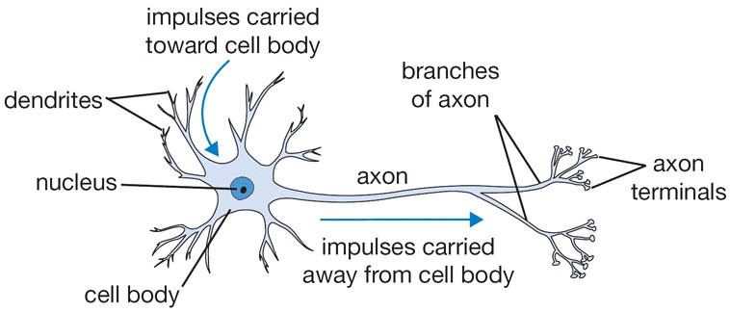
a neuron is …

Slide 5
What is an artificial Neural network?
Perceptrons and connections between them.
input
Artificial Neuron
output

Slide 6
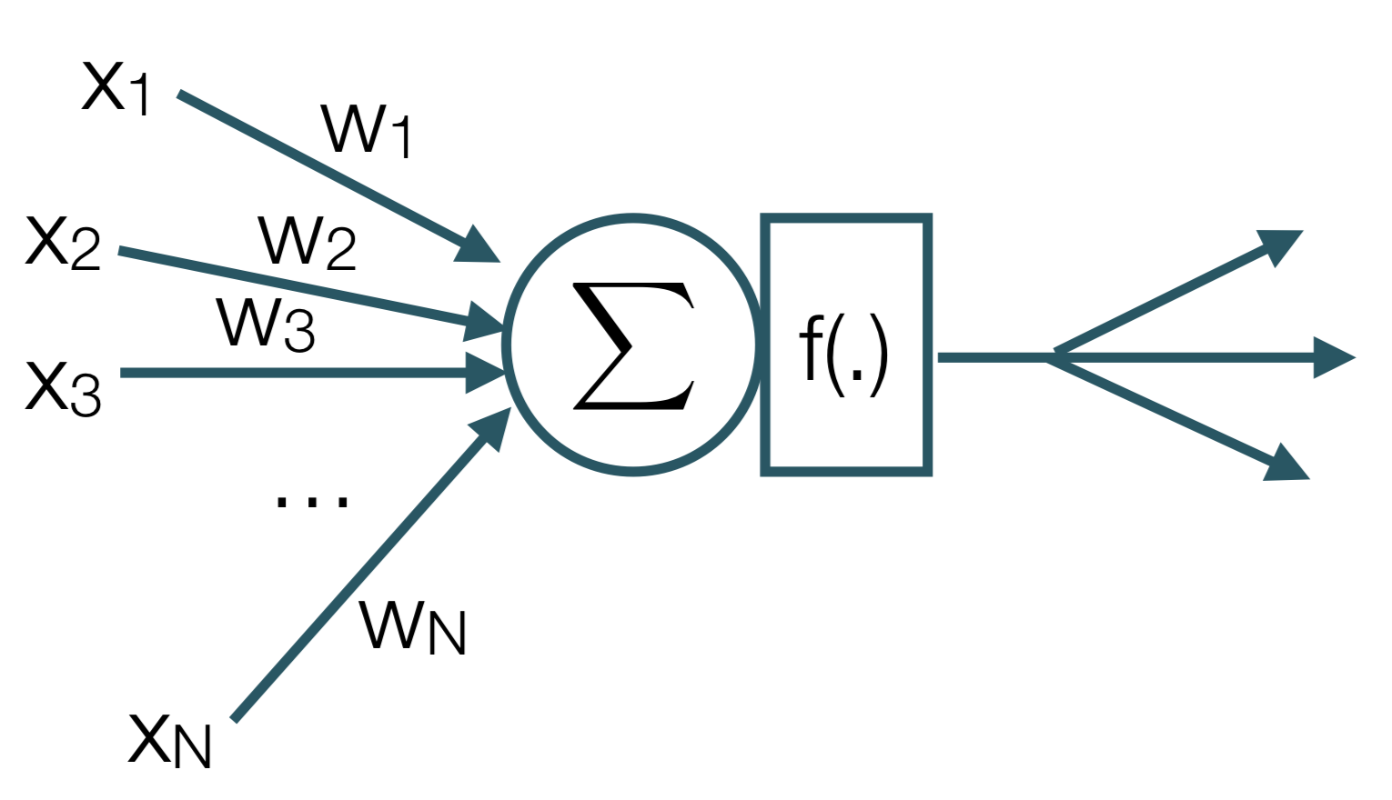
Mimicking a neuron’s function

Slide 7
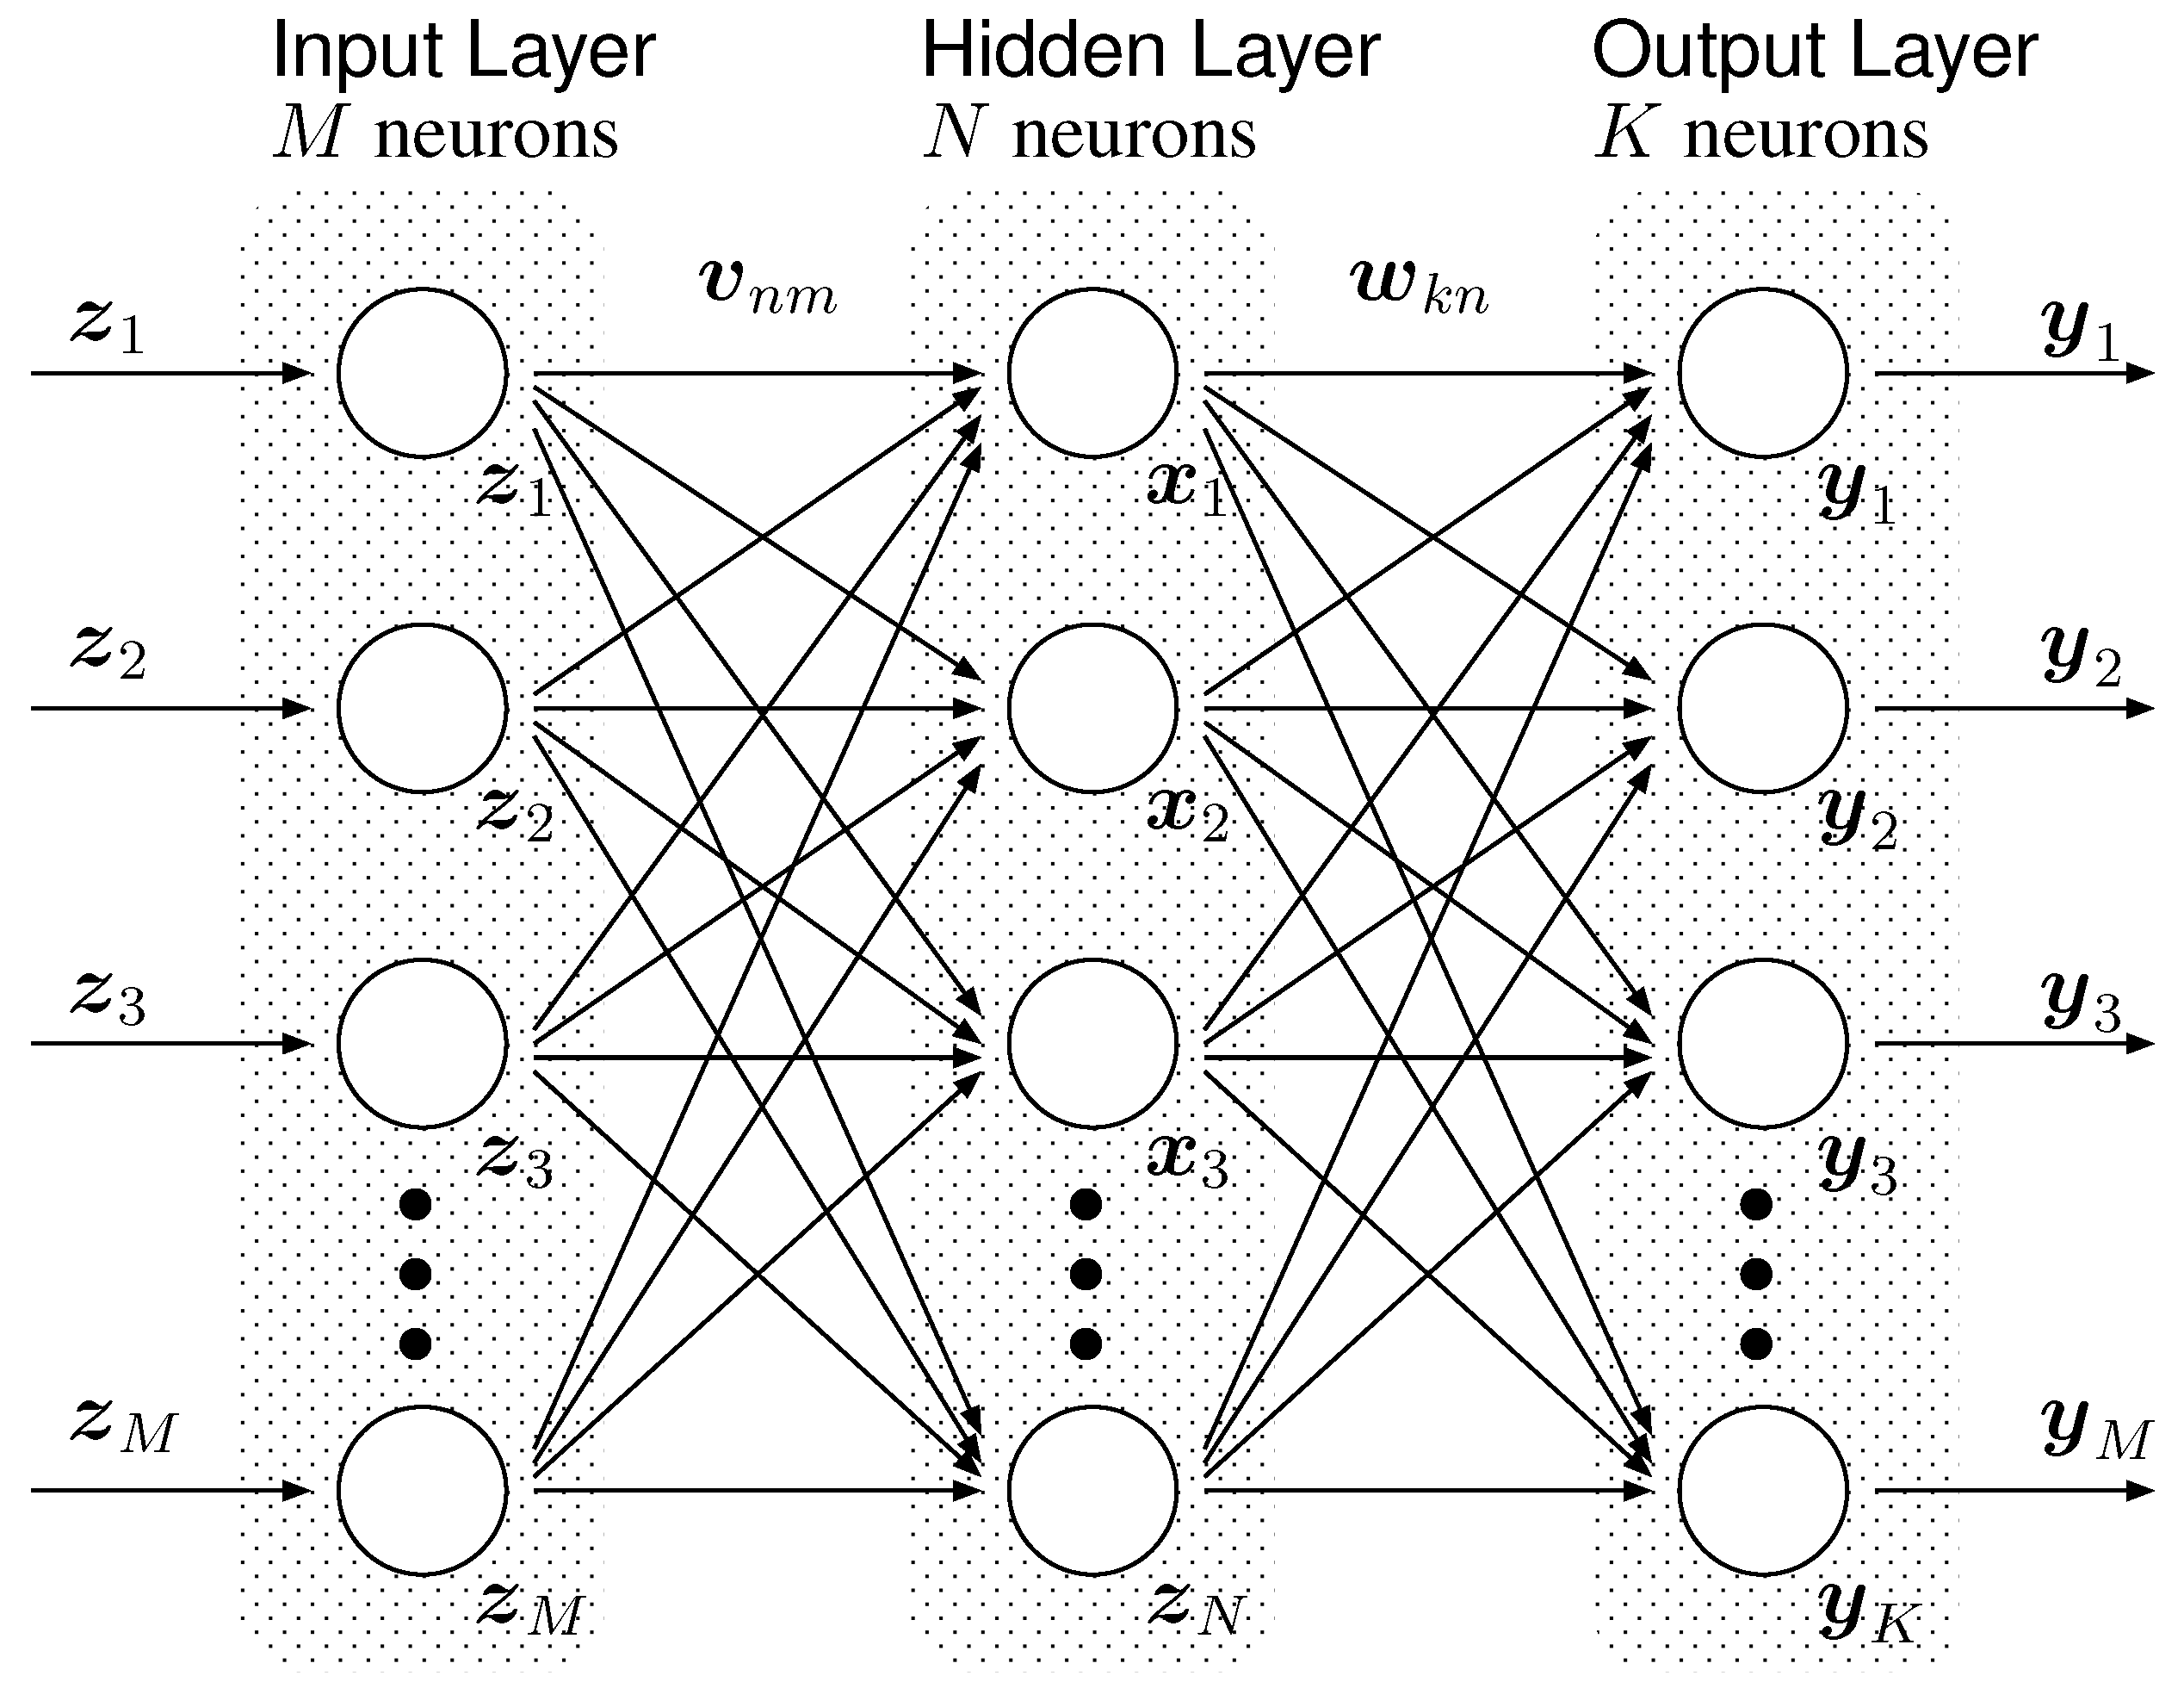
Multi layer Perceptron

Slide 8
Some features of MLP
MLPs consist of three or more layers of nodes
MLPs are fully connected
MLP is a class of feedforward artificial neural networks (ANNs)

Slide 9

Input layer
Input layer simply emits input Zi
Output layer
Has specific number of neurons. Ex: 10 if we have can have 10 different results

Slide 10
Hidden layers
each neuron in the hidden layer uses a non-linear activation function

Slide 11
Activation Functions
The activation function in a neural network is a function used to transform the activation level of a unit (neuron) into an output signal.
The activation function essentially divides the original space into typically two partitions, having a "squashing" effect.

Slide 12
feedforward neural network
A feedforward neural network is an artificial neural network wherein connections between the units do not form a cycle.

Slide 13
Recurrent neural network
A recurrent neural network (RNN) is a class of artificial neural network where connections between units form a directed cycle. This allows it to exhibit dynamic temporal behavior.

Slide 14
Backpropagation
Backpropagation is a method used in artificial neural networks to calculate the error contribution of each neuron after a batch of data (in image recognition, multiple images) is processed

Slide 15
resources
https://secure.ecs.soton.ac.uk/notes/comp6229/l7_neuralnetworks.pdf

