Slide 1
DigiHaul Ltd Shipment Data
Sinah Behsangar

Slide 2
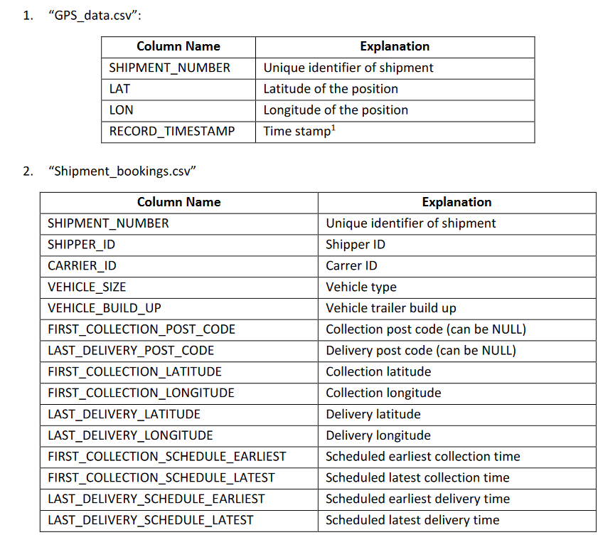
PROJECT OVERVIEW
Datasets and Their Features
GPS_data:
GPS data from DigiHaul’s driver app
Shipment_bookings:
Information about the shipment, carriers, vehicles, collection and delivery schedules and GPS co-ordinates.
New_bookings:
Same information as Shipment_bookings but for a different period.

Slide 3
DATA CLEANING AND PRE-PROCESSING
Issues To Address
Latitude and longitude values:
Inconsistent decimal places in different files
No exact match between final delivery location and actual delivery location.
Time data values:
British Summer Time zone different to the rest of the time data.
1
2
1
2

Slide 4



DATA CLEANING AND PRE-PROCESSING
Corrective Measures
Latitude and longitude values:
Google maps API called to generate new values based on final delivery address post code.
Time Data Values:
all converted to standardised format.
Other measures:
Duplicate rows (if any) were removed.
1
2
3

Slide 5
LATE DELIVERIES
Q4 2023 (Oct 1st – Dec 31st)
Steps:
‘Shipment_bookings’ records filtered by last delivery schedule date: 3235 instances / rows.
Filtered dataset joined with ‘GPS_data’ on Shipment ID
Extracted rows with latitude and longitude matches between delivery address and driver location
Actual delivery time is timestamp value of those rows.
Late deliveries found by comparing actual delivery time against last delivery schedule time plus 30 minutes.

Slide 6
LATE DELIVERIES
Q4 2023 (Oct 1st – Dec 31st)
Nearly one third of the shipments did not meet the on-time delivery threshold.
These late shipments, along with their respective shipper IDs were stored in a separate file.
There were 29 shippers with a total of 1055 late deliveries.
32.75%
67.25%

Slide 7




PREDICTION MODEL
Feature Engineering and Data Preparation
‘DELIVERY_DISTANCE’
Distance between first collection location and last delivery location
‘LATE_DELIVERY’
Binary label column that indicates if a shipment is late
Categorical features one-hot coded
Data Preparation & Feature Engineering
Model Selection & Evaluation
Original Data
Valuable Insights

Slide 8
PREDICTION MODEL
Model Selection & Training
5 ML models simultaneously trained to choose best performing one:
Logistic Regression
Decision Tree
Random Forests
Gradient Boosting
Neural Networks
ML model
ML model
ML model
ML model
ML model
Highest performance Model

Slide 9
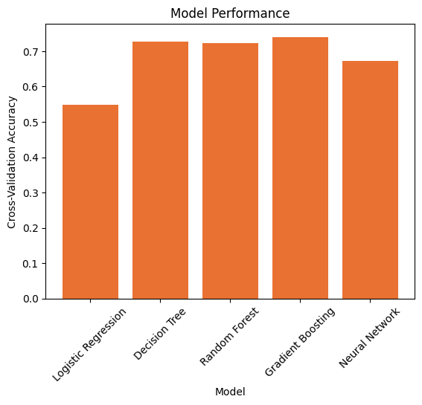
PREDICTION MODEL
Model Evaluation & Application
Evaluation metrics:
Cross-validation accuracy
Precision
Recall
F-1 score
Support
Best performing models:
Gradient Boosting
Decision Tree
Random Forest
0.727
0.724
0.740
0.672
0.549

Slide 10
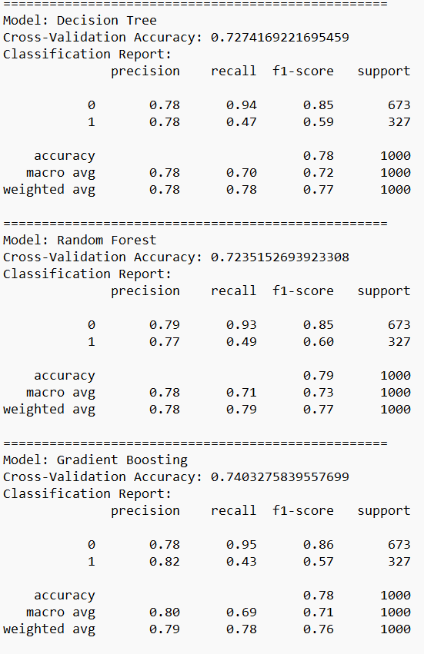
PREDICTION MODEL
Model Evaluation & Application
Overall best model:
Gradient Boosting

Slide 11
PREDICTION MODEL
Prediction on ‘New_bookings.csv’
A quarter of the shipments in ‘Newbokings.csv’ were predicted to have delays
24.85%
75.15%

Slide 12
THANK YOU
Questions?

