Slide 1

Does an allocation to Bitcoin improve the funds’ performance?
Springboard Capstone II

Slide 2
The problem
Bitcoin, as a decentralized digital currency, offers a unique investment avenue beyond the traditional financial system.
Should investment firms consider allocating funds to Bitcoin from improved performance?
Investing in Bitcoin presents an opportunity for portfolio diversification, with the potential for uncorrelated returns.

Slide 3

Questions answered in this study
How has been the performance of Bitcoin (i.e., risk and returns) compared to the S&P 500 and the price of gold during the past 5 years?
How does the inclusion of Bitcoin change a portfolio's characteristics, and can it help improve a portfolio's performance?
Could Bitcoin be used as a hedge against inflation?
In the light of our fund's goal to minimize risk: What is the minimum volatility portfolio, consisting of these three asset classes? And for comparison: Which portfolio would maximize risk-adjusted returns?
Based on the historical data what will be the return on each of these investments over the next year?
The answers to these questions will help the management team to decide on their investment strategies.

Slide 4

Data wrangling

Slide 5

Data
Analysis covers a 7-year period (January 2017- December 2022)
Daily open price, high price, low price, close price, adjusted close price, and volume for
BTC
S&P500
Gold
Monthly inflation data
Adjusted close prices are used in this analysis

Slide 6
Data Preprocessing
Data formatting
Correcting the data types: Ensuring accurate assignment of data types
Joining data:
Merging daily data for BTC, S&P500, and gold.
Combining monthly data for BTC, S&P500, gold, and inflation

Slide 7
Exploratory data analysis

Slide 8
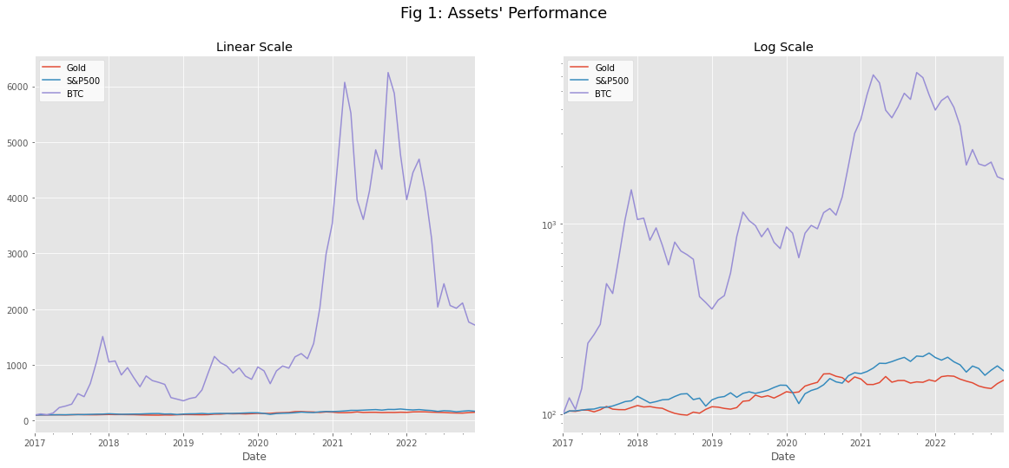
Standardized returns
Price change related to the initial price
Figure 1 shows the strong outperformance of BTC over the investigated period.
Figure 1 shows that S&P500 performed better than Gold, overall, throughout the investigated period.
Figure 1 also shows the high volatility of BTC compared to S&P500 and gold.

Slide 9
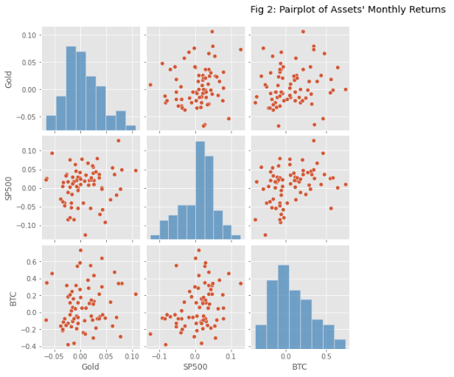
Monthly returns
The range of monthly return is much larger for BTC than for gold and S&P500.
There is no apparent linear relationship between the three assets.
The distributions are all look to be normal.

Slide 10
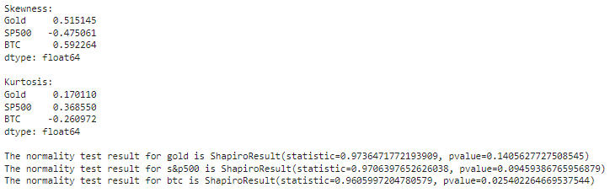
Skewness, Kurtosis, and Normality test
It would be interesting to know if the models of risk and return computed by the fund can be relied on. One of the most important assumptions underlying risk and return models is that the returns data are normally distributed. Since the model outputs are relied on for investment decisions, it is crucial to ensure that this model assumption is valid. Therefore, alongside computing risk and return profiles for the three assets under consideration, the normality assumption will also be tested.
The skewness values show that gold and BTC are moderately positive skewed. While S&P500 is slightly negative skewed.
The Kurtosis values indicate that all distributions are platykurtic.
The p-values show that among the three assets only the distribution of Bitcoin's monthly return is non-normal.

Slide 11
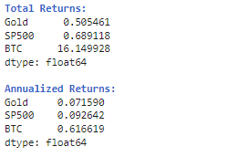
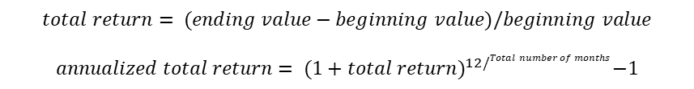
Annualized total return
Annualized total return is used to calculate the average annual return of an investment over a specified period.
It considers the effect of compounding on the investment's performance.
BTC had the highest annual total return.
$$total return= (ending value−beginning value)/beginning value$$
$$annualized total return= {(1+total return)}^{12/Total number of months}−1$$

Slide 12
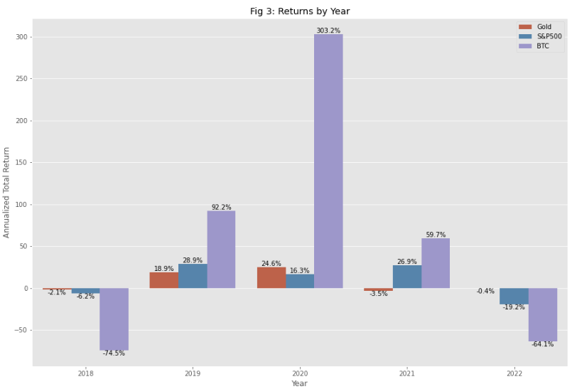
Comparison of asset returns
BTC outperformed in 2019, 2020, and 2021, with 2020 being the best year for it.
BTC lost a lot of its value in 2018 and 2022.

Slide 13
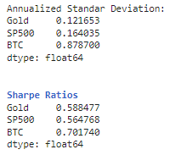
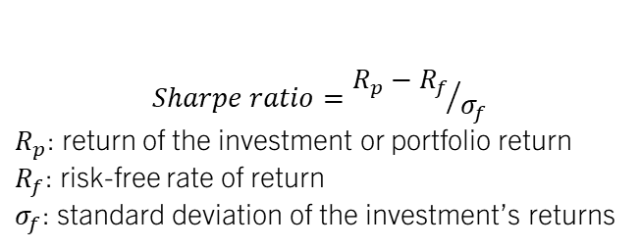
Risk and volatility: 1. sharpe ratio
$$Sharpe ratio={R_{p}−R_{f}}/{σ_{f}}$$
$R_{p}$: return of the investment or portfolio return
$R_{f}$: risk-free rate of return
$σ_{f}$: standard deviation of the investment’s returns
The Sharpe Ratio is a measure of risk-adjusted performance that assesses the return earned in excess of a risk-free rate per unit of volatility.
A higher Sharpe Ratio indicates better risk-adjusted performance, as it suggests that the investment is providing higher returns for the level of risk taken.
The risk-free rate is assumed to be 0.
Sharpe ratio values suggest that investing in BTC was a worthwhile risk.

Slide 14
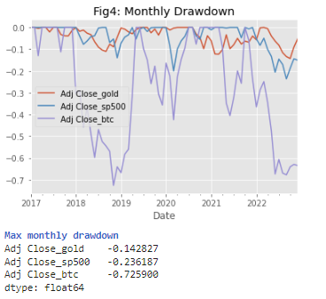
Risk and volatility: 1. Maximum Drawdown
The largest percentage loss from a market peak to trough.
It is calculated by finding the maximum percentage decline from a peak to a trough during a specific investment period.
A smaller maximum drawdown is generally considered more favorable, as it indicates that the investment has been relatively stable and has experienced smaller losses during the specified period.
BTC has the most significant drawdown with around -73% and gold had the lowest with about 14%.
Investing on BTC is much riskier based on the historical data.

Slide 15

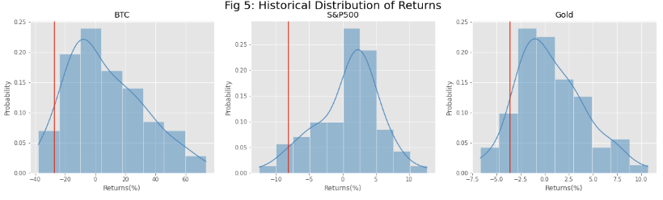
Historical value at risk
VaR is a threshold with a given confidence level that losses will not exceed a certain level based on the historical data.
It involves determining the loss level, expressed as a percentage, that would have been exceeded with a given probability based on past market behavior.
95% was used as the confidence level.
Acknowledging the shortcomings of volatility as a risk measure (e.g. it captures upside volatility as well, which might actually be desirable), Bitcoin's VaR of about 27% has been more than 3-times that of S&P500, and about 9-times that of gold.
For BTC, there is a 5% chance that the monthly losses will exceed 27%.

Slide 16
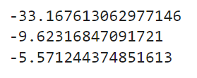
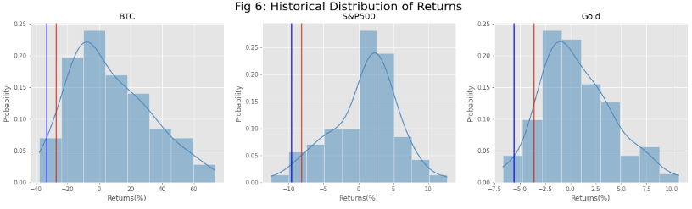
Historical expected shortfall
Conditional Value at Risk (CVaR), is an estimate of expected losses sustained in the worst 1-x% of scenarios.
CVaR is computed by averaging the losses that exceed the Value at Risk (VaR) threshold. It provides a more comprehensive measure of the potential downside risk compared to VaR.
On average, the expected loss beyond the 95% VaR threshold is 33% of the measured value for Bitcoin. This number is 9.6% for S&P500 and only 5.6% for gold.

Slide 17
Summary
 | Gold | S&P500 | BTC
Annual Return (%) | 7.2 | 9.3 | 61.7
Annual Volatility (%) | 12.2 | 16.4 | 87.9
Sharpe Ratio | 0.6 | 0.6 | 0.7
Max Drawdown (monthly in %) | -0.1 | -0.2 | -0.7
VaR95 (%) | 3.6 | 8.2 | 27.0
CVaR5 (%) | 5.6 | 9.6 | 33.2
Bitcoin was the best performing asset during the period of study. Although it was also the riskiest asset in absolute terms, it offers the best risk-adjusted returns. On the other extreme, gold was the worst performing asset, but it was also the least risky asset in absolute terms. On a risk-adjusted basis, however, gold offered the worst risk-adjusted returns. When constructing a portfolio for the investment fund, it is crucial to remember the fund manager's objective: to minimize volatility in the fund by constructing a portfolio involving the lowest risk.

Slide 18
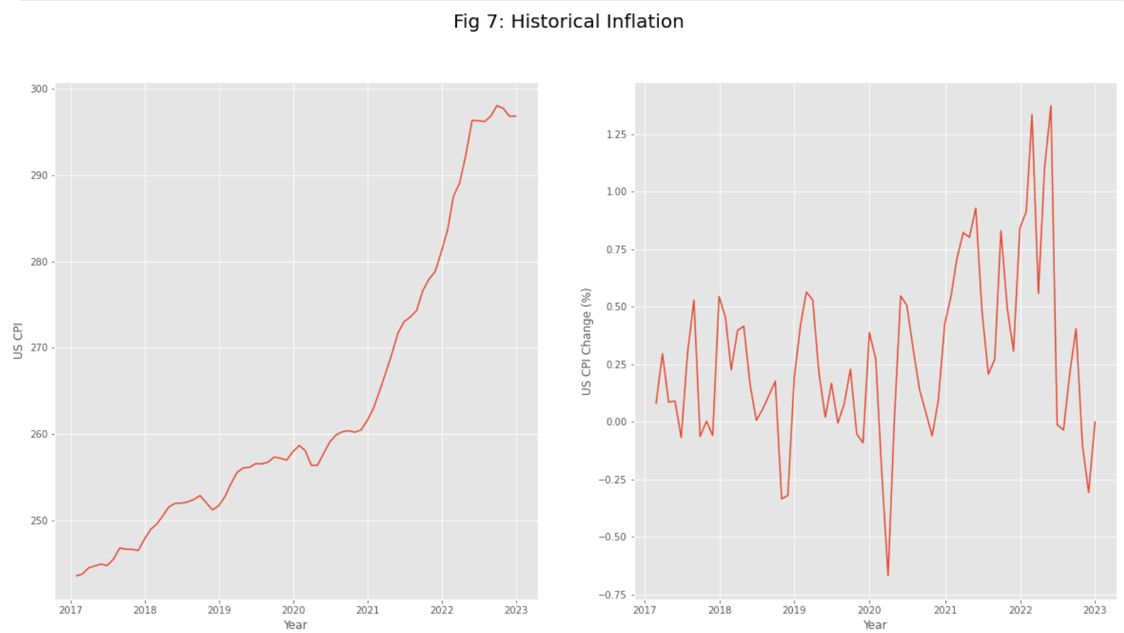
The effect of inflation
Inflation data is also considered during the portfolio construction process. The portfolio construction process utilized in this study is premised on two important factors, namely the selection of assets to include in the portfolio and the quantity of each asset to include.
Total inflation change during the study period is 21.84%.
Average monthly inflation change during the study period is 0.28%.

Slide 19

inflation
Taking inflation into account is important for two reasons. First, it is important to ensure that the assets chosen for investment have the potential to deliver returns above the inflation rate. Second, when inflation increases, the assets should also appreciate in value, but ideally by a larger magnitude.
The trajectory of inflation in America is shown in Figure 7. In the 5-year period under study, inflation in America increased by 21.84% as measured by the Consumer Price Index (CPI). The mean monthly CPI change over the period was 0.28%. Keeping in mind that the Federal Reserve targets a 'healthy' inflation rate of 2%, deemed necessary for economic growth, this study will adopt the 2% level as the hurdle rate which an investment must achieve in order to beat inflation. The results from the previous chapters show that all the assets being considered for this portfolio have the potential to surpass this hurdle rate.

Slide 20
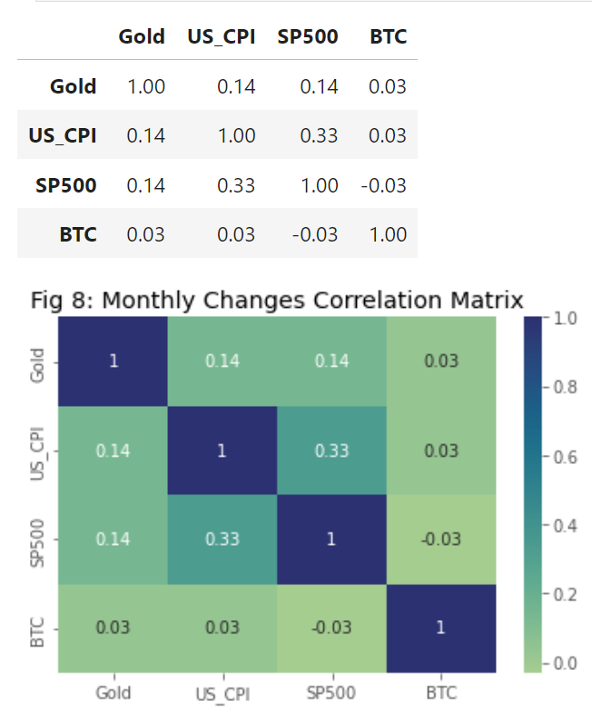
Assets Correlation: 1. heatmap
In order to curtail inflationary effects, the returns from the assets that make up the portfolio must be positively correlated with inflation, meaning that as inflation rises, the assets also generate positive returns.
As can be observed from the heatmap above, the S&P 500 is most positively correlated with the CPI, although the degree of correlation is a weak positive one. In general, as inflation increases, the S&P 500 index also rises. That makes the S&P 500 index the best hedge for inflation among the three assets. Bitcoin and gold have no correlation to inflation, making them less suitable as inflation hedges.
The heatmap above also showed that Bitcoin, gold and S&P 500 returns are all weakly correlated at best, making them all ideal for inclusion into a portfolio. The rationale for including them all in the portfolio is that adding a risky asset whose returns are uncorrelated, or inversely correlated, with those of assets in the portfolio reduces the overall portfolio's risk by reducing volatility.

Slide 21
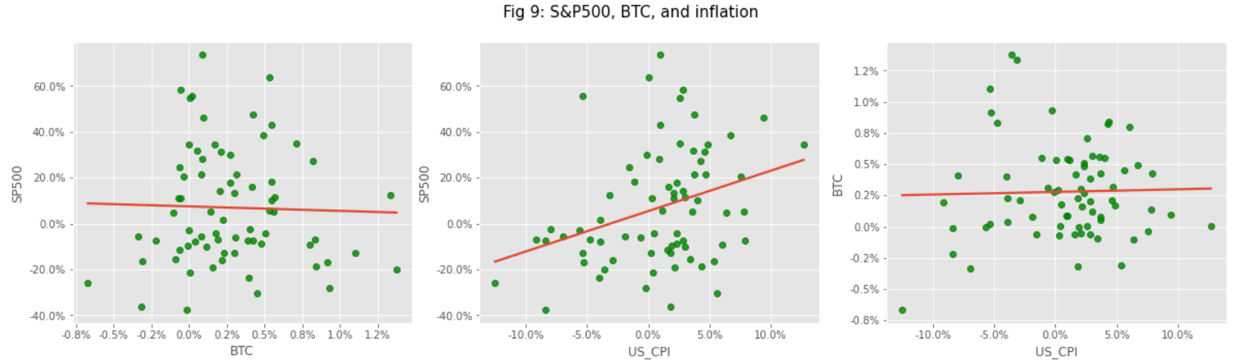
Assets Correlation: 1. scatterplot
There has been no consistent relationship between changes in the price of Bitcoin and inflation since 2017. Bitcoin does not offer good hedging properties against inflation, as it has been largely uncorrelated to changes in the general price level. It seems neither positively nor negatively affected by inflation.
It's also worth noting the positive correlation between the S&P 500 and Bitcoin. A correlation coefficient of 0.3 suggests that Bitcoin tends to move in the same direction as equities, thus offering only limited diversification benefits in a portfolio with equities.

Slide 22
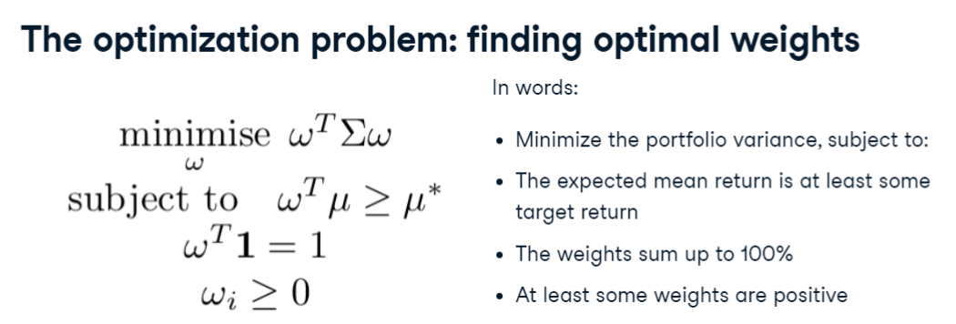
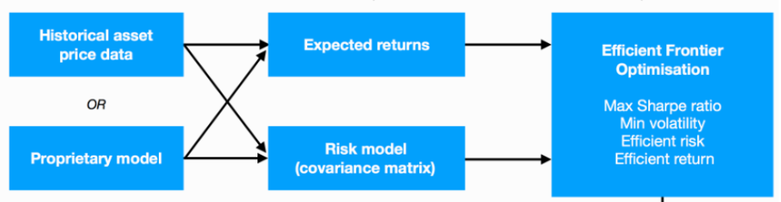
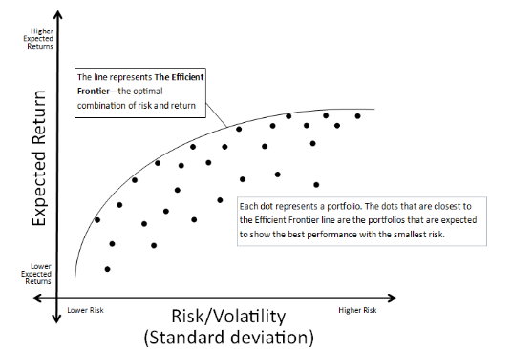
Portfolio optimization
The Efficient Frontier is a key concept in portfolio theory and investment management. It represents a set of optimal portfolios that offer the maximum expected return for a given level of risk or the minimum risk for a given level of expected return.
Risk and Return: The Efficient Frontier illustrates the trade-off between risk and return in a portfolio. Generally, as an investor seeks higher expected returns, they must be willing to accept a higher level of risk.
Portfolios on the Frontier: Portfolios lying on the Efficient Frontier are considered "efficient" because they provide the maximum expected return for a given level of risk or the minimum risk for a given level of expected return.
Diversification: Diversification plays a crucial role in constructing portfolios on the Efficient Frontier. By combining assets with different risk and return profiles, investors can create diversified portfolios that offer higher returns for a given level of risk.
Risk-Free Rate: The Efficient Frontier is often depicted along with a risk-free rate. The point of tangency between the capital market line (representing the risk-free rate) and the Efficient Frontier is known as the "tangency portfolio" or the "market portfolio."
Optimal Portfolio Selection: Investors can select a portfolio from the Efficient Frontier based on their risk tolerance and return objectives. The specific portfolio chosen depends on individual preferences and constraints.

Slide 23
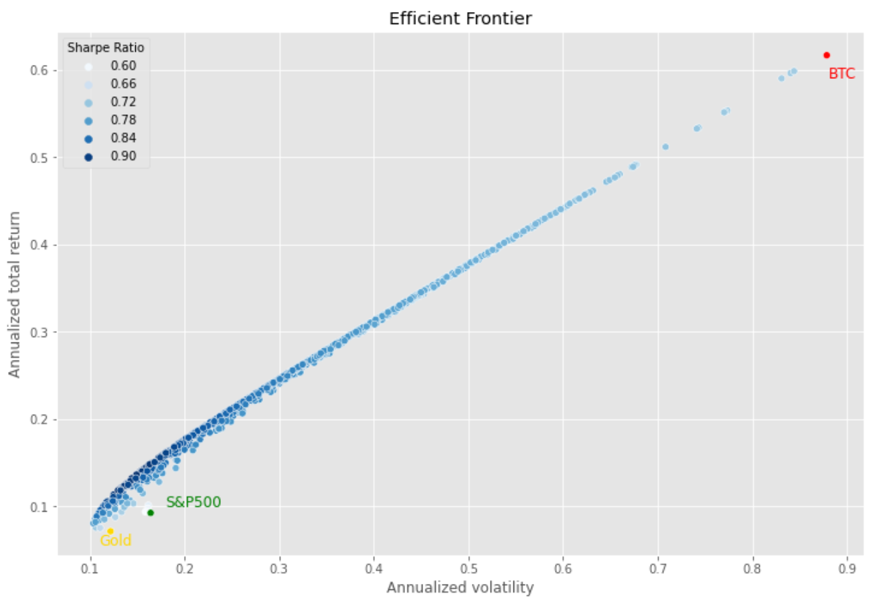
Best portfolios
Best portfolios:
Maximum Sharpe ratio portfolio
Minimum volatility portfolio
Minimum volatility portfolio with at least 10% Bitcoin investment
 | Max_Sharpe_Portfolio | Min_Volatility_Portfolio | Min_Volatility_Portfolio (min 10% BTC allocation)
Gold_Weight (%) | 57.08 | 66.68 | 68.91
S&P500_Weight (%) | 28.80 | 33.32 | 21.09
BTC_Weight (%) | 14.12 | 0.00 | 10.00
Annualized_Portfolio_Return (%) | 15.46 | 7.86 | 13.05
Annualized_Portfoluo_Volatility (%) | 78.85 | 47.55 | 66.09
Portfolio_Sharpe_ratio | 17.07 | 12.32 | 16.72

Slide 24
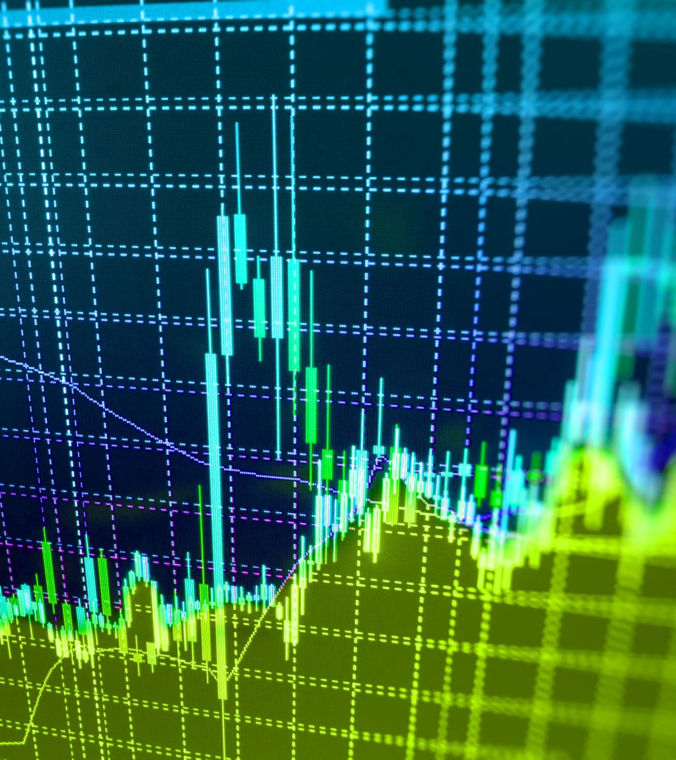
Portfolio performance prediction using machine learning
Calculate monthly returns based on the last business day of the month.
Find the daily covariance of assets for each month
Generate 1,000 portfolios based on random weights following a uniform distribution and calculate the portfolios’ return and volatility
Find the "ideal" portfolios for each date and use them as targets for machine learning
Creating some features to be able to predict our ideal portfolios. Price movement were used as a feature. To do this a daily exponentially-weighted moving average (EWMA) were created and resampled to the monthly timeframe. Finally, the monthly moving average of price were moved one month in the future to be used as a feature for predicting future portfolios.
Targets: Targets will be the best set of weights for the portfolio based on the Sharpe ratio.
Features: The exponentially weighted moving averages of prices

Slide 25
Machine learning results
Linear regression
Random forest
The MAE of the training set is: 0.159
The MAE of the test set is: 0.368
The MAE of the training set is: 0.059
The MAE of the test set is: 0.380
Overall, linear regression’s prediction performance is slightly better than random forest.

Slide 26

conclusion
The truth is, the mean historic returns, or the historic portfolio variance are not perfect inputs and do not reflect future expected risk and return perfectly. The resulting weights of our optimization problem, would have worked well in the past, but we have no guarantee that it will work well in the future.
It is recommended to invest between 10% and 13% on Bitcoin.

