Slide 1
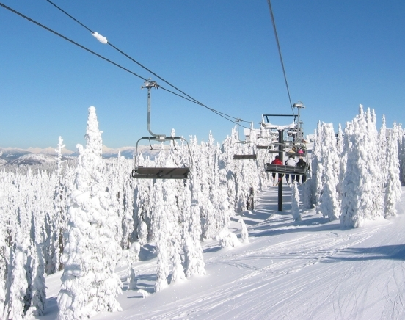
Analysis of the Big Mountain Resort’s Pricing Strategy
Sina Darban Khales

Slide 2
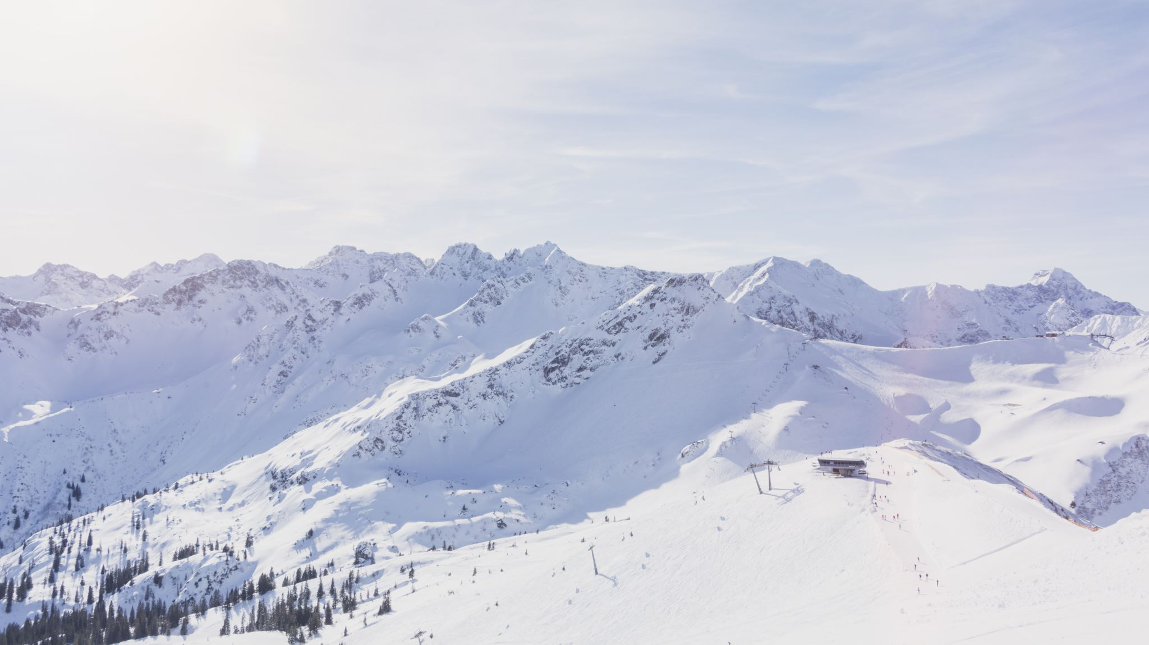
Project’s objectives
The resort has been charging based on the market average without considering the facilities and their attractiveness to visitors.
The objectives of the project are:
Develop a pricing model for ski resort tickets
Propose some strategies to either cut costs without undermining the ticket price or will support an even higher ticket price.

Slide 3
Key findings
There is no obvious relationship between the state that the resort located in and the ticket price.
The initial analysis showed strong linear relationship between the ticket price and the following features:
The vertical change in the elevation from the summit to the base (vertical_drop)
The number of fast four-person chairs (fastQuads)
The total number of chairlifts at the resort (total-chairs)
The total area covered by the snow making machines (Snow Making_ac)
The number of runs on the resort (Run' features).

Slide 4
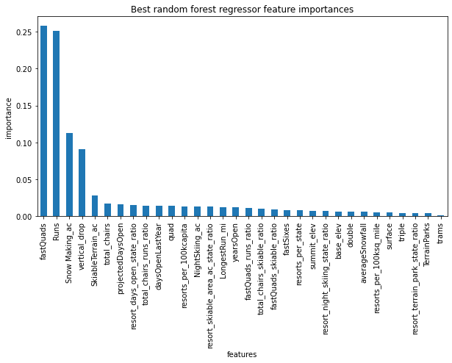
Model results (I)
The results of the initial analysis were confirmed by the outputs of the final model for the most part.
Except total_chairs, all other features were fond to be important by the final model.

Slide 5
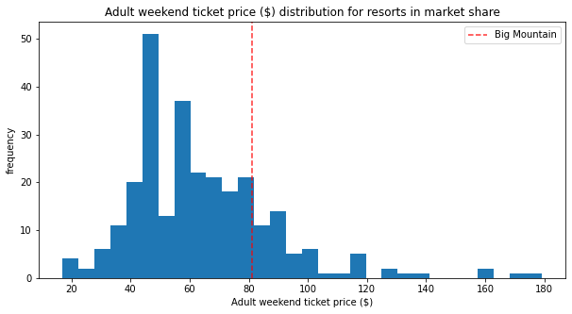
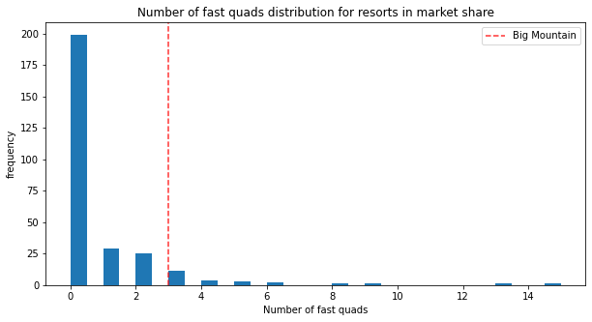
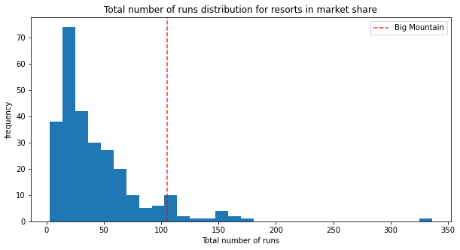
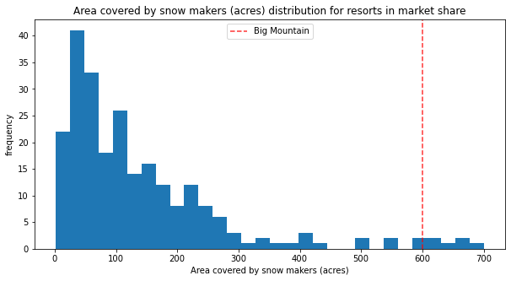
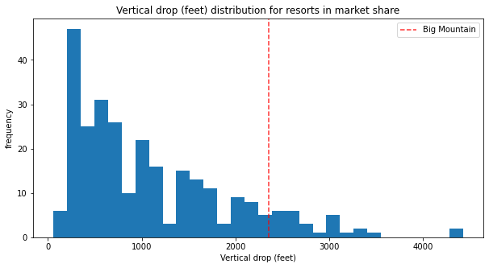
Model results (II)
Big Mountain stands high on all the league charts of facilities offered.
Big Mountain is undercharging its visitors.
While the current ticket price is $81, the fair ticket price was found to be $95.87.

Slide 6
Proposed strategies
Four different scenarios were investigated with the goal of reducing the cost and/or increasing the profitability of the resort:
1. Permanently closing up to 10 of the least used runs.
2. Increase the vertical drop by adding a run to a point 150 feet lower down but requiring the installation of an additional chair lift to bring skiers back up, without additional snow making coverage
3. Same as number 2, but adding 2 acres of snow making cover
4. Increase the longest run by 0.2 mile to boast 3.5 miles length, requiring an additional snow making coverage of 4 acres

Slide 7
Discussion
Closing 10 chairs will save the resort $12,229,710 throughout a season.
The second scenario can increase the revenue of the resort by $15,065,471 over a season.
The third scenario can bring $17,322,717 more to the resort.
The fourth scenario does not have any value and is not recommended to be followed.

Slide 8
Conclusion
None of the investigated scenarios can be suggested as the best solution due to lack of information.
Lack of enough information on the initial cost and the operating cost of these changes made the analysis to be a ballpark figure only.
Big Mountain still has a fair ticket price from the model.
Big Mountain can increase its profit by reducing the number of chairs and increasing the vertical drop and the snow making coverage.

