Slide 1
Robustness of Brain Tumor Segmentation under MRI Corruptions
Mohammad Moghareh Dehkordi, Ons Bahrouni and Sina Mozaffari Tabar
Computer-Aided Medical Procedures II (IN2022)
Summer Semester 2026
21.05.2026

Slide 2
Dataset · BraTS 2020
368
Patients with full ground-truth segmentation
4
Co-registered modalities · T1, T1ce, T2, FLAIR
3
Nested regions evaluated · WT, TC, ET
BraTS Robustness · CAMP2 (IN2022) · TUM
2 / 18

Slide 3
The Research Question
What happens to brain tumor segmentation when the FLAIR modality is corrupted?
Two Corruptions
Three Mitigations
One Paired Comparison
Gaussian Noise
Multiplicative Bias Field
Linear Filters
N4 Correction
Fine-tuning
55 patients
BraTS Robustness · CAMP2 (IN2022) · TUM
3 / 18

Slide 4

Pretrained Model and Clean Baseline
MONAI (brats_mri_segmentation)
SegResNet architecture with pretrained MONAI weights
Input: T1 · T1ce · T2 · FLAIR
Output: WT · TC · ET tumor masks
Clean baseline on test set (n=55)
0.914
0.886
0.766
WT DSC
TC DSC
ET DSC
BraTS Robustness · CAMP2 (IN2022) · TUM
4 / 18

Slide 5
Data Split and Evaluation Setup
TRAIN
70%
VAL
15%
TEST
15%
258
55
55
patients
patients
patients
Fine-tuning
Severity selection + Checkpoint selection
Final evaluation
Same 55 test patients across every condition · per-patient deterministic corruption seed
BraTS Robustness · CAMP2 (IN2022) · TUM
5 / 18

Slide 6
Two Realistic FLAIR Corruptions
① Gaussian Noise
② Bias Field
Additive · High-frequency
Multiplicative · Low-frequency
FLAIR ← FLAIR + N(0, σ²)
FLAIR ← FLAIR × b(x)
Possible causes
Scanner noise
Weak signal
Fast acquisition
Patient motion
Possible causes
Magnetic field inhomogeneity
Coil sensitivity differences
Acquisition setup
Severity grid
σ ∈ {0.5, …, 3.0}
Severity grid
Strength ∈ {0.2, …, 1.2}
Chosen σ = 3.0
Chosen strength = 1.2
BraTS Robustness · CAMP2 (IN2022) · TUM
6 / 18

Slide 7
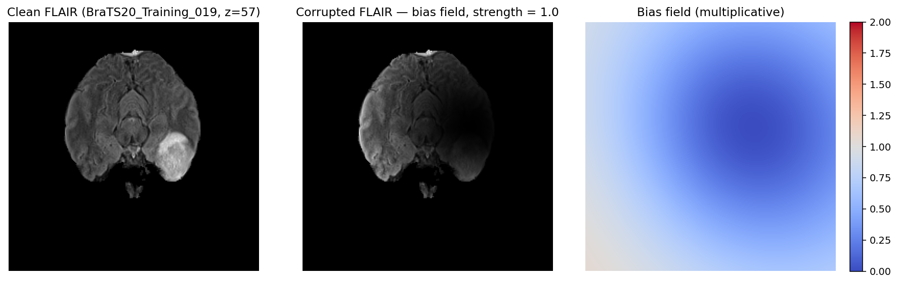
Bias Field: Smooth Intensity Distortion
Smooth intensity warp — not random noise.
Simple smoothing cannot reliably reverse it.
BraTS Robustness · CAMP2 (IN2022) · TUM
7 / 18

Slide 8
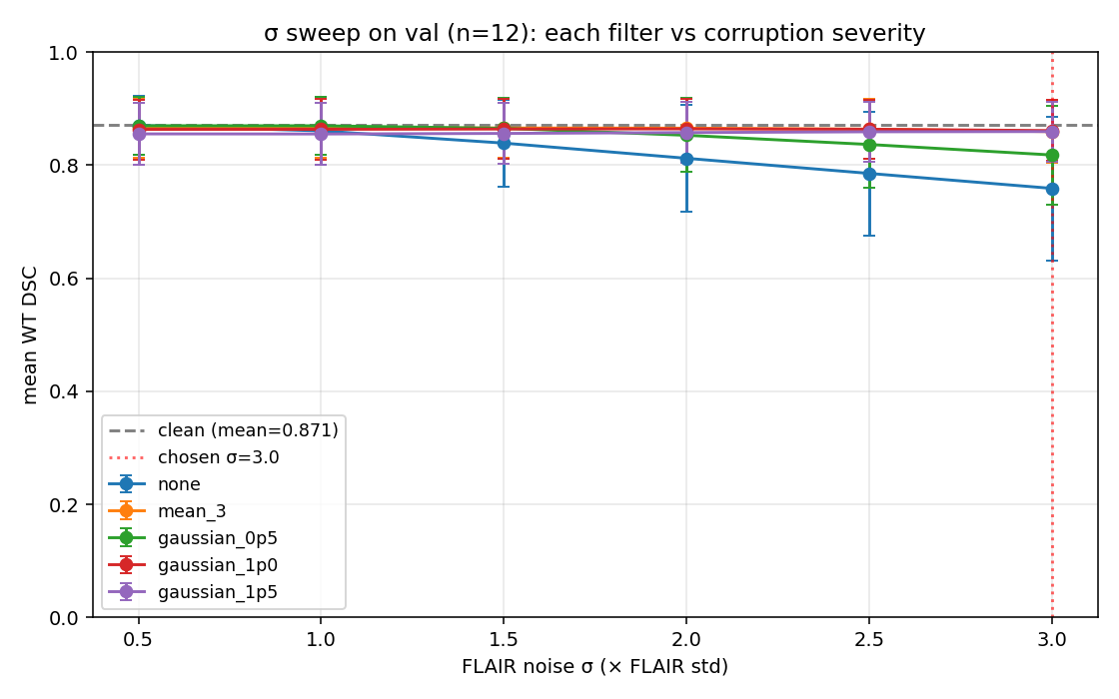
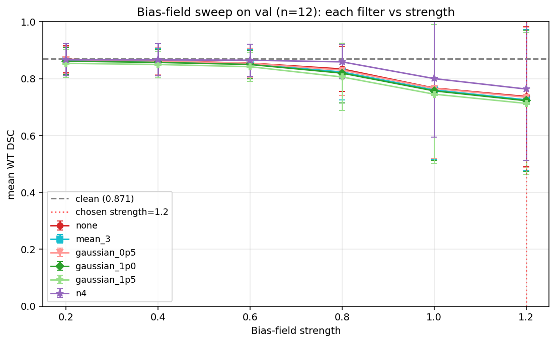
Severity Selection on Validation Set
Gaussian noise
Raw corrupted performance drops as σ increases.
Smoothing filters stay close to the clean baseline.
Final level selected: σ = 3.0.
Bias field
Smoothing filters do not recover the distortion.
N4 remains the most stable correction.
Final level selected: strength = 1.2.
BraTS Robustness · CAMP2 (IN2022) · TUM
8 / 18

Slide 9
Data-Level Mitigations: Preprocessing
Applied to corrupted FLAIR before the model sees it
filter
what it does
category
none
—
Control
mean_3
3³ uniform kernel
Smoothing
gaussian_0p5
σ = 0.5 voxel
Narrow
gaussian_1p0
σ = 1.0 voxel
Moderate
gaussian_1p5
σ = 1.5 voxel
Wider
N4
fit + divide multiplicative b(x)
Gold std for bias
BraTS Robustness · CAMP2 (IN2022) · TUM
9 / 18

Slide 10
Model-Level Mitigation: Fine-Tuning
Start from
MONAI bundle weights
Optimizer
AdamW · LR 1e-5
Loss
DiceCELoss (sigmoid)
Augmentation
FLAIR-only · prob 0.7
Gaussian-FT
σ ~ U(0.2, 3.0)
Bias-FT
strength ~ U(0.2, 1.2)
Steps · val
3000
BraTS Robustness · CAMP2 (IN2022) · TUM
10 / 18

Slide 11
Evaluation Metrics (WT, TC, and ET tumor regions)
Metric
Formula
Measurement
Dice Score (DSC)
Dice · 2·|P∩G|/(|P|+|G|) · [0,1]
Overlap quality (higher is better)
Hausdorff (HD95)
Hausdorff distance 95th-percentile · mm
Boundary (lower is better)
Additional metrics computed
Sensitivity, false-positive volume and false-negative volume
BraTS Robustness · CAMP2 (IN2022) · TUM
11 / 18

Slide 12
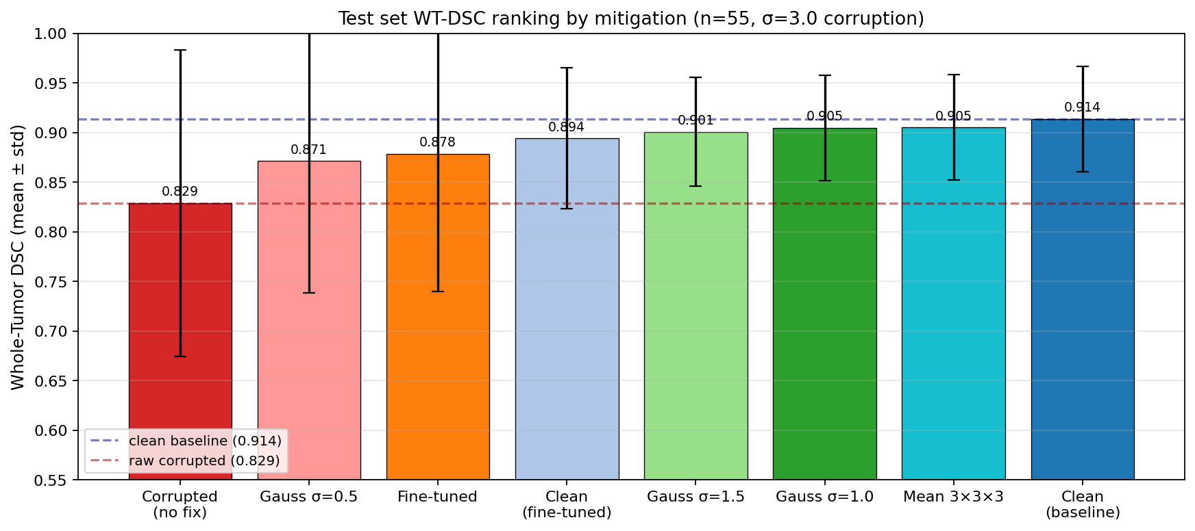
Gaussian · Test Results
Linear filters fully recover. Fine-tune slightly behind.
Gaussian noise mainly introduced random high-frequency artifacts that could be removed effectively with smoothing filters.
Fine-tuning required the model to internally adapt to noisy inputs, making recovery less effective than direct preprocessing.
BraTS Robustness · CAMP2 (IN2022) · TUM
12 / 18

Slide 13
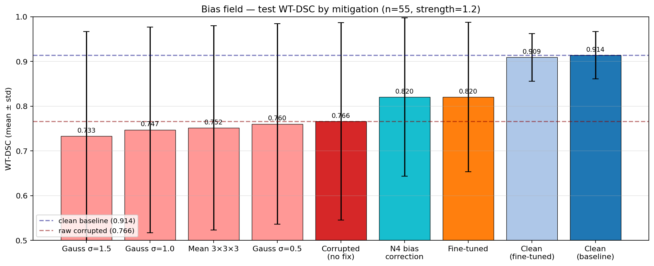
Bias Field · Test Results
Bias field introduces smooth global intensity distortion rather than random noise.
Linear smoothing filters blurred useful structures and performed worse than the corrupted input itself.
N4 bias correction and fine-tuning achieved the best recovery by directly addressing intensity inhomogeneity.
BraTS Robustness · CAMP2 (IN2022) · TUM
13 / 18

Slide 14
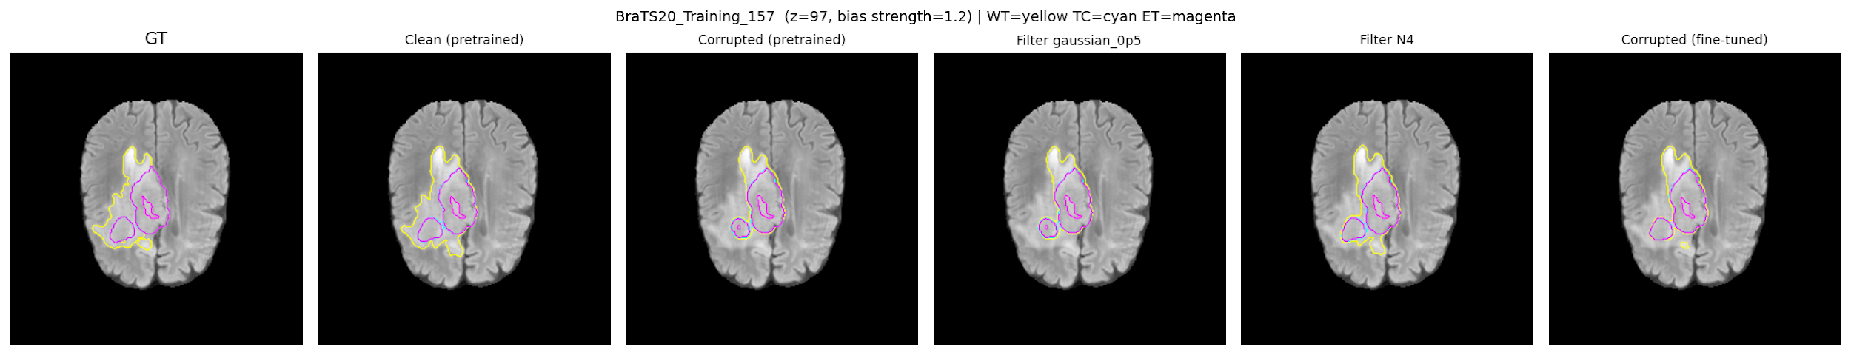
Qualitative · Bias-Corrupted Patient Test
BraTS Robustness · CAMP2 (IN2022) · TUM
14 / 18

Slide 15
Forgetting Check · Cost on Clean Inputs
Gaussian-augmented FT
Bias-augmented FT
−2.0
−0.5
pts WT-DSC
pts WT-DSC
noticeable
negligible
Gaussian augmentation caused stronger adaptation and more forgetting on clean data.
Bias augmentation was closer to natural MRI variation and preserved clean performance better.
BraTS Robustness · CAMP2 (IN2022) · TUM
15 / 18

Slide 16
Key Findings
1
Simple filtering works best for Gaussian noise
2
Bias field requires N4 correction or fine-tuning
3
Bias-augmented fine-tune barely forgets · −0.5 pts
BraTS Robustness · CAMP2 (IN2022) · TUM
16 / 18

Slide 17
Limitations
Only two corruption types were evaluated; other MRI artifacts remain unexplored.
Experiments were performed on a single segmentation architecture (MONAI SegResNet).
The bias field corruption was synthetic and closely matched the assumptions of N4 correction.
BraTS Robustness · CAMP2 (IN2022) · TUM
17 / 18

Slide 18
Thank you!
Any Questions?

