Slide 1
NewsGuard AI: A Deep Learning System for Fake News Detection
Real-Time Verification, Recommendation, and Summarization

Slide 2
The Problem: The Rise of Misinformation
In today's digital age, the rapid spread of false information poses a significant threat.
Global Concern: The dissemination of fake news across digital platforms has become a major global issue, impacting public opinion and political stability.
Erosion of Trust: It undermines public trust in online media and the ability to access trustworthy information.
Rapid Propagation: False information travels faster and more broadly online than factual news, often leveraging emotional language to appear credible.
Scale Overwhelms Manual Efforts: The sheer volume of online content consistently outpaces the capacity of traditional human fact-checking.

Slide 3
Our Solution: Introducing NewsGuard AI
NewsGuard AI is a comprehensive system designed to combat misinformation through a multi-faceted approach.
Core Functions: It provides three key services:
Real-time Verification: Automatically classifies news articles as "Real" or "Fake".
Credible Recommendation: Retrieves relevant, authentic articles from trusted sources if an article is deemed real.
Concise Summarization: Generates summaries of recommended articles for efficient consumption.
Technology: Built using a fine-tuned deep learning model and deployed as an interactive web application with Streamlit for wide accessibility
Transparency: Incorporates LIME (Local Interpretable Model-agnostic Explanations) to provide clear, user-friendly explanations for its classifications, enhancing user trust.

Slide 4
Project Objectives
The system was developed to meet a clear set of requirements and specifications:
High Classification Accuracy: Achieve robust performance in distinguishing between real and fake news, with a test accuracy of 93.01% and an AUC score of 0.98
Model Interpretability: Provide local explanations for each classification by highlighting the words and phrases that most influenced the model's prediction.
User-Friendly Explanations: Present all results, including classifications and confidence scores, in simple, non-technical language.
Privacy and Accessibility: Protect user privacy by not storing submitted articles and provide an anonymous interface without requiring user accounts.

Slide 5
The Dataset: WELFake
The model was trained and validated using a large, recognized dataset.
Source: The WELFake dataset, a comprehensive collection widely used for fake news classification research.
Composition: Contains 72,134 news articles, with a balanced distribution of 35,028 real and 37,106 fake articles, which is crucial for preventing model bias.
Diversity: Aggregated from four diverse sources (Kaggle, McIntire, Reuters, BuzzFeed) to ensure the model generalizes well across different writing styles and topics.
Features Used: The model primarily leverages the article's Title and Text for classification, with the Label serving as the ground truth

Slide 6
System Architecture & Core Workflow
NewsGuard AI is designed as a modular system with a clear, step-by-step process.
User Input: A user submits a news article's title and text via the web interface
Preprocessing: The text is rigorously cleaned, normalized, and tokenized. Stylistic features (e.g., punctuation count, sentence length) are also extracted.
Classification: The preprocessed data is fed into the Bidirectional CuDNNLSTM model, which classifies the article as "Real" or "Fake" and provides a calibrated confidence score.
AI Explanation (LIME): LIME generates a visual explanation, highlighting the key words that influenced the model's decision.

Slide 7
System Architecture & Core Workflow (Continued)
Verification & Summarization:
If Real, the system searches NewsAPI for related articles from credible sources and summarizes them.
If Fake, this step is skipped to avoid amplifying misinformation.
Results Presentation: All outputs are displayed to the user in a clear, interactive format.

Slide 8
The Core Engine: Bidirectional CuDNNLSTM
The choice of model was a strategic balance of performance and efficiency.
Architecture: A Bidirectional Long Short-Term Memory (LSTM) network processes text in both forward and backward directions, capturing deeper contextual understanding crucial for analyzing news.
CuDNN Acceleration: Utilizes NVIDIA’s CuDNN library for GPU acceleration, leading to significantly faster training and inference times compared to a standard LSTM. This was essential for rapid hyperparameter tuning and meeting real-time requirements.
Why not BERT? While powerful, BERT's high computational cost and resource demands made it impractical for this project's scope and the need for a responsive user experience. The fine-tuned CuDNNLSTM provided an optimal balance of high accuracy and practical deployability.

Slide 9
Performance Evaluation
Metric | Score | Description
Accuracy | 0.93 | The overall percentage of articles correctly classified.
Precision | 0.92 | When the model predicts "Fake," it is correct ~93% of the time
Recall | 0.94 | The model successfully identifies ~95% of all actual fake news articles.
F1-Score | 0.93 | A strong balance between precision and recall, indicating overall robustness
AUC Score | 0.98 | Excellent ability to distinguish between real and fake news.

Slide 10
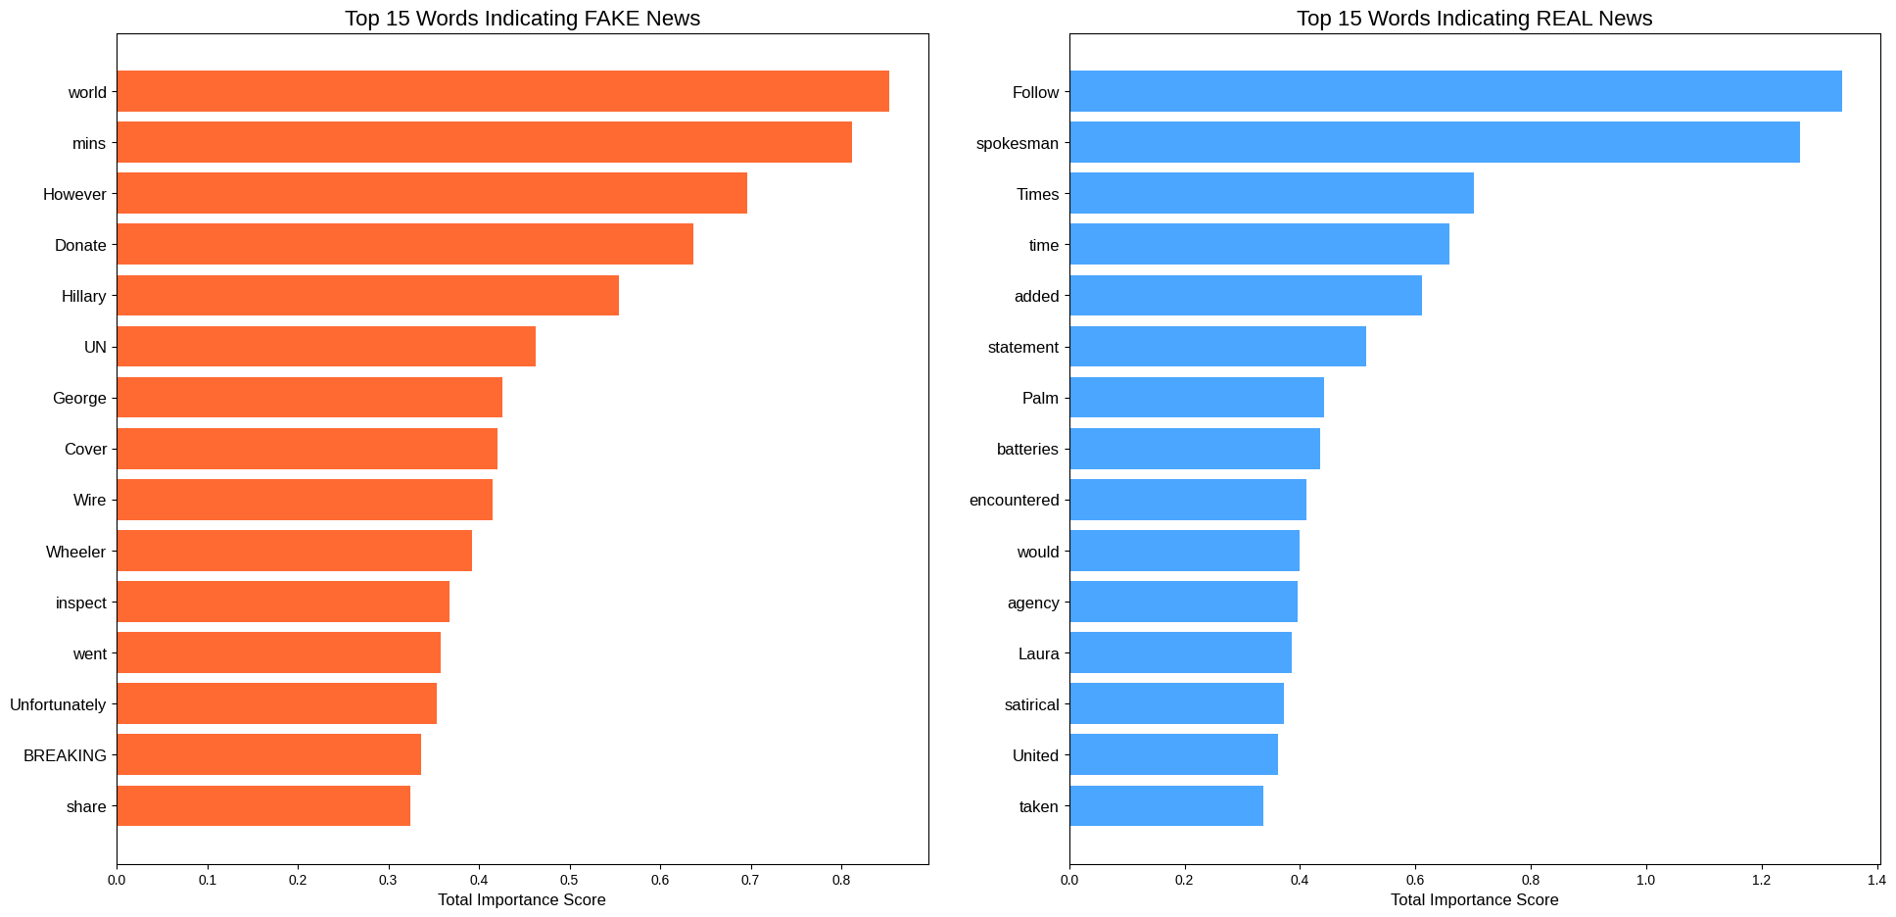
Building Trust: Interpretability with LIME
Transparency is a core ethical principle of the system, achieved through LIME.
Function: LIME (Local Interpretable Model-agnostic Explanations) explains why the model made a specific prediction for an individual article.
Process: It highlights the words that most strongly contributed to the "Real" or "Fake" classification.
Benefit: This moves the system beyond a "black box," building user trust, encouraging critical evaluation of the AI's reasoning, and helping users learn to identify markers of misinformation themselves.

Slide 11
Ensuring Reliability: Probability Calibration
Model confidence scores were refined to ensure they accurately reflect true probabilities.
The Problem: A raw deep learning model can be highly confident (e.g., 99%) even when it's wrong.
The Solution: We applied calibration techniques to adjust the model's output probabilities so that a confidence score of 'X%' truly corresponds to an 'X%' likelihood of being correct.
The Method: Isotonic Regression proved most effective, significantly improving the alignment between predicted probabilities and actual outcomes.

Slide 12
Development Challenge: Fighting Data Leakage
A major challenge was identifying and mitigating hidden bias in the training data.
The Issue: An initial model achieved a suspiciously high accuracy of 98%.
The Investigation: Using LIME, we discovered the model was "cheating." It learned to associate source names like "reuters" with real news, creating a data leakage problem and an unreliable model.
The Solution: We performed multiple iterations of aggressive preprocessing, adding biased keywords to a custom stop-word list and retraining the model. This forced the model to learn from the actual content and style of the articles, resulting in a more robust and genuinely accurate system.

Slide 13
The User Experience: Streamlit Interface
The system is delivered through an intuitive and interactive web application.
Technology: Built with Streamlit, a Python framework that allows for rapid development of data-centric web apps.
Layout: A clean interface allows users to easily input an article's title and text.
Output: Results are presented clearly with a classification card, confidence score, and distinct tabs for exploring the "AI Explanation" (LIME) and "Verification Sources"

Slide 14
Future Work & Enhancements
The project has a clear roadmap for future development to expand its capabilities.
Continuous Model Improvement: Implement a process for ongoing retraining with new data to adapt to evolving misinformation trends.
Multimodal Detection: Extend analysis to include images and videos to detect sophisticated, multimedia-based fake news
Browser Extension: Develop a browser extension to provide real-time credibility feedback directly to users as they browse the web.
Multilanguage Support: Expand the system to detect fake news in multiple languages using models like mBERT

Slide 15
Conclusion
This project successfully developed a robust and transparent AI system for fake news detection.
High Performance: The optimized Bidirectional CuDNNLSTM model with an attention mechanism significantly outperforms baseline models and achieves high accuracy on a challenging dataset.
Comprehensive Solution: The system moves beyond simple classification by integrating summarization, credible article retrieval, and critically, model interpretability through LIME.
Reliable and Transparent: Through rigorous preprocessing, model calibration, and a focus on explainability, the project demonstrates a reliable and ethical approach to the complex problem of automated misinformation detection.

