Slide 1
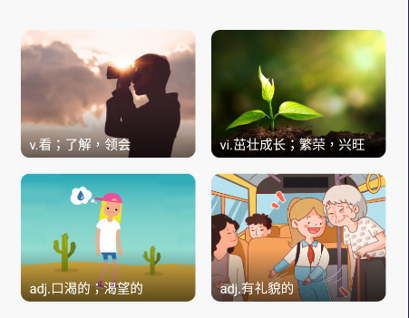
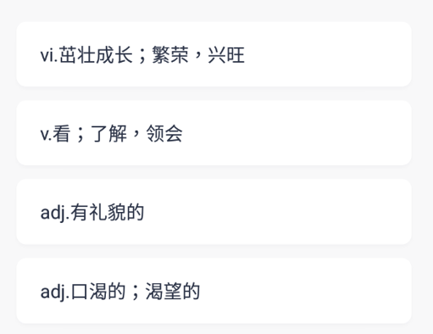
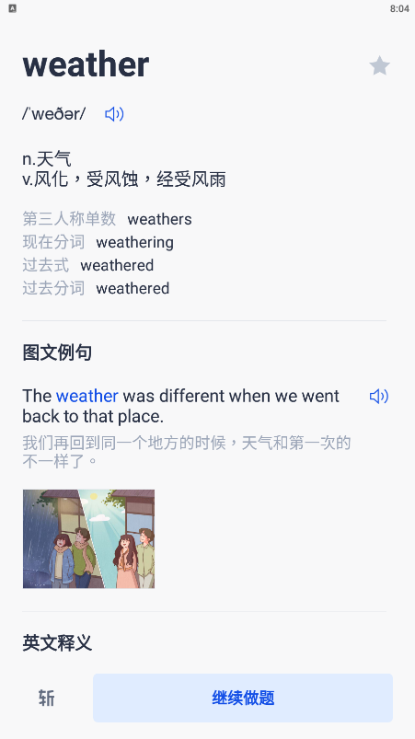
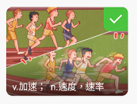

Flow Chart 流程图
首先判断是否是图片问题
是否为中文释义问题
跳出单词卡片
(出现“继续做题“按钮）
否
否
是
是
点击其中一张
是
点击继续

Slide 2
Flow Chart 流程图

Slide 3

Click Area Detection 高价值区域检测与点击
The Bai Ci Zhan App has multiple sorts of visual questions that allows the users to reinforce their vocabulary, including:
Picking matching pictures upon seeing different words,
Choosing the most germane explanation in Chinese.
Apart from the different kinds of questions, we must also deal with the continue button that would jump out from time to time between questions

Slide 4
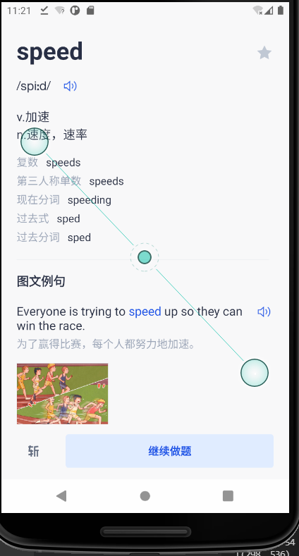
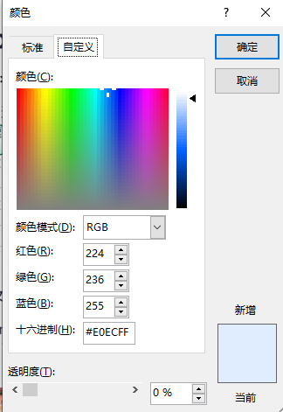
The background area of the continue button which contains text “继续做题” in the lower right part of the screen as shown in figure-1 has a BGR value of (255,236,224)

Slide 5
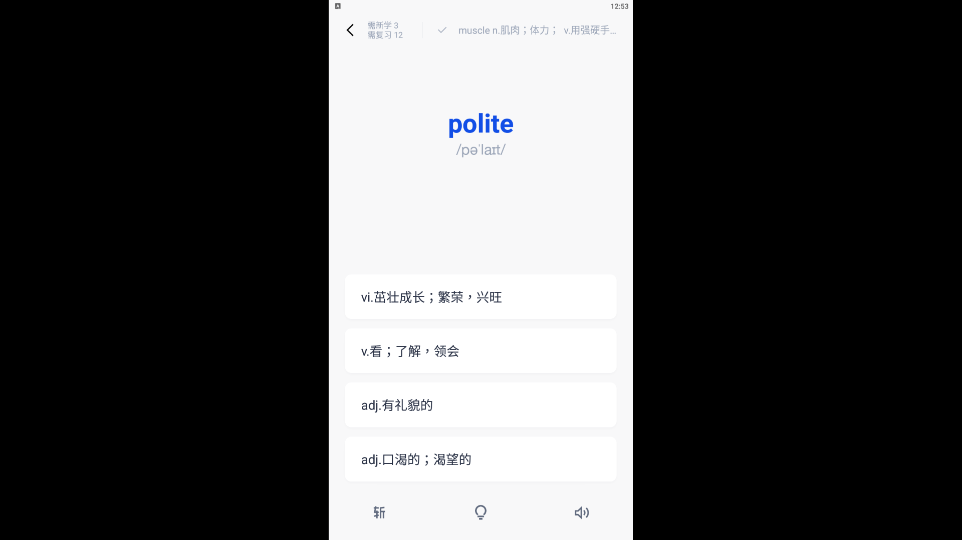
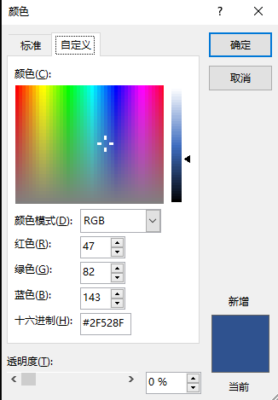
The boxes that contain Chinese paraphrases are of background color with BGR value of
(143, 82, 47)

Slide 6
Audio Detection

