Slide 1

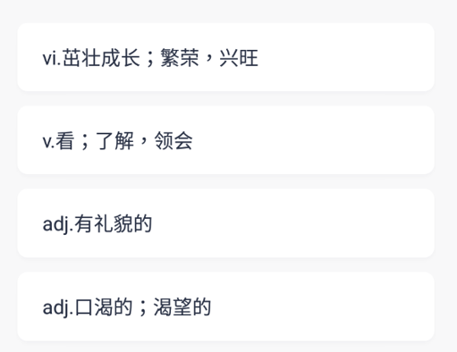
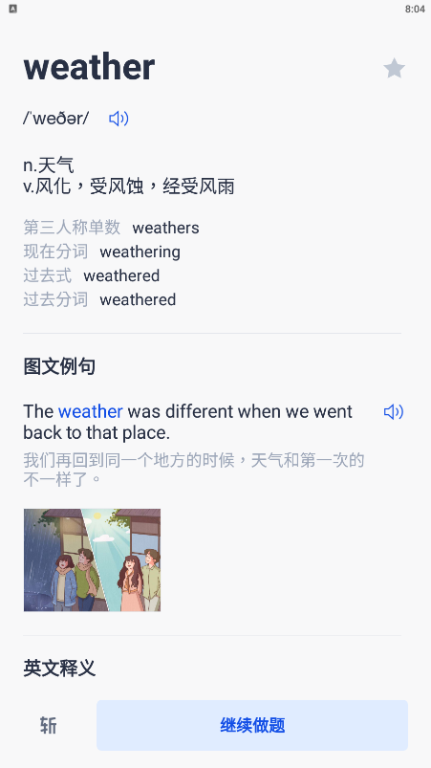


Flow Chart 流程图
首先判断是否是图片问题
是否为中文释义问题
跳出单词卡片
(出现“继续做题“按钮）
否
否
是
是
点击其中一张
是
点击继续

Slide 2
Flow Chart 流程图

Slide 3
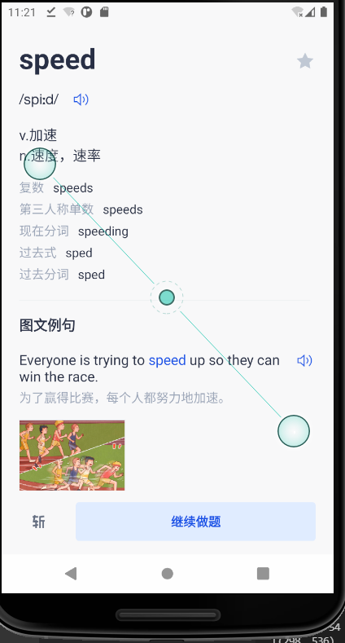
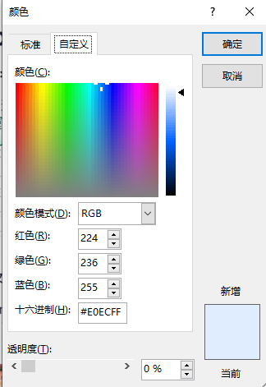
The background area of the continue button which contains text “继续做题” in the lower right part of the screen as shown in figure-1 has a BGR value of (255,236,224)

Slide 4
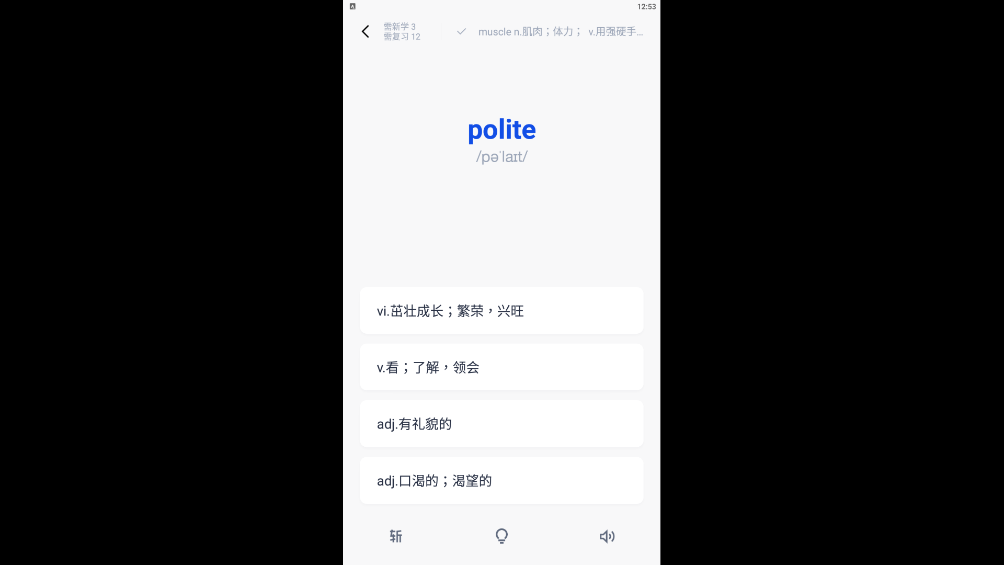
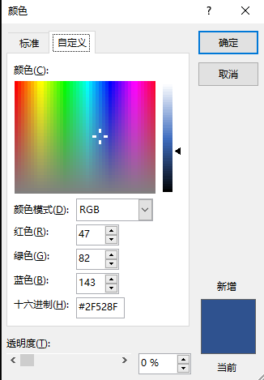
The boxes that contain Chinese paraphrases are of background color with BGR value of
(143, 82, 47)

