Slide 1
BCSE307P · Compiler Design Laboratory · Fall 2026-27
A Domain-Specific Language and Compiler Front-End for Data Science Pipelines
Prepared by SINCHANA B KURKURI · 24BDS0352 · Slot L49+L50
Presented to DR. RANJITHKUMAR S, Assistant Professor Sr. Grade 1
github.com/Sinchana-B-Kurkuri/A-Domain-Specific-Language-and-Compiler-Front-End-for-Data-Science-Pipelines
ds-pipeline-compiler.streamlit.app

Slide 2
Agenda
1 Introduction
2 Problem Statement
3 Objectives
4 Literature Survey
5 System Design
6 Methodology
7 Compiler Concepts Used
8 Implementation
9 Testing and Results
10 Conclusion
11 Future Enhancements
References · Appendix
2

Slide 3
Introduction
Chapter 1
Background
A pipeline is an ordered set of steps whose later stages depend on earlier declarations: dataset, columns, splits, models
Compiler stages fit naturally: lexing recognizes vocabulary, parsing gives structure, semantics checks context
Valid programs can then be lowered and transformed before any back-end runs
Motivation
Training before a train split, duplicate model names, or bad percentages are visible in the description itself
Catching them early isolates the cause without opening a dataset
Execution is symbolic, so demos need no data or ML libraries
3

Slide 4
Problem Statement
Chapter 2
Design a small language processor that accepts a pipeline description, rejects malformed or inconsistent programs with source-referenced diagnostics, and translates accepted ones into an inspectable instruction sequence.
Area | Implemented scope | Boundary
Language | One named pipeline, 7 statement forms | No loops, expressions, functions
Validation | Token, grammar, declaration, ordering, column, split rules | No CSV schema or type inference
Transformation | AST lowering + 4 IR passes | No machine-code generation
Execution | Readable symbolic trace | No file loading or model fitting
Interaction | CLI + Streamlit dashboard | No scheduler or visual editor
4

Slide 5
Objectives
Chapter 3
# | Phase 1 objective | Status
1 | Concise, unambiguous grammar for pipelines | Achieved
2 | Lexer with line/column errors | Achieved
3 | Recursive-descent parser building an AST | Achieved
4 | Symbol table tracking pipeline state | Achieved
5 | Semantic analysis: dependencies, scope, types | Partial
6 | Lowering to a simple IR | Achieved
7 | At least one optimization pass | Achieved (4 passes)
8 | Symbolic execution engine with readable trace | Achieved
9 | Evaluation on valid and invalid programs | Achieved
Objective 5 is partial: no general type system, multi-pipeline scope, or allowed-value lists. Added beyond Phase 1: drop statement, 4 passes, benchmark, dashboard.
5

Slide 6
Literature Survey & Background
Chapter 4
Approach | Primary concern | Relation to this project
Apache Airflow | DAG task scheduling and execution | Orchestration is outside the DSL
Luigi | Batch-job dependency management | Similar idea, different abstraction level
Kubeflow Pipelines | ML workflow infrastructure | No deployment or real ML execution here
scikit-learn Pipeline | Transformer/estimator composition | This project validates a textual description
This project | Tokens, AST, symbol table, linear IR | Inspectable compiler demo with checked invariants
Aho et al.: compiler stages · Nystrom: recursive descent · Python re and dataclasses
Gap: a small, inspectable compiler example in data science vocabulary
6

Slide 7
System Design: Architecture & Data Flow
Chapter 5
Source text
›
Lexer
Tokens
›
Parser
PipelineNode
›
Semantic
SymbolTable
›
IR generator
IRInstruction
›
Optimizer
4 passes
›
Symbolic
executor
Semantic output feeds IR generator, which feeds the optimizer, then the executor returns trace strings.
Failure propagation
First error stops compilation: LexicalError, SyntaxError_ or SemanticError
CLI catches these; dashboard also catches unexpected errors and marks later stages skipped
Interfaces
CLI and dashboard share the same modules
Six stages in the dashboard; five default CLI sections
7

Slide 8
System Design: Modules & Workflow
Chapter 5
Module | API | Responsibility
lexer.py | tokenize | Tokens with line/column
parser.py | Parser.parse_pipeline | Grammar check, builds PipelineNode
ast_nodes.py | Stmt dataclasses | AST data model
semantic.py | analyze, SymbolTable | Dependency and state checks
ir.py | lower_to_ir | One instruction per statement
optimizer.py | optimize | Four ordered IR passes with notes
executor.py | execute | Symbolic trace strings
cli.py | main | Stage flags and error messages
Interfaces
Dashboard pages: Overview, Compiler Playground, Architecture, Performance
Layout: src/, tests/, examples/, benchmarks/, dashboard/, docs/
8

Slide 9
Methodology
Chapter 6
Phased development
Phase 1: grammar, architecture, lexer/parser/AST/semantic prototype
Phase 2: package refactor, IR, optimizer, executor, CLI, 19 tests
Final: drop construct, safe optimizer, benchmark, dashboard, 267 tests
19 Git commits record the milestones
Design decisions
Hand-written scanner and parser keep grammar-to-code explicit (ANTLR4 skipped)
One pipeline per file avoids scope resolution
Free-identifier algorithm names avoid ML library coupling
First-error reporting avoids cascading diagnostics
9

Slide 10
Compiler Concepts: Lexing & Parsing
Chapter 7
Lexical analysis
One master regex with named groups, ordered by priority
Keywords converted from identifiers; trainer stays an identifier
STRING before BAD_STRING, PERCENT before NUMBER
Lines one-based, columns zero-based; EOF appended
pipeline_decl ::= 'pipeline' IDENT '{' statement* '}'
statement ::= load | clean | select | drop
| split | train | evaluate
load_stmt ::= 'load' STRING ';'
clean_stmt ::= 'clean' IDENT ';'
select_stmt::= 'select' IDENT (',' IDENT)* ';'
drop_stmt ::= 'drop' IDENT (',' IDENT)* ';'
split_stmt ::= 'split' split_name '=' PERCENT ';'
train_stmt ::= 'train' IDENT '=' IDENT ';'
evaluate ::= 'evaluate' IDENT ';'
Recursive-descent parser (LL(1))
Disjoint FIRST sets, no left recursion, no backtracking
peek / advance / expect helpers
A missing semicolon is reported at the next token
10

Slide 11
Compiler Concepts: AST, Symbol Table, Semantics
Chapter 7
Abstract syntax tree
Dataclass nodes: Load, Clean, Select, Drop, Split, Train, Evaluate under PipelineNode
Braces and semicolons dropped; each node keeps its source line
21
3
semantic rules
error classes
Sample rules
Load before clean/select/drop/split
Data prep must precede any train
Split % in (0,100), cumulative ≤ 100%
Train needs a train split; evaluate needs a trained model
No duplicate load, split or model names
Cannot select a dropped column or drop every column
Symbol table
Flags: data_loaded, data_cleaned
Maps: splits, models, definition lines
selected_columns, dropped_columns, first_train
11

Slide 12
Compiler Concepts: IR & Optimization
Chapter 7
Intermediate representation
7 opcodes: LOAD, CLEAN, SELECT, DROP, SPLIT, TRAIN, EVAL
Flat list of op + args, source line kept
Demo: 11 → 7 instructions (36.4%)
unreachable: removed OP_TRAIN (line 12)
after last OP_EVAL
dead-train: removed OP_TRAIN
'dead_model' (line 10)
drop-merge: merged 2 adjacent OP_DROP
(lines 5, 6) into one
duplicate: removed repeated OP_CLEAN
(line 4)
IR instructions: 11 -> 7
Four optimizer passes
Remove instructions after last evaluate
Remove trains never evaluated
Merge adjacent drops
Collapse adjacent duplicate clean/select
Correctness is checked with an evaluation-record oracle, not trace text equality.
12

Slide 13
Implementation
Chapter 8
Component | Detail
Language | Python 3.14.7, stdlib only for compiler
Libraries | re, dataclasses, typing, argparse
Testing | pytest 9.1.1
Dashboard | Streamlit 1.66.0
Platform | Windows 11
Highlights
Benchmark: synthetic programs, warm-up, GC control, 3 repetitions, median per stage
Dashboard runner times each real stage and keeps earlier results if a later stage fails
CLI: python -m ds_pipeline_dsl.cli examples/valid_basic.pipe --ir --optimized-ir
Source limit 100,000 chars in dashboard; token display capped at 1000 rows
Module | Lines
semantic.py | 177
optimizer.py | 157
parser.py | 154
cli.py | 87
lexer.py | 68
13

Slide 14
Testing: Expected vs Actual Outputs
Chapter 9
Input file | Actual captured result
valid_basic.pipe | Evaluated model 'model' (simulated accuracy trace)
invalid_lexical_error.pipe | Lexical Error at line 2, col 9: unexpected character '@'
invalid_syntax_error.pipe | Syntax Error at line 3: expected SEMI, found CLEAN
invalid_train_before_split.pipe | Semantic Error at line 5: training data has not been defined…
invalid_split_total_over_100.pipe | Semantic Error at line 6: cumulative split total would be 110%
invalid_duplicate_model.pipe | Semantic Error at line 7: model 'model' is already defined at line 6
invalid_select_dropped_column.pipe | Semantic Error at line 5: column 'student_id' was dropped at line 4…
All 20 supplied examples matched expectations: 7 accepted, 13 rejected (1 lexical, 1 syntax, 11 semantic). Rejected programs exit with code 1.
14

Slide 15
Results: Tests, Dashboard & Performance
Chapter 9
267
tests passed, 0 failed
11 → 7
optimizer demo instructions
~7 µs
per statement, near-linear
Lexer dominates at 9999 statements (61.6%); optimization speeds execution 1.69×. Live dashboard: ds-pipeline-compiler.streamlit.app
15

Slide 16
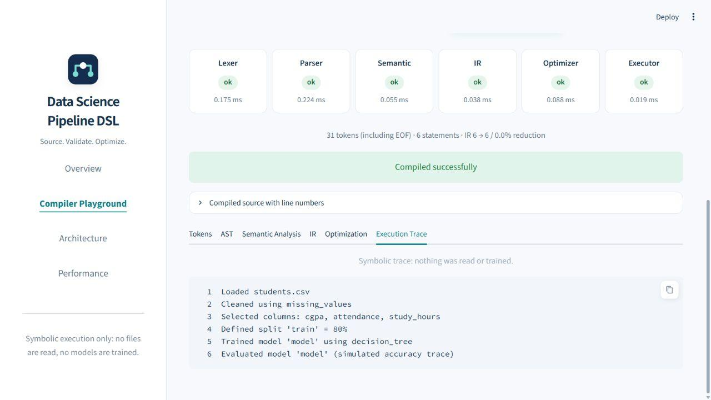
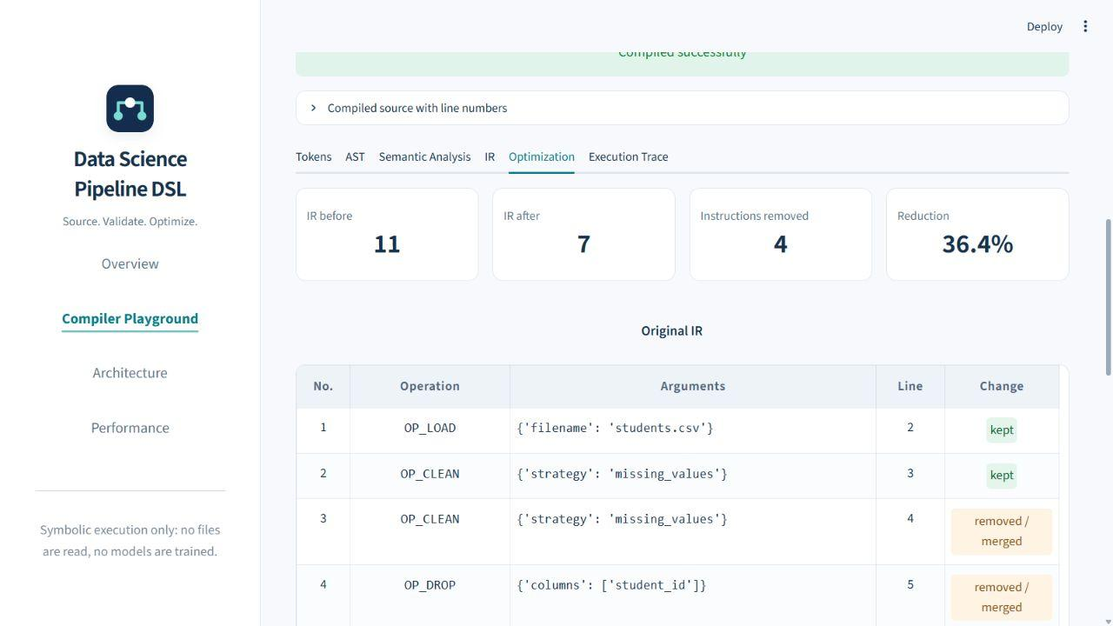
Dashboard Screenshots: Compiler Playground
Chapter 9
Successful compile: per-stage status and timing, then the symbolic execution trace
Optimization tab: IR 11 → 7 (36.4% reduction) with kept / removed / merged labels
Live app: ds-pipeline-compiler.streamlit.app · Pages: Overview, Compiler Playground, Architecture, Performance
16

Slide 17
Conclusion
Chapter 10
Achievements
Complete front-end: lexer, LL(1) parser, AST, symbol-table semantics, IR, four-pass optimizer, symbolic executor
CLI and dashboard expose every intermediate stage
267 passing tests and 20 example outcomes; optimizer preserves evaluation records
Limitations
Symbolic execution only; no schema or type checks
Free-identifier strategies and algorithms
One pipeline per file; stops at the first error
Benchmark: one machine, one synthetic template
17

Slide 18
Future Enhancements
Chapter 11
Language & validation
Optional schema for strategies/algorithms; dataset schema validation; multiple pipelines with scopes
Diagnostics
Statement-level error recovery with multiple diagnostics; warning channel for unused models
Execution & optimization
Scale statement; concrete ML backend over the same IR
Evaluation
More program families, memory profiling, property-based tests, browser rendering checks
18

Slide 19
References
[1] Aho, Lam, Sethi, Ullman, Compilers: Principles, Techniques, and Tools, 2nd ed., Pearson.
[2] R. Nystrom, Crafting Interpreters, "Parsing Expressions", craftinginterpreters.com
[3] Python Software Foundation, re: Regular expression operations, docs.python.org
[4] Python Software Foundation, dataclasses: Data Classes, docs.python.org
[5] pytest developers, pytest documentation, docs.pytest.org
[6] Streamlit documentation, docs.streamlit.io
[7] Apache Airflow Architecture Overview, airflow.apache.org
[8] Luigi documentation, luigi.readthedocs.io
[9] Kubeflow Pipelines Overview, kubeflow.org
[10] scikit-learn Pipeline API documentation, scikit-learn.org
[11] S. B. Kurkuri, project repository: github.com/Sinchana-B-Kurkuri/A-Domain-Specific-Language-and-Compiler-Front-End-for-Data-Science-Pipelines
19

Slide 20
Appendix: Key Code & Supplementary Material
# ir.py (excerpt)
@dataclass
class IRInstruction:
op: str
args: dict
def lower_to_ir(ast, symbol_table):
ir = []
for stmt in ast.statements:
if isinstance(stmt, LoadStmt):
ir.append(IRInstruction("OP_LOAD",
{"filename": stmt.filename,
"line": stmt.line}))
...
# examples/optimizer_demo.pipe
pipeline student_prediction {
load "students.csv";
clean missing_values;
clean missing_values;
drop student_id;
drop name;
select cgpa, attendance, study_hours;
split train = 80%;
train model1 = decision_tree;
train dead_model = logistic_regression;
evaluate model1;
train trailing_model = svm;
}
Report appendices also hold the full EBNF, the diagnostic catalogue (S01-S21), and reproduction commands.
20

