Slide 1
BCSE307P — COMPILER DESIGN LABORATORY
A Domain-Specific Language and Compiler
Front-End for Data Science Pipelines
REVIEW 2 | PHASE 2: CORE IMPLEMENTATION
Fall Semester 2026–27
Sinchana B Kurkuri
24BDS0352 | Slot: L49+L50

Slide 2
Project Overview & Motivation
A custom compiler front-end that turns machine-learning pipeline specification into a clean, declarative language — purpose-built for the data science workflow.
WHAT IT IS
WHY IT MATTERS
The Data Science Pipeline DSL (Domain-Specific Language) is a custom compiler frontend designed to simplify and standardize the creation of machine learning pipelines.
It addresses the complexity and boilerplate of setting up end-to-end data workflows, removing repetitive setup code around common pipeline tasks.
Load
→
Clean
→
Select
→
Split
→
Train
→
Evaluate
Tasks the DSL expresses declaratively

Slide 3
Phase 1 → Phase 2 Progress
PHASE 1 — RECAP
PHASE 2 — OBJECTIVES ACHIEVED
Single-file prototype that proved the viability of the language grammar and logic:
Refactored the monolith into a proper Python package (ds_pipeline_dsl) with separated modules
Introduced an Intermediate Representation stage (lower_to_ir)
Implemented an Optimizer to collapse redundant statements and drop unreachable code
Created a Symbolic Executor for a human-readable execution trace
Exposed a fully-featured CLI (cli.py) for inspecting each compiler stage
Established a rigorous automated test suite covering all stages and error states
initial_prototype.py
Lexer
Parser
AST
Semantic
LACKED
Modularity
Intermediate representation
Optimizations
Executor
Testing infrastructure

Slide 4
System Architecture
A standard multi-pass compiler architecture, front-end analysis through to back-end execution
FRONT-END — ANALYSIS
DSL Source
→
Lexer
→
Parser / AST
→
Semantic Analyzer
↓
BACK-END — SYNTHESIS & EXECUTION
IR (lower_to_ir)
→
Optimizer
→
Symbolic Executor
→
CLI
lexer.py → parser.py → semantic.py → ir.py → optimizer.py → executor.py, orchestrated end-to-end by cli.py

Slide 5
Core Modules — Lexer, Parser, AST, Semantic Analysis
1
lexer.py
LexicalError
2
parser.py
SyntaxError
Converts raw DSL source into a sequential stream of tokens.
Constructs an Abstract Syntax Tree (AST) from the token stream.
Token namedtuple + regex rules. Discards whitespace/comments; raises LexicalError on invalid characters.
Recursive-descent Parser using peek(), advance(), expect(). Raises SyntaxError_ on grammar violations.
3
ast_nodes.py
Dataclasses
4
semantic.py
SemanticError
Defines the AST node structures.
Validates the logical correctness of the AST.
Dataclasses: PipelineNode, LoadStmt, CleanStmt, SplitStmt, TrainStmt, EvaluateStmt.
SymbolTable tracks datasets, splits, models. Checks ordering (e.g. no train before split) and split bounds (0–100). Raises SemanticError.

Slide 6
Intermediate Representation (IR)
ir.py
LOWERING: AST → IR
Lowers the hierarchical AST into a flat Intermediate Representation.
AST Statement Node
(e.g. a pipeline statement)
DATA STRUCTURE
IRInstruction dataclass — an opcode (op) + a dictionary of arguments (args)
↓ one-to-one lowering
IRInstruction
{ op, args }
CORE LOGIC
Maps each AST statement node into exactly one corresponding IRInstruction, sequentially
INTERACTION
Receives the validated AST from semantic.py and outputs an IR instruction list to the optimizer
Sequential list of IRInstructions → passed to optimizer.py

Slide 7
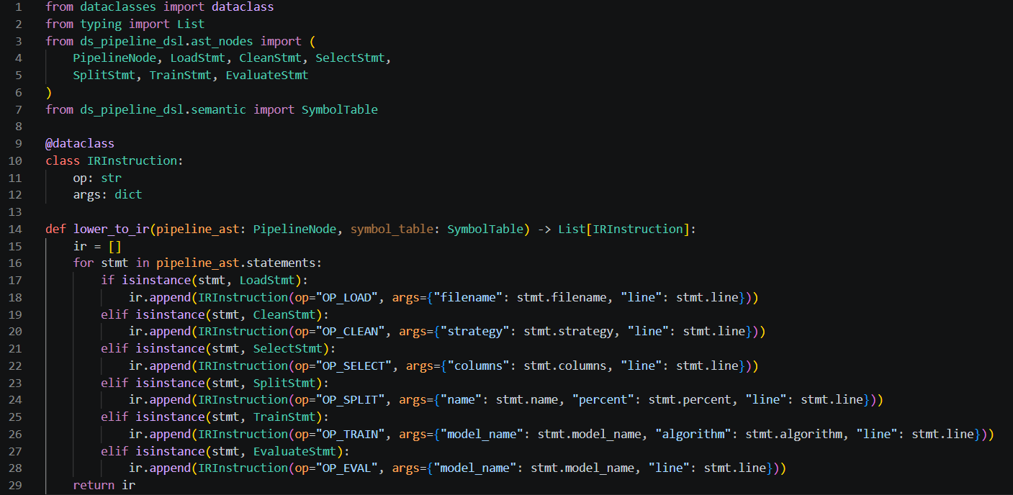

Slide 8
Optimizer & Symbolic Executor
optimizer.py
executor.py
Improves the efficiency of the compiled code by transforming the IR.
Performs a symbolic execution of the optimized IR.
Two passes applied together:
Data structures — generates and returns a list of human-readable trace strings
Core logic — iterates over the optimized IR list and maps each opcode to a formatted, declarative status message
Interaction — the final endpoint of the compilation pipeline, translating machine-like IR back to the user context
Duplicate collapse — collapses immediately consecutive duplicate instructions (e.g. redundant OP_CLEAN or OP_SELECT with identical arguments)
Dead-code stripping — strips unreachable instructions that follow an OP_EVAL instruction
Interaction: takes unoptimized IR from ir.py → provides optimized IR to the executor.

Slide 9
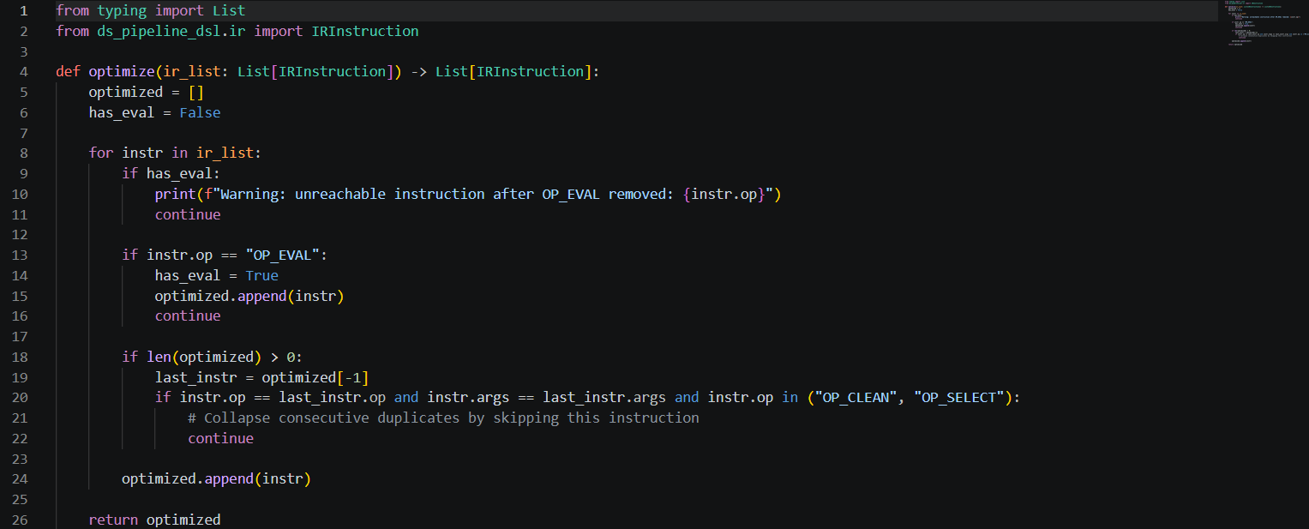

Slide 10
CLI & Error Handling
cli.py
GRACEFUL ERROR HANDLING
Provides a user-facing command-line interface and orchestrates the entire compiler pipeline.
cli.py captures specific exceptions to display clean error messages — without raw Python tracebacks:
STAGE-INSPECTION FLAGS (argparse)
LexicalError
raised by lexer.py on invalid characters
--tokens
Token stream
SyntaxError
raised by parser.py on grammar violations
--ast
Abstract syntax tree
--ir
Intermediate representation
SemanticError
raised by semantic.py on logical violations
--optimized-ir
Optimized IR
Also selectively prints data from each intermediate stage, based on the flags passed above.
--trace
Symbolic execution trace

Slide 11
Functional / End-to-End Demonstration
Four .pipe files under examples/ demonstrate the compiler end-to-end via the CLI
Valid Basic Pipeline
Prints all 5 stages (Tokens, AST, IR, Optimized IR, Trace), concluding with the successful 6-line evaluation trace.
1
python -m ds_pipeline_dsl.cli examples/valid_basic.pipe
Semantic Error — Train Before Split
Semantic Error at line 5: training data has not been defined... (execution halts gracefully).
2
python -m ds_pipeline_dsl.cli examples/invalid_train_before_split.pipe
Lexical Error — Invalid Character
Lexical Error at line 2, col 9: unexpected character '@' (execution halts gracefully).
3
python -m ds_pipeline_dsl.cli examples/invalid_lexical_error.pipe
Syntax Error — Missing Semicolon
Syntax Error at line 3: expected SEMI, found CLEAN ('clean') (execution halts gracefully).
4
python -m ds_pipeline_dsl.cli examples/invalid_syntax_error.pipe

Slide 12
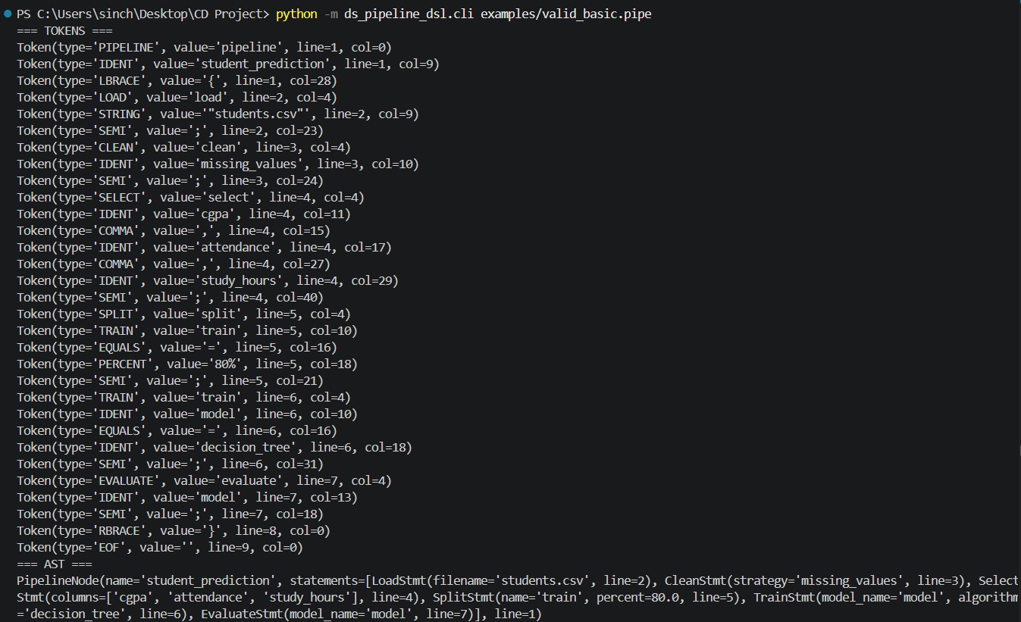
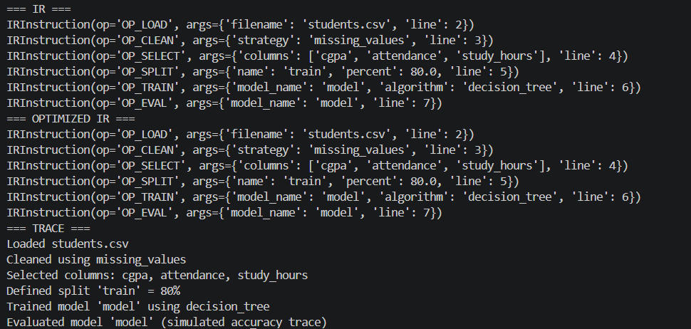

Slide 13
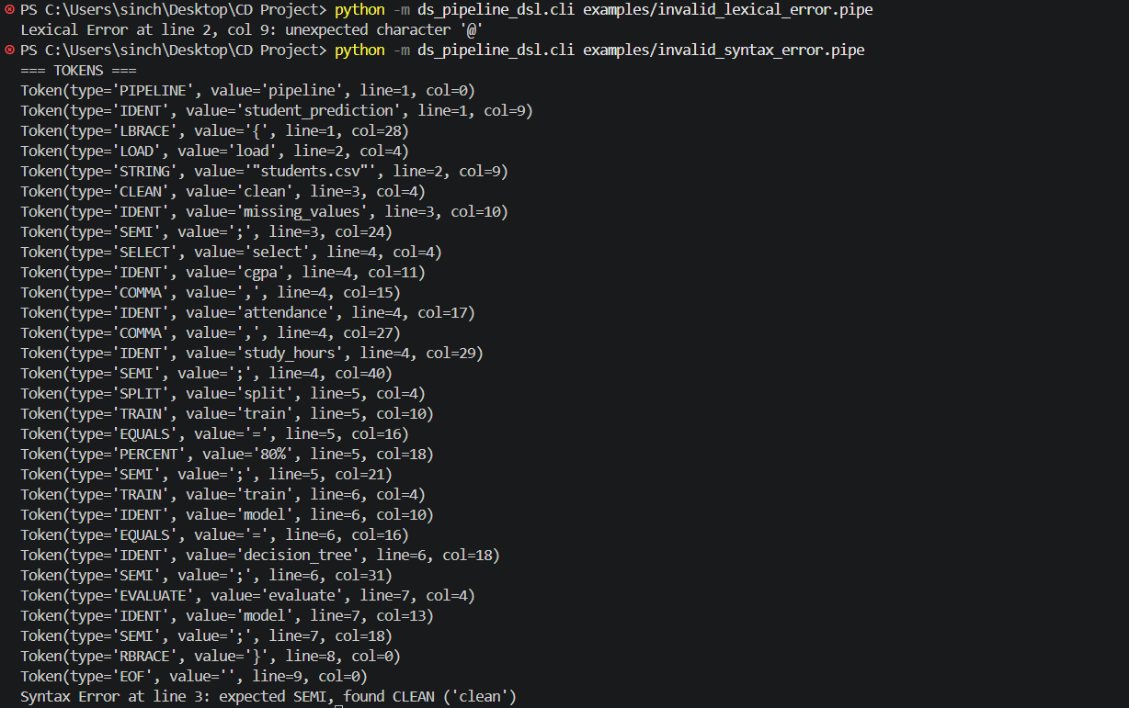

Slide 14
Testing & Results
19 / 19
An automated test suite covers all compiler stages and error states.
TESTS PASSED • 0.16s
Test File | Verified Behavior | Tests | Status
test_lexer.py | Valid token generation; correct error handling for illegal characters | 2 | Passed
test_parser.py | AST node construction; syntax error generation for missing elements | 2 | Passed
test_semantic.py | Valid logical flows; split-bounds checks; missing prerequisites (e.g. train before split) | 3 | Passed
test_ir.py | Correct generation of flat opcodes; preserved sequential ordering from AST to IR | 1 | Passed
test_optimizer.py | Elimination of exact duplicate operations; stripping of dead code following evaluations | 3 | Passed
test_executor.py | Proper formatting and generation of the final symbolic trace | 1 | Passed
test_cli.py | Argument flag ingestion; stage visualization; graceful catching/formatting of errors | 3 | Passed
test_examples.py | End-to-end execution of all 4 .pipe examples, verifying expected successes and failures | 4 | Passed

Slide 15
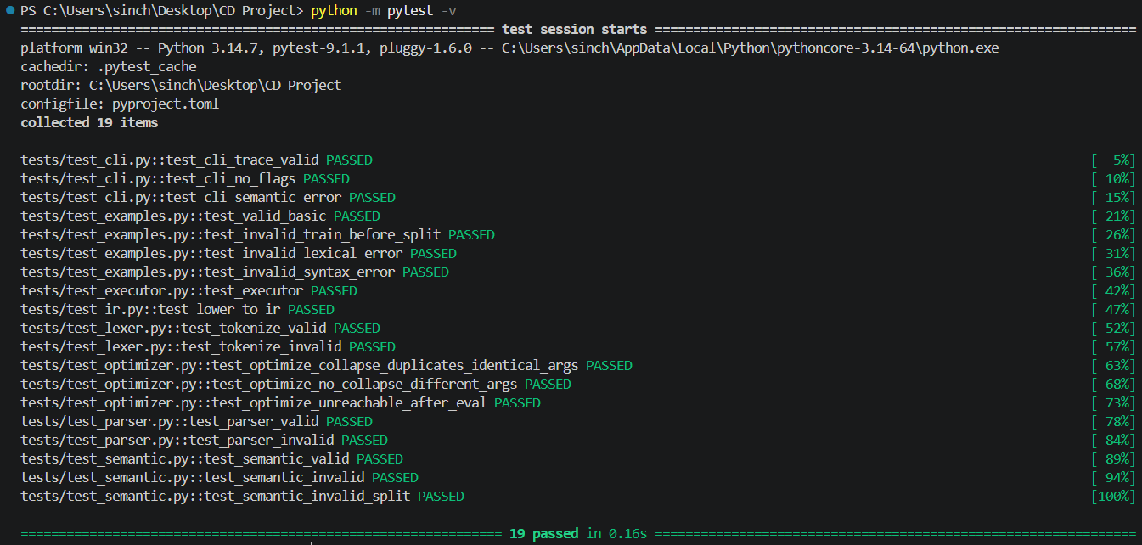

Slide 16
Limitations & Future Enhancements
KNOWN LIMITATIONS
FUTURE ENHANCEMENTS
The executor is purely symbolic — it produces human-readable trace statements rather than performing actual machine learning operations
No real datasets are loaded — the compiler references data files for validation but does not read file contents
No real model training or prediction — evaluated models are placeholder simulations
Limited optimization — only the duplicate-collapse and unreachable-code-removal rules currently defined in optimizer.py
Enhanced semantic analysis — stronger dependency, reference, and argument validation to detect more pipeline errors before execution
DSL construct expansion — additional data-processing constructs propagated through the complete pipeline
Advanced optimization passes — redundant-operation and dead-stage elimination
Comprehensive testing and performance evaluation — complex/boundary cases, end-to-end integration tests, performance across pipeline sizes

Slide 17
CONCLUSION — REVIEW 2 PROGRESS SUMMARY
Phase 2 effectively evolved the Data Science Pipeline DSL from a proof-of-concept into a robust, structured compiler frontend.
By introducing an intermediate representation, an optimization pass, and extensive testing, the ds_pipeline_dsl package sets a strong foundation for future backend execution capabilities.
8
19 / 19
4
COMPILER MODULES
TESTS PASSED
DEMO PIPELINES
Source code:
https://github.com/Sinchana-B-Kurkuri/A-Domain-Specific-Language-and-Compiler-Front-End-for-Data-Science-Pipelines

