Slide 1
Fault-Tolerant Routing
Performance Comparison of RIP and OSPF
Convergence Under Network Failures
Harshith Reddy V · 24BCE2479
B.Tech Computer Science and Engineering
Sinchana B Kurkuri · 24BDS0352
B.Tech Computer Science and Engineering (Data Science)
VIT Vellore · Fall Semester 2026-27 · October 2026
BCSE308P · F1 Team21
01
Notes:
Official project title appears on slide. Team in ascending register number. Faculty: Dr. Sreethar S, Associate Professor Grade 1. State that the dashboard replays completed Packet Tracer experiments and includes three assumed link estimates.

Slide 2
Problem and motivation
A surviving physical path does not guarantee uninterrupted service
A failure changes the usable topology. Routers must recognise the change and select a route.
The lab question: how did RIP and OSPF behave on the same four-router ring?
Observed service recovery
Route changes
Evidence and uncertainty
BCSE308P · F1 Team21
02
Notes:
Explain redundancy versus recovery. This is a controlled educational comparison. Do not claim a general ranking from single runs. Protocol mechanisms: RFC2453 https://www.rfc-editor.org/info/rfc2453/ and RFC2328 https://www.rfc-editor.org/info/rfc2328/.

Slide 3
Existing protocols and the comparison gap
Property | RIPv2 | OSPFv2
Mechanism | Distance vector | Link state and SPF
Metric | Hop count | Cumulative cost
Recorded AD | 120 | 110
Saved scope | Version 2; no auto-summary | Process 1; area 0
Specifications explain mechanisms. Our recordings show this topology’s behaviour. Neither establishes repeatability from one timed run.
BCSE308P · F1 Team21
03
Notes:
Primary sources [1] RFC2453, [2] RFC2328, [3] RFC1058. Administrative distances are visible in route screenshots. No new routing protocol was developed. Default timer discussion belongs to theory, not a measured timing claim.

Slide 4
Objectives and educational contribution
Compare the same topology and addressing
Verify before, alternate and restored routes. Retain the recorded timing values and their provenance.
Define the timing boundary
Use OCRT for observed end-to-end recovery, with explicit stopwatch and simulator limitations.
Make the evidence inspectable offline
Present recorded screenshots, assumed estimates and illustrative paths with distinct labels.
BCSE308P · F1 Team21
04
Notes:
Novelty is modest: reproducible evidence organisation, a clearly bounded metric and an evidence-linked offline dashboard. It is not an original protocol and does not claim to outperform research literature.

Slide 5
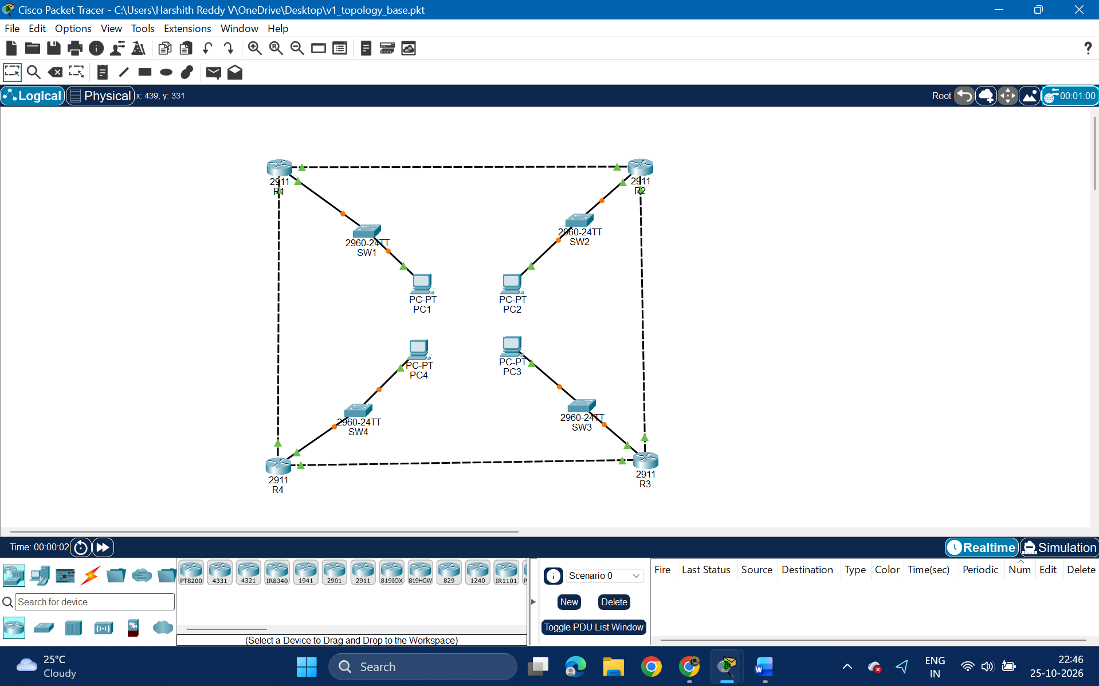
Topology and verified addressing
4 × Cisco 2911
4 × Cisco 2960-24TT
4 × PC-PT
/30 transit links
/24 LANs
PC .10, gateway .1
Recorded evidence (Packet Tracer) · E06. Addresses verified separately against saved .pkt files.
BCSE308P · F1 Team21
05
Notes:
Original evidence image E06 from CNPj34.docx. Ring R1-R2-R3-R4-R1; no diagonal. Actual masks and endpoint interfaces are in the report and interactive inspector. A failed router’s own LAN is not gateway-redundant. Saved files are version9.0.1.0858; CPU Intel Core Ultra5 125H, current system designated by user.

Slide 6
Methodology and OCRT
1 Verify the route and start PC ping
2 Trigger failure and start stopwatch
3 Wait for consecutive successful replies
4 Preserve route and ping evidence
5 Restore the failed component
Observed Connectivity
Recovery Time
From failure trigger until replies become consistently successful.
Includes human reaction, detection, routing, ARP and simulator processing.
External stopwatch. Not ping RTT or a timeout-count calculation.
BCSE308P · F1 Team21
06
Notes:
Guide Phase3.2: stop at the first reply followed by another successful reply. Phase3.4 limitation is reproduced verbatim in report/dashboard/README; reaction approx0.3–1s is guide-stated uncertainty. No rerun or new measurement is claimed. PC capture accepts ping -t destination; IOS syntax differs.

Slide 7
Scenarios and data status
Case | Traffic / action | Available observation
A: R1–R2 | PC1 to PC2; G0/0 shutdown | Measured single-run timing and route change
Other three links | R2–R3, R3–R4, R4–R1 | Assumed (estimated – not measured)
B: R4 off | PC1 to PC3; router power-off | RIP later run; OSPF earlier run
C: link restored | R1–R2 re-enabled | Route return; OSPF TTL/path interval
No completed ping summaries. No repeated-trial dataset. Image E22 remains needs-confirmation and is excluded as restoration proof.
BCSE308P · F1 Team21
07
Notes:
The performed router-failure experiment differs from guide PC2→PC4. Preserve actual PC1→PC3/R4 case. All original images are retained losslessly. Assumed cases have run_count0 and blank evidence IDs. Measurements are n1; absence of numeric OCRT for no-loss OSPF is not zero.

Slide 8
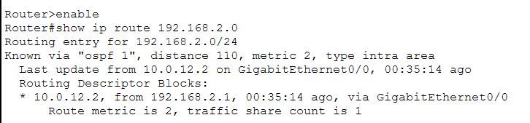
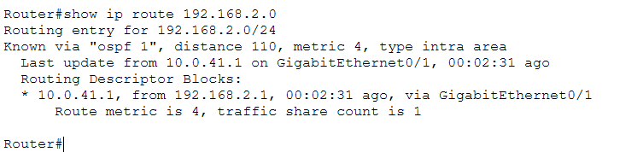
Link failure: recorded and assumed values
Recorded before: OSPF cost 2
Recorded after: OSPF cost 4
Hatched bars: Assumed (estimated – not measured). Solid bars: recorded R1–R2 single runs.
Four-link descriptive averages, including three Assumed links: RIP 25.75 s / OSPF 7.00 s. Reduction of averages 72.82%. No statistical claim.
BCSE308P · F1 Team21
08
Notes:
Chart is editable. Source CNPj34 table: R1R2 26/7s MEASURED n1; R2R3 24/6s ASSUMED; R3R4 28/8s ASSUMED; R4R1 25/7s ASSUMED. Assumed (estimated – not measured) applies to every estimate and derived summary. Per-link reductions73.08% measured-single-run,75%,71.43%,72% Assumed. Average25.75/7=3.6786; reduction of averages72.8155%. These are four-case descriptive summaries, not repeated-trial means. E28/E31 prove cumulative routes, not durations. Each screenshot is Recorded evidence (Packet Tracer).

Slide 9
Router failure and restoration require care
Observation | RIP | OSPF
R4 off, PC1 to PC3 | ≈11 s in later run | Earlier run: no loss observed; OCRT not measurable
Route after R4 off | Via R2, hop metric 2 | Via R2, cost 3
R1–R2 restored | Route returned; timing unreliable | ≈11 s to TTL 124–126 path change
Unlike earlier/later router-failure runs are not directly comparable. No-loss OSPF is never a zero-second recovery measurement.
BCSE308P · F1 Team21
09
Notes:
Recorded evidence (Packet Tracer), CNPj34 ExpB/C tables, E07/E20/E23/E37 routes. Opposite LAN routes were equal-cost via R2/R4. Already forwarding via R2 is an unverified explanation for no-loss OSPF. OSPF C timing refers to TTL/path change, not outage OCRT. E22 excluded. No loss count/percentage is available.

Slide 10
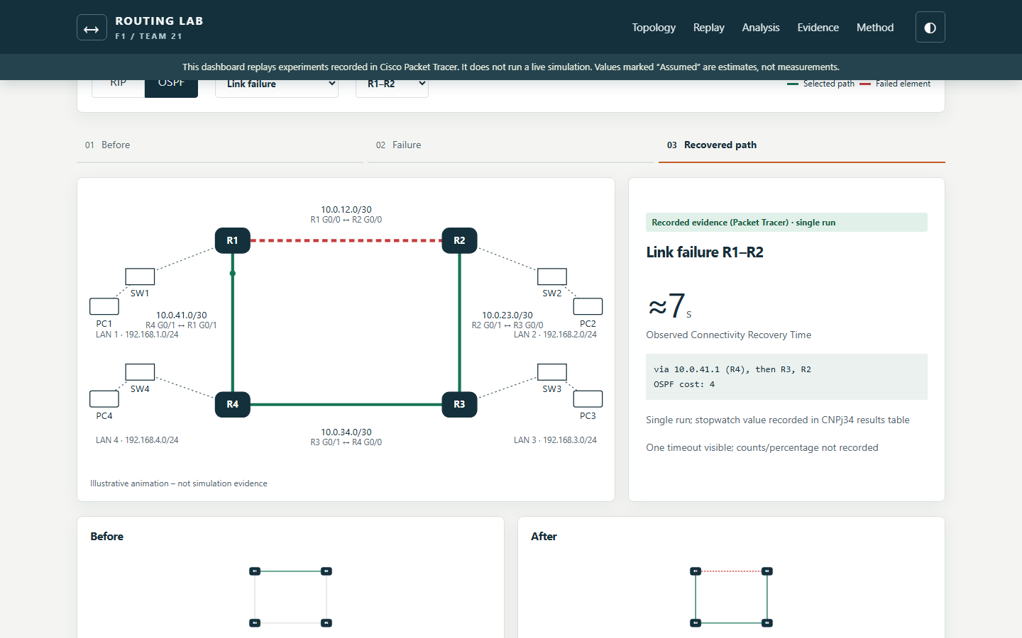
Offline dashboard demonstration
Open index.html
Select protocol and scenario
Step through evidence
Toggle Assumed values
Inspect source screenshots
Illustrative animation – not simulation evidence. Screenshot of the tested offline frontend.
BCSE308P · F1 Team21
10
Notes:
The original Packet Tracer screenshots in the player carry Recorded evidence (Packet Tracer) labels. The dashboard itself is an offline presentation of those experiments, not a live simulator. Test screenshot: Testing/dashboard_experiment_player.png. HTML/CSS/vanillaJS with Chart.js4.4.8. Data/results.csv is canonical. Explain data.js, app.js, generate_charts.py and validate_data.py.

Slide 11
Limitations and future scope
Current evidence
Next controlled experiments
Single timed runs
Three Assumed link estimates
Unlike router-failure runs
Stopwatch and simulator effects
Missing completed ping summaries
Time all four links individually
Repeat matched trials at least ten times
Automate timestamp collection
Verify active forwarding paths
Compare emulated or real routers
BCSE308P · F1 Team21
11
Notes:
Assumed (estimated – not measured) values are not independent experimental corroboration. Average across supplied mixed-status cases is not repeated-trial mean. Future repeated trials would justify mean±SD; none is claimed now. BFD, tuned timers, EIGRP and multi-area OSPF are possible future extensions, not implemented results.

Slide 12
Conclusion and references
The measured R1–R2 runs favour OSPF
≈26 s RIP versus ≈7 s OSPF OCRT, single run each. Both protocols used an alternate ring route and returned to the preferred route after restoration.
The four-link descriptive average includes three Assumed estimates. Stronger claims need individually timed, repeated and matched experiments.
Primary references
[1] Malkin, RFC 2453, 1998 [2] Moy, RFC 2328, 1998
[3] Hedrick, RFC 1058, 1988 [4–5] Cisco RIP / OSPF documentation
BCSE308P · F1 Team21
12
Notes:
References: [1] G. Malkin, “RIP Version 2,” RFC 2453, Nov. 1998, doi:10.17487/RFC2453. https://www.rfc-editor.org/info/rfc2453/
[2] J. Moy, “OSPF Version 2,” RFC 2328, Apr. 1998, doi:10.17487/RFC2328. https://www.rfc-editor.org/info/rfc2328/
[3] C. Hedrick, “Routing Information Protocol,” RFC 1058, Jun. 1988, doi:10.17487/RFC1058. https://www.rfc-editor.org/info/rfc1058/
[4] Cisco, “Cisco IOS IP Routing: RIP Command Reference: RIP Commands,” online documentation, accessed Oct.26,2026. https://www.cisco.com/c/en/us/td/docs/ios/iproute_rip/command/reference/irr_book/irr_rip.html
[5] Cisco, “IP Routing: OSPF Configuration Guide, Cisco IOS XE Release 2,” online documentation, accessed Oct.26,2026. https://www.cisco.com/c/en/us/td/docs/ios-xml/ios/iproute_ospf/configuration/xe-2/iro-xe-2-book.pdf
Conclusion only for the observed single-run link comparison. Faculty Dr.Sreethar S. Both members must explain the data policy and code.

