Slide 1
My Vivino — Data-Driven Wine Recommendation System
Replacing a rules-based engine with scalable machine learning
Prepared By
Sinchana Rai & Khagendra Adhikari
Qwasar Silicon Valley
February 4, 2026

Slide 2
Business Problem
The Challenge:
My Vivino serves thousands of wines to a large user base
Existing recommendations rely on static rules
Limited personalization reduces engagement and discovery
Objective
Develop a scalable recommendation system that leverages historical user behavior to deliver personalized wine suggestions.
Strategic Shift
Rules → Data → Personalization

Slide 3
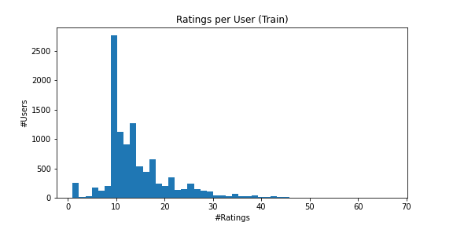
Dataset & Modeling Rationale
Dataset Overview — X-Wines:
1,007 wines
10,561 users
150,000 historical ratings
Key Insight
The highly sparse user–item interaction matrix motivates the use of matrix factorization–based collaborative filtering.

Slide 4
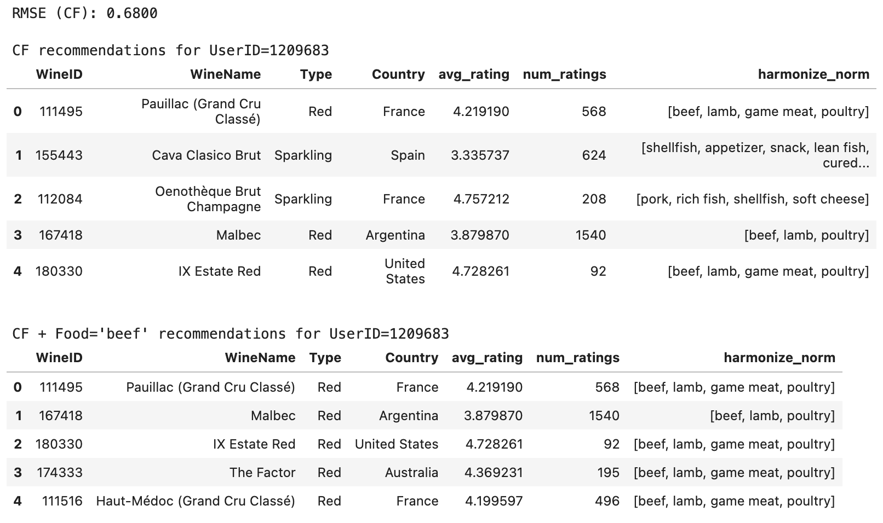
Recommendation Examples
What This Shows:
Personalized discovery
Context-aware suggestions
Production-ready fallback

Slide 5
Business Impact
Expected Impact
Improved recommendation
Increased user engagement
Higher conversion potential
Better product discovery
Production Readiness
Modular pipeline
No data leakage
Robust cold-start strategy
Scalable architecture
Strategic Value
Establishes the foundation for real-time personalization at scale.

