Slide 1
CI/CD Pipeline

Slide 2
Scenarios of DevOps culture
Cross-functional Collaboration
Scenario: A software development team is working on a new feature. They regularly collaborate with operations engineers to ensure that the infrastructure requirements are considered early in the development process. Operations engineers provide feedback on scalability, performance, and deployment strategies, contributing to a smoother release process.

Slide 3
Automated Deployment
Scenario: Whenever a developer commits new code to the repository, a CI/CD pipeline automatically builds the application, runs unit tests, and deploys the changes to a staging environment for further testing. This automation reduces manual effort and ensures that new features can be quickly validated and deployed.

Slide 4
Infrastructure as Code (IaC)
Scenario: A DevOps team uses configuration management tools like Terraform or Ansible to define and provision infrastructure resources such as virtual machines, databases, and networks. Infrastructure configurations are version-controlled alongside application code, enabling consistent and reproducible deployments across different environments.

Slide 5
Monitoring and Alerting
Scenario: An application experiences a sudden increase in error rates. DevOps engineers use monitoring tools like Prometheus or Datadog to identify the root cause of the issue quickly. Automated alerts notify the team, enabling them to respond promptly and mitigate the impact on users.

Slide 6
Feedback Loop
Scenario: After a production deployment, users report performance issues with a critical feature. The DevOps team conducts a post-mortem analysis to identify the cause of the problem and implements improvements to prevent similar issues in the future. Feedback from users is incorporated into the development process to prioritize performance optimizations.

Slide 7
Blue-Green Deployment
Scenario: A DevOps team implements a blue-green deployment strategy to minimize downtime during software updates. They maintain two identical production environments: one (blue) running the current version of the application and the other (green) running the updated version. Traffic is gradually routed from the blue environment to the green environment, allowing for seamless cutover with minimal disruption.

Slide 8
CI/CD Pipeline
Continuous Integration (CI) and Continuous Delivery (CD) are fundamental practices in DevOps that automate the process of building, testing, and deploying software, enabling teams to release high-quality updates rapidly and reliably

Slide 9
Scenario: Imagine A Software Development Team Working On An E-commerce Platform. They Have Implemented CI/CD Pipelines To Streamline Their Release Process.
Continuous Integration (CI)
In this scenario, developers frequently commit their code changes to a shared repository hosted on a platform like GitHub. Each commit triggers a series of automated tasks, including Build
Automated Tests: After the build process, automated tests are executed to validate the functionality and quality of the software. These tests include unit tests, integration tests, and possibly end-to-end tests. If any tests fail, developers are notified immediately, allowing them to address issues promptly.
Code Quality Checks: Additionally, static code analysis tools may be employed to assess the codebase for adherence to coding standards, potential bugs, and security vulnerabilities.

Slide 10

Real-Time Example
List of steps
Developer A commits a code change to add a new payment gateway integration feature.
The CI server detects the new commit and triggers the CI pipeline.
The code is built, tests are executed, and code quality checks are performed automatically.
If all tests pass and the code meets quality standards, the changes are considered for further integration and deployment.

Slide 11
Continuous Delivery (CD)
Once the code changes have been successfully integrated and tested through the CI pipeline, they are ready for deployment to production-like environments. CD involves automating the deployment process to ensure that updates can be released to users quickly and reliably.

Slide 12

Real stories

Slide 13
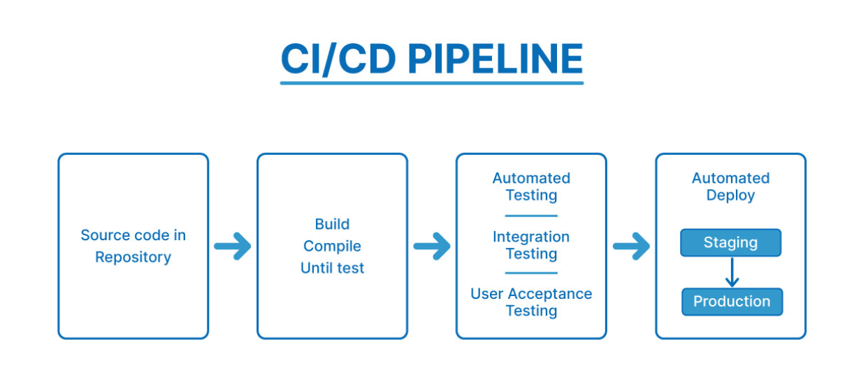

Slide 14
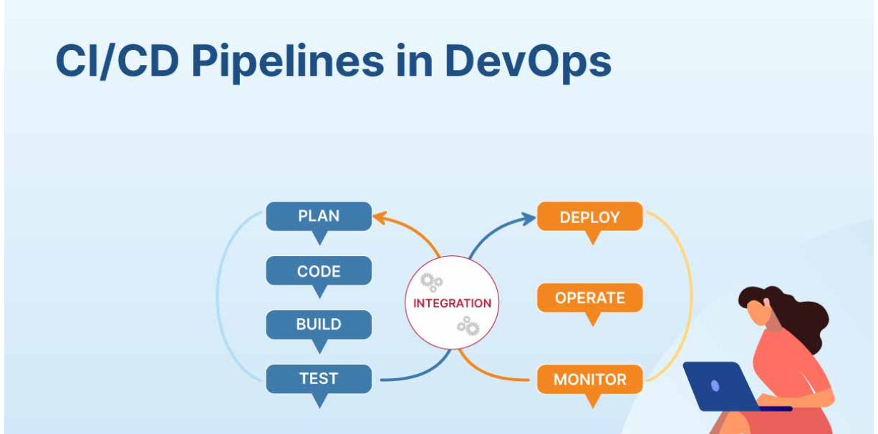

Slide 15
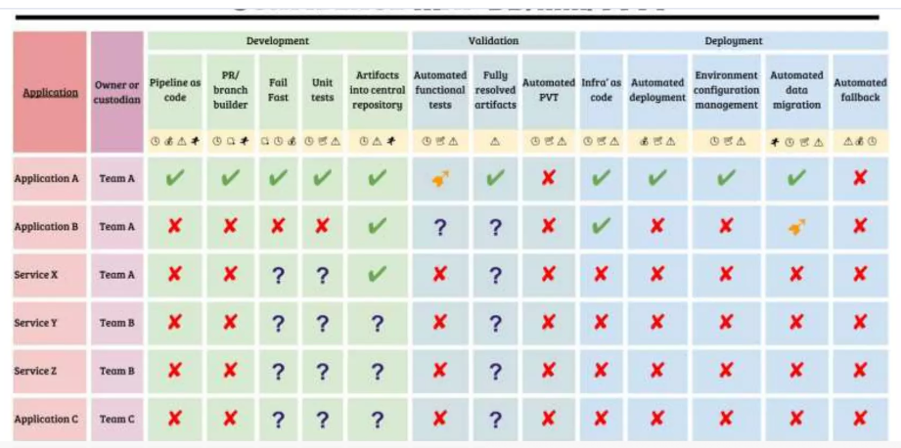
CI/CD Pipeline Maturity Metrics Confidence map

Slide 16
Summary
Developers regularly check for code changes in a shared repository. Every time a code change is detected, it triggers an automated build process that compiles the new Code, runs automated tests to check for errors, and reports the results. When an issue is found, developers are immediately notified to quickly fix the issue and push code changes to the main branch.

Slide 17
CD(Summary)
These phases refer to automating Deployment to the target environment. This target environment can be testing or production, or any other environment. In Continuous Deployment, there is no human intervention. The code changes are automatically deployed to production.

Slide 18
Summary (CI)
Source code (such as Java or C) is built, packaged, or containerized into deployable instances. Team testing phase
Merging Code from different branches of the repository happens. Code changes trigger notifications to CI/CD orchestration tools (such as Jenkins) by repositories (Git or SVN) that run the appropriate pipelines.

Slide 19
Summary (CD)
During this phase, test variants such as user acceptance, performance, regression, and production acceptance testing (depending on operations) are run manually or automatically (also known as dynamic application validation). (For example, automated tests are run using UFT, Xray, Selenium, or Robot Framework.)
The developer is responsible for writing the tests. Test scripts are written automatically.

Slide 20
Exercise
Fork a repository containing a basic HTML/CSS website, enable GitHub Pages, and customize the website.

Slide 21
Fork the Repository
Go to the repository Simple HTML/CSS Starter on GitHub.
Click the "Fork" button in the top-right corner of the page.
This will create a copy of the repository in your GitHub account.

Slide 22
Enable GitHub Pages
Once you've forked the repository, go to your forked repository on GitHub.
Click on the "Settings" tab.
Scroll down to the "GitHub Pages" section.
Choose the branch main and the root directory where your website files are located.
Click the "Save" button.
GitHub Pages will now be enabled for your forked repository, and your website will be accessible at a URL provided in the "GitHub Pages" section.

Slide 23
Customize the Website
Clone your forked repository to your local machine.
Open the HTML and CSS files in a text editor.
Make changes to the content, styles, or layout of the website as desired.
Save your changes.

Slide 24
Commit and Push the Changes:
Commit your changes to your local repository.
Push the changes to GitHub.
Verify the Changes:
Go to the GitHub Pages URL provided in the "GitHub Pages" section of your repository's settings.
You should see the updated version of the website reflecting the changes you made.

