Slide 1
Secure the data Hiding In Images Uisng Steganography
CAPSTONE PROJECT
Presented By:
Student Name : Sinchana K S
College Name & Department : Surana College, MCA Department

Slide 2
OUTLINE
Problem Statement
Technology used
Wow factor
End users
Result
Conclusion
Git-hub Link
Future scope

Slide 3
Problem Statement
This project demonstrates a basic form of image encryption, where a secret message is embedded into an image using pixel manipulation. The process allows for hiding confidential information inside a seemingly normal image, which can only be retrieved with the correct passcode. The primary aim is to offer a simple, visual form of message hiding and security, with basic encryption and decryption operations based on user input.

Slide 4
Technology used
Python: The main programming language for implementing the algorithm and managing image processing.
OpenCV (cv2): A library that allows for efficient image manipulation and processing.
Dictionaries: Used for mapping characters to their corresponding ASCII values during the encryption
and decryption process.
Image Manipulation: The core of the project, where pixel values are adjusted to encode the
secret message within the image.

Slide 5
Wow factors
The ability to hide a message inside an image and extract it later using a passcode is a fun yet simple example of steganography. The project allows users to see how basic encryption works visually, creating a sense of security while adding an interactive, intriguing aspect to image processing.

Slide 6
End users
.
Tech enthusiasts: People who are learning encryption, cryptography, or steganography.
Developers: Those who want to experiment with basic cryptography or image manipulation.
Privacy-conscious individuals: Users who want to send confidential information in a disguised format, which looks like a normal image.

Slide 7
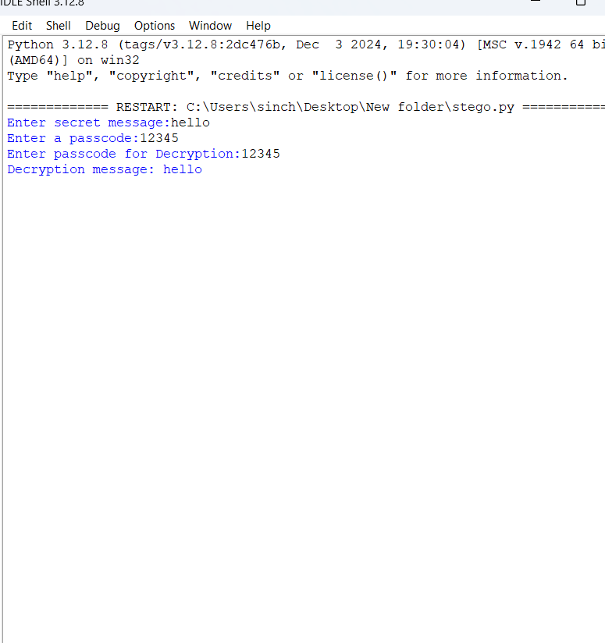
Results
The result is a modified image (encrypted image) where each pixel has been altered to represent a character from the secret message. When decrypted with the correct passcode, the original message is restored. The system is simple and demonstrates basic concepts of encryption, though it is not intended for real-world security due to its simplicity.

Slide 8

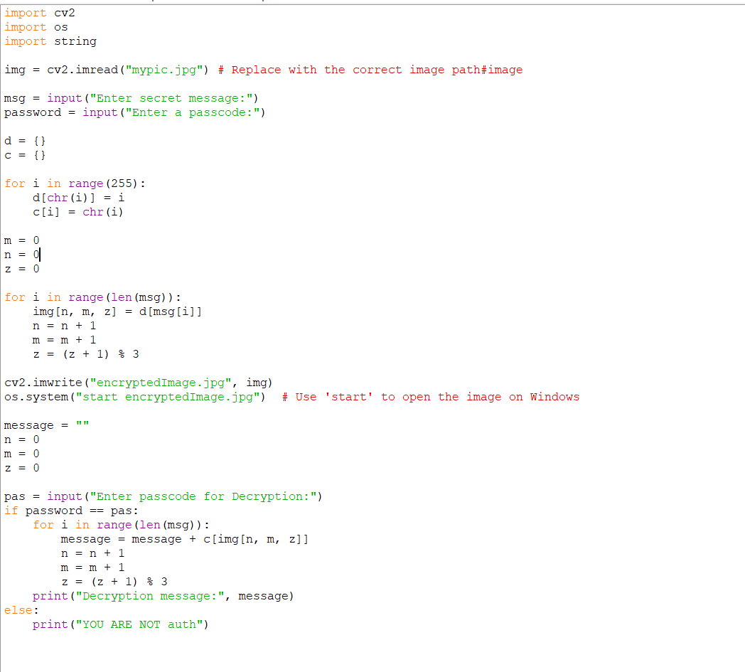

Slide 9
Conclusion
This image encryption project provides an accessible introduction to the concept of steganography and cryptography. While it is not highly secure, it effectively illustrates how digital images can be used to store hidden information. The encryption and decryption process is straightforward, and the use of a passcode provides a basic level of protection for the hidden message.

Slide 10
GitHub Link
https://github.com/Sinchana090602/Stegonography.git

Slide 11
Future scope(optional)
Stronger Encryption: Implementing advanced cryptographic algorithms such as AES or RSA to
ensure more robust security.
Handling Large Messages: Improve the method to handle larger secret messages without
compromising the quality or integrity of the image.
GUI Interface: Develop a graphical user interface to make the tool more user-friendly, especially
for those unfamiliar with coding.
Steganography Enhancements: Research and develop more sophisticated methods to hide
messages within images without significantly altering the image’s visual appearance.
File Format Support: Expand the tool to support other image file formats (e.g., PNG, GIF) a
d other media like audio or video for broader applications of steganography.

Slide 12
THANK YOU

