Slide 1
Credit card fraud detection
using machine learning algorithms

Slide 2
Abstract
It is vital that credit card companies are able to identify fraudulent credit card transactions so that customers are not charged for items that they did not purchase.
Such problems can be tackled with Data Science and its importance, along with Machine Learning, cannot be overstated.
Surveys suggest that typically 5% of the overall transaction will be fraud and organisations are losing their revenue because of fraud.

Slide 3
Common types of Fraud
Online Fraud
Threat
Credit card fraud
Theft of inventory
Increase in non-cash transaction=more opportunities of fraud

Slide 4
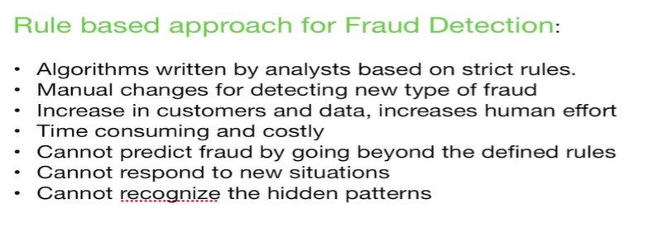
How to deal with Fraud

