Slide 1
Customer Retention

Slide 2
Problem statement
Customer satisfaction has emerged as one of the most important factors that guarantee the success of online store.it has been posited as a key stimulant of purchase, repurchase intentions and customer loyalty.
models have been carried out to propose the models for customer activation and customer retention.
Five major factors that contributed to the success of an e-commerce store have been identified as:
service quality,
system quality,
information quality,
trust and net benefit.
The research furthermore investigated the factors that influence the online customers repeat purchase intention.
The combination of both utilitarian value and hedonistic values are needed to affect the repeat purchase intention (loyalty) positively, which are very much critical for customer satisfaction.

Slide 3
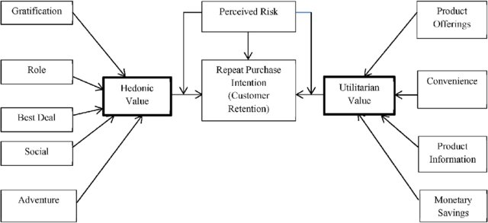
Life Cycle of Purchase values

Slide 4
Understanding
So initially we are given the dataset having various information about many questions that were captured from the survey of e-commerce websites by respondants over a period of time..
Information of the respondants include basic data such as City,Age group,which site they will usually use to shop?,Gender, Performance of website. etc
Many such parameters captured in the survey will be the deciding factor to opt for an e-commerce website which will then be used to improve to analyze the business trends across the market.
So basically, we will analyze the dataset to find the patterns of trends and analyze the data to gain insights of what’s happening in the market which is eventually decided by the customer’s mindset.

Slide 5
Exploratory Data Analysis
At first we will correct the header patterns of the feature by removing the unwanted space & numbers that is there in the feature columns to convert it into readable format.
We will then analyse the data set by knowing shape,statistics,sum of null values present in the dataset,datatypes of the features,unique values, unique value counts.This will help us to know main characteristics of the datasets.
Typically we use many Graphs to analyze the dataset. In the current problem statement we will begin by plotting series of pie charts representing each feature based on the value counts. we have used matplotlib library instance to plot the graph
ex: How old are you ?, Gender of the respondant

Slide 6
Plots used for Visualization
Pie chart
Line plot
Violin plot
Count plot
Strip plot
All the other plots listed here can be used to Analyze continuous variables and categorical variables
Box plot- to find the Outliers,Quartiles,Range
Scatterplot- to know the relationship between one feature with the other
Heatmap- to know the correlation of one variable with the other
Histplot- to know the frequency of occurance

Slide 7
Conclusion of the analysis
On analysis, we found that,
There are double the number of women than men who have taken this survey.
Most of the people are in their 30's followed by 20's, teenagers and senior citizen are the least in number.
Most of the people belong from delhi, noida and banglore, ambiguity can also be seen as noida has two categories (noida and grater noida) which needs to be handled
Most of the people shopping online are shopping from a long time.
Majority of people shop online less than 10 times a year,and least people will shop 42 times & above.Ambiguity can be seen for range 42 times and above since we have lesser numbers to analyze,which then will be handled

Slide 8
Conclusion of the analysis
On analysis, we found that :
Intent behind shopping-
Satisfaction- Almost all the people who have shopped from amazon, flipkart and paytm are satisfied. People who shop from a more number of online brands doesn’t seem to be satisfied.
Benefits- People shopping from amazon and paytm are getting benefits from the loyalty points, flipkart and sanpdeal also seem to give such benefits but people who shop from almost everywhere disagree with this statement too
Online retailing-
Highest number of people have been shopping online for above 4 years except for the age group below 20 years and above 50 years. People who are shopping online for 1-2 years does not include teenagers and elder people.
Online retailing- Even though people who are shopping online for more than 3 years donot use the application rather use search engine and direct url's in large number which indicates that online brands should update all their platforms rather than just application.

Slide 9
Conclusion of the analysis
On analysis, we found that :
Brand image-
Amazon, Flipkart have been had the highest votes for having all the positive points and have maintained a very good brand image followed by paytm and the myntra.
We can clearly see that most of the time people abandon the bag is beacuse they get a better alternative offer or promo code not applicable. There is also lack of trust seen in amazon, flipkart and paytm by some people.
Loyalty-
Customers seem to be more loyal to amazon, flipkart and paytm as even though many of them have given negative remarks about them still they would recommend these platforms to their friend

Slide 10
Thanks

