Slide 1

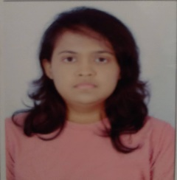


Sinchana S
Education and certificates
Bachelor of Technology Computer Science : 2017 - 2021
Analyst/Software Engineer
Skills Spring Boot Spring MVC
JPA CRUD/JPA
Base Location: ^{Banglore}
Email ID:
sinchana.a.s@capgemini.com
_{Mobile No:} +91 9989826271
Grade:
A4
Backend
Spring Boot/Spring Security
Oracle
PostgreSQL
REST-API
Strengths
A self driven learner with Front-End and Back-End knowledge. Passionate about implementing and launching new projects.
Has knowledge on Java Microservice Development using Spring framework.Has knowledge on creating efficient REST API’s and JUNIT TESTING at service and controller layer.
Ready to learn new technologies/Frameworks and implement them to further improve my knowledge.
A team player with good communication skill always ready to work for the enrichment of knowledge.
.
Achivement
Movie Ticket Booking Application
Completed end to end case study using Spring boot with proper MVC structure in backend. Implemented basic authentication and also unit testing at service and controller layer.Implemented front end using react js.
Database
SQL database – Oracle/PostgreSQL
Student Management System
Frontend Technologies
Vue js / Vuetify
Completed end to end case study using Spring boot with proper MVC structure in backend. Implemented basic authentication and also unit testing at service and controller layer.Implemented front end Vue js and Vuetify.
Software Engineering Skills Github
Maven
Postman
Breast Cancer Detection using CNN
Created CNN model to detect breast cancer using x ray scans.
Presentation Title | Author | Date © Capgemini 2017. All rights reserved | 1

