Slide 1
Airbnb Data Analysis Using Pure Python and NumPy
A Complete Data-Driven Project Without Pandas or Visualization Libraries
Sinchana M

Slide 2
Project Overview
Analyzed an Airbnb dataset using only core Python and NumPy.
Focused on data cleaning, exploration, and insights.
Challenges were overcome manually with custom logic.

Slide 3
Dataset Information
Contains listing data including:
Price
Minimum nights
Number of reviews
Availability
Reviews per month
Format: CSV, manually read and processed.
CSV is used to manually load data from the .csv file
NumPy is used for all numerical calculations.

Slide 4
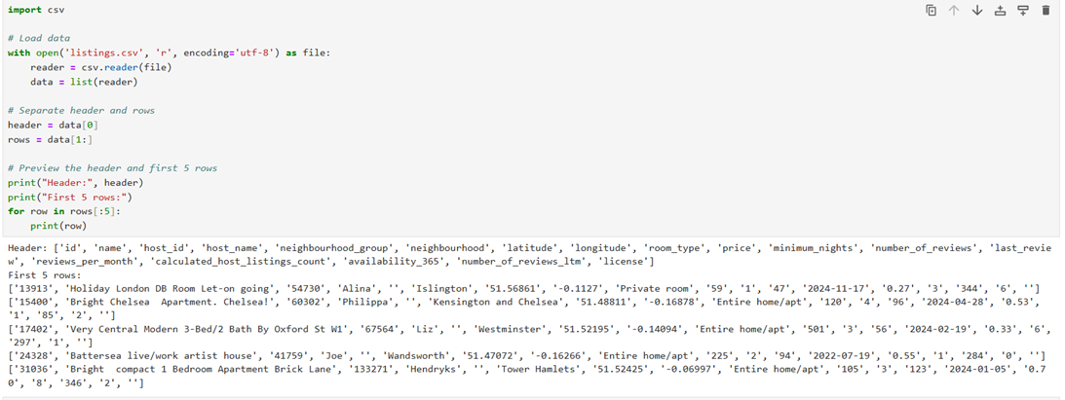

Slide 5
Basic Data Exploration
The code opens the dataset and reads each row into a list.
It separates the column names (header) from the actual data, helping us refer to both clearly throughout the project.
This also helps us understand the dataset’s size and structure before analysis.
Exploring columns and rows.
Fetching missing values per column.

Slide 6
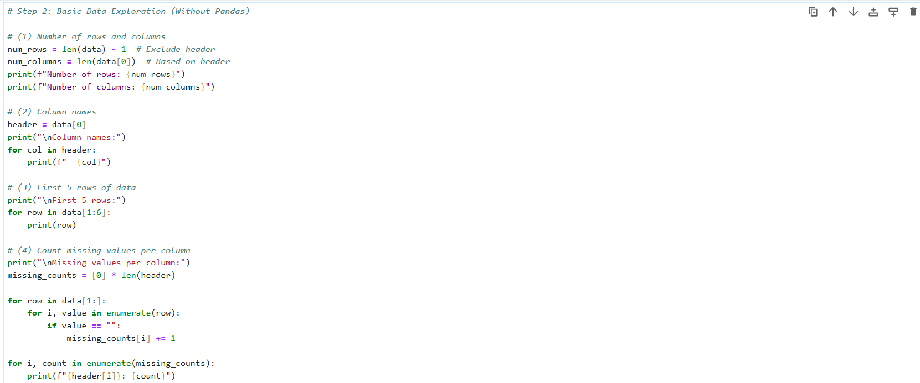

Slide 7
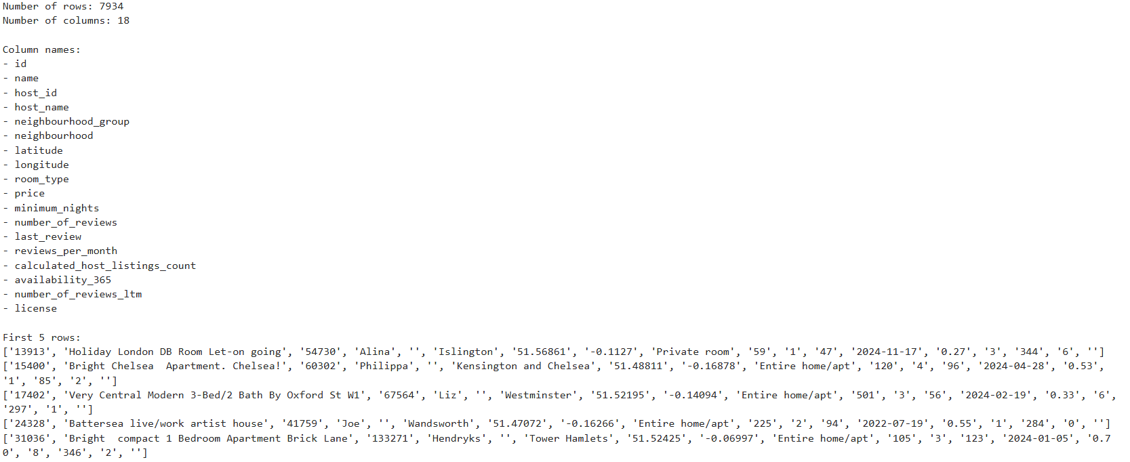

Slide 8
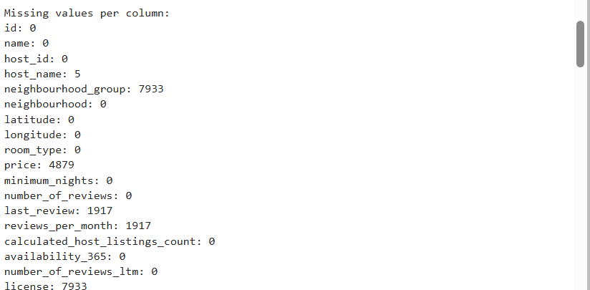

Slide 9
Handling Missing Values
A new cleaned dataset was initiated.
Missing values in ‘price’ and ‘last_review’ were handled using custom logic.
Manual iteration and NumPy Boolean indexing were used.
Malformed rows were also dropped.

Slide 10
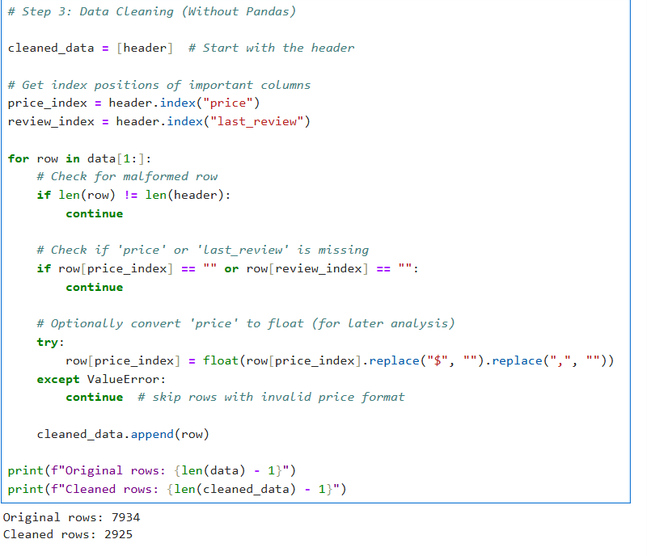

Slide 11
Data Cleaning
The ‘price’ column was converted to float manually.
The ‘last_review’ column parsed into datetime using string manipulation.
And this fills the requirement for mathematical operations.
Conversion was done using list comprehensions and NumPy arrays. For example:
prices = np.array([float(row[9].replace(‘$’, ‘ ‘).replace(‘ , ‘ , ‘ ‘)) for row in rows]).
Thus, obtained new cleaned data list.

Slide 12
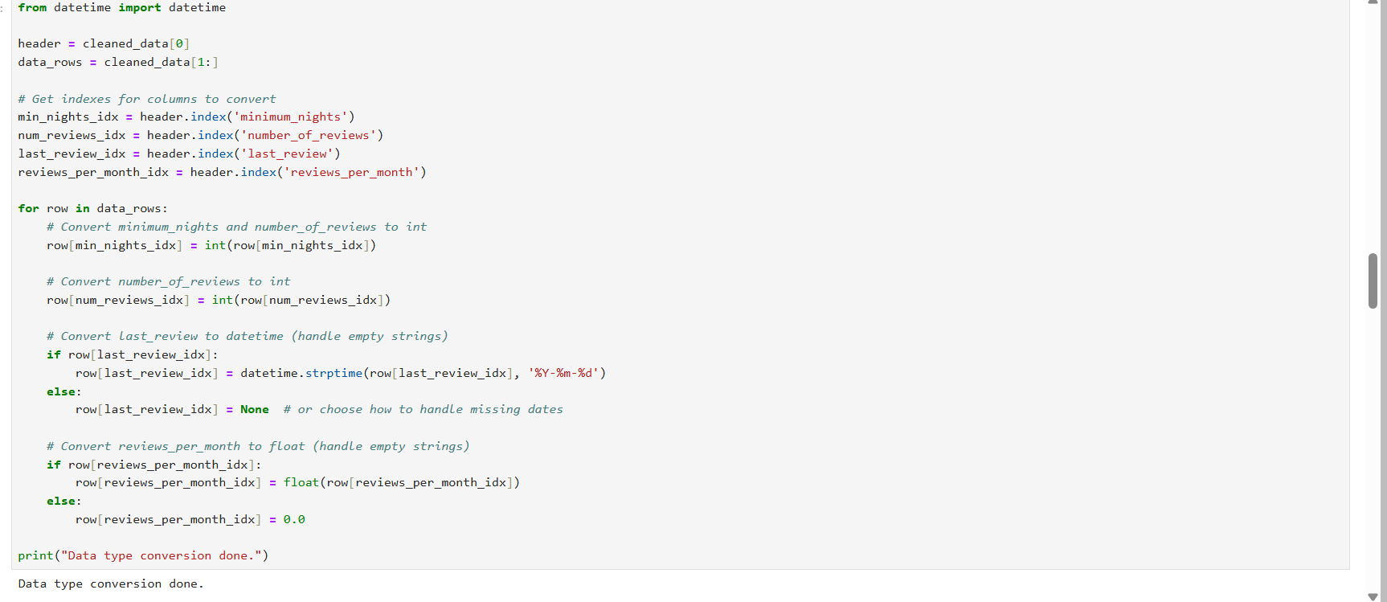

Slide 13
Data type conversions
This code spot the index of necessary columns from cleaned data and apply loop for conversions.
Values of ‘ min_nights_idx ’ and ‘ num_reviews_idx ‘ converted into respective integers using int().
If the value of ‘ last_reviews_idx ‘ isn’t empty it is converted into date time object using datetime.strptime() function.
conversion of the 'reviews_per_month' column to a floating-point number.

Slide 14
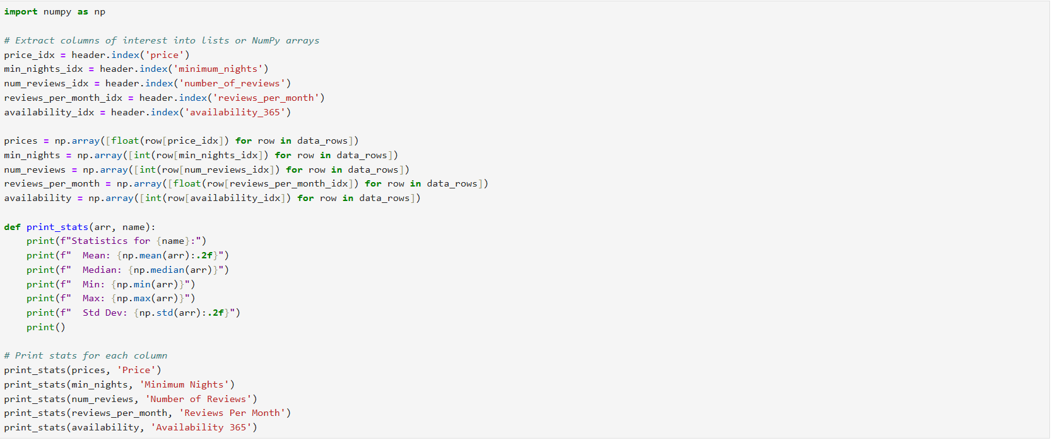

Slide 15
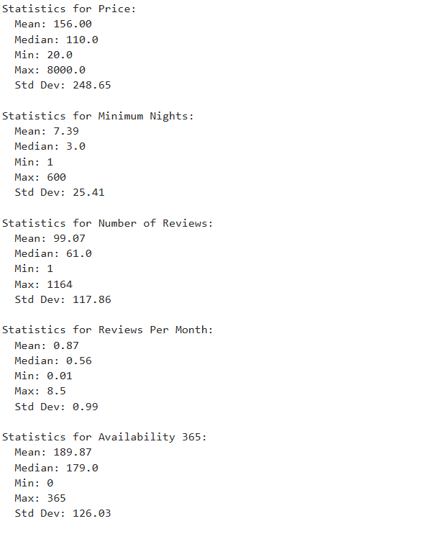

Slide 16
Basic statistical Analysis
The code extracts numerical data from specific columns into NumPy arrays.
Then it calculates mean, median, min, max, and standard deviations.
This provide the quick summary of the central tendency and spread of the data.

Slide 17
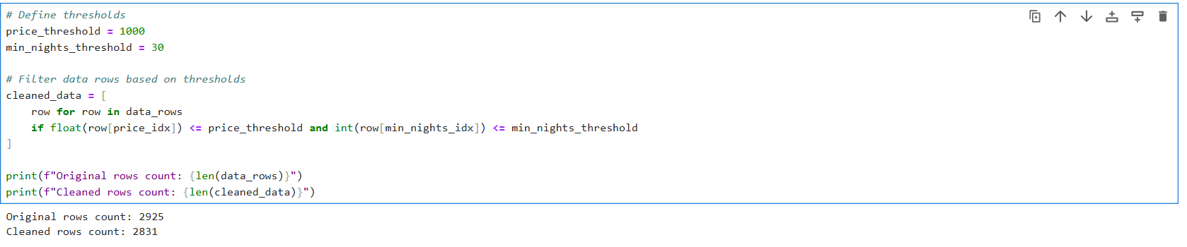

Slide 18
Outlier Handling
Removed price outliers greater than $1000.
Removed listings with unrealistic ‘minimum_nights’ values.
Rechecked summary statistics to validate the effect.
Hence, obtained the Filtered Data.

Slide 19
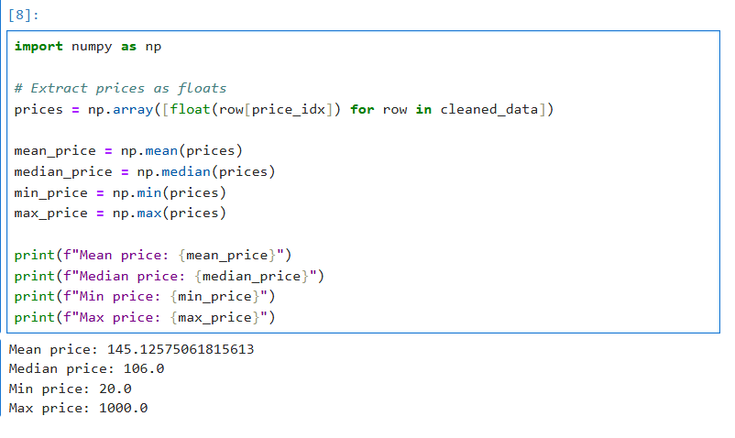

Slide 20
Basic Descriptive statistics of Filtered Data
Code puts the price data into NumPy array, calculates and displays the average, median, minimum, and maximum prices.
Custom logic was used to compute mean, standard deviation, boxplots stats (IQR, Q1, Q3).
This helps understand price distribution.

Slide 21
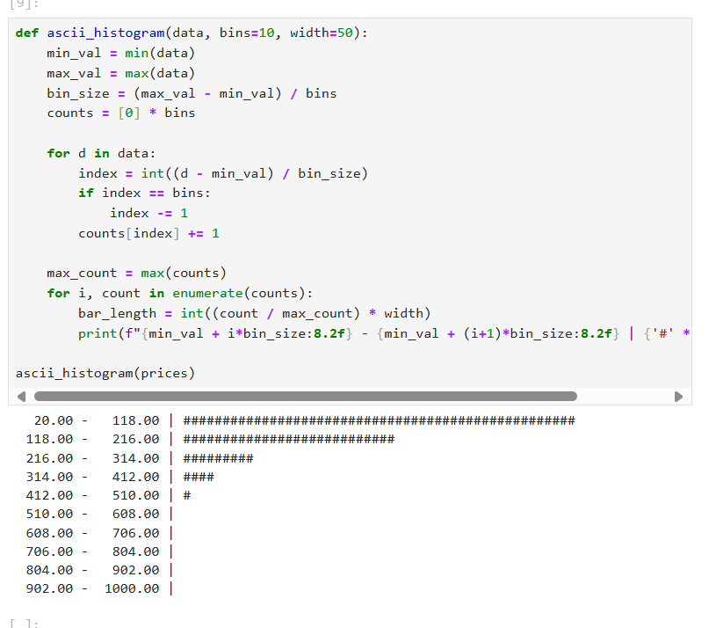

Slide 22
Data Visualization – Histogram
ascii_histogram function is used to create a simple text-based histogram of numerical data.
This results in manually created a text-based histogram.
The data range is divided into bins, and each bin’s count is represented by a bar of ‘#’.

Slide 23
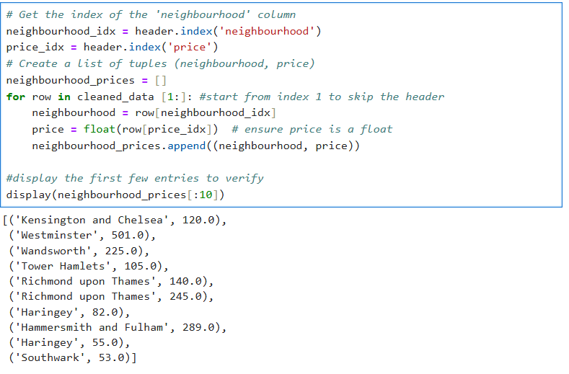

Slide 24
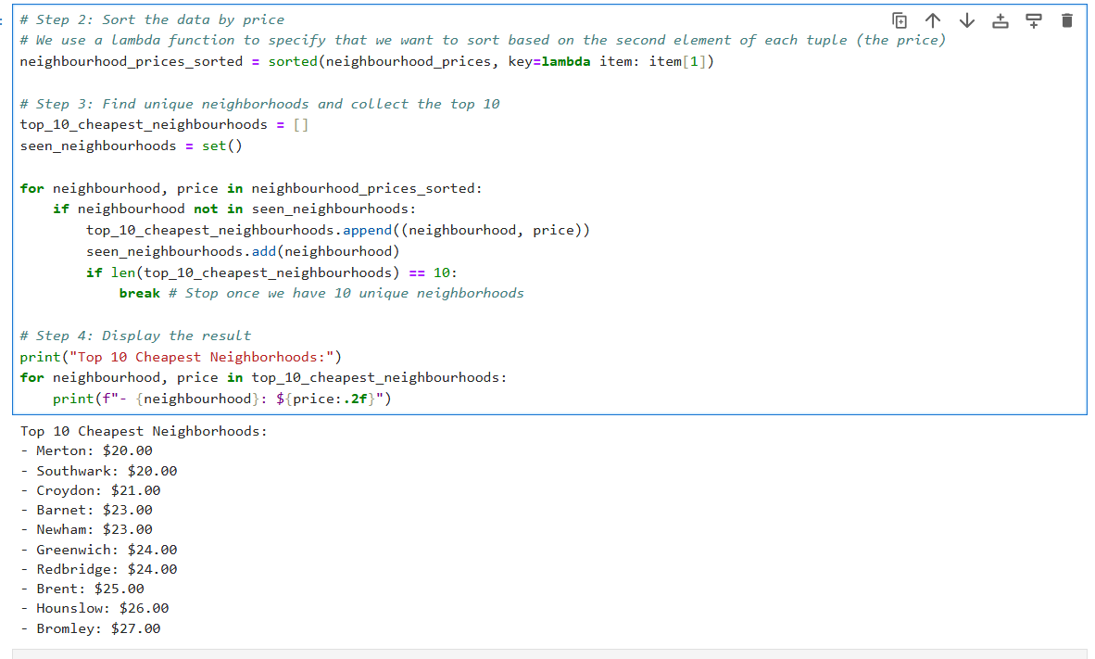

Slide 25
Top 10 Cheapest Neighborhoods
The code sorts the neighborhood and price as tuples, ensuring the price is a float.
It identifies unique neighborhoods with the lowest average prices and prints the top 10.

Slide 26
Insights From The Analysis
The 10 unique neighborhoods offering listings as low as $20 - $27, proving that budget travel is possible even in cites like London.
Removing unrealistic prices improved the data quality and insights more reliable. Effective outlier handling significantly boosted accuracy.
Our unique sorting method ensured only 10 distinct neighborhoods were chosen, giving more diversity and practical insight,
The project proves that the affordable travel is still possible in metropolitan cities when backed by clean, data-driven decisions.

Slide 27
Challenges Faced During NumPy – Only Analysis
Larger files were slower to process using only NumPy.
Custom logic had to be written for statistics like mean, median, and count.
No built – in functions for missing values – required manual loops and filtering.
Data type conversion (e.g., strings to float or date) required custom logic.
Couldn’t visualize outliers – relied only on printed summaries and manual inspection.
Tracking headers and column indexes, and value types across all rows manually was complex.
Identifying cheapest neighborhoods needed grouped aggregation from scratch.

Slide 28
Why NumPy – Only Approach Was Chosen
To demonstrate mastery of core Python and NumPy.
Wanted to avoid shortcuts provided by higher – level libraries.
This helped build a deeper understanding of data structures and logic.
Learned how Pandas simplifies what NumPy handles manually.
Added value to my learning experience.

Slide 29
Future Scope and Improvements
Add data visualizations using Matplotlib or Seaborn.
Automate more of cleaning process.
Build a dashboard using Streamlit or Dash.
Integrate geolocation for mapping listings.

Slide 30
Final Summary and Acknowledgements
This Project explored Airbnb data using only Python and NumPy.
Covered data cleaning, transformation, outlier handling, and insights.
Faced and overcame technical limitations manually.
This project marks a foundational step in my Data Science journey.

