Slide 1
Part localization for robotic manipulation
Cesar Sinchiguano
Master diploma thesis

Slide 2
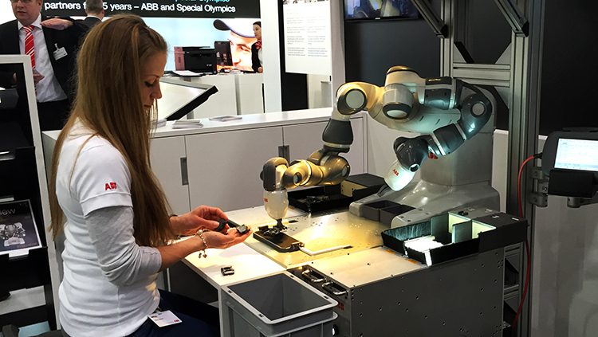
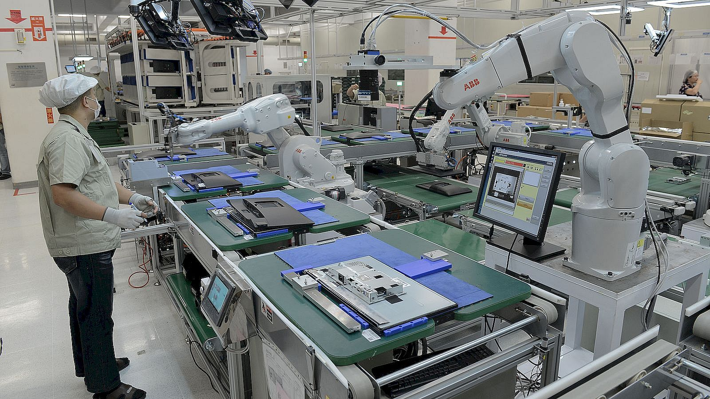
Introduction

Slide 3
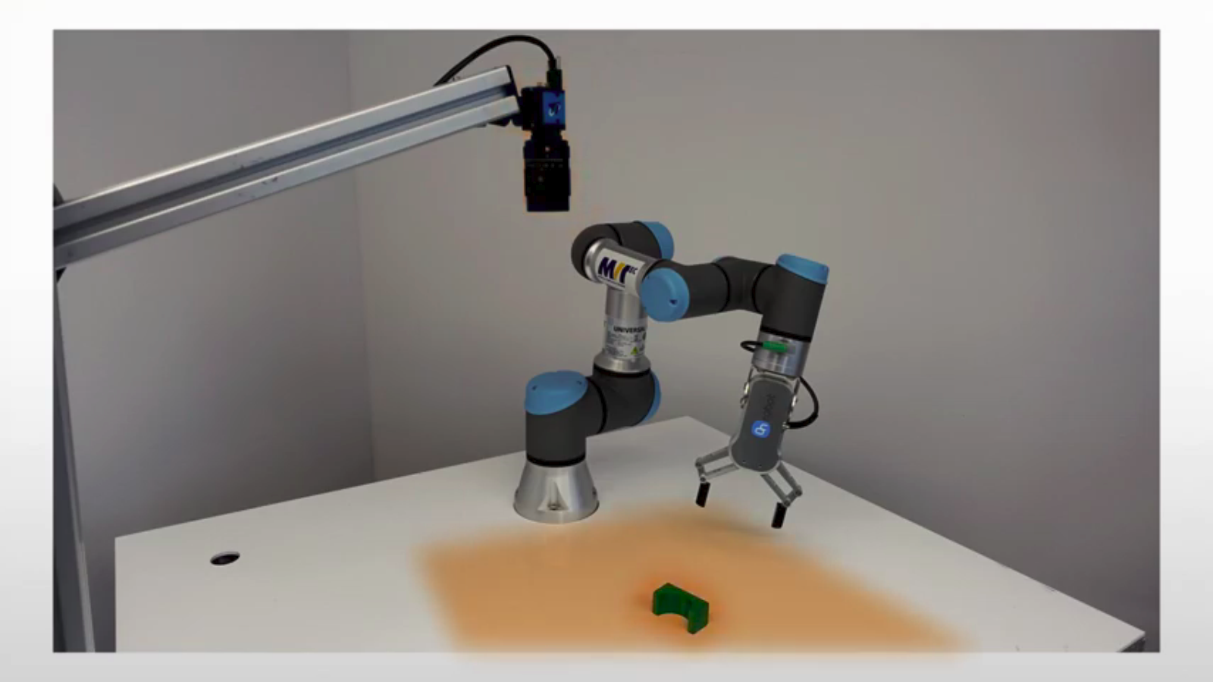
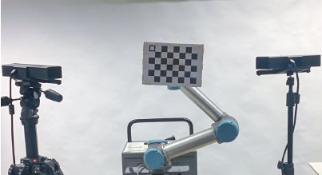
Goal of the thesis
Developing a robot-camera calibration method
Developing a method to localize an isolated part

Slide 4
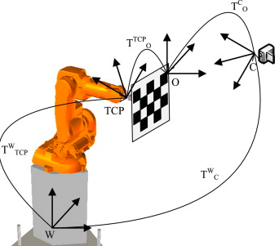
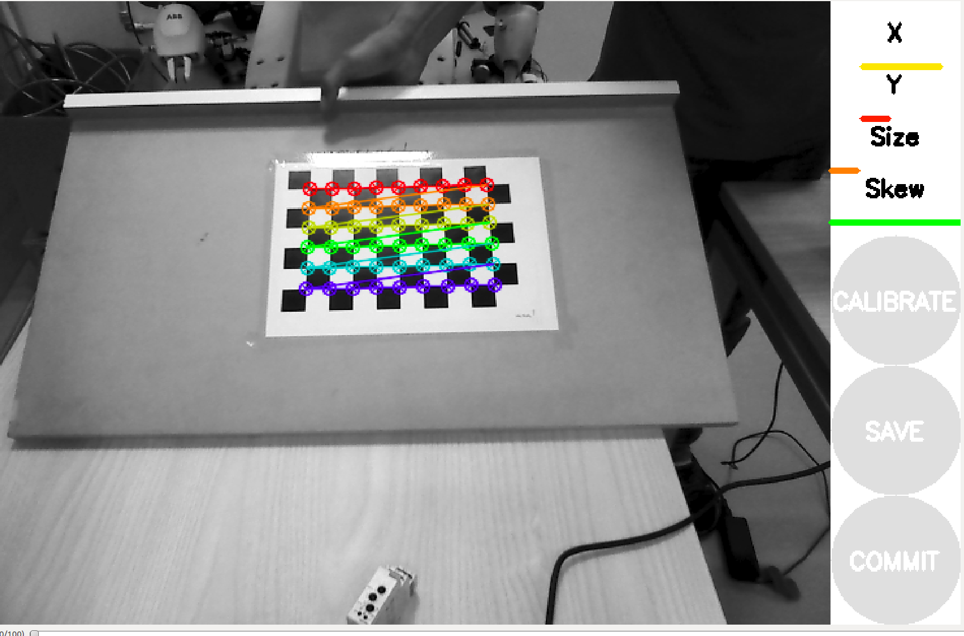
Robot-Camera Calibration
Sensor internal parameter
Sensor external parameters

Slide 5
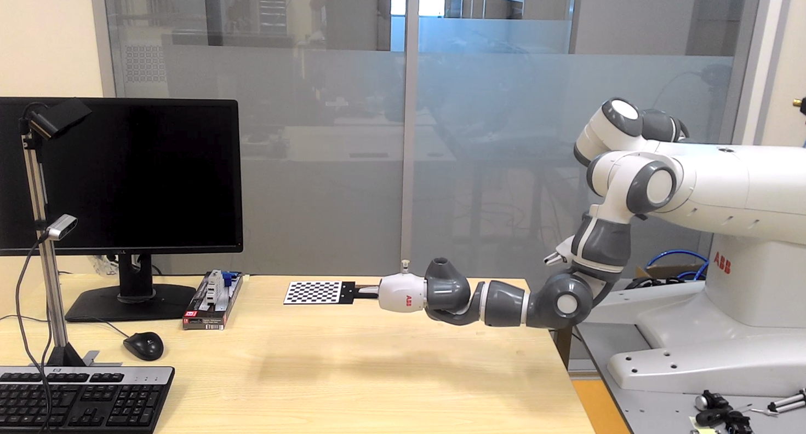
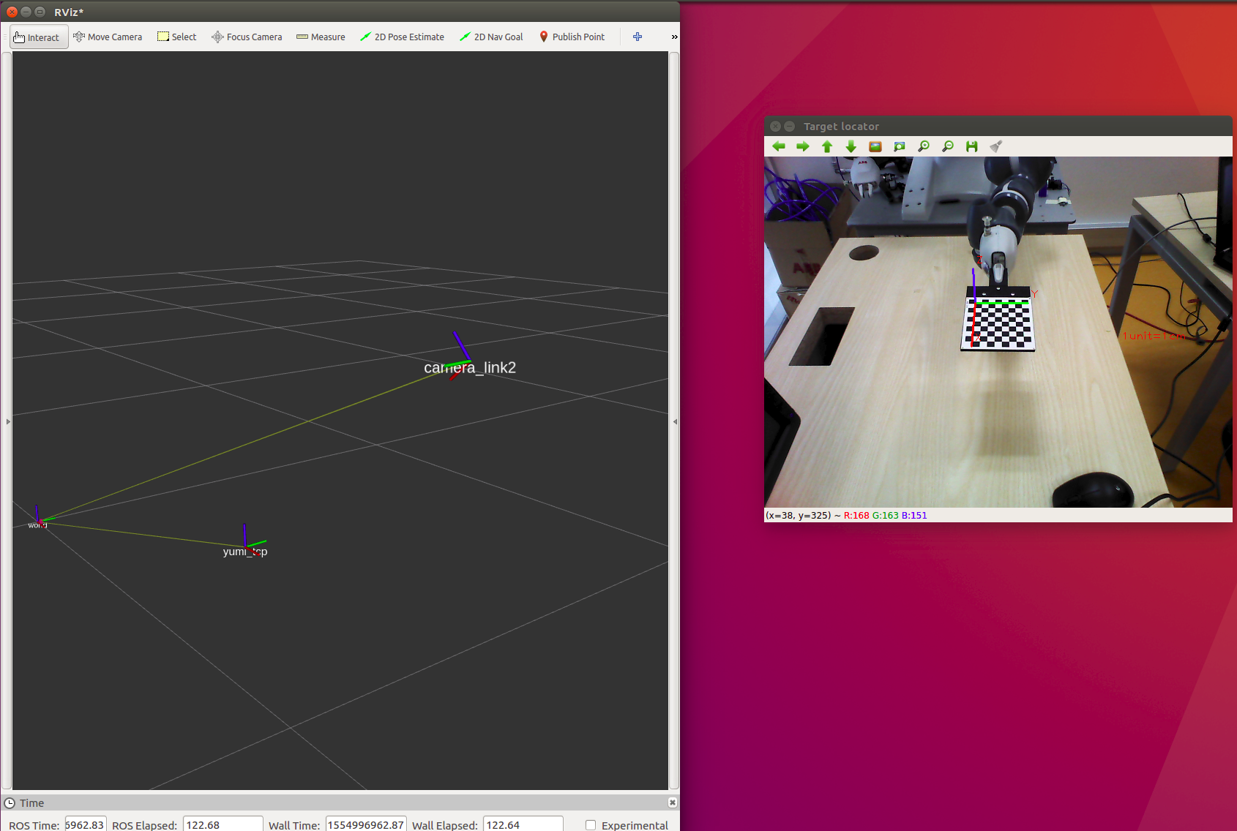

Robot-Camera Calibration

Slide 6
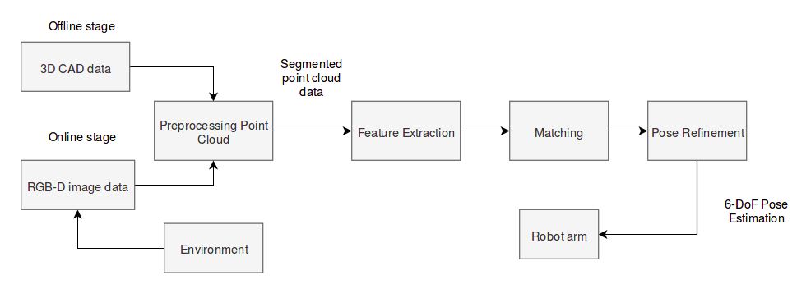
A 3D Object Pose Estimation Pipeline

Slide 7
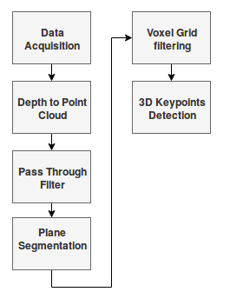
A 3D Object Pose Estimation Pipeline

Slide 8
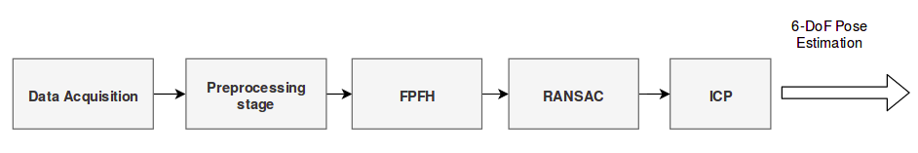
A 3D Object Pose Estimation Pipeline

Slide 9
Validation Test

Slide 11
Conclusions and Future Directions
RealSense D435 camera
  poor quality of point cloud
Astra camera
  good performance (partial view as reference cloud)
Bin-picking (Occlusion and clutter)
  Feature descriptors
  Matching strategy

Slide 12
Thank you

Slide 14
Answer
There are two approach for object recognition,
Model-based recognition
Learning-based recognition
We decided to go for model-based recognition since we already saw a working application wiht this method. And the topic was quite new for my supervisor and of course for me also. We did not even have any clue how to start. So I did my research in bin-picking application and most of the them use mode-based recognition.
There are many detection algorithms for 3D object pose estimation using artificial neural networks. The difficulty would be to find the best performing ones with available source codes, get familiar with them. And then create a program that will compute 3D positions of the detected objects from the provided depth data, but no after a dedicated training on the our industrial object.

Slide 15
Slide 1:
Left image: YuMi robot https://www.abb-conversations.com/2015/04/introducing-yumi-the-worlds-first-truly-collaborative-robot/
Right image: https://www.hafactory.it/2019/05/09/industrial-robots-384000-units-were-shipped-globally-in-2018/
Slide 2:
Robot-camera: https://www.researchgate.net/publication/289587273_Automatic_Calibration_of_a_Robot_Manipulator_and_Multi_3D_Camera_System/figures?lo=1
Localize an isolated part: https://www.youtube.com/watch?v=9F2AcnbWsVw

