Slide 1
Part localization for robotic manipulation
Cesar Sinchiguano
Master diploma thesis

Slide 2
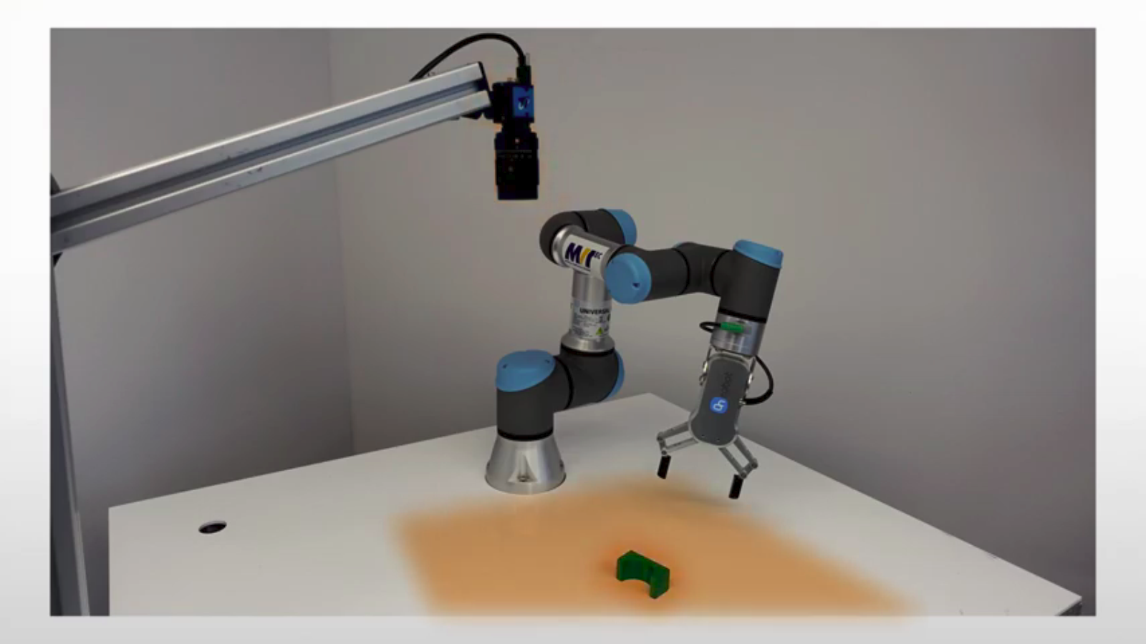
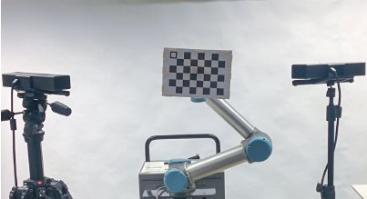
Goal of the thesis
Developing a robot-camera calibration method
Devoloping a method to localize an isolated part

Slide 3
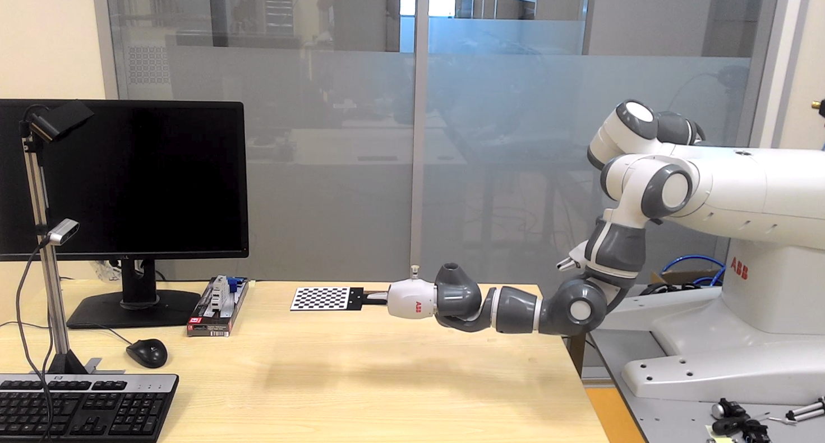
Robot-Camera Calibration
Sensor internal parameter
Sensor external parameters
Eye-To-Hand Calibration

Slide 6
Slide 2:
Robot-camera: https://www.researchgate.net/publication/289587273_Automatic_Calibration_of_a_Robot_Manipulator_and_Multi_3D_Camera_System/figures?lo=1
Loclizes an isolated part: https://www.youtube.com/watch?v=9F2AcnbWsVw

