Slide 1
Part localization for robotic manipulation
Cesar Sinchiguano
Master diploma thesis

Slide 2
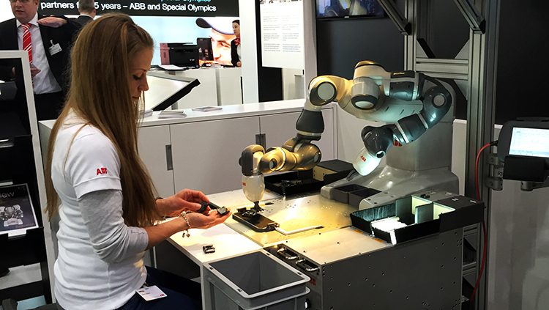
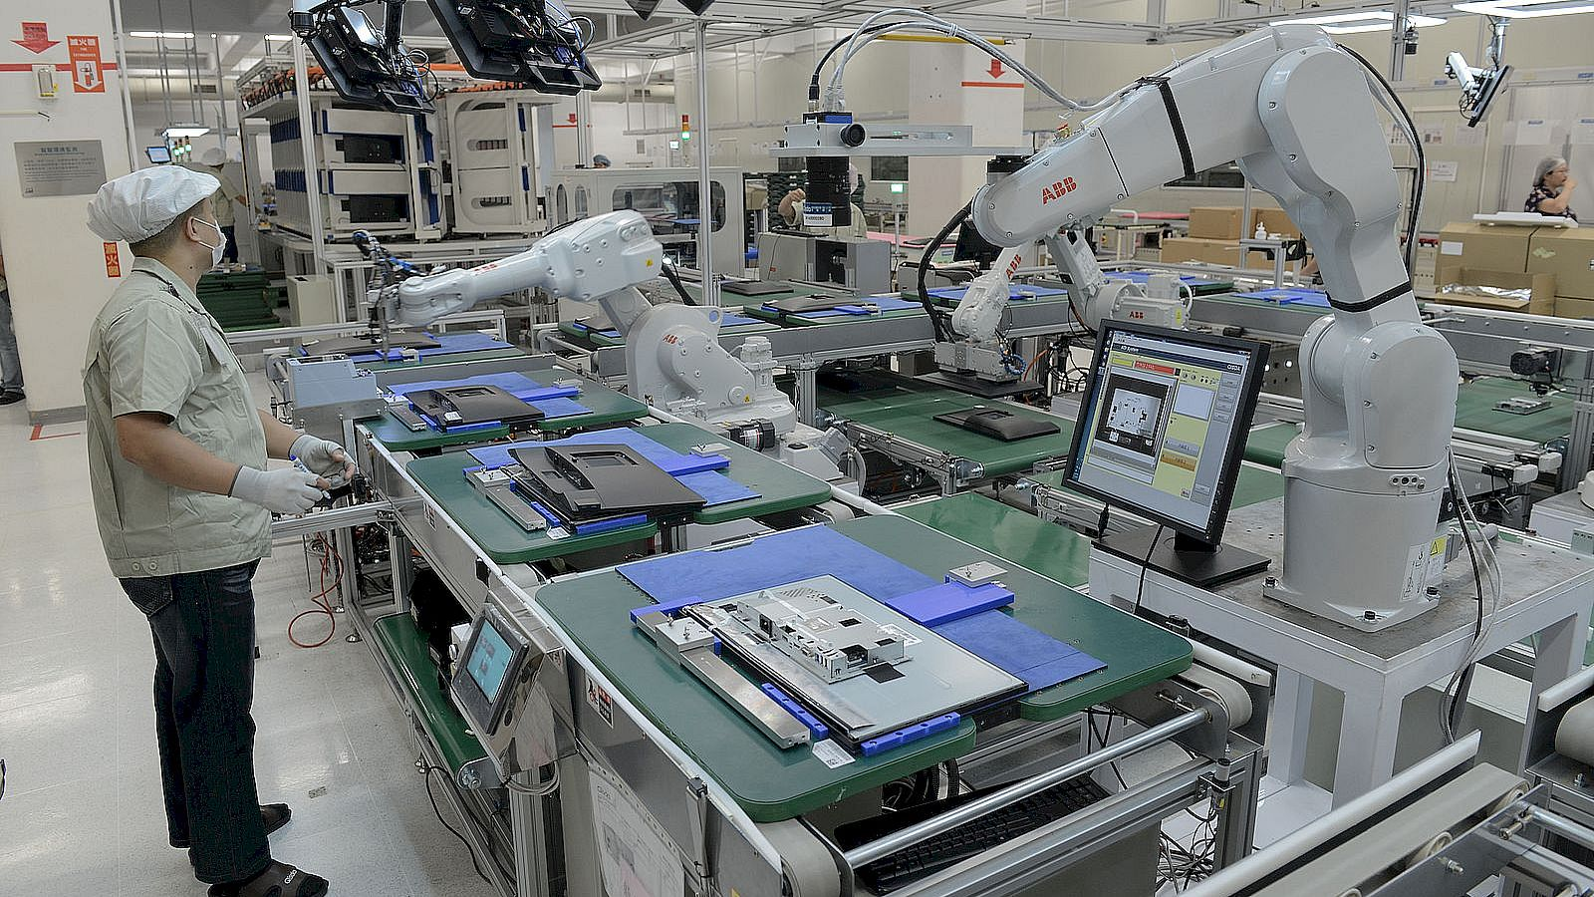
Introduction
2
A co-robot
Model-based recognition
  3D CAD model
  Feature descriptors
    Local and global
  Matching process
  Refinement
Learning-based recognition
  Deep learning model
  Representation of the object

Slide 3
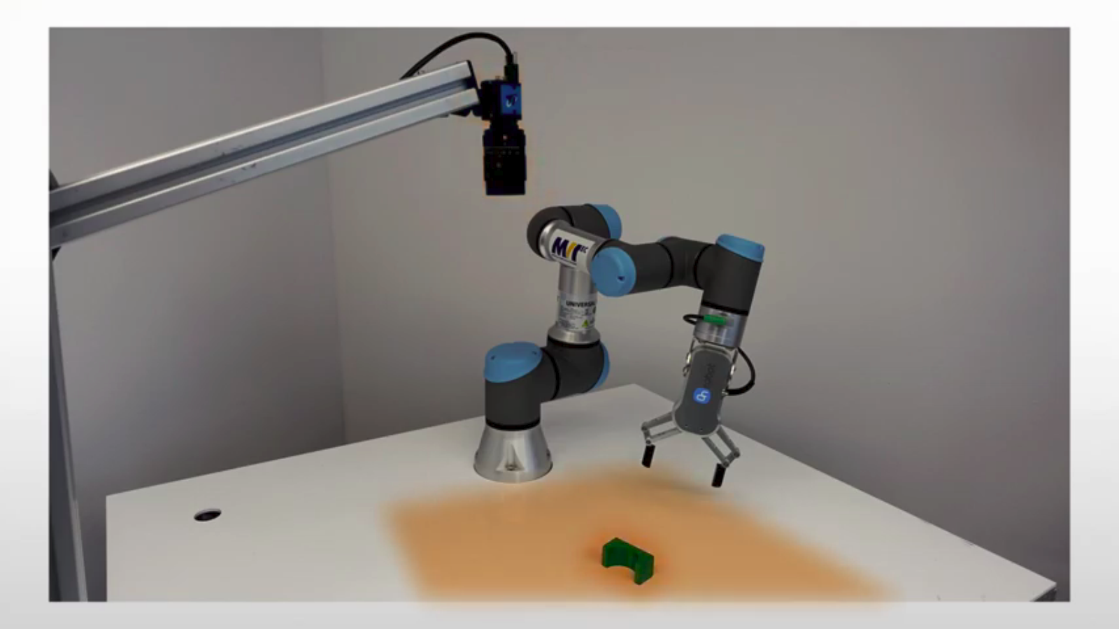
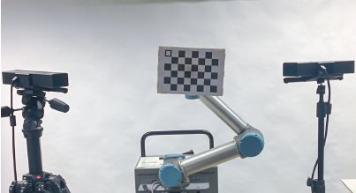
Goal of the thesis
3
Implement a robot-camera calibration method
Implement a method to localize an isolated part

Slide 4
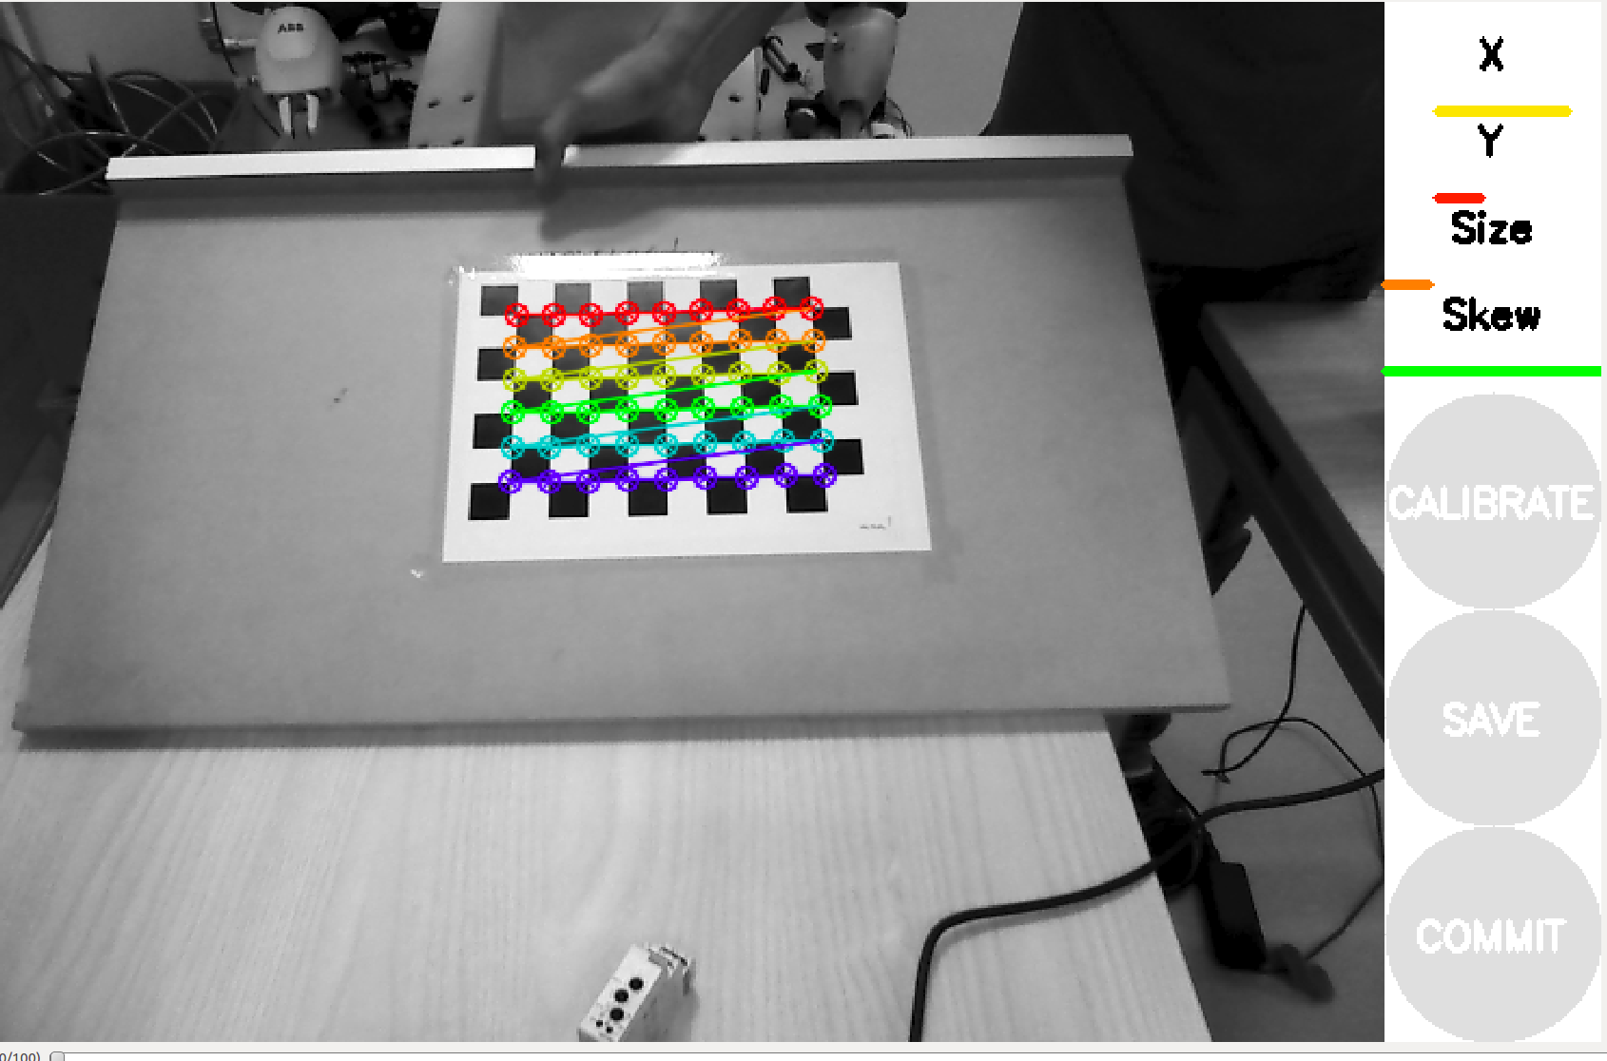
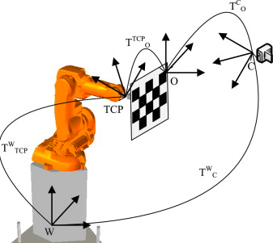
Robot-Camera Calibration
4
Intrinsic parameter
  Focal distance
  Image center point
  Lens distortion
  OpenCV, industrial_calibration
Extrinsic parameters
  Position and Orientation (Custom-made plate)
  Perspective-n-Point Problem

Slide 5
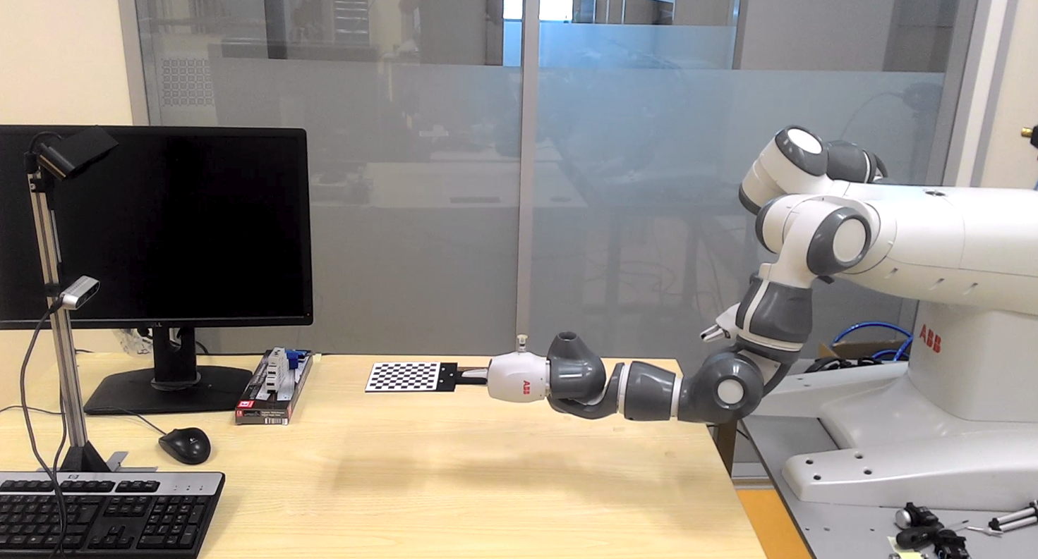
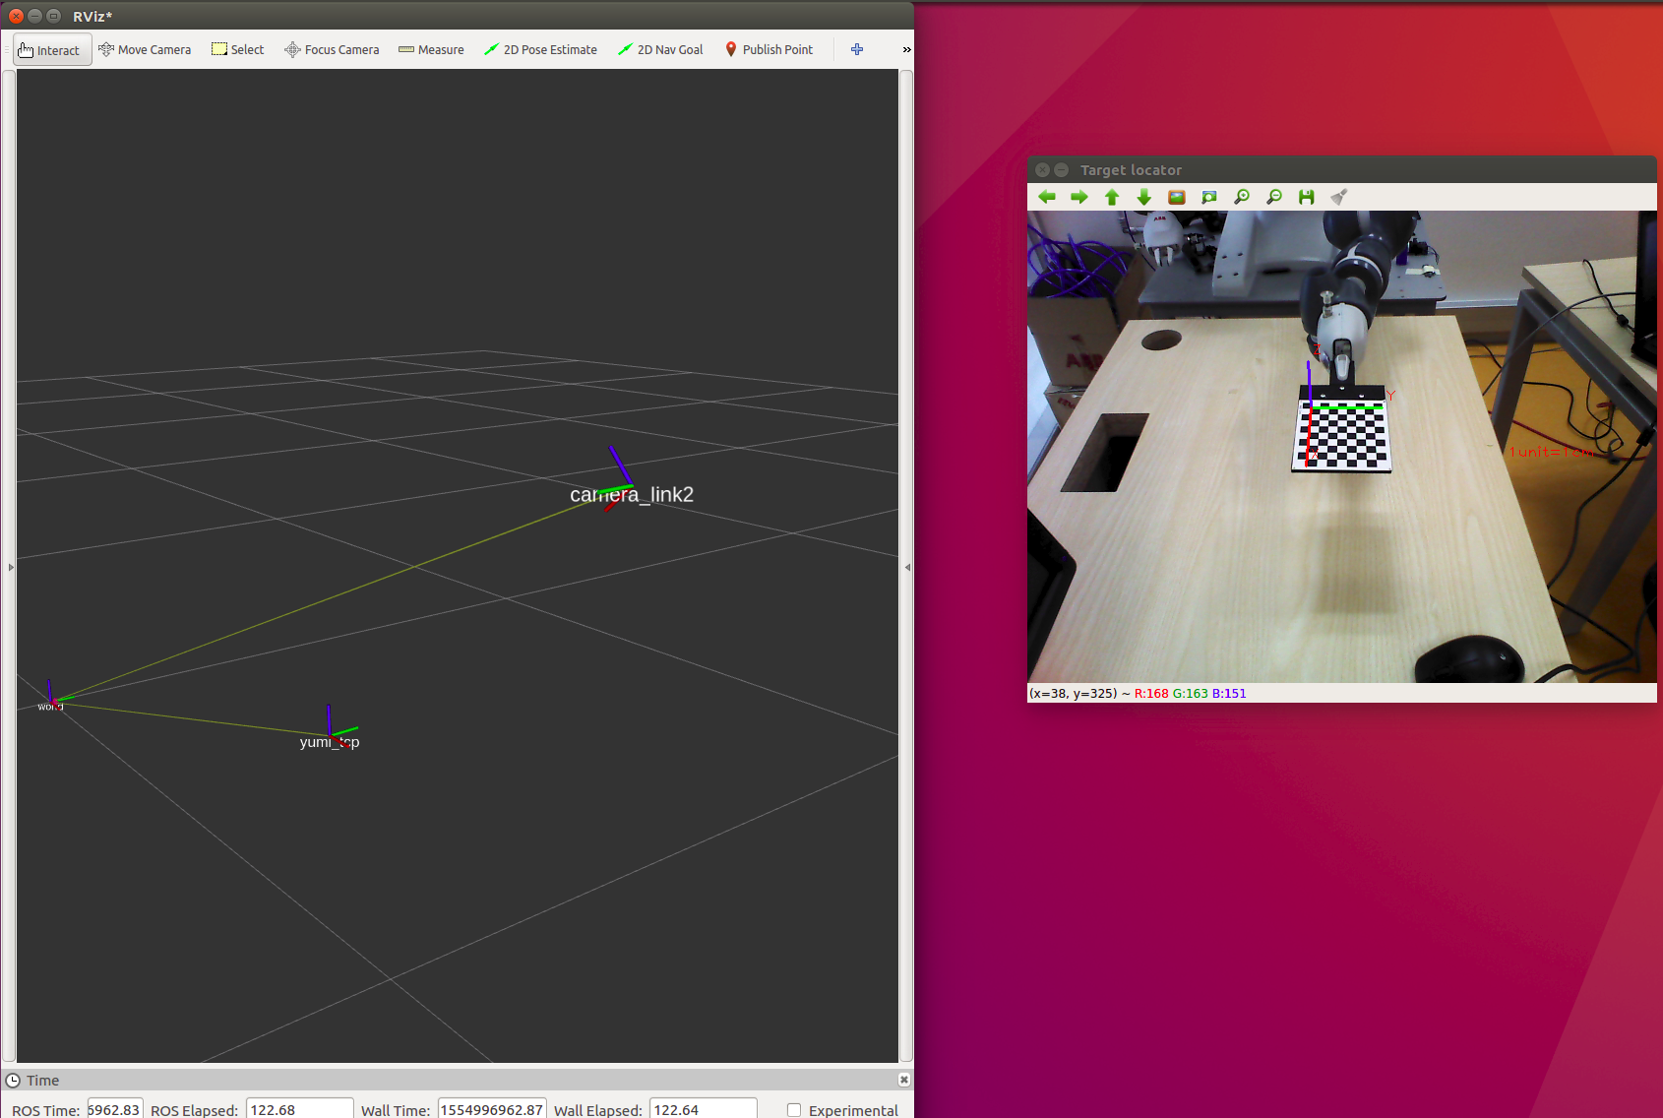

Robot-Camera Calibration
5
ROS:
  Modular
  Pass-through messages

Slide 6
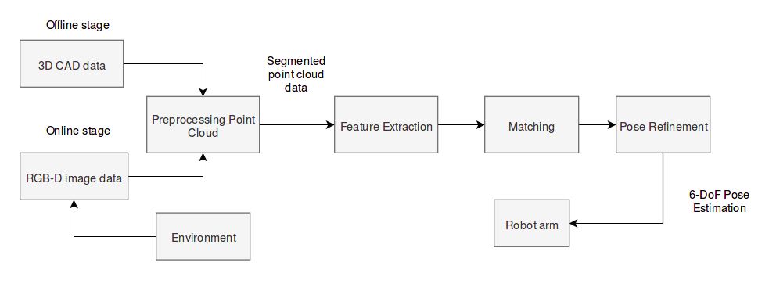
A 3D Object Pose Estimation Pipeline
6
Two point clouds (CAD model and sensory device)
Local features instead of global features
Hypothesize and test approach (RANSAC)
ICP
ROS network

Slide 7
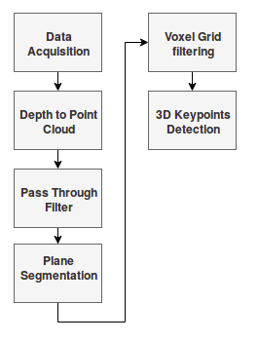
A 3D Object Pose Estimation Pipeline
7
Preprocessing step
  Point cloud from sensory device
  Constraints or threshold (particular field x, y, or z)
  Undiserable points (representing table) →RANSAC plane fitting method
  Downsampling step
  Point cloud itself

Slide 8
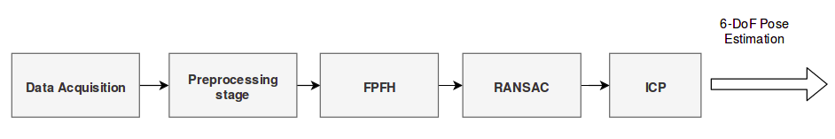
A 3D Object Pose Estimation Pipeline
8

Slide 9
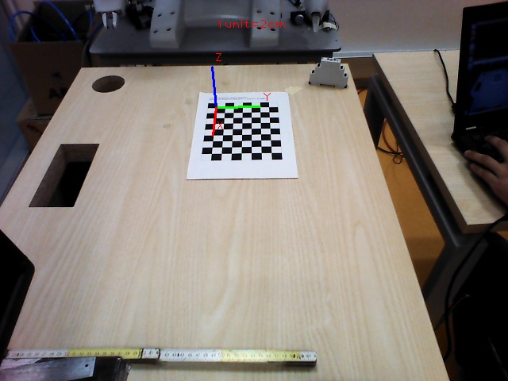
Validation Test
9
3D Object Pose Estimation System
  Two experiments (CAD and partial view of the object)
  New workobject (checkerboard)
  Translation and rotation error

Slide 10
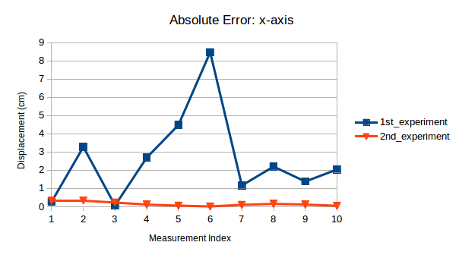
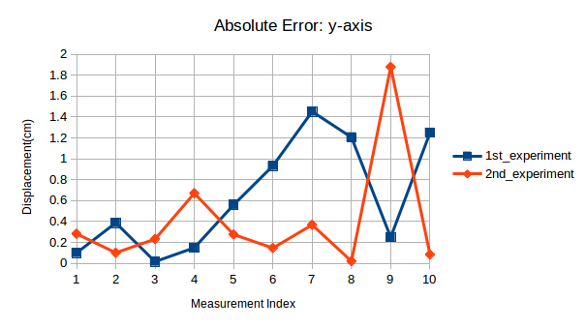
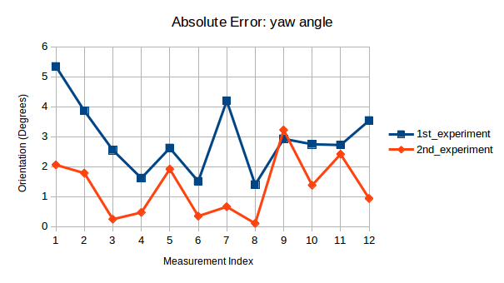
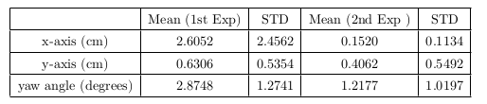
Pose Estimation Results
10

Slide 11
Conclusions and Future Directions
11
RealSense D435 camera
  poor quality of point cloud
Astra camera
  good performance (partial view as reference cloud)
Bin-picking (Occlusion and clutter)
  Feature descriptors
  Matching strategy

Slide 12
Thank you
12

Slide 14
Answer
There are two approaches for object recognition,
Model-based recognition
Learning-based recognition
We decided to go for model-based recognition since we already saw a working application with this method ( Photoneo Company). And the topic was quite new for my supervisor and of course for me also. We did not even have any clue how to start. So I did my research in bin-picking application and most of them use model-based recognition.
There are many detection algorithms for 3D object pose estimation using artificial neural networks. The difficulty would be to find the best-performing ones with available source codes, get familiar with them. And then create a program that will compute 3D positions of the detected objects from the provided depth data, but no after a dedicated training on our industrial object.

Slide 15
Slide 1:
Up: YuMi robot https://www.abb-conversations.com/2015/04/introducing-yumi-the-worlds-first-truly-collaborative-robot/
Down: Universal Robot https://www.hafactory.it/2019/05/09/industrial-robots-384000-units-were-shipped-globally-in-2018/
Slide 2: right image: Robot-camera https://www.researchgate.net/publication/289587273_Automatic_Calibration_of_a_Robot_Manipulator_and_Multi_3D_Camera_System/figures?lo=1 left image: object recognition
Localize an isolated part: https://www.youtube.com/watch?v=9F2AcnbWsVw

Slide 17
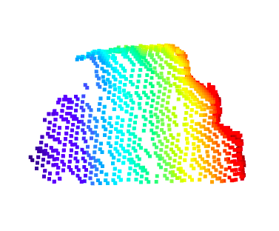
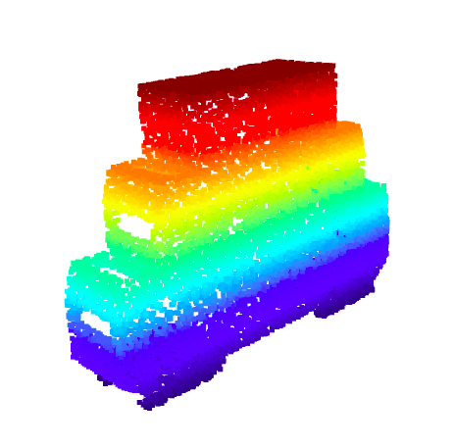
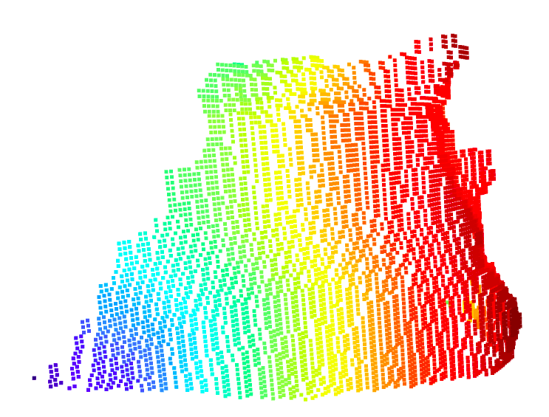
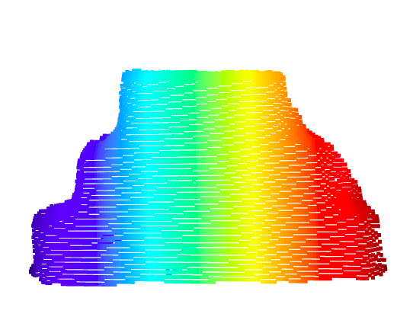
Point Clouds
Astra Camera
CAD model
RealSense d435
RealSense d415

Slide 18
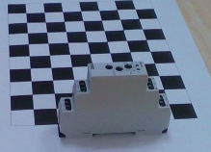
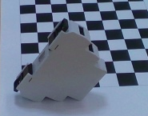
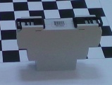
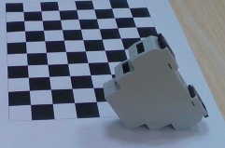
Templates

Slide 19
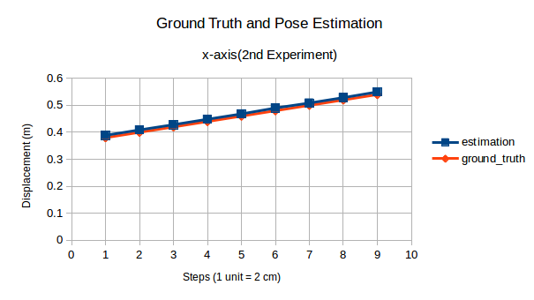
RealSense d415

Slide 20
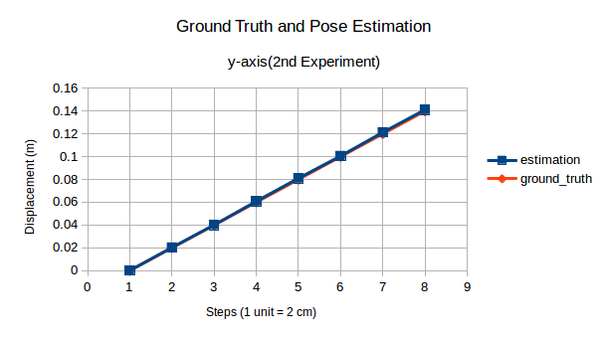
RealSense d415

