Slide 1
Part localization for robotic manipulation
Cesar Sinchiguano
Master diploma thesis

Slide 2
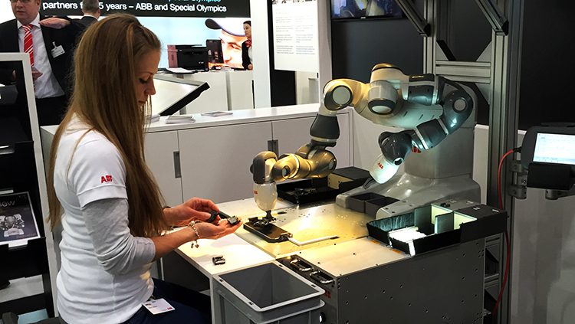
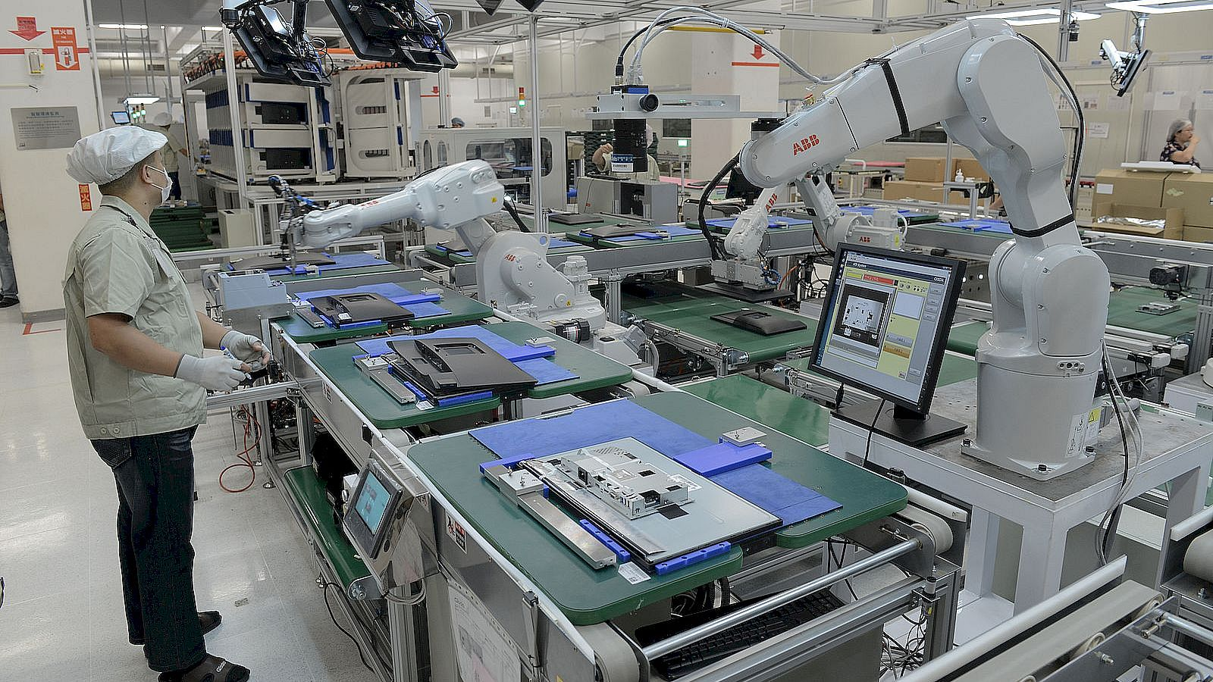
Introduction
2
A co-robot
Model-based recognition
  3D CAD model
  Feature descriptors
    Local and global
  Matching process
  Refinement
Learning-based recognition
  Deep learning model
  Representation of the object

Slide 3
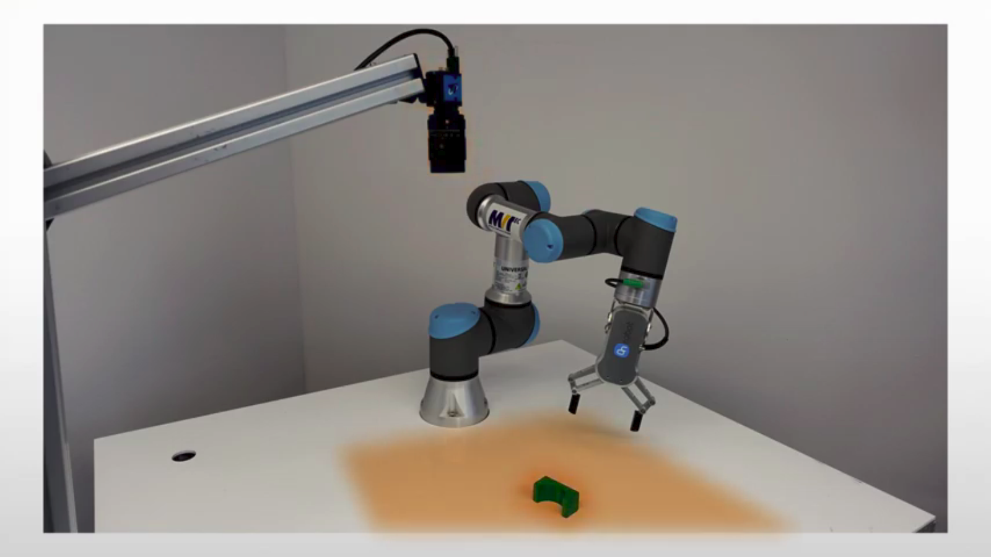
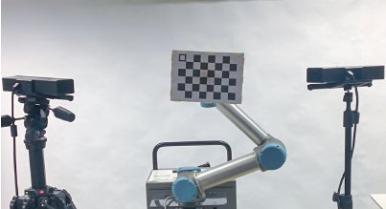
Goal of the thesis
3
Implement a robot-camera calibration method
Implement a method to localize an isolated part

Slide 4
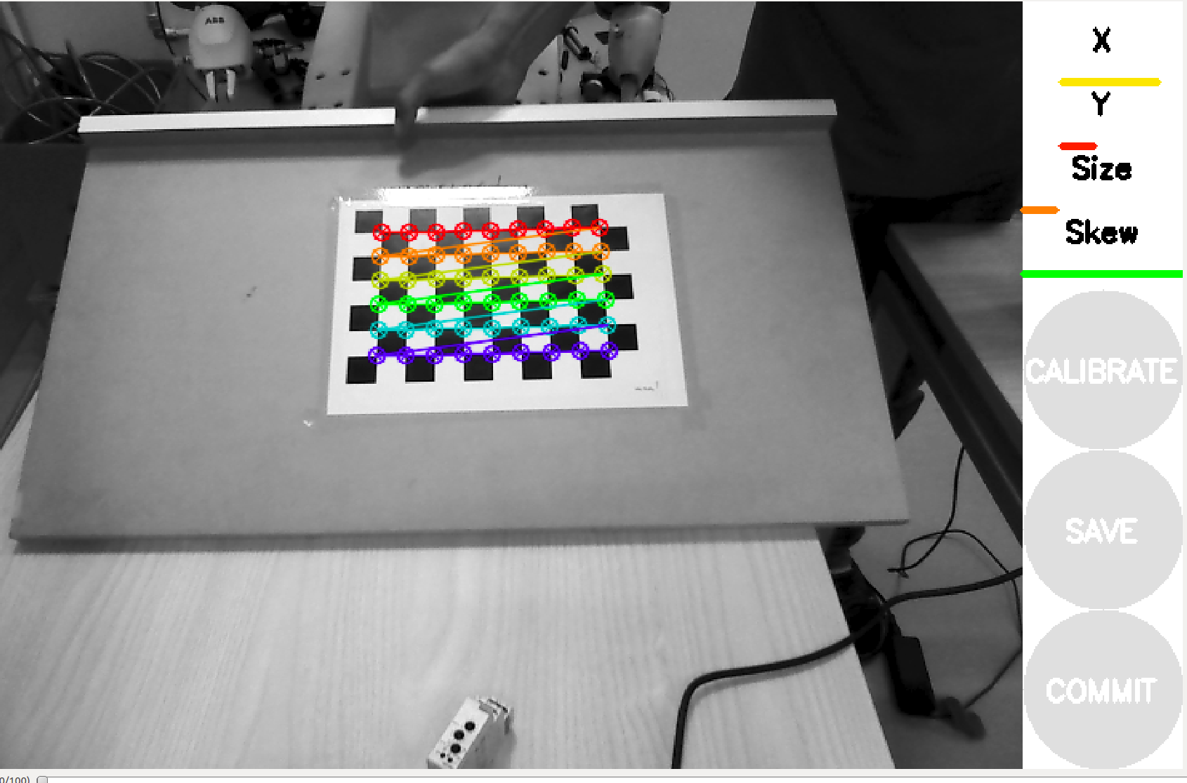
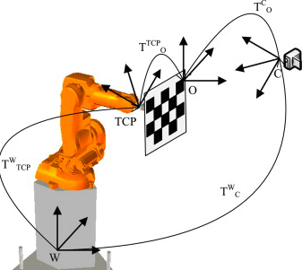
Robot-Camera Calibration
4
Intrinsic parameter
  Focal distance
  Image center point
  Lens distortion
  OpenCV, industrial_calibration
Extrinsic parameters
  Position and Orientation (Custom-made plate)
  Perspective-n-Point Problem

Slide 5
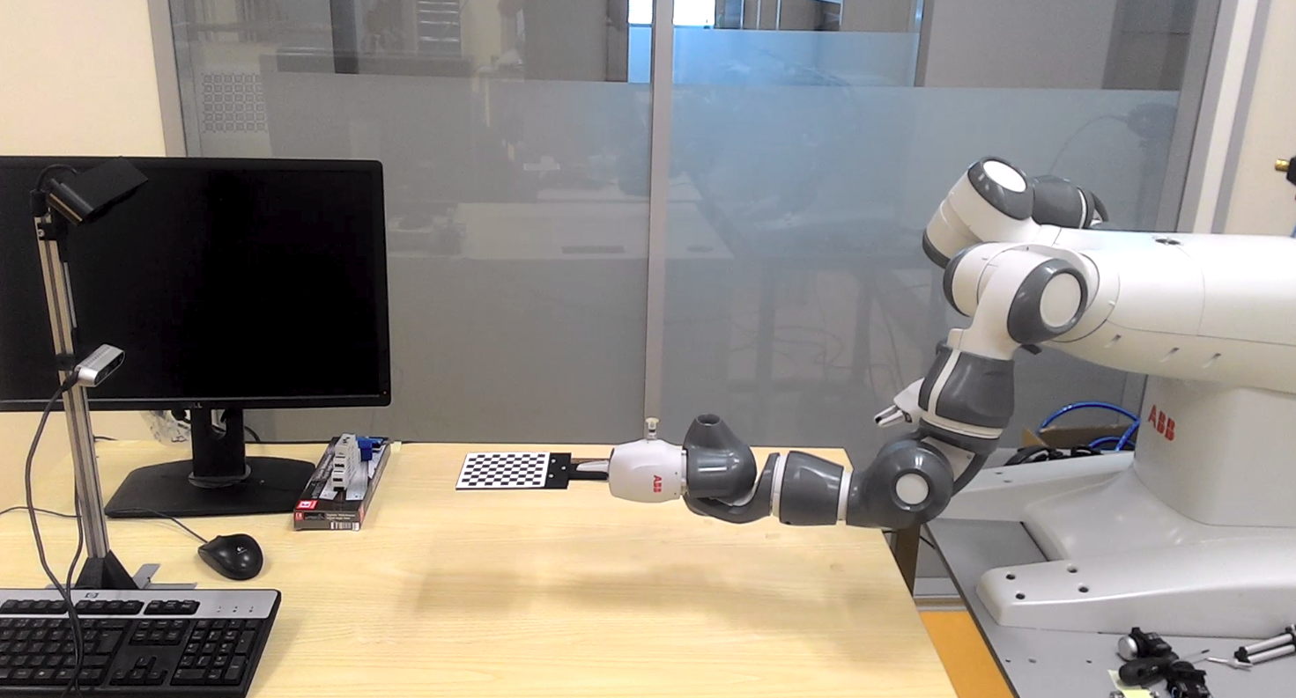
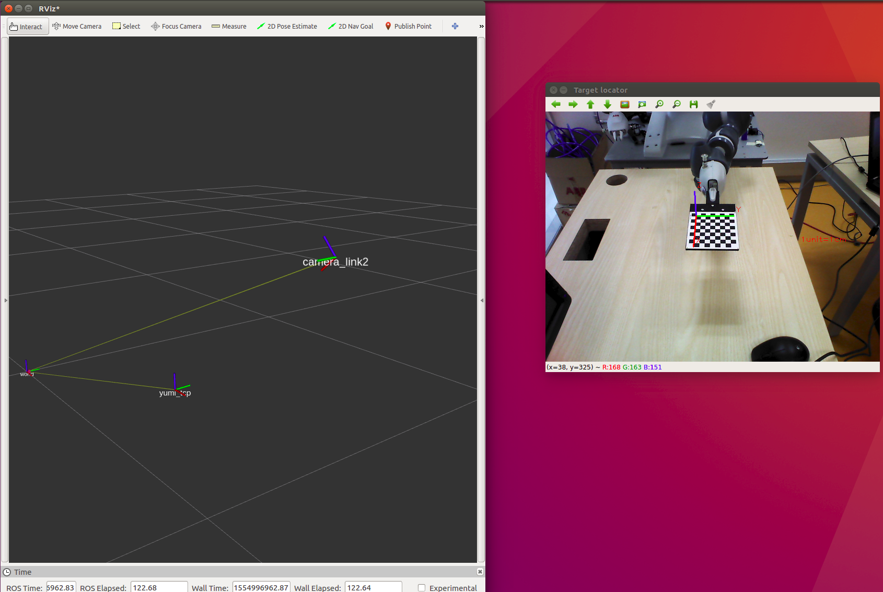

Robot-Camera Calibration
5
ROS:
  Modular
  Pass-through messages

Slide 6
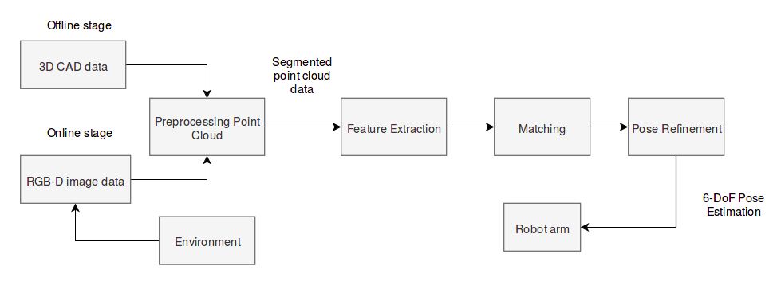
A 3D Object Pose Estimation Pipeline
6
Two point clouds (CAD model and sensory device)
Local features instead of global features
Hypothesize and test approach (RANSAC)
ICP
ROS network

Slide 7
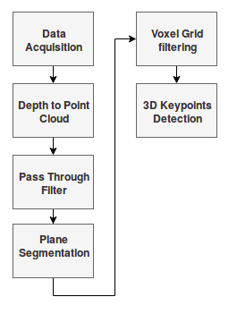
A 3D Object Pose Estimation Pipeline
7
Preprocessing step
  Point cloud from sensory device
  Constraints or threshold (particular field x, y, or z)
  Undiserable points (representing table) →RANSAC plane fitting method
  Downsampling step
  Point cloud itself

Slide 8
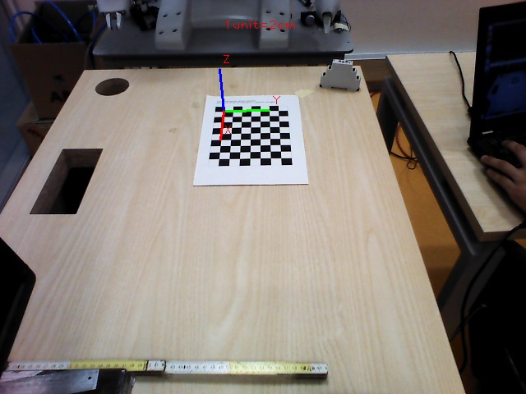
Validation Test
8
3D Object Pose Estimation System
  Two experiments (CAD and partial view of the object)
  New workobject (checkerboard)
  Translation and rotation error

Slide 9
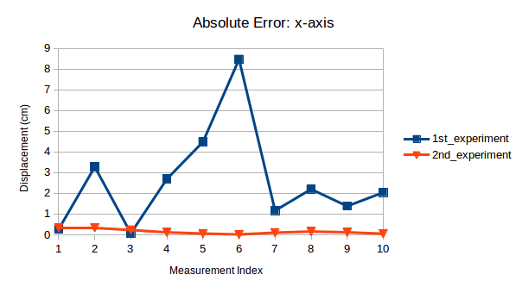
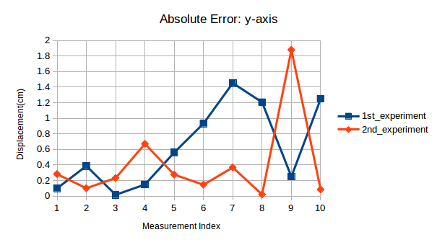
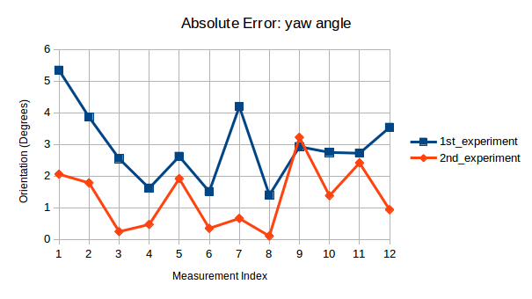
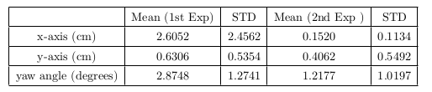
Pose Estimation Results
9

Slide 10
Conclusions and Future Directions
10
RealSense D435 camera
  poor quality of point cloud
Astra camera
  good performance (partial view as reference cloud)
Bin-picking (Occlusion and clutter)
  Feature descriptors
  Matching strategy

Slide 11
Thank you
11

Slide 13
Answer
There are two approaches for object recognition,
Model-based recognition
Learning-based recognition
We decided to go for model-based recognition since we already saw a working application with this method ( Photoneo Company). And the topic was quite new for my supervisor and of course for me also. We did not even have any clue how to start. So I did my research in bin-picking application and most of them use model-based recognition.
There are many detection algorithms for 3D object pose estimation using artificial neural networks. The difficulty would be to find the best-performing ones with available source codes, get familiar with them. And then create a program that will compute 3D positions of the detected objects from the provided depth data, but no after a dedicated training on our industrial object.

Slide 14
Slide 1:
Up: YuMi robot https://www.abb-conversations.com/2015/04/introducing-yumi-the-worlds-first-truly-collaborative-robot/
Down: Universal Robot https://www.hafactory.it/2019/05/09/industrial-robots-384000-units-were-shipped-globally-in-2018/
Slide 2: right image: Robot-camera https://www.researchgate.net/publication/289587273_Automatic_Calibration_of_a_Robot_Manipulator_and_Multi_3D_Camera_System/figures?lo=1 left image: object recognition
Localize an isolated part: https://www.youtube.com/watch?v=9F2AcnbWsVw

Slide 15
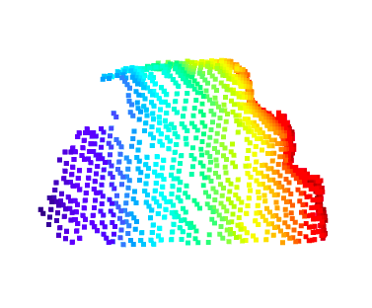
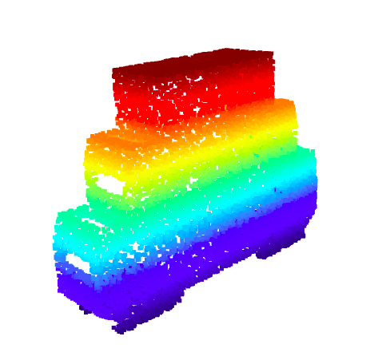
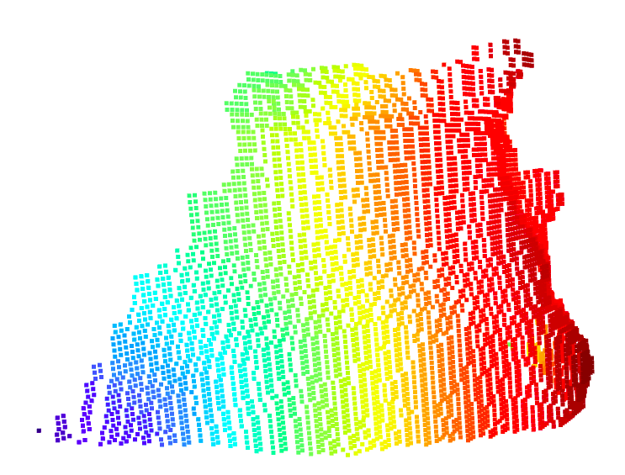
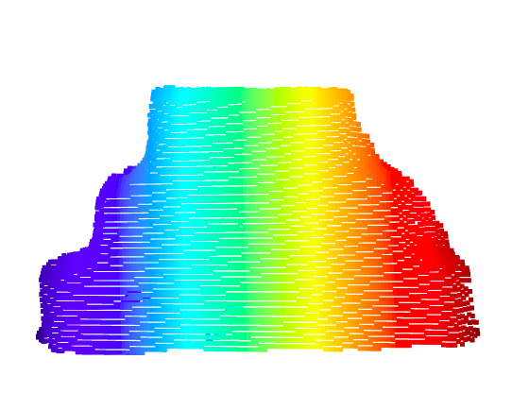
Point Clouds
Astra Camera
CAD model
RealSense d435
RealSense d415

Slide 16
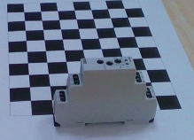
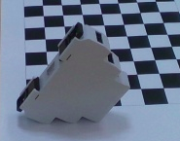
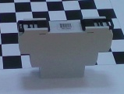
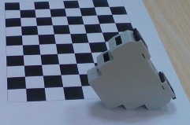
Templates

Slide 17
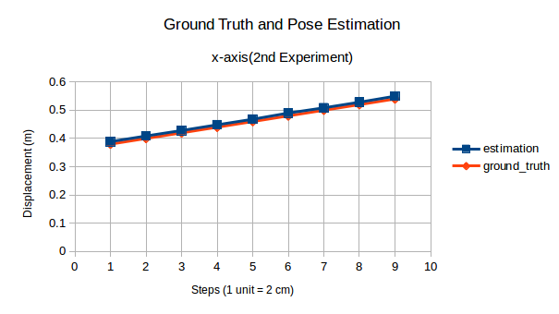
RealSense d415

Slide 18
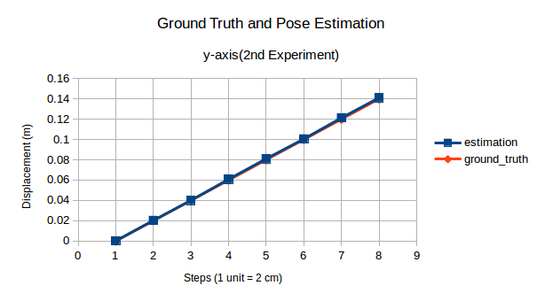
RealSense d415

