Slide 1

Multi-Robot Systems with ROS Lesson 3
Summer 2015
Teaching Assistant: Roi Yehoshua
roiyeho@gmail.com

Slide 2
Agenda
Creating a monitor node
Multi-robot coordinate frames
Sharing robots’ positions
Leader-Followers formation

Slide 3
Creating the monitor node
Now we will create the monitor node that will listen for the ready messages and announce when all robots are ready
The monitor will receive the team size as an argument
Add the file monitor.cpp to the package

Slide 4
monitor.cpp (1)
#include "ros/ros.h"
#include <multi_sync/RobotStatus.h>
#define MAX_ROBOTS_NUM 20
unsigned int teamSize;
unsigned int robotsCount = 0;
bool robotsReady[MAX_ROBOTS_NUM];
ros::Subscriber team_status_sub;
ros::Publisher team_status_pub;
void teamStatusCallback(const multi_sync::RobotStatus::ConstPtr& status_msg);

Slide 5
monitor.cpp (2)
int main(int argc, char **argv)
{
if (argc < 2) {
ROS_ERROR("You must specify team size.");
return -1;
}
char *teamSizeStr = argv[1];
teamSize = atoi(teamSizeStr);
// Check that robot id is between 0 and MAX_ROBOTS_NUM
if (teamSize > MAX_ROBOTS_NUM || teamSize < 1 ) {
ROS_ERROR("The team size must be an integer number between 1 and %d", MAX_ROBOTS_NUM);
return -1;
}
ros::init(argc, argv, "monitor");
ros::NodeHandle nh;
team_status_pub = nh.advertise<multi_sync::RobotStatus>("team_status", 10);
team_status_sub = nh.subscribe("team_status", 1, &teamStatusCallback);
ROS_INFO("Waiting for robots to connect...");
ros::spin();
}

Slide 6
monitor.cpp (3)
void teamStatusCallback(const multi_sync::RobotStatus::ConstPtr& status_msg)
{
int robot_id = status_msg->robot_id;
if (!robotsReady[robot_id]) {
ROS_INFO("Robot %d is ready!\n", robot_id);
robotsReady[robot_id] = true;
robotsCount++;
if (robotsCount == teamSize) {
ROS_INFO("All robots GO!");
multi_sync::RobotStatus status_msg;
status_msg.header.stamp = ros::Time::now();
status_msg.header.frame_id = "monitor";
team_status_pub.publish(status_msg);
}
}
}

Slide 7
Compiling the Node
Add the following lines to CMakeLists.txt:
Then call catkin_make
## Declare a cpp executable
add_executable(move_robot_sync src/move_robot.cpp)
add_executable(monitor src/monitor.cpp)
## Add cmake target dependencies of the executable/library
## as an example, message headers may need to be generated before nodes
# add_dependencies(multi_sync_node multi_sync_generate_messages_cpp)
## Specify libraries to link a library or executable target against
target_link_libraries(move_robot_sync
${catkin_LIBRARIES}
)
target_link_libraries(monitor
${catkin_LIBRARIES}
)

Slide 8
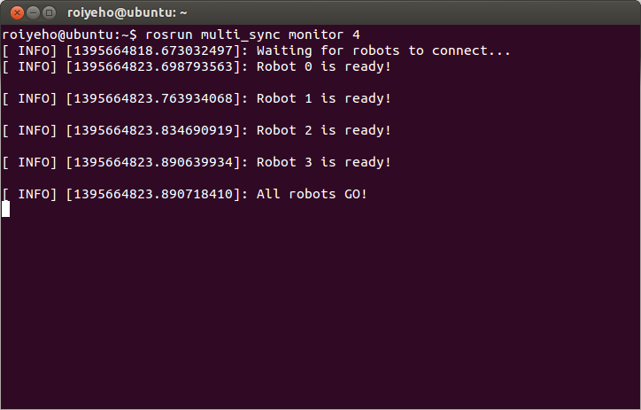
Running the monitor
Open a new terminal and run
rosrun multi_sync monitor 4

Slide 9
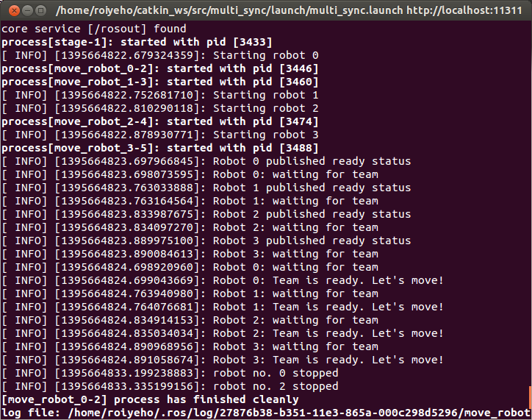
Running the monitor
You should now see the robots start to move after receiving the team ready signal

Slide 10
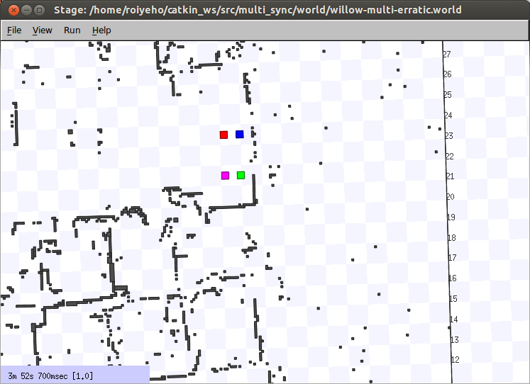
Running the monitor

Slide 11
Coordinate Frames
In ROS various types of data are published in different coordinate frames
Such as the positions of different robots
Coordinate frames are identified by a string frame_id in the format /[tf_prefix/]frame_name
The frame_id should be unique in the system

Slide 12
Multi-Robot Coordinate Frames
When running multiple robots in Stage, it provides separate /robot_N frames
Let’s run Stage with multiple robot instances
Run view_frames to create a diagram of the frames being broadcast by tf
To view the TF tree type:
$ roslaunch stage_multi stage_multi.launch
$ evince frames.pdf

Slide 13
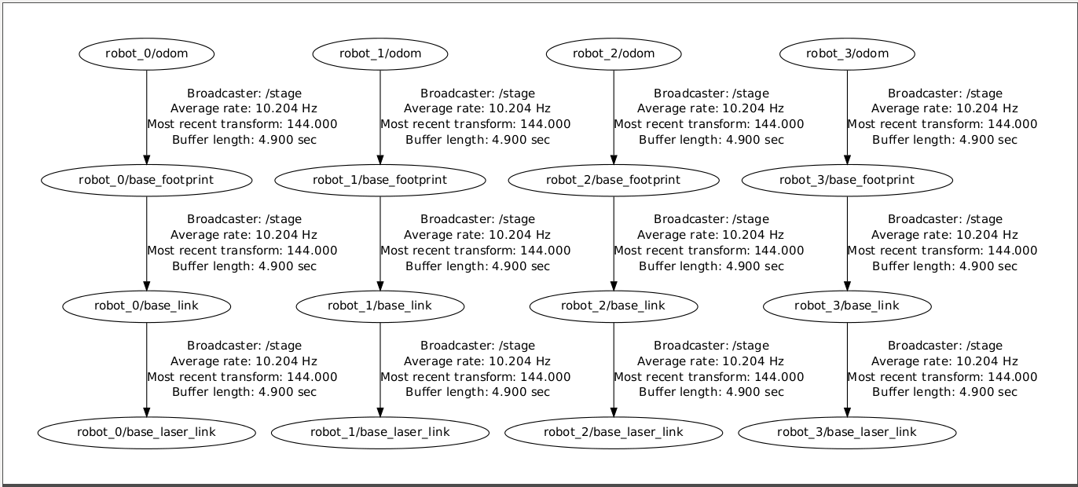
TF Tree

Slide 14
tf_echo
tf_echo reports the transform between any two frames broadcast over ROS
Usage:
Let's look at the transform of base_footprint frame with respect to odom frame of robot 0:
$ rosrun tf tf_echo [reference_frame] [target_frame]
$ rosrun tf tf_echo robot_0/odom robot_0/base_footprint

Slide 15
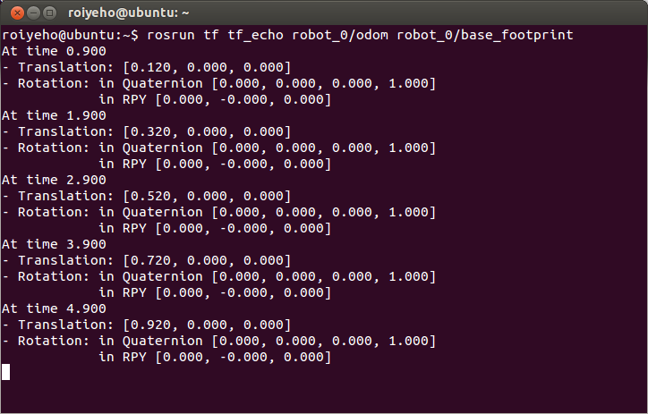
tf_echo

Slide 16
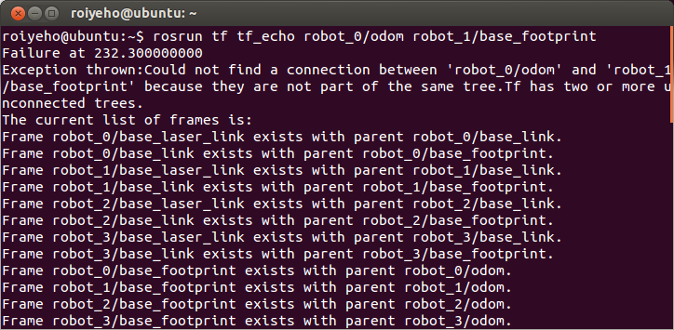
tf_echo
If we try to print the transform between frames of different robots, we will receive the following error:
We need to connect the disconnected parts of the TF tree if we want the robots to be able to relate to each other

Slide 17
Static Transform Publisher
Since all the robots share the same map, we will publish a static transformation between the global /map frame and the robots /odom frames
static_transform_publisher is a command line tool for sending static transforms
Publishes a static coordinate transform to tf using an x/y/z offset and yaw/pitch/roll. The period, in milliseconds, specifies how often to send a transform. 100ms (10hz) is a good value.
static_transform_publisher x y z yaw pitch roll frame_id child_frame_id period_in_ms

Slide 18
tf_prefix
To support multiple "similar" robots tf uses a tf_prefix parameter
Without a tf_prefix parameter the frame name "base_link" will resolve to frame_id "/base_link"
If the tf_prefix parameter is set to "robot1", "base_link" will resolve to "/robot1/base_link"
Each robot should be started in a separate namespace with a different tf_prefix and then it can work independently of the other robots

Slide 19
Robot’s Launch File
robot_0.launch
Copy the file for robot_1, robot_2 and robot_3
In each launch file change the namespace and the tf_prefix and adjust the static transform to the robot’s initial location
<launch>
<group ns="robot_0">
<param name="tf_prefix" value="robot_0" />
<node pkg="tf" type="static_transform_publisher" name="link_broadcaster" args="6.5 18.5 0 0 0 0 /map /robot_0/odom 100" />
</group>
</launch>

Slide 20
Package Launch File
tf_multi.launch
The <include> tag enables you to import another roslaunch XML file into the current file
It will be imported within the current scope of your document, including <group> and <remap> tags
<launch>
<param name="/use_sim_time" value="true"/>
<node name="stage" pkg="stage_ros" type="stageros" args="$(find tf_multi)/world/willow-multi-erratic.world"/>
<include file="$(find tf_multi)/launch/robot_0.launch" />
<include file="$(find tf_multi)/launch/robot_1.launch" />
<include file="$(find tf_multi)/launch/robot_2.launch" />
<include file="$(find tf_multi)/launch/robot_3.launch" />
</launch>

Slide 21
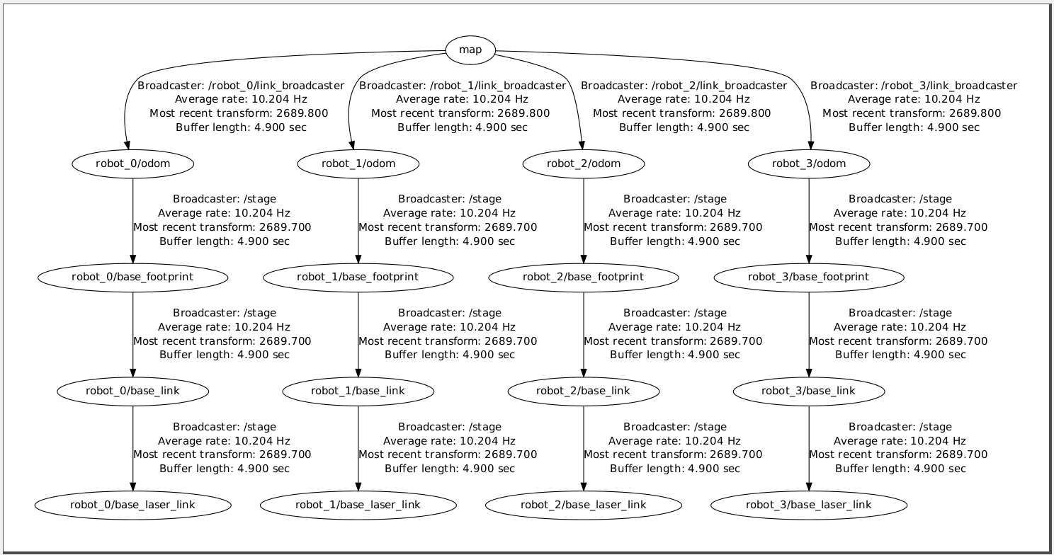
TF Tree
Now after running tf_multi.launch, you will get the following TF tree:

Slide 22
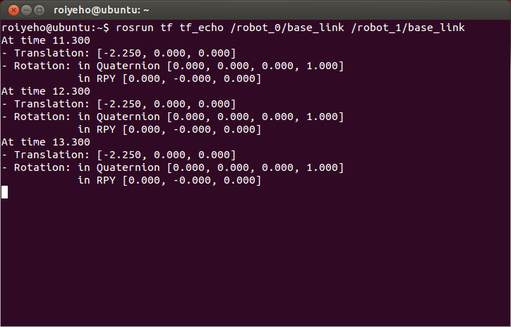
TF Tree
For example, now we can print the relative position between robot_0 and robot_1:

Slide 23
Writing a TF listener
We will now create a node that will print the robots’ positions using a TF listener
First create a package called tf_multi that depends on roscpp, rospy and tf:
Copy the world and map files from stage_multi
Build the package by calling catkin_make
Open the package in Eclipse and add a new source file called print_location.cpp
$ cd ~/catkin_ws/src
$ catkin_create_pkg tf_multi roscpp rospy tf

Slide 24
World File
Change willow-multi-erratic.world file so the map won’t be rotated
window
(
size [ 745.000 448.000 ]
#rotate [ 0.000 -1.560 ]
scale 28.806
)
# load an environment bitmap
floorplan
(
name "willow"
bitmap "willow-full.pgm"
size [54.0 58.7 0.5]
# pose [ -29.350 27.000 0 90.000 ]
pose [ 0 0 0 0 ]
)
# robots
erratic( pose [ 6.5 18.5 0 0 ] name "robot0" color "blue")
erratic( pose [ 4.25 18.5 0 0 ] name "robot1" color "red")
erratic( pose [ 6.5 16.5 0 0 ] name "robot2" color "green")
erratic( pose [ 4.25 16.5 0 0 ] name "robot3" color "magenta")

Slide 25
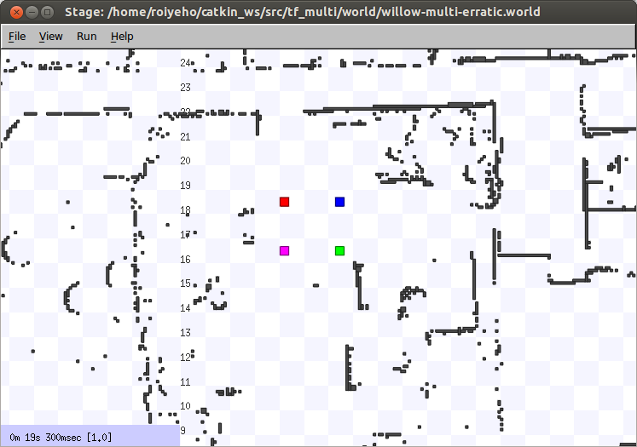
World File

Slide 26
Creating a TF Listener
A tf listener receives and buffers all coordinate frames that are broadcasted in the system, and queries for specific transforms between frames
Once the listener is created, it starts receiving tf transformations over the wire, and buffers them for up to 10 seconds
To use the TransformListener, you need to include the tf/transform_listener.h header file

Slide 27
lookupTransform
To query the listener for a specific transformation, you need to pass 4 arguments:
We want the transform from this frame ...
... to this frame.
The time at which we want to transform. Providing ros::Time(0) will get us the latest available transform
The object in which we store the resulting transform
listener.lookupTransform("/frame1", "/frame2", ros::Time(0), transform);

Slide 28
Helper Methods
tf::resolve (string frame_id, string tf_prefix)
determines the fully resolved frame_id obeying the tf_prefix
tf::TransformListener::waitForTransform
returns a bool whether the transform can be evaluated. It will sleep and retry until the duration of timeout has been passed.

Slide 29
Find Robot Position
We will now create a TF listener to determine the current robot's position in the world
The listener will listen for a transform from /map to the /robot_N/base_footprint frame
Add the following code to print_position.cpp

Slide 30
getRobotPosition()
pair<double, double> getRobotPosition()
{
tf::TransformListener listener;
tf::StampedTransform transform;
pair<double, double> currPosition;
try {
string base_footprint_frame = tf::resolve(tf_prefix, "base_footprint");
listener.waitForTransform("/map", base_footprint_frame, ros::Time(0), ros::Duration(10.0));
listener.lookupTransform("/map", base_footprint_frame, ros::Time(0), transform);
currPosition.first = transform.getOrigin().x();
currPosition.second = transform.getOrigin().y();
}
catch (tf::TransformException &ex) {
ROS_ERROR("%s",ex.what());
}
return currPosition;
}

Slide 31
main() function
#include <ros/ros.h>
#include <tf/transform_listener.h>
using namespace std;
string tf_prefix;
pair<double, double> getRobotPosition();
int main(int argc, char** argv) {
ros::init(argc, argv, "print_position");
ros::NodeHandle nh;
// Get tf_prefix from the parameter server
nh.getParam("tf_prefix", tf_prefix);
pair<double, double> currPosition;
ros::Rate loopRate(1);
while (ros::ok()) {
currPosition = getRobotPosition();
ROS_INFO("Current pose: (%.3f, %.3f)", currPosition.first, currPosition.second);
loopRate.sleep();
}
return 0;
}

Slide 32
Compiling the Node
Change the following lines in CMakeLists.txt:
Then call catkin_make
cmake_minimum_required(VERSION 2.8.3)
project(tf_multi)
…
## Declare a cpp executable
add_executable(print_position src/print_position.cpp)
…
## Specify libraries to link a library or executable target against
target_link_libraries(print_position ${catkin_LIBRARIES})

Slide 33
Robot’s Launch File
Add to robot_0.launch:
<launch>
<group ns="robot_0">
<param name="tf_prefix" value="robot_0" />
<node pkg="tf" type="static_transform_publisher" name="link_broadcaster" args="6.5 18.5 0 0 0 0 /map /robot_0/odom 100" />
<node pkg="tf_multi" type="print_location" name="print_location" output="screen" />
</group>
</launch>

Slide 34
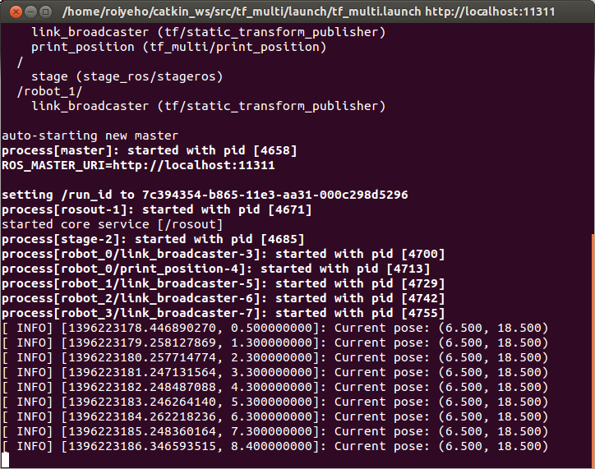
Running the Launch File
Now run roslaunch tf_multi tf_multi.launch

Slide 35
Other Robots’ Positions
Each robot can easily access the other robots’ positions using an appropriate TF listener
We will add the robot number as an argument to the getRobotPosition() function

Slide 36
getRobotPosition()
pair<double, double> getRobotPosition(int robot_no)
{
tf::TransformListener listener;
tf::StampedTransform transform;
pair<double, double> currPosition;
try {
string robot_str = "/robot_";
robot_str += boost::lexical_cast<string>(robot_no);
string base_footprint_frame = tf::resolve(robot_str, "base_footprint");
listener.waitForTransform("/map", base_footprint_frame, ros::Time(0), ros::Duration(10.0));
listener.lookupTransform("/map", base_footprint_frame, ros::Time(0), transform);
currPosition.first = transform.getOrigin().x();
currPosition.second = transform.getOrigin().y();
}
catch (tf::TransformException &ex) {
ROS_ERROR("%s",ex.what());
}
return currPosition;
}

Slide 37
main()
int main(int argc, char** argv) {
ros::init(argc, argv, "print_position");
ros::NodeHandle nh;
// Get tf_prefix from the parameter server
nh.getParam("tf_prefix", tf_prefix);
pair<double, double> currPosition;
ros::Rate loopRate(0.5);
int team_size = 4;
while (ros::ok()) {
for (int i = 0; i < team_size; i++) {
currPosition = getRobotPosition(i);
ROS_INFO("Robot %d position: (%.3f, %.3f)", i, currPosition.first, currPosition.second);
}
ROS_INFO("--------------------------");
loopRate.sleep();
}
return 0;
}

Slide 38
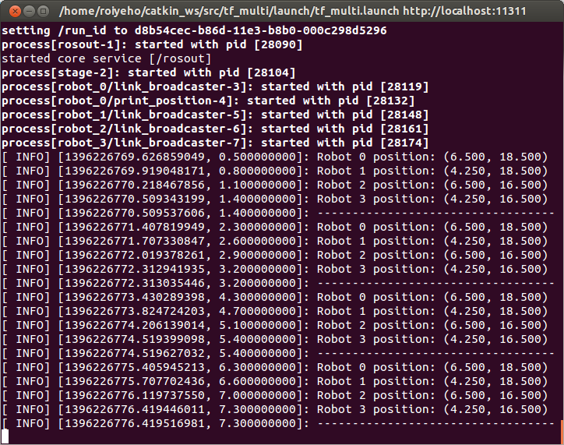
Running the Launch File

Slide 39
Moving a Robot with Teleop
Now we are going to move one of the robots using the teleop_twist_keyboard node
Run the following command:
This assumes that you have installed the teleop_twist_keyboard package
You should see console output that gives you the key-to-control mapping
You can now control robot_0 with the keyboard
$ rosrun teleop_twist_keyboard teleop_twist_keyboard.py cmd_vel:=robot_0/cmd_vel

Slide 40
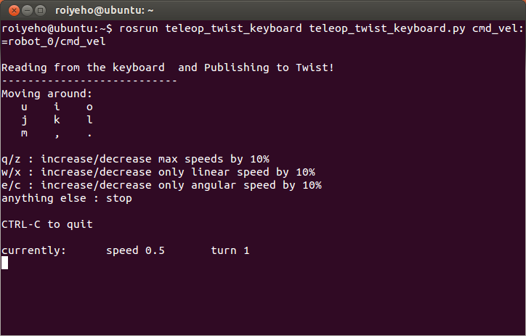
Moving a Robot with Teleop

Slide 41
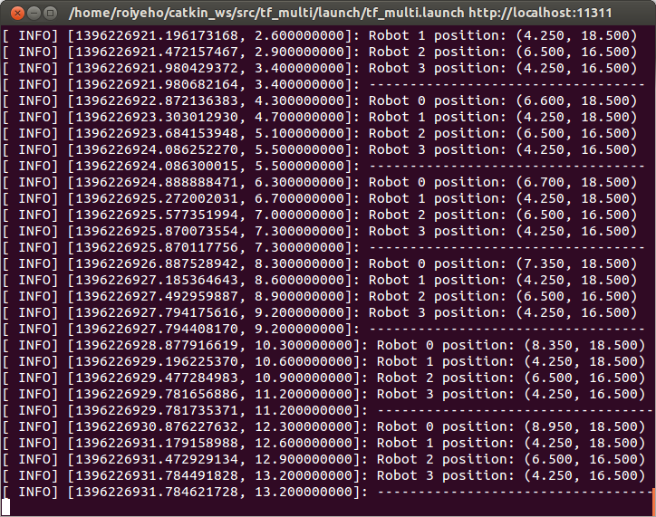
Moving a Robot with Teleop
Moving robot 0 forward:

Slide 42
Leader-Follower Formation
We will now create a node named follower that will make one robot follow the footsteps of another robot
The node will receive as a command-line argument the leader’s robot number
We will use a TF listener between the two robots’ base_footprint frames
The transform is used to calculate new linear and angular velocities for the follower, based on its distance and angle from the leader
The new velocities are published in the cmd_vel topic of the follower

Slide 43
follower.cpp (1)
#include <ros/ros.h>
#include <tf/transform_listener.h>
#include <algorithm>
#define MIN_DIST 0.8
#define MAX_LINEAR_VEL 0.7
#define MAX_ANGULAR_VEL 3.14
using namespace std;
int main(int argc, char** argv) {
if (argc < 2) {
ROS_ERROR("You must specify leader robot id.");
return -1;
}
char *leader_id = argv[1];
ros::init(argc, argv, "follower");
ros::NodeHandle nh;

Slide 44
follower.cpp (2)
ros::Publisher cmd_vel_pub = nh.advertise<geometry_msgs::Twist>("cmd_vel", 10);
tf::TransformListener listener;
string tf_prefix;
nh.getParam("tf_prefix", tf_prefix);
string this_robot_frame = tf::resolve(tf_prefix, "base_footprint");
cout << this_robot_frame << endl;
string leader_str = "/robot_";
leader_str += leader_id;
string leader_frame = tf::resolve(leader_str, "base_footprint");
cout << leader_frame << endl;
listener.waitForTransform(this_robot_frame, leader_frame, ros::Time(0), ros::Duration(10.0));
ROS_INFO("%s is now following robot %s", tf_prefix.c_str(), leader_id);
ros::Rate loopRate(10);

Slide 45
follower.cpp (3)
while (ros::ok()) {
tf::StampedTransform transform;
try {
listener.lookupTransform(this_robot_frame, leader_frame, ros::Time(0), transform);
} catch (tf::TransformException &ex) {
ROS_ERROR("%s",ex.what());
}
float dist_from_leader = sqrt(pow(transform.getOrigin().x(), 2) +
pow(transform.getOrigin().y(), 2));
geometry_msgs::Twist vel_msg;
if (dist_from_leader > MIN_DIST) {
vel_msg.linear.x = min(0.5 * dist_from_leader, MAX_LINEAR_VEL);
vel_msg.angular.z = min(4 * atan2(transform.getOrigin().y(),
transform.getOrigin().x()), MAX_ANGULAR_VEL);
}
cmd_vel_pub.publish(vel_msg);
loopRate.sleep();
}
return 0;

Slide 46
Compiling the Follower Node
Change the following lines in CMakeLists.txt:
Then call catkin_make
cmake_minimum_required(VERSION 2.8.3)
project(stage_multi)
…
## Declare a cpp executable
add_executable(print_position src/print_position.cpp)
add_executable(follower src/follower.cpp)
…
## Specify libraries to link a library or executable target against
target_link_libraries(print_position ${catkin_LIBRARIES})
target_link_libraries(follower ${catkin_LIBRARIES})

Slide 47
Leader-Follower Formation
In the following example we will make robot_1 follow robot_0 and robot_2 follow robot_1 so they all move together in a line formation

Slide 48
Robot’s Launch File
Add to robot_1.launch:
Add to robot_2.launch:
<launch>
<group ns="robot_1">
<param name="tf_prefix" value="robot_1" />
<node pkg="tf" type="static_transform_publisher" name="link_broadcaster" args="4.25 18.5 0 0 0 0 /map /robot_1/odom 100" />
<node pkg="tf_multi" type="follower" name="follower" args="0" output="screen" />
</group>
</launch>
<launch>
<group ns="robot_2">
<param name="tf_prefix" value="robot_2" />
<node pkg="tf" type="static_transform_publisher" name="link_broadcaster" args="6.5 16.5 0 0 0 0 /map /robot_2/odom 100" />
<node pkg="tf_multi" type="follower" name="follower" args="1" output="screen" />
</group>
</launch>

Slide 49
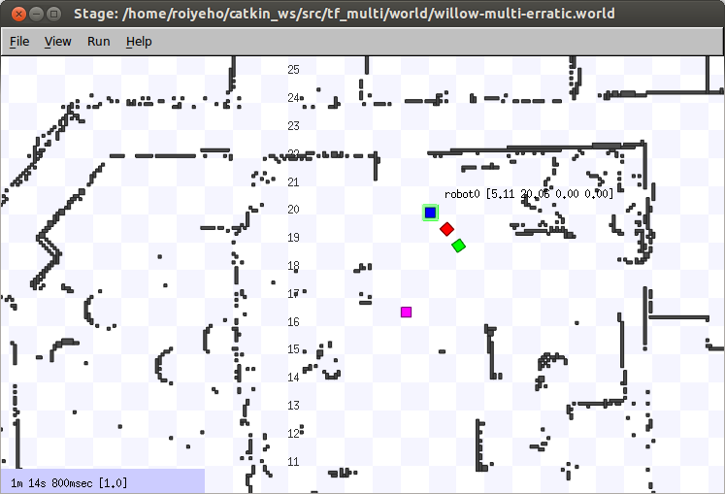
Leader-Followers Formation

Slide 50
Homework – Assignment 1
Implement a simple line formation control for a team of robots
More details can be found at: http://u.cs.biu.ac.il/~yehoshr1/89-689/assignment1/Assignment1.html

