Slide 1
Title of the Project: Malignant Comment Classifier

Slide 2
PROBLEM STATEMENT AND UNDERSTANDING
The proliferation of social media enables people to express their opinions widely online. However, at the same time, this has resulted in the emergence of conflict and hate, making online environments uninviting for users. Although researchers have found that hate is a problem across multiple platforms, there is a lack of models for online hate detection.
To protect users from being exposed to offensive language on online forums or social media sites, companies have started flagging comments and blocking users who are found guilty of using unpleasant language. Several Machine Learning models have been developed and deployed to filter out the unruly language and protect internet users from becoming victims of online harassment and cyberbullying.

Slide 3
EDA AND VISUALIZATION STEPS
Checking null values: The first and foremost step after importing the training and testing sets in pandas dataframe is to check for the null values. Using ‘isnull()’ function on both training and testing sets. Here I discovered no missing values so the data is clean and hence I can proceed to the next step.
Text Normalizing: As I did not found any missing values now I can proceed for the data preprocessing. Since our data is directly extracted from online platforms it contains special characters, numbers, unnecessary spaces etc., hence the text has to be normalize. Such as converting data to lower case, removing ‘\n’, removing unnecessary whitespaces between characters, removing punctuation.
Lemmatization: Since the data is now clean and consistent, it is the right time to perform Lemmatization.

Slide 4
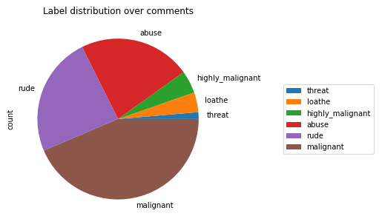
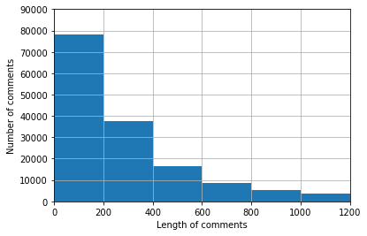
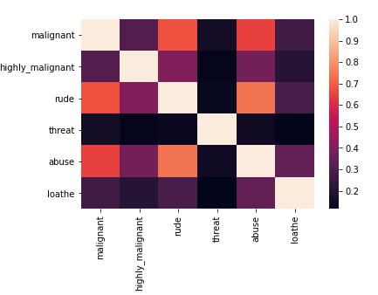
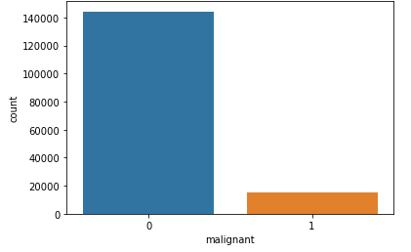
Visualization

Slide 5
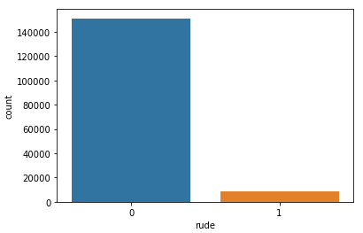
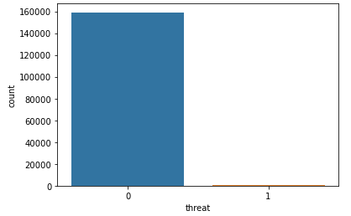
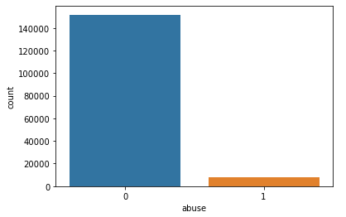
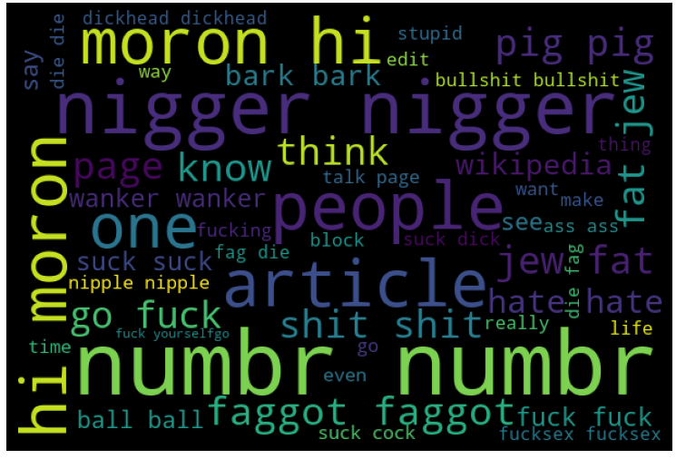

Slide 6
STEPS AND ASSUMPTIONS
In this project we have not assumed anything and since the data is collected from various online platforms which is a text format so we handled it.
After that, we splitted the data into training and testing set. We trained the model using five classification algorithms namely Logistic Regression, Decision Tree Classifier, Random Forest Classifier, KNeighbors Classifier and AdaBoost Classifier. And used hyperparameter tuning and created a Auc Roc Curve which gives a graph between True positive rate and false positive rate.

Slide 7
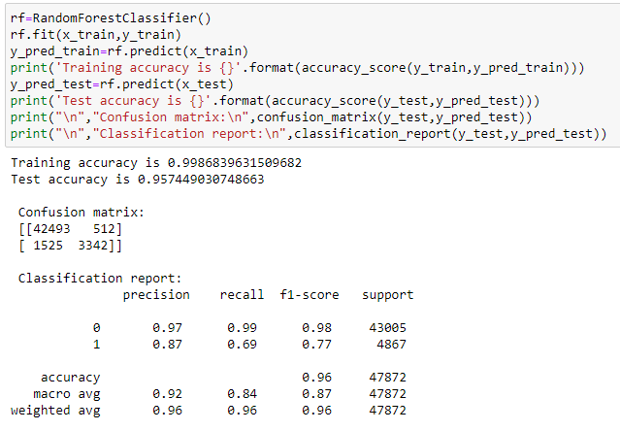
Finalized Model
Out of five classification models Random Forest Classifier is giving the more accuracy with improved cross validation score. So we have finalized this model as the best fit for our dataset.
Thus we evaluated the model and tuned this model.

Slide 8
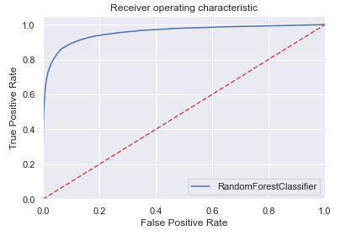
The below graph is the Auc Roc Curve which is plotted between false positive rate and true positive rate. The number of words that are toxic from the group of tested words are of 90% accurate

Slide 9
Conclusion:
After evaluating the results procured during the training phase of my project and the results that I received from the websites, I can claim that the random Forest classifier performs better other classification models. And using it we have predicted the output for the testing set which is in another file.
This project allowed me to work with five different classification models and further, I was able to implement them on Natural Language Processing use-case. The various data pre-processing and feature engineering steps in the project made me to have knowledge of the efficient methods that can be used to clean textual data. I understood the working of various classification models such as Decision tree, KNeighbors, Logistic Regression, Random Forest and AdaBoost Classifier. I got introduced to the concepts of lemmatization, stopwords and advantages of using it in textual data. Finally doing hyper-parameter tuning for the model helped me to achieve optimum results.

Slide 10


