Slide 1
MICRO-CREDIT-PROJECT

Slide 2
PROBLEM STATEMENT AND UNDERSTANDING
A Microfinance Institution (MFI) is an organization that offers financial services to low income populations. MFS becomes very useful when targeting especially the unbanked poor families living in remote areas with not much sources of income. The Microfinance services (MFS) provided by MFI are Group Loans, Agricultural Loans, Individual Business Loans and so on.
Credit loans are risky nut at the same time it is also a product that generates profit for the institutions through differential boring lending rates etc.

Slide 3
EDA STEPS AND VISUALIZATIONS
This involves generating summary statistics for numerical data in the dataset.
Creating various graphical representations to understand the data better.
We have performed initial investigation of data so as to discover patterns, to spot anomalies, to test hypothesis and to check assumptions and to find the correlation with the help of summary statistics and graphical representation.

Slide 4
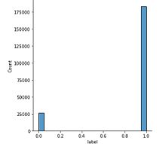
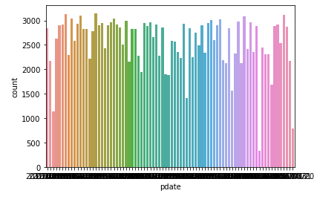
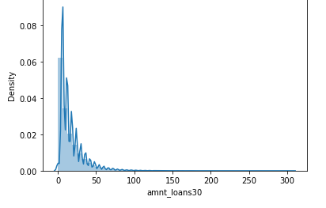
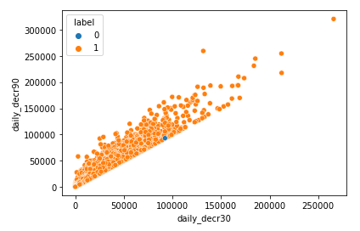
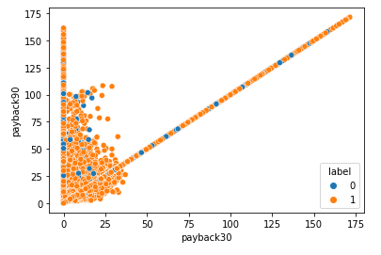
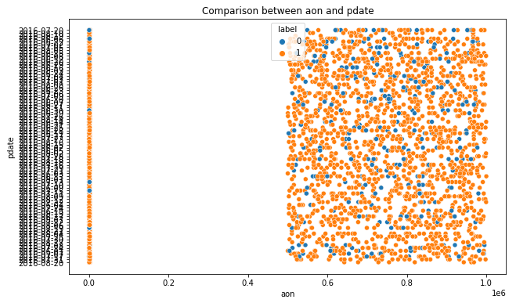

Slide 5
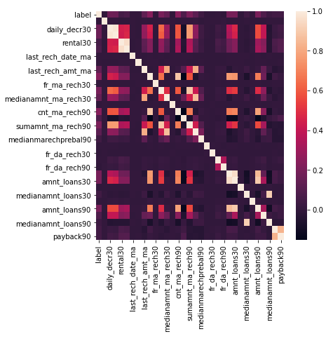
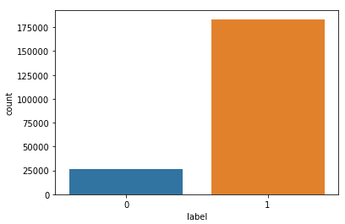
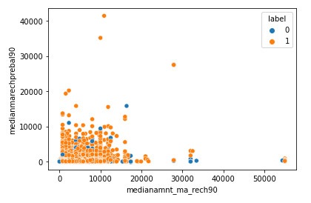

Slide 6
STEPS AND ASSUMPTIONS
In this project we have not assumed anything and since the data is imbalanced we used the upsampling technique to increase the minority class. This may create a zero-values samples to increase the sampling rate.
After the data is balanced we splitted the data into training and testing set. We trained the model using five classification algorithms namely Logistic Regression, Decision Tree Classifier, Ridge Classifier, GaussianNB Classifier, XGBoost Classifier. And used hyperparameter tuning and plotted precision-recall curve and AUC-ROC curve.

Slide 7
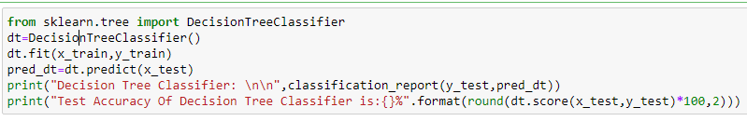
Finalized model
Out of five classification models the Decision Tree Classifier is giving the more accuracy with improved cross validation score. So we have finalized this model as the best fit for the given dataset.
Thus we plotted the precision-recall curve and the AUC-ROC curve for this model.

Slide 8
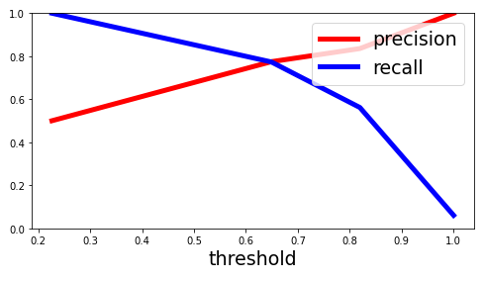
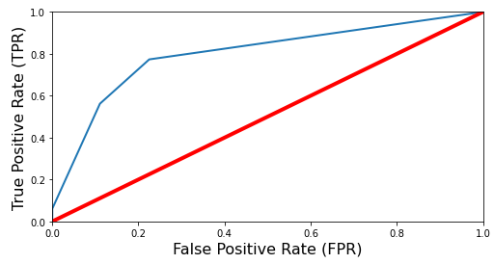
Above graph is a precision recall curve. We can clearly see that the recall is falling of slightly at a precision of around 77%. Because of that we may want to select the precision/recall tradeoff before that maybe at around 75 %. we are now able to choose a threshold, that gives the best precision/recall tradeoff for our current machine learning problem. we can see that we would need a threshold of around 0.6. Then we could train a model with exactly that threshold and would get the desired accuracy.
The above graph is a AUC-ROC CURVE in which the red line in the middle represents a purely decision classifier and therefore our classifier should be as far away from it as possible. Our Decision Tree model seems to do a good job. Of course we also have a tradeoff here, because the classifier produces more false positives, the higher the true positive rate is.

Slide 9
CONCLUSION
There is no definitive guide of which algorithms to use given any situation. What may work on some data sets may not necessarily work on others. Therefore, always evaluate methods using cross validation to get a reliable estimate.
Sometimes we may be willing to give up some improvement to the model if that would increase the complexity much more than the percentage change in the improvement to the evaluation metrics.
In some classification problems, false negative is a lot more expensive that false positives. Therefore, we can reduce cut-off points to reduce the false negative.
Missing values sometimes add more information to the model than we might expect. One way of capturing is to add.

Slide 10


