Slide 1
Title of the Project: Rating Prediction Project

Slide 2
PROBLEM STATEMENT AND UNDERSTANDING
The rise in E -commerce, has brought a significant rise in the importance of customer reviews. There are hundreds of review sites online and massive amounts of reviews for every product. Customers have changed their way of shopping and according to a recent survey, 70 percent of customers say that they use rating filters to filter out low rated items in their searches.
The ability to successfully decide whether a review will be helpful to other customers and thus give the product more exposure is vital to companies that support these reviews, companies like Amazon , Flipkart, E-Bay etc.

Slide 3
EDA AND VISUALIZATION STEPS
Checking null values: The first and foremost step after importing the training and testing sets in pandas dataframe is to check for the null values. Using ‘isnull()’ function on the dataset. Here I discovered no missing values so the data is clean and hence I can proceed to the next step.
Text Normalizing: As I did not found any missing values now I can proceed for the data preprocessing. Since our data is directly extracted from online platforms it contains special characters, numbers, unnecessary spaces etc., hence the text has to be normalize. Such as converting data to lower case, removing punctuation.
Removing Stopwords:As we all know, it is one of the most crucial steps in text preprocessing for use-cases that involve text classification. Removing stopwords ensures that more focus is on those words that define the meaning of the text.
To remove stopwords from my data, first we imported stopwords from nltk.corpus then we removed them.

Slide 4
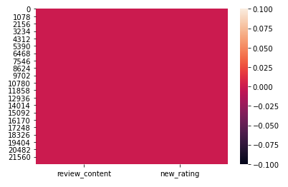
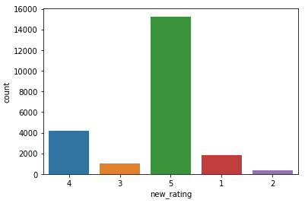
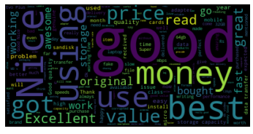
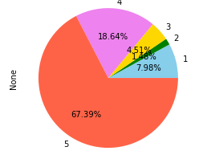
Visualization

Slide 5
STEPS AND ASSUMPTIONS
In this project we have not assumed anything and since the data is collected from various online platforms which is a text format so we handled it.
After that, we splitted the data into training and testing set. We trained the model using four regression algorithms namely Linear Regression, Decision Tree regression, Gradient Boosting Regression and XGBoosting Regressor. And used hyperparameter tuning to improve the model accuracy.

Slide 6
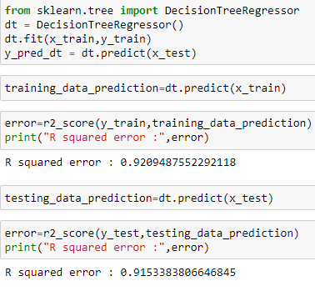
Finalized Model
Out of four classification models Decision Tree Regression is giving the more accuracy with improved cross validation score. So we have finalized this model as the best fit for our dataset.
Thus we evaluated the model and tuned this model.

Slide 7
Conclusion:
After evaluating the results procured during the training phase of my project and the results that I received from the websites, I can claim that the Decision Tree Regressor performs better than other regression models. And using it we have predicted the output and compared the actual and predicted rating.
This project allowed me to work with four different regression models and further, I was able to implement them on Natural Language Processing use-case. The various data pre-processing and feature engineering steps in the project made me to have knowledge of the efficient methods that can be used to clean textual data. I understood the working of various classification models such as Decision Tree regressor, Gradient Boosting Regressor, Linear Regression, XGboost Regressor. I got introduced to the concepts of wordcloud, stopwords and advantages of using it in textual data. Finally doing hyper-parameter tuning for the model helped me to achieve optimum results.

Slide 8


