Slide 1

Basic Details of the Team and Problem Statement
Problem Statement Title: AI Model for Optimizing Planting Times
Team Name: EduVision Innovators
Team Leader Name: B.Anil Kumar
Institute Code : Q9
Institute Name: Malla Reddy College Of Engineering(MRCE)

Slide 2



Idea/Approach Details
Data Collection:
Gather local climate data (temperature, precipitation, frost dates, etc.)
Collect soil conditions (moisture, pH, texture, etc.)
Integrate crop-specific growth patterns and historical data.
2.Predictive Modeling:
Use machine learning (Random Forest, LSTM) to predict optimal planting times based on historical and real-time data.
3.User-Friendly Mobile App:
Provide actionable recommendations through a mobile interface.
Display optimal planting windows, weather forecasts, and soil readiness.
4.Real-Time Monitoring:
Integrate IoT sensors for real-time field data.
Send push notifications for weather alerts (e.g., frost, rainfall).
5.Personalization:
Tailor advice based on location, crop types, and soil conditions.
Continuously improve predictions with user feedback and data.

Slide 3
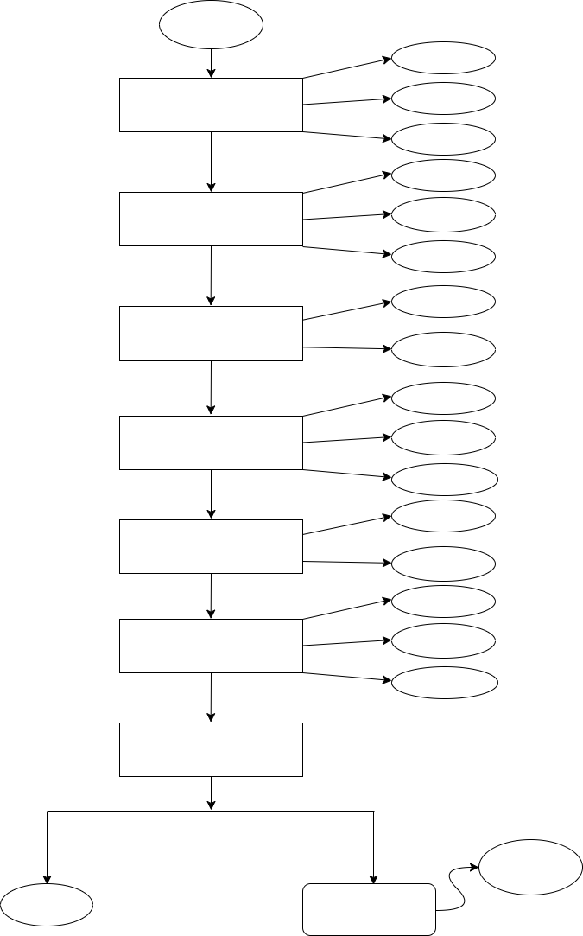

Flow Chart
Start
Climate
Data Collection
Soil
Crop Data
Cleaning
Data Preprocessing
Normalization
Feature Engi...
Local Climate
Train Predictive AI Model
Crop Info
Cross-validation
Model Evaluation
Metrics
Model Robust
Wheath.Forecast
Real-Time Integration
API
Planting Window
Generate Predictions
Yield Predict
Alerts
User Interface
Improvement
END
Feedback

Slide 4











Development Stack
Application
Java
Python
Android Studio
SQL
JavaScript
Database
Frontend Development
Backend Development

Slide 5

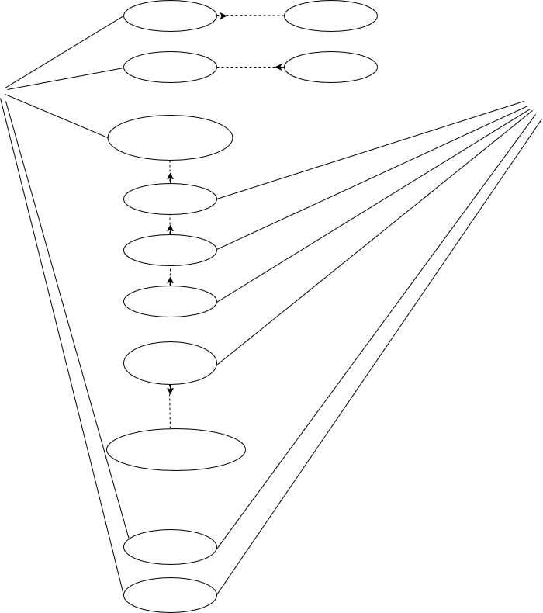
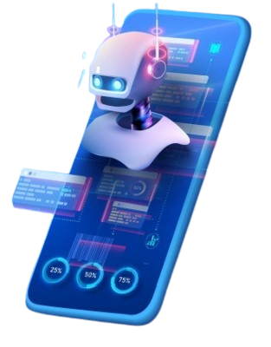
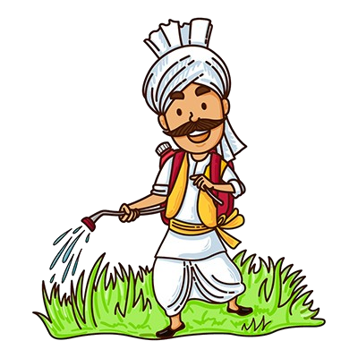
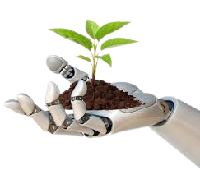
Application Flow
<<include>>
Register
Verify
<<include>>
Login
Password
Dashboard
System
User
Location
Crop Type
Soil Type
Climate Data
Planting-Time
(Recommendation)
Alerts
Logout

Slide 6
Team Member Details
Team Leader Name: B.Anil kumar
Branch : CSE
Team Member 1 Name: S.Sai Kiran
Branch : CSE
Team Member 2 Name: Type : L.Shabbir
Branch : CSE
Year :II
Year :II
Year :II

Slide 7


