Slide 1
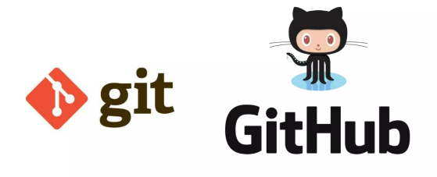
Introduction to git and github

Slide 2
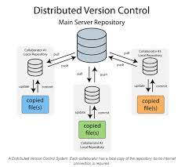
What is Git?
Git is a distributed Version Control System (VCS) designed to make it easier to have multiple versions of a code base, sometimes across multiple developers or teams.
It allows you to see changes you make to your code and easily revert them.
A system that records changes to a set of files
Over a period of time is Version Control System.
Git manages to a tree o files over time. It is fast
and can merge complex files.

Slide 3
What is github
Github.com is a website that hosts git repositories on a remote server.
Hosting repositories on Github facilitates the sharing of codebases among teams by providing a GUI to easily fork or clone repos to a local machine.
By pushing your repositories to Github, you will pretty much automatically create your own developer portfolio as well.
You can track issues, build & test the things and finally deploy.
It provides version control and keep your code in one place.
It provides great collaboration with different developers and keep records of who did what and when.

Slide 4
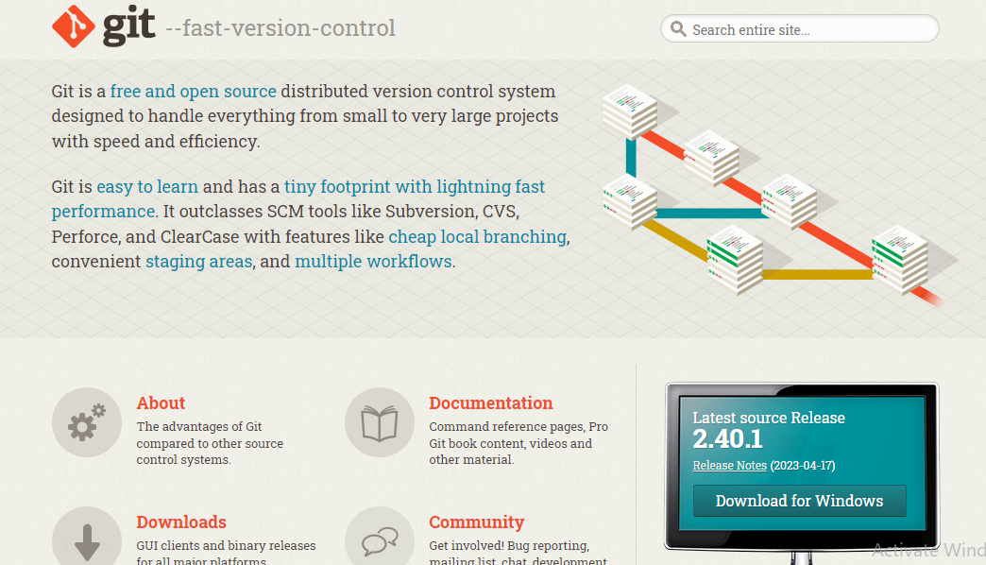
https://git-scm.com/ https://github.com/

Slide 5
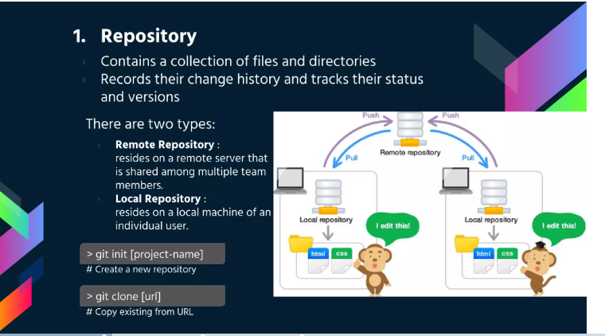
Repository

Slide 6
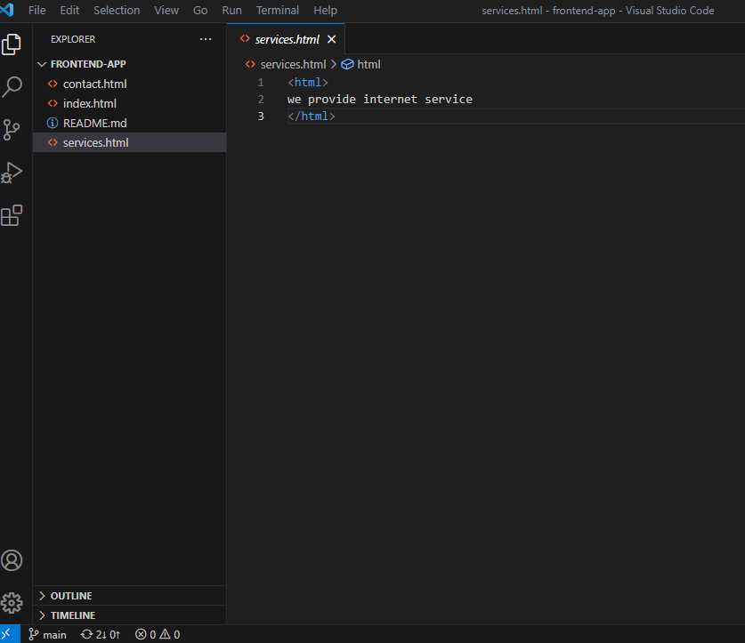

Slide 7
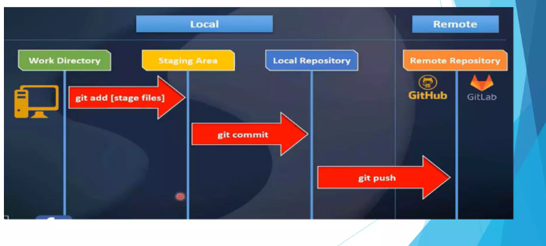
We have three stages in local repository
Work directory: it is a place where developers write a code.
Staging area: this is a stage where the files created are added.
Local repository: this is the stage the commit is done and push is done to remote repository.

Slide 8
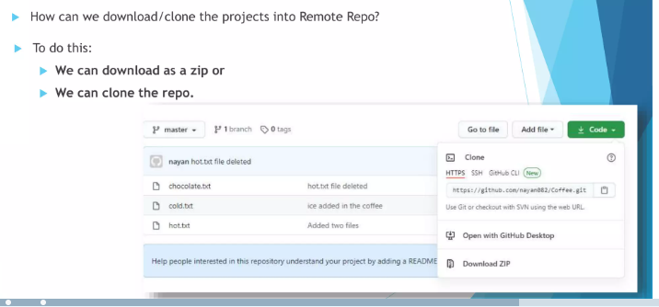
Clone

Slide 9
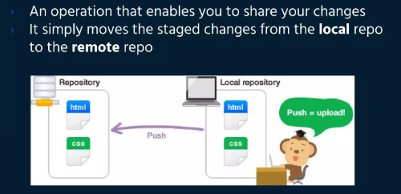
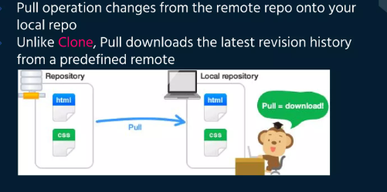
Push and pull
Push
Pull

Slide 10
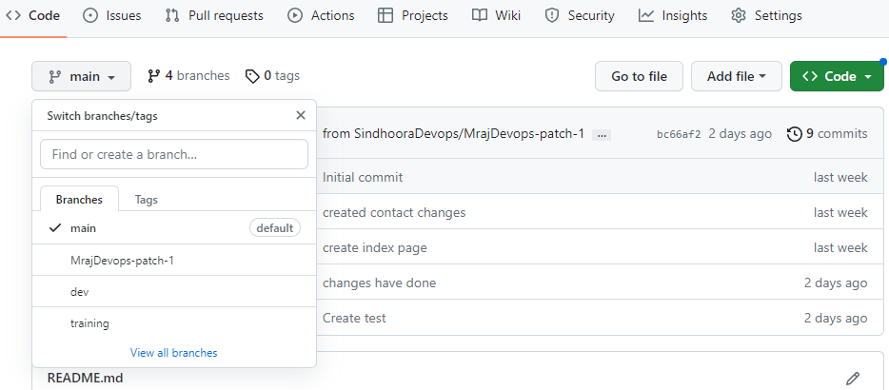
Branch
An independent line o development.
Perfect for working on new features and fix bugs.
Each repository has master branch by default.

Slide 11
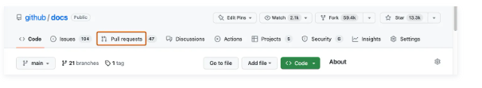
Merge
Easy to identify what is the issue
Can be quick to resolve when conflict arises.
In a pull request, you propose that changes you've made on a head branch should be merged into a base branch.

Slide 12
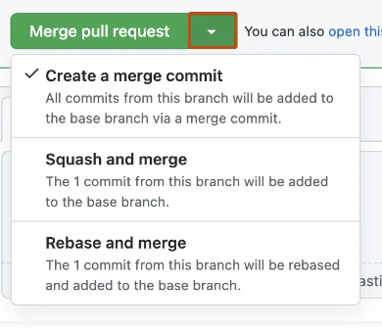
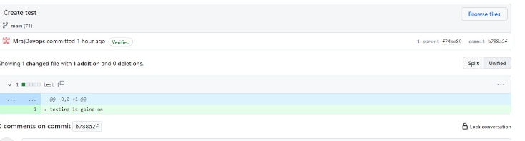

Slide 13
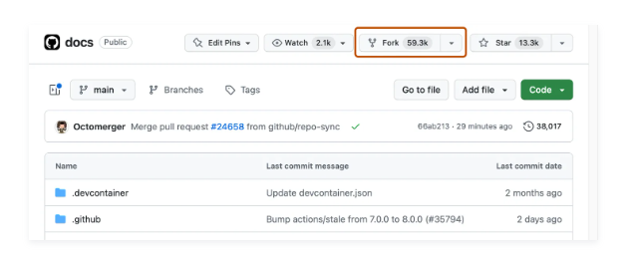
FORK
A fork is a new repository that shares code and visibility settings with the original “upstream” repository. Forks are often used to iterate on ideas or changes before they are proposed back to the upstream repository, such as in open source projects or when a user does not have write access to the upstream repository.

Slide 14
Thank you

